Slide 1
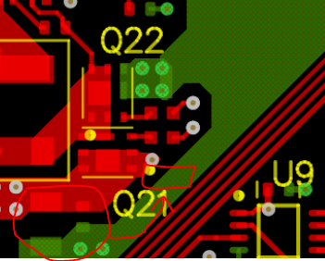
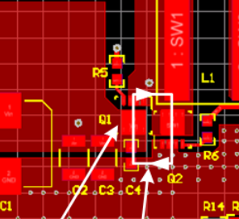
TPS55288 layout guideline app note.
Rotate the input ceramic caps with 90 degrees like EVM. The Buck switching leg parasitic inductance will be reduced.

Slide 2
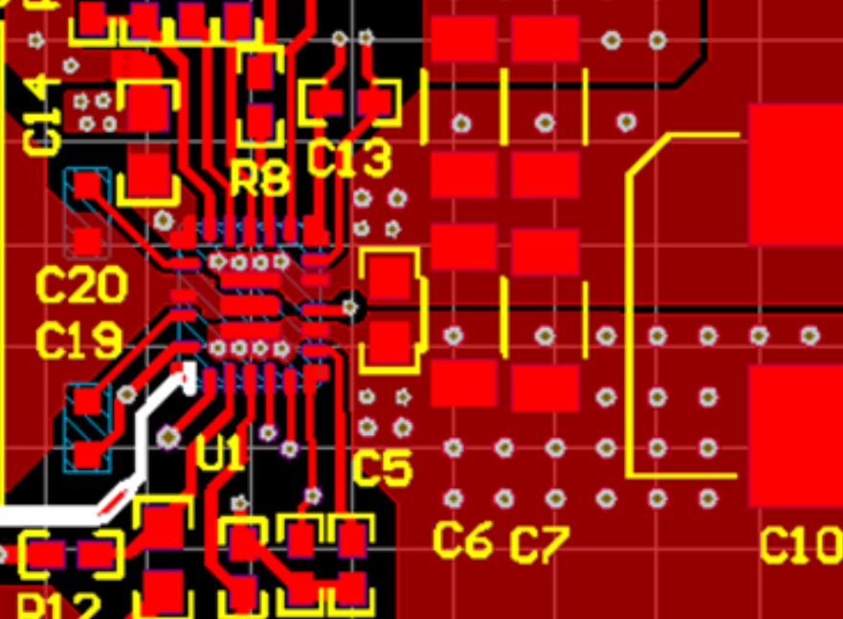
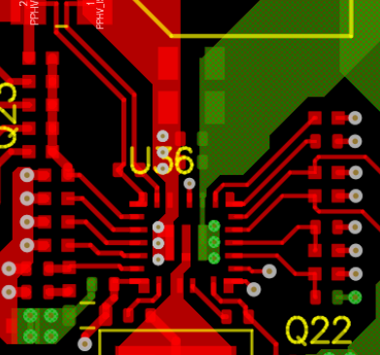
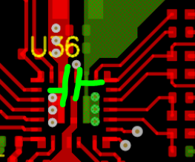
The GND trace is too thin. Suggest widen the GND trace on top layer like EVM.
Move the Cout C174 closer to IC.
Put the C175 on bottom layer close to pin 26 and pin 24 vias.
Add more Vout and GND vias near C174 like EVM (C5.)

Slide 3
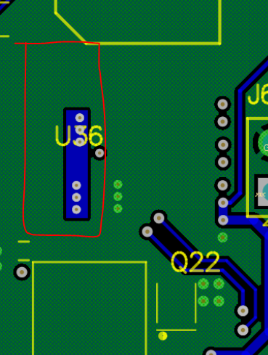
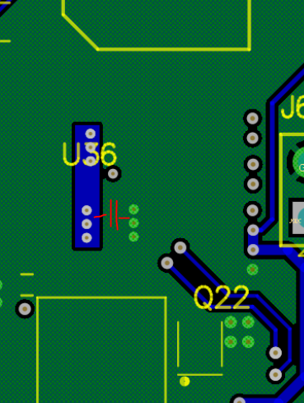
Widen the Vout plane area to help improve the thermal dissipation.
To debug the current PCB, solder a 1uF ceramic capacitor across the Vout plane and GND plane. And update the compensations.

