Slide 1
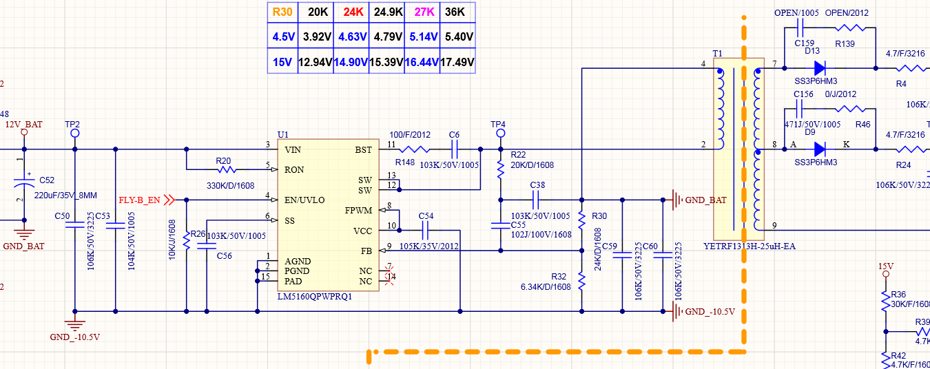
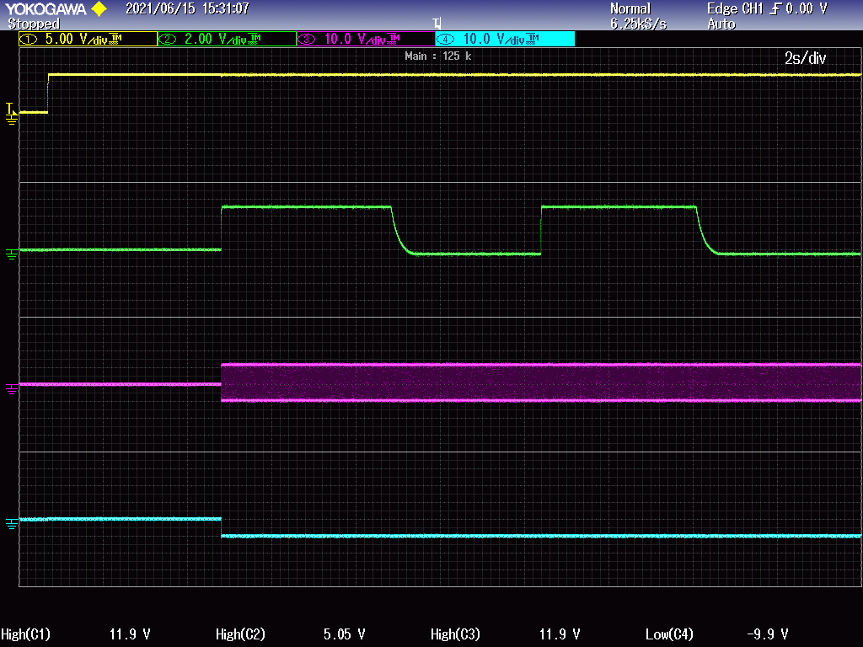
③
①
②
④
12V_BAT
U1-pin4
T1-pin2
GND_-10.5V

Slide 2
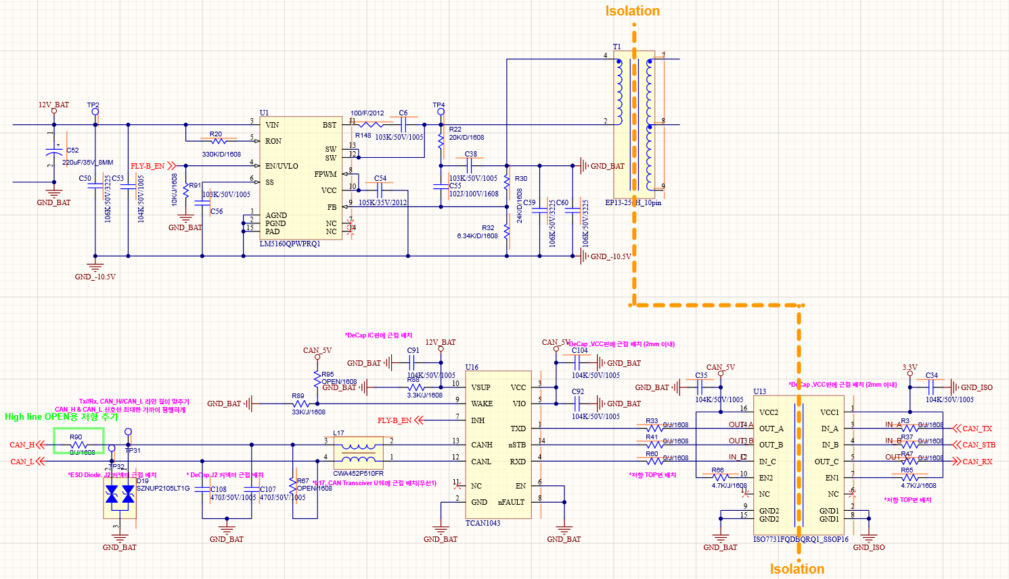
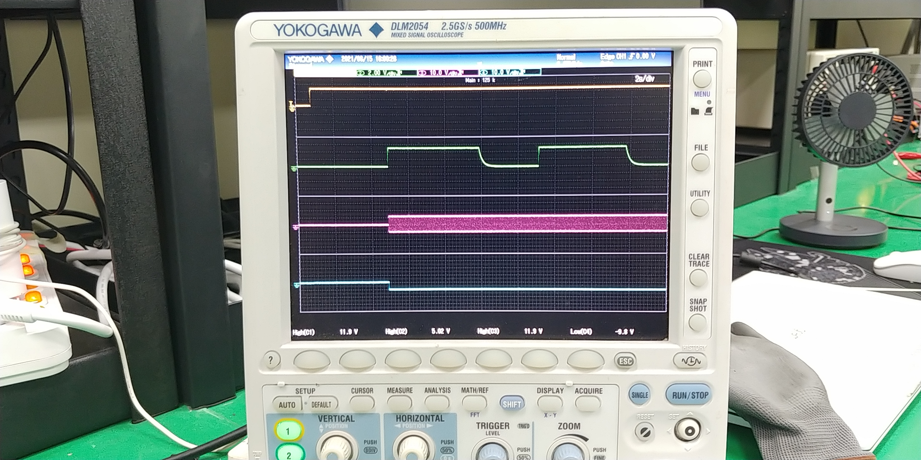
③
①
②
④
12V_BAT
U1-pin4
T1-pin2
GND_-10.5V

