Slide 1
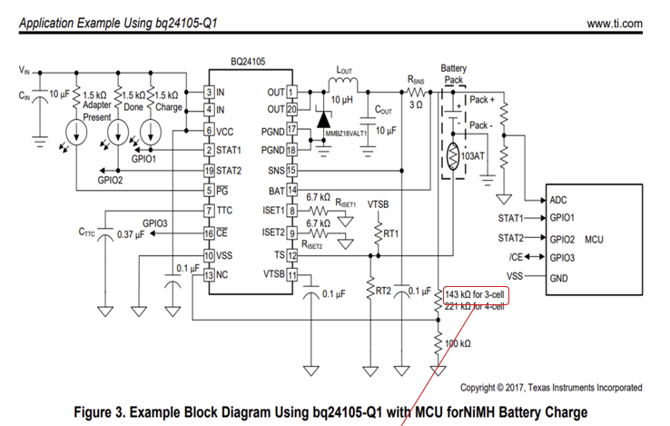
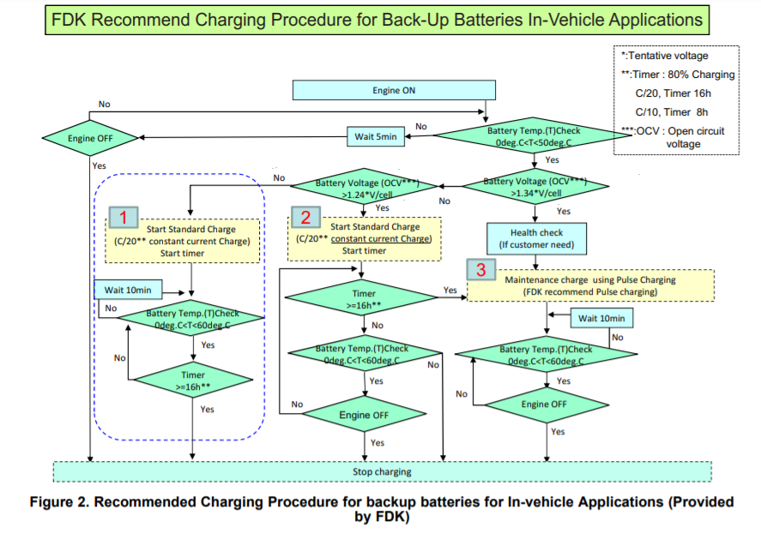
3)Who is checking time?
BQ24105 or MCU?
-→MCU
1. You setup your TS pin and thermistor so that the specified temperature range is followed. The charger will suspend charge when the TS pin is outside of the set temperature range. See Section 8.3.2 of the datasheet.
5)
MCU check temp right?
Because
(1)need to support
“wait timer” before check temp
(2)Temp is difference(60 or 50)
MCU must check temp by mcu
1)Who is check ?
BQ24105 or MCU?
I think check by MCU.
But your sample circuits
Don’t connect TS line
Need to connect to MCU?
-→MCU
SO need to check TS line
By MCU
3)Who is checking time?
BQ24105 or MCU?
-→ MCU
2)Who is check ?
BQ24105 or MCU?
How to check ?
1: STAT1 and STAT2
or
2:ADC
-→ check ADC
No change
Status
STAT1:OFF
STAT2:ON
3)Who is checking time?
BQ24105 or MCU?
--- >MCU
1)Who is check ?
BQ24105 or MCU?
I think check by MCU.
But your sample circuits
Don’t connect TS line
Need to connect to MCU?
-→MCU
4)Who is counting?
BQ24105 or MCU?
-→ BQ24105

