Slide 1
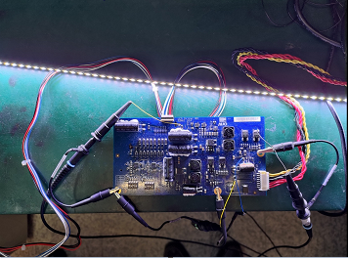
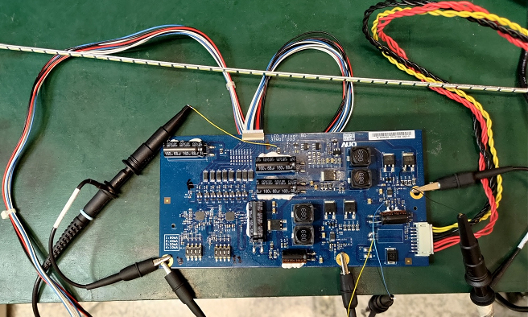
Initial condition：
Setting Output current 100mA(fixed)
Input voltage 24V
Lighting up success
Lightbar
When C10 use in 2.2PF, lighting up success,but use in 100nf lighting up fail
Output to lightbar
Power IC
Input 24V

Slide 2
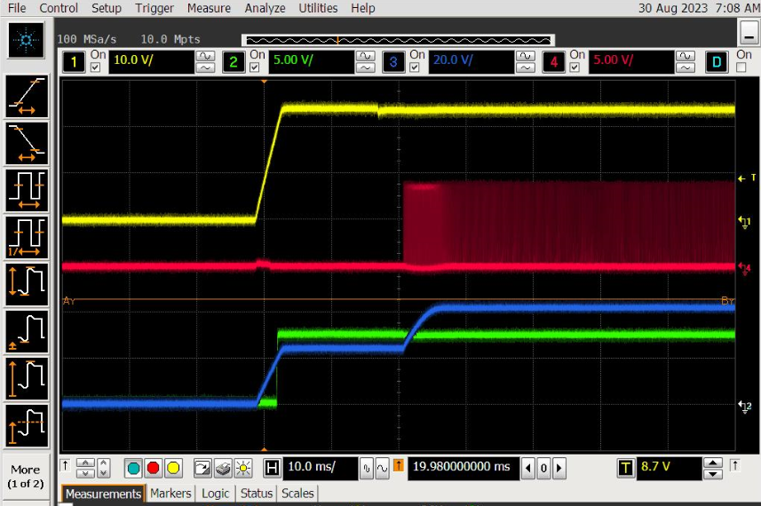
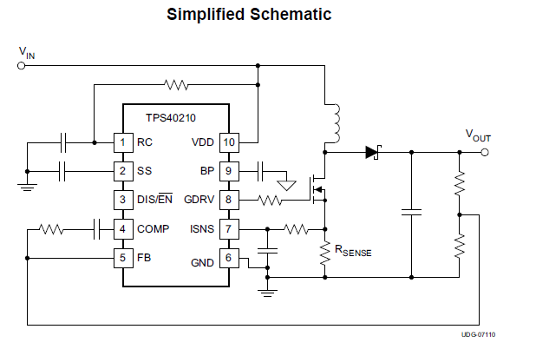
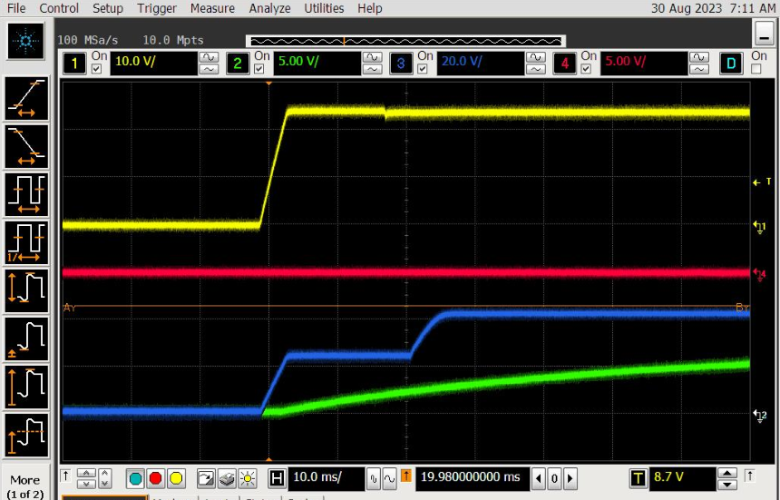
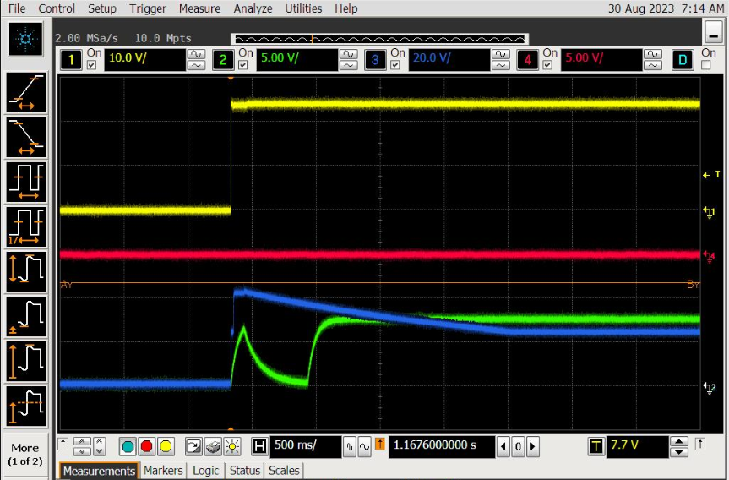
Vin
PASS
(Css =2.2pF)
Vin
Vout
GDRV
Css
Vss
GDRV
Vss
Vout
Vin
Fail
(when Css = 100nF)
Vin
GDRV
Zoom out
Vout
Vss

Slide 3
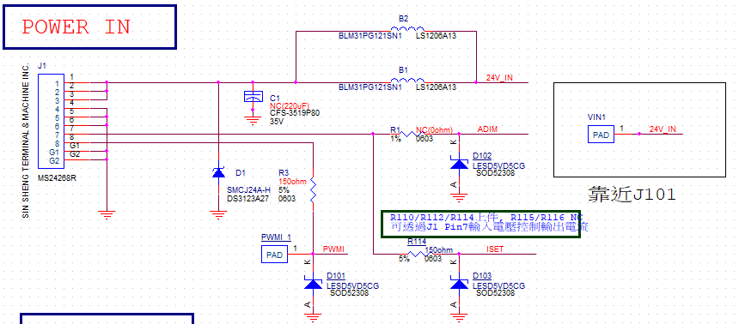
LED Driver Board application circuit(power-in side)
：

Slide 4
LED Driver Board application circuit

