Slide 1
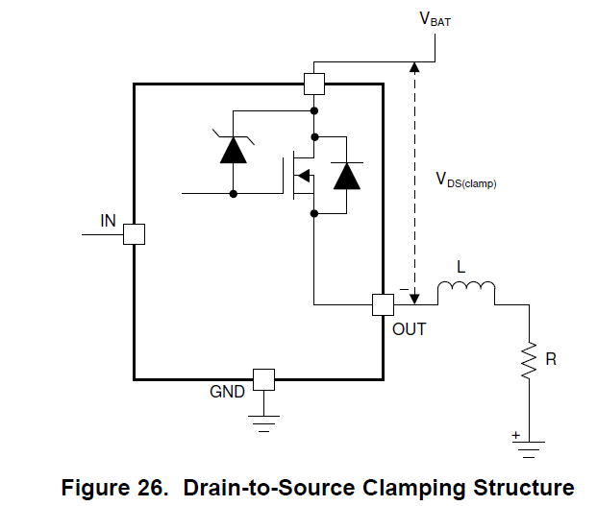
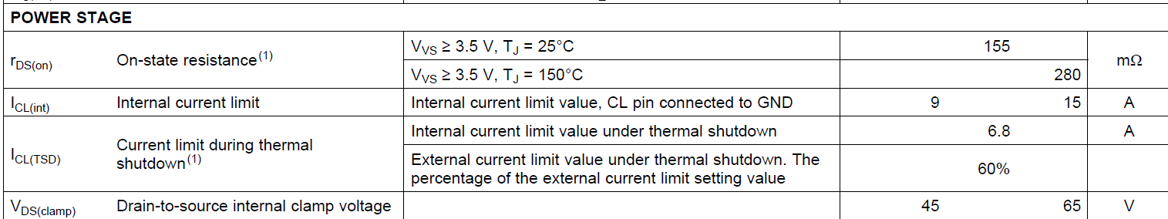
Is this a VDS(Clamp) diode?
Even if it is not clamped to 65V, won't the IC be damaged?

