Slide 1
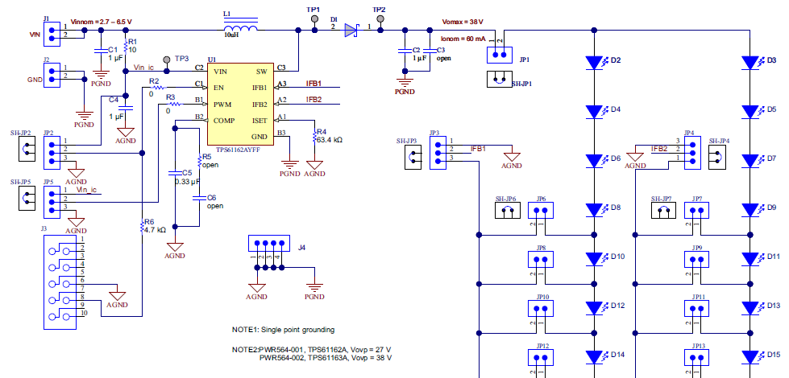
schematic
Inductor – 4.7uH
LED 1ch – 8 series
LED 2ch – 8 series
spec
LED current – CC / 16mA
LED dimming – PWM dimming / 2%~100%
PWM duty control on EN pin high
Problem – turn off-> turn on test on dimming 2%~18% .
TPS61163A OVP issue and output voltage drop.

Slide 2
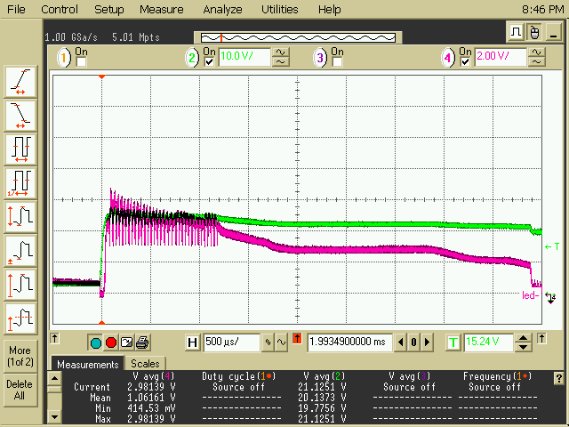
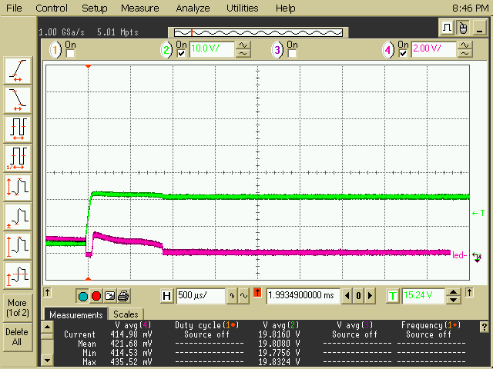
Good board test
Comp cap – 330nF
Dimming 2% _ turn on / good
Ch2 – SW voltage
Ch3 – Ifb1 voltage
SW voltage is under 30V.
Output voltage is good.
Comp cap – 330nF
Dimming 100% _ turn on / good
Ch2 – SW voltage
Ch3 – Ifb1 voltage
SW voltage is under 30V.
Output voltage is good.
min 동작 됨

Slide 3
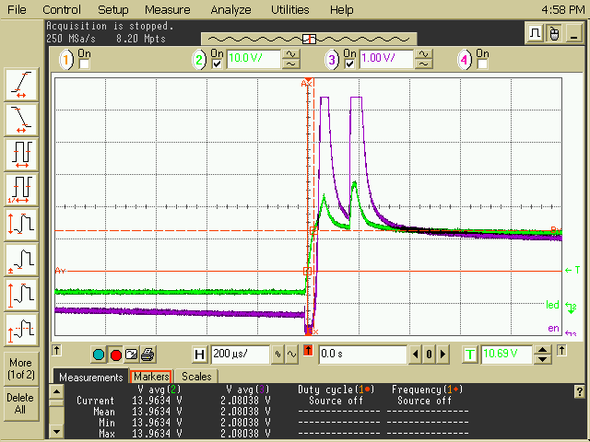
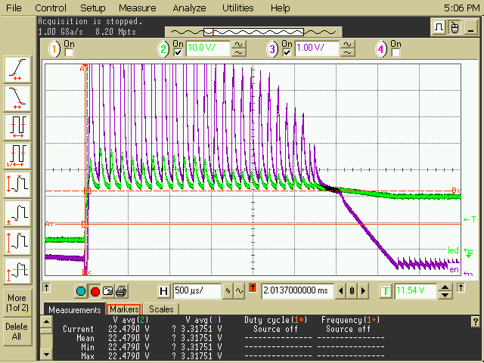
Fail board test – comp cap change test
Comp cap – 330nF
Dimming 2% _ turn on / Fail.
Ch2 – SW voltage
Ch3 – Ifb1 voltage
SW OVP and output drop.
Zoom in waveform so don’t see output voltage is drop.
min 동작 안됨
Comp cap – 330nF
Dimming 2% _ turn on / good.
Ch2 – SW voltage
Ch3 – Ifb1 voltage
SW is measured OVP level but don’t OVP protection.
Output voltage is good.
min 동작 됨

Slide 4
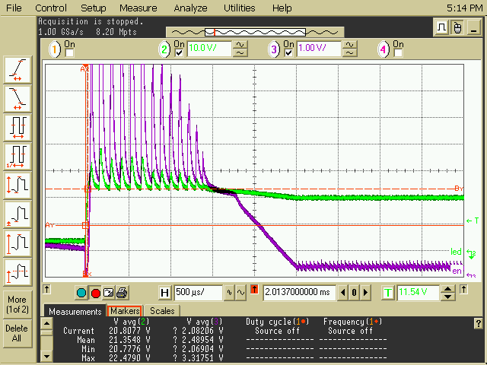
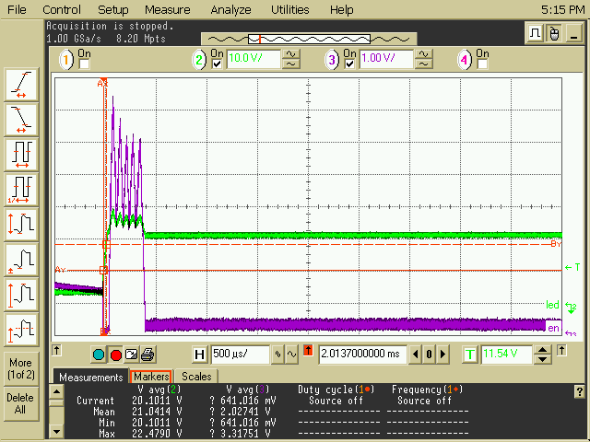
Fail board test – comp cap change test
Comp cap – 220nF
Dimming 2% _ turn on / good.
Ch2 – SW voltage
Ch3 – Ifb1 voltage
SW is measured OVP level but don’t OVP protection.
Output voltage is good.
min 동작 됨
Comp cap – 220nF
Dimming 100% _ turn on / good.
Ch2 – SW voltage
Ch3 – Ifb1 voltage
SW is measured OVP level but don’t OVP protection.
Output voltage is good.
max 밝기

Slide 5
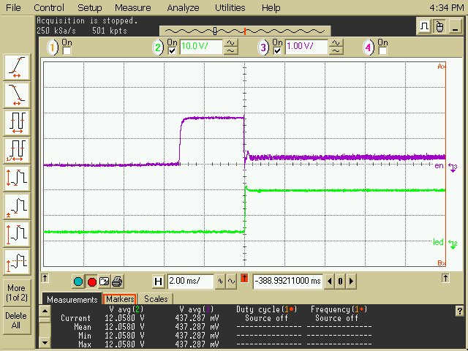
Fail board test – comp cap change test
Comp cap – 220pF
Dimming 2%시 turn on 파형 / 정상동작
Ch2 – SW voltage
Ch3 – Ifb1 voltage
Don’t see over shoot waveform and output is good.

