Slide 1

2023.7.10
For more information about the BQ25730RSNR
Kyocera Industrial Tools Corporation
Engineering Department

Slide 2
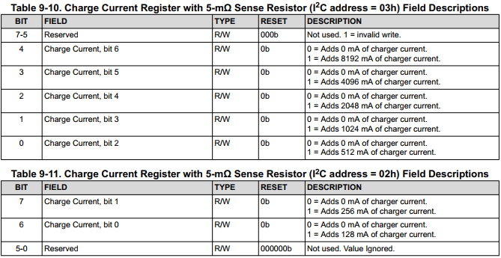

The problem
・ The charging stop is not controlled correctly in our prototype circuit.
The ・ charge current is correctly controlled by the charge current value set by I2C.
Even if "charge current 0A" is set or "CHRG_inhibit" is set to 1b, the charge current does not reach 0A.
The 1.43A of the charger continues to flow to the battery side.

Slide 3
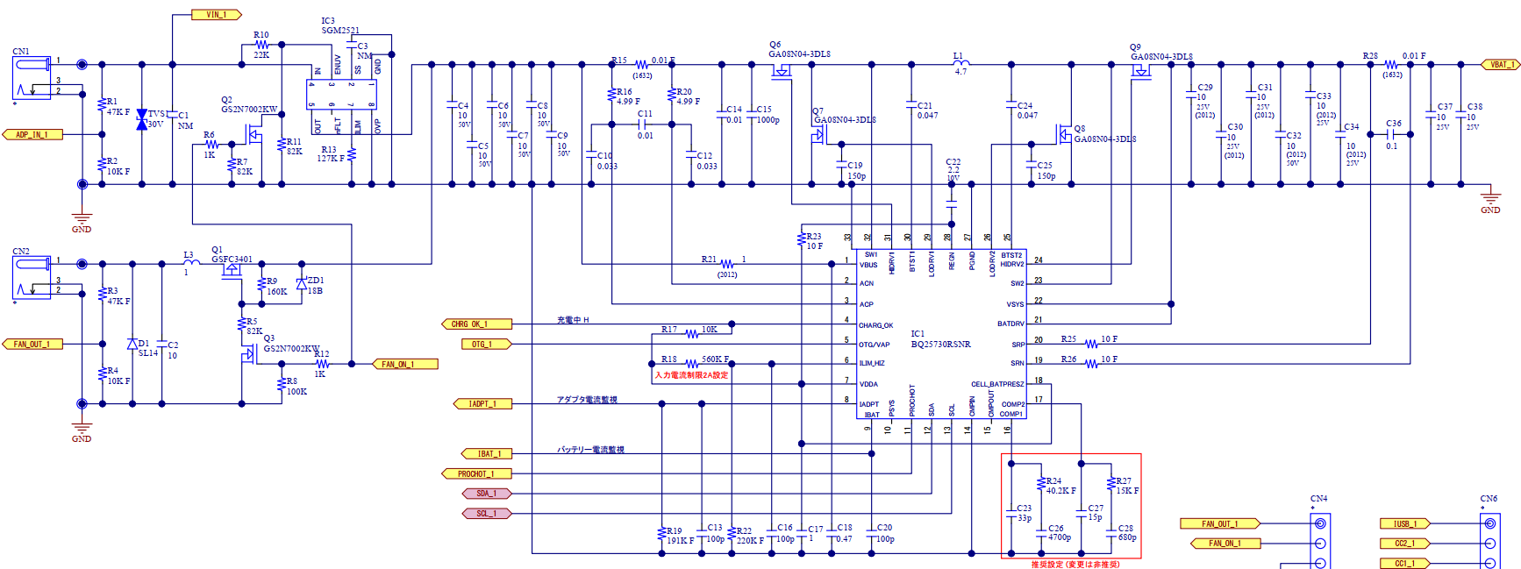
DISCO circuit configuration
For use with 4cell batteries and uses a 21A_1.43A charger.
Charger: 21A_1.43A
Battery(4cell): Max16.8V

Slide 4
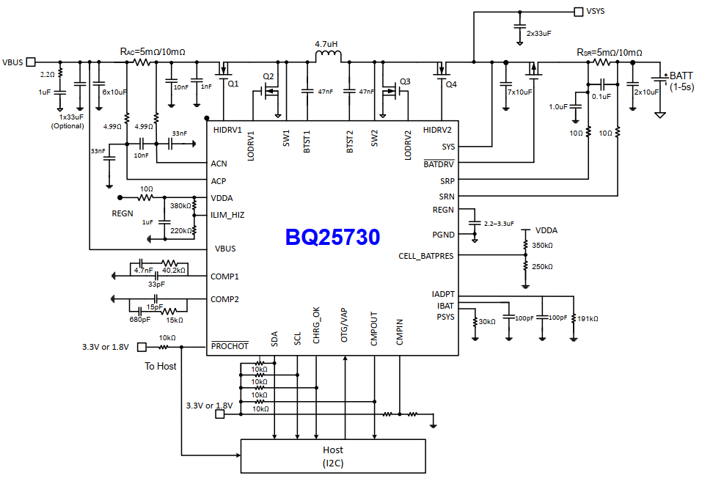
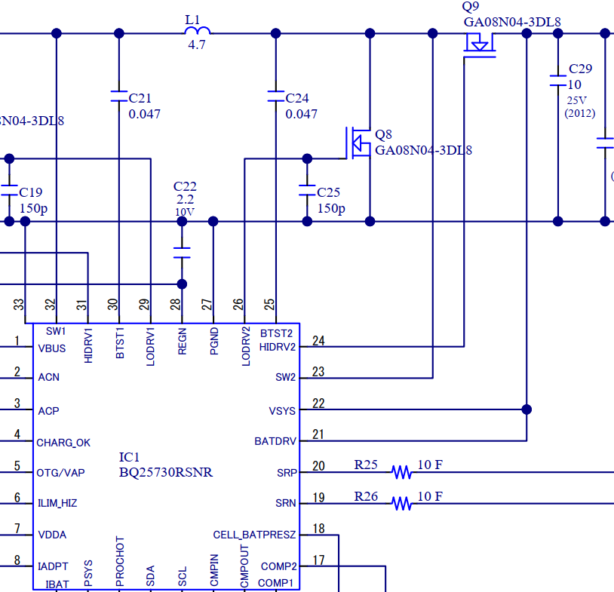
Inquiries
The application circuit provided by TI is configured to connect the BATDRV to the P-ch MOSFET gate.
In our circuit, the P-ch MOS is not implemented by shorting BATDRV and VSYS.
In charge control, does this circuit configuration affect the cause that charging does not stop?
TI application circuit
Kit prototype circuit

Slide 5
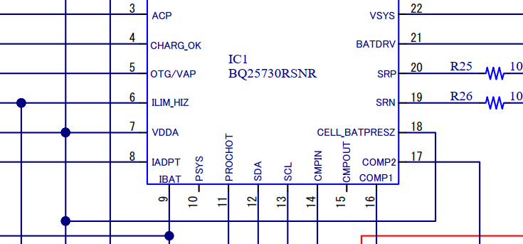
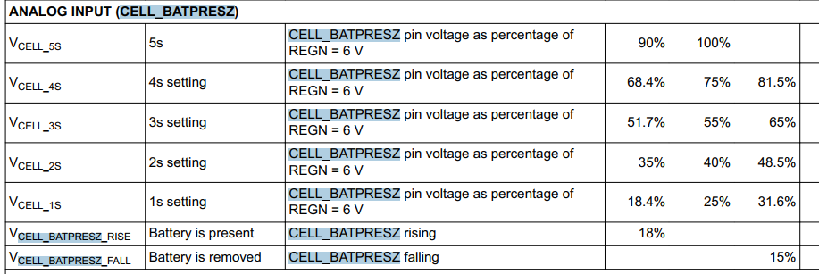
[Notes]
"Cell_BATPRESZ" pin was connected to VDDA, but added a voltage divider resistor for 4cell judgment and fixed it manually.

