Slide 1
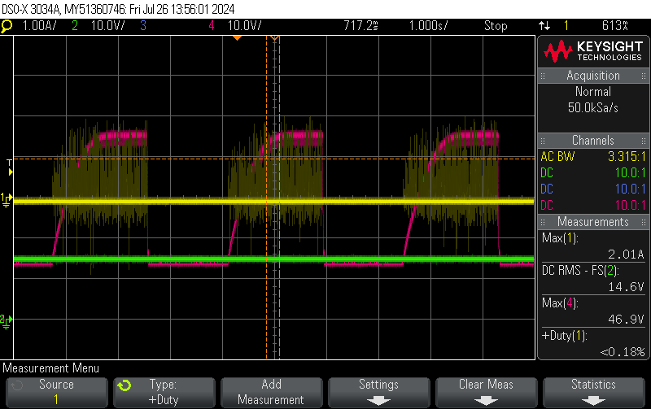
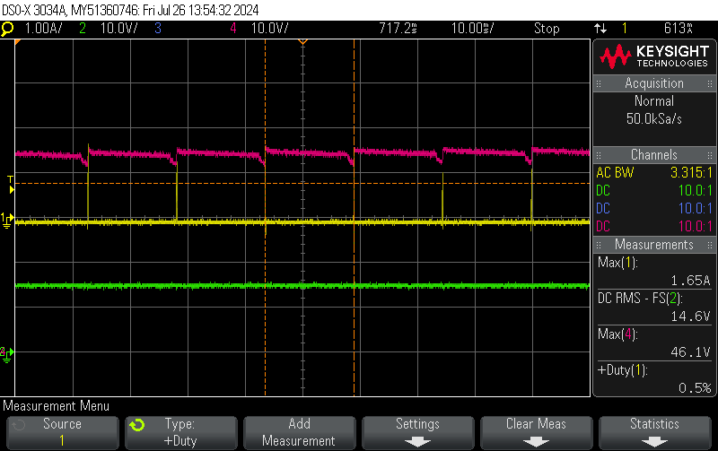
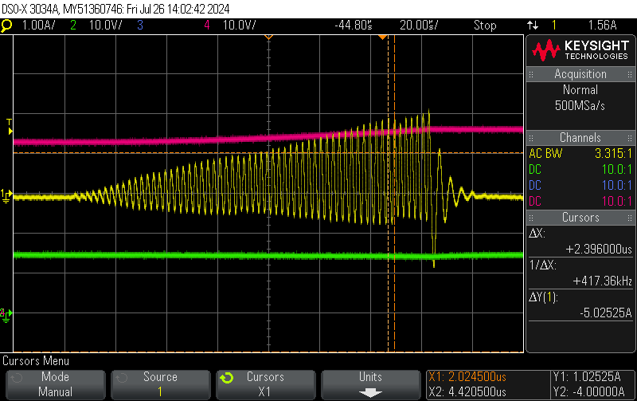
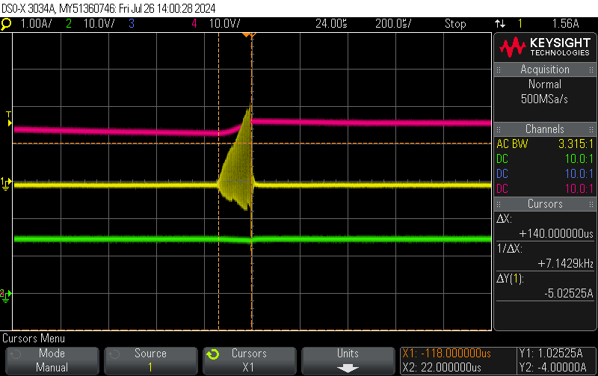
□ Input Current
Q1 : Is narrow-band high current normal operation?
Is there a way to reduce narrow-band impulse current?
When I changed R_sens from 0.5 ohm to 2 ohm, average
current was reduced, but peak current was not reduced at on time.
(※ Due to the narrow-range shock current, it is affecting the adjacent power and ground. In the next step PCB, the input power and ground will be separated, but if there is a way to improve the components around the TPS923652, please let me know.)
Q2 : If the input current in the form of a sine wave is wrong,
please tell me how to improve it.
CH1 Yellow : Input Current
1.97A peak, -800mA min
CH2 Green : Input Voltage 14.6V rms
CH4 Red : Output Voltage
CH1: Peak Current period: 15.5mS
duty ratio : around under 1%
CH1: VSYS I
CH2: VSYS V
주기: 417kHz
CH1: Current 1.97A max, -800mA min
CH2: VSYS 14.6V rms
13.5V min

Slide 2
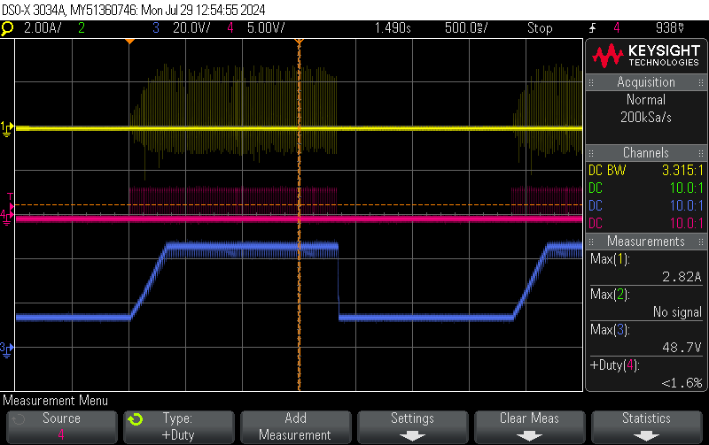
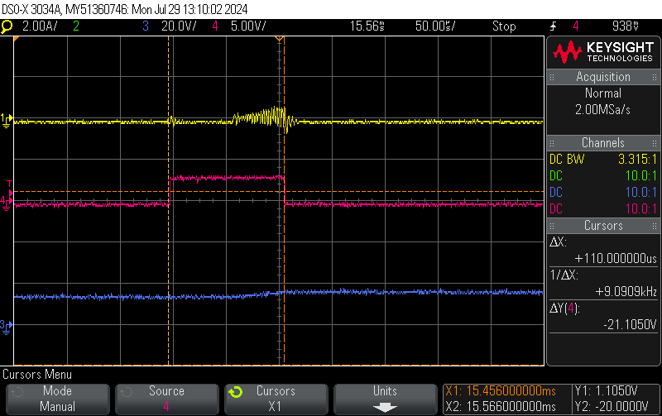
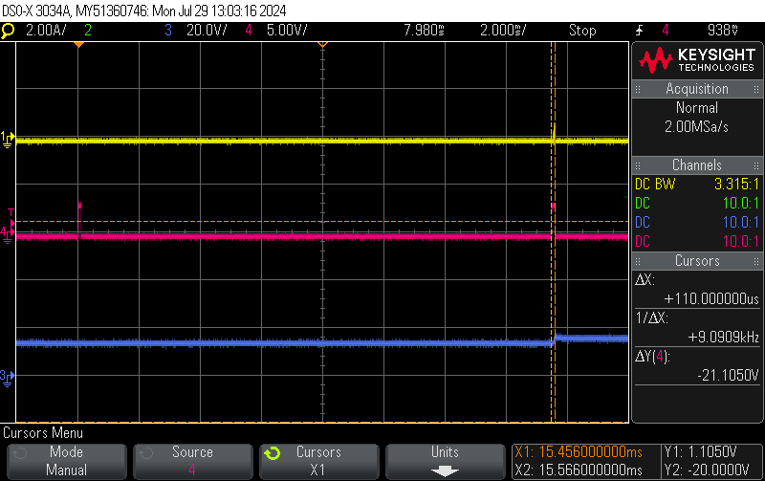
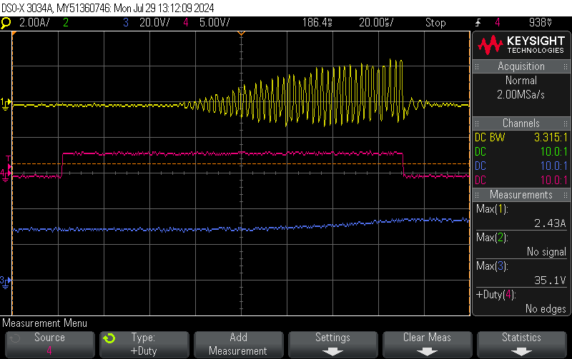
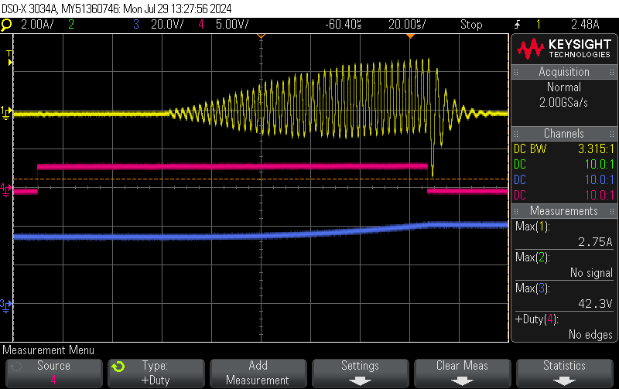
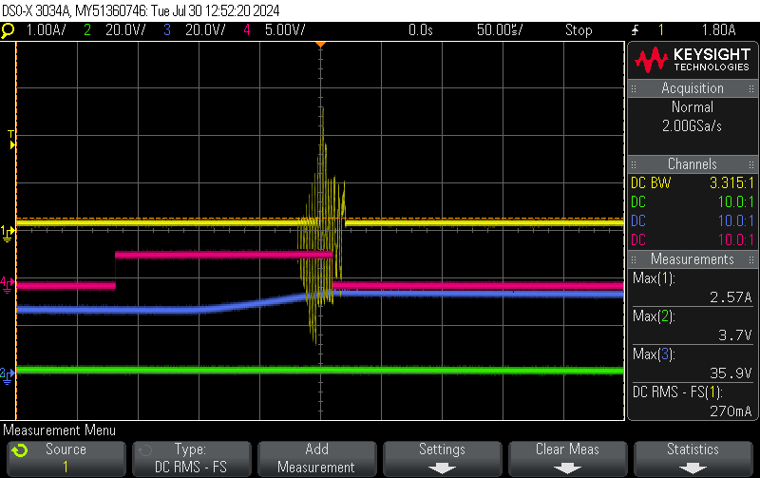
□ PWM Duty ratio and start-Up current for reference
ⓐ
ⓑ
ⓒ
Vout (Desired Output )
2-Sec On
ⓐ
2-Sec Off
□ PWM Start
ⓑ
ⓐ
. PWM High : 110uSec,
(PWM High width : 110uS ~ 192uS)
. Period : 15.5mSec
ⓒ
Yellow: Input current (R_sens_0.5 ohm)
period : 2.4uSec(417kHz)
1st PWM Pulse
2nd PWM Pulse
105uS
122~158.4~192uS
Yellow: Input current (R_sens_2 ohm)

Slide 3
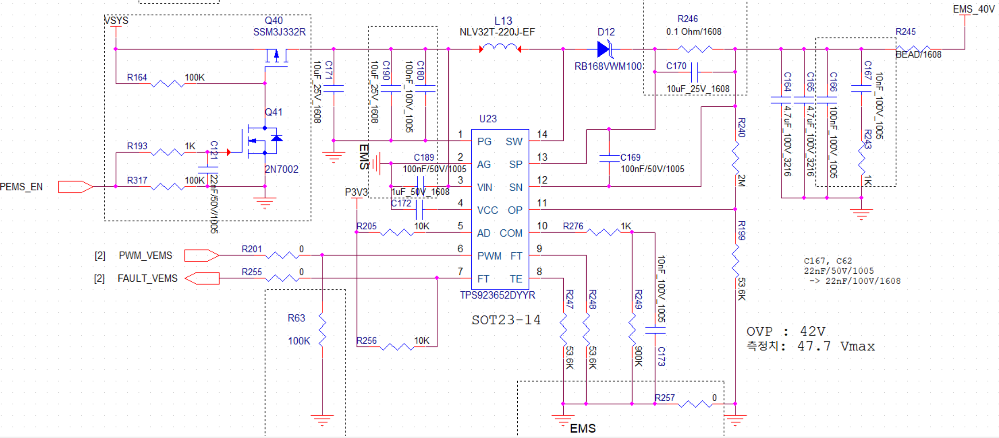
□ TPS923652 schematic (After)
1S rampUp
1S rampUp
Current Probe
1s
2S off
L13
MSS6132-223MLC
22uH shield 20% 1.9A (from 110mA)
DCR 158mΩ
12V~ 16.8V
R246
0.5 Ω /1608
A
DRV8871
VM
4.7uF 25V
OUT1
LOAD
560kΩ
OUT2

Slide 4
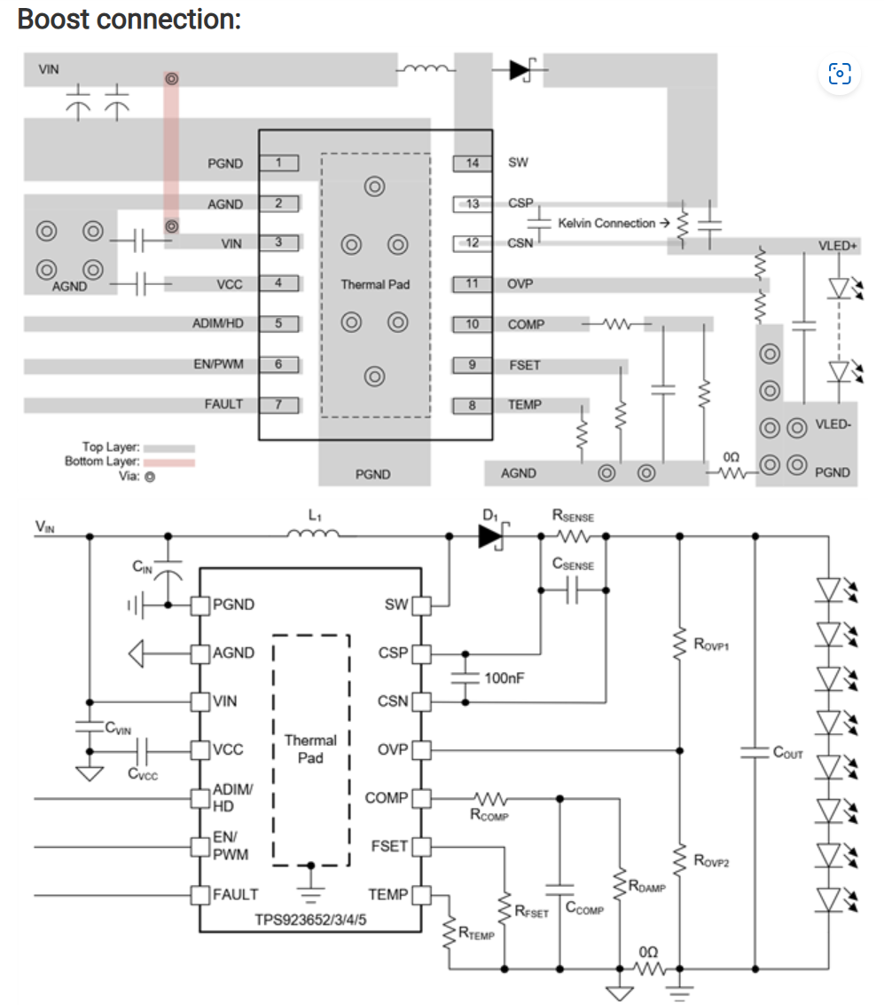
□ TPS923652 PCB DG (Before)
Issue : The switching noise generated in the currently designed PCB is affecting other logic, so I would like to modify it with Ti's guide in the next step PCB version.
Requests: May I have your recommended values ​​for
- R_COMP, C_COMP, C_DAMP
- R_SENS, C_SENS.2.
3. Our design spec
- Vin: 12~16.8V.
- Vout: 40V.
- The output current is under 100mA excluding the output capacitor charging current,
and there is no need for current limit.
L13
D12
C171
C180
C189
C169
R246
C170
C172
C165
C164
C166
R276
C173
R249
12V~ 16.8V
R247
R248
R257

