Slide 1
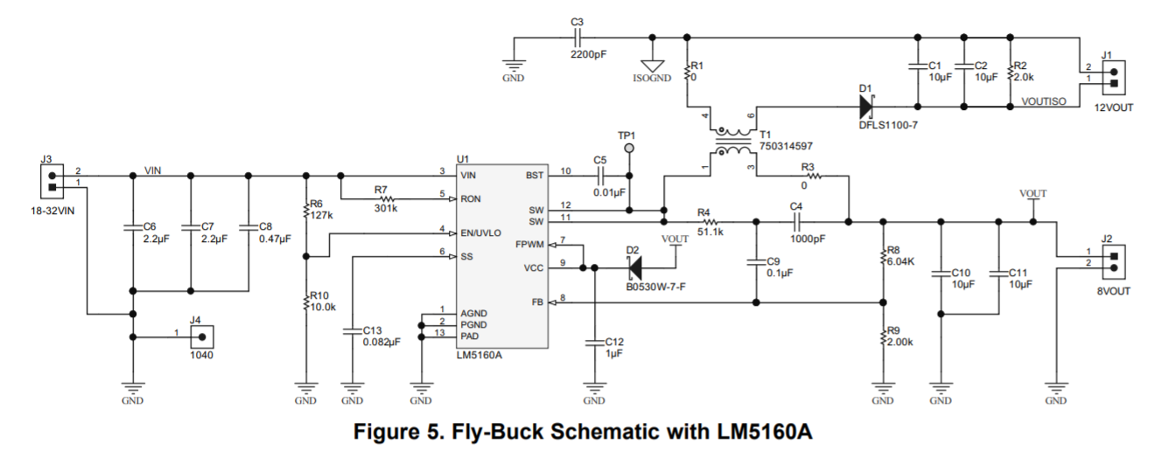
WURTH
744873680
(Coupled inductor, 68uH)
12Vout, 1A
24Vin
470k
470k
10k
12Vout
No Load

Slide 2
SW waveform
SW(TP1)
SW(TP1)
Vout-sec=11.04V
Vout-sec=9.6V
Secondary side
(D1 anode)
Secondary side
(D1 anode)
Secondary side no load, Primary side no load
Secondary side 0.1A load, Primary side no load
SW(TP1)
SW(TP1)
Vout-sec=7.3V
Vout-sec=5.4V
Secondary side
(D1 anode)
Secondary side
(D1 anode)
Secondary side 0.3A load, Primary side no load
Secondary side 0.5A load, Primary side no load

