Slide 1
PMID capacitance must exceed the 4uF minimum after derating for applied voltage and temperature (i.e. what is the capacitor's capacitance after the max input voltage is applied?)
▶ VBUS Input voltage ( 5V from type-C usb connector)
Capacitor of PMID : 20uF/25V (Two 10uF were stacked using rework). CL10A106MA8NRNC, X5R ±20%.
2. The PROG pin sets fsw=1.5MHz but the inductor is 3.3uH not 1uH. The IC is internally compensated for 1uH at 1.5MHz and could be feedback-loop unstable with 3.3uH.
▶ I’ve replace inductor from 3.3uH to 1uH(TFM322512ALMA1R0MTAA) and test again this Morning. Issue was improved, but not fixed.
3. If the shipFET is installed, the BATP resistor must connect to the drain side of the shipFET.
▶ It is scheduled to be applied in the next step of PCB modification.
4. With 4S battery pack, some protection for BAT and BATP pins is required to prevent battery hot plug from damaging those 20-V rated pins. I have no data supporting the use of an RC snubber at the battery connector for hot plug protection. In theory it should work but the resistor may get hot if the system load causes repeated battery current supplement events. We recommend a TVS diode at the battery connector and/or, if shipFET is installed, a 33nF from BATP pin to ground to a form an RC filter with the 100ohm series resistor.
▶ It is scheduled to be applied in the next step of PCB modification.
On the schematic, the rework to add the 100nF PMID and SYS capacitors likely is not effective due to the wire that connects to the SYS ground. The point of those capacitors is shunt switching noise to IC GND pin with as little resistance as possible.
▶ The 100nF capacitor was well connected to PMID and SYS pin 27 GND Trace by rework, and then an additional wire was connected to SYS GND.
From your plots, I do not understand how a charged battery connected at BAT pin (through the shipFET) can have its voltage move as much as your plots show unless
1. the battery pack protector is opening/closing. ▶ looks closing. The protector doesn't seem to be working.
2. there is a large series resistor between the battery and the IC BAT pin. ▶ Current probe for measure(1mΩ) + Internal resister of Battery pack (≤ 50mΩ)
What do the charger's status and fault registers report during/after the scope plot events? The fault registers are "sticky" meaning that don't clear until they are read.
I recommend getting a BQ25798EVM and testing your software with the EVM.
▶ This morning, I read the register dump before and after the EVENT occurred, but there was no change in the fault status register.
Regards,

Slide 2
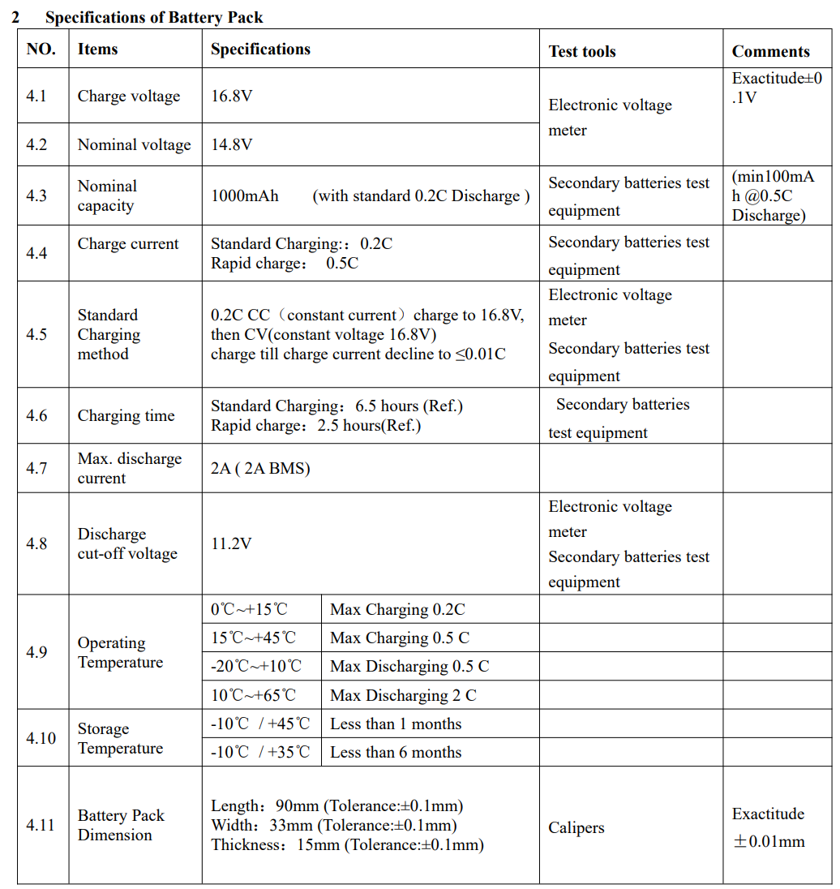
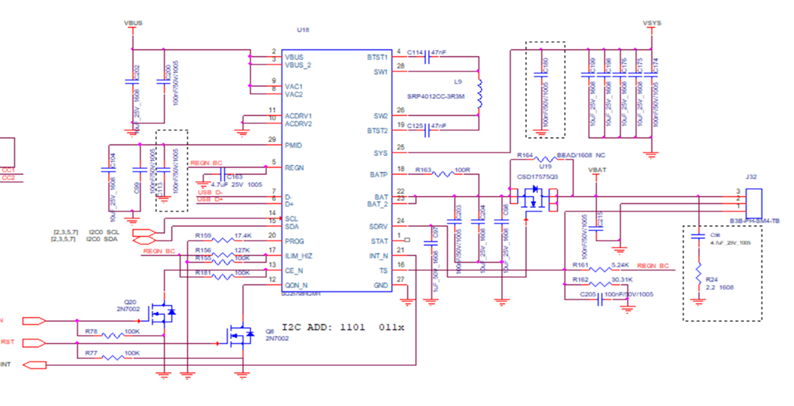

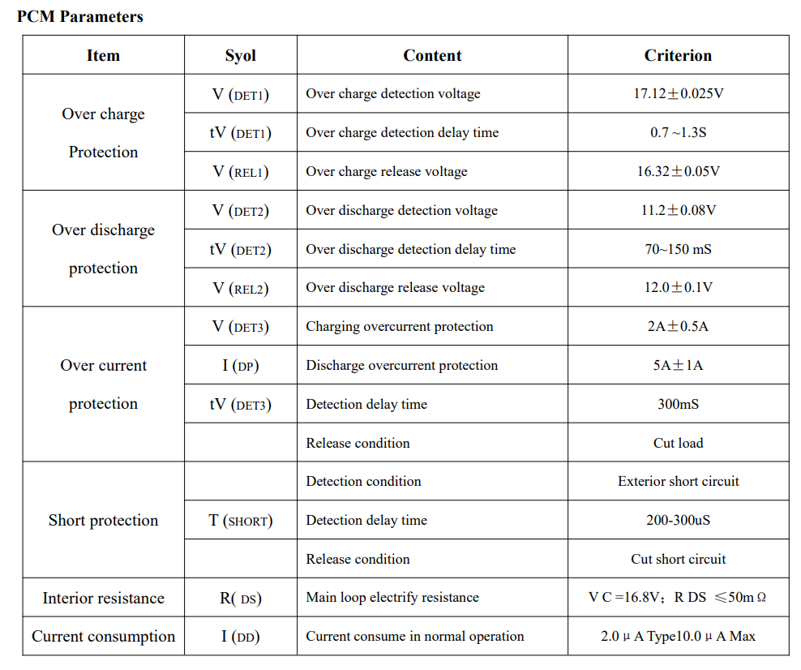
□ Battery Pack & Connection with Main PBA
Spec of Battery Pack
CH4 (SYS Voltage)
CH2 (BAT Voltage)
CH1 (BAT Current)
CH3 (PMID voltage)
J32
Current Porbe
to measure current(ch1)
: 1mΩ
BAT CON
3 (+BAT)
PCM Parameters of Battery Pack
2 (GND)
1 (NTC)

Slide 3
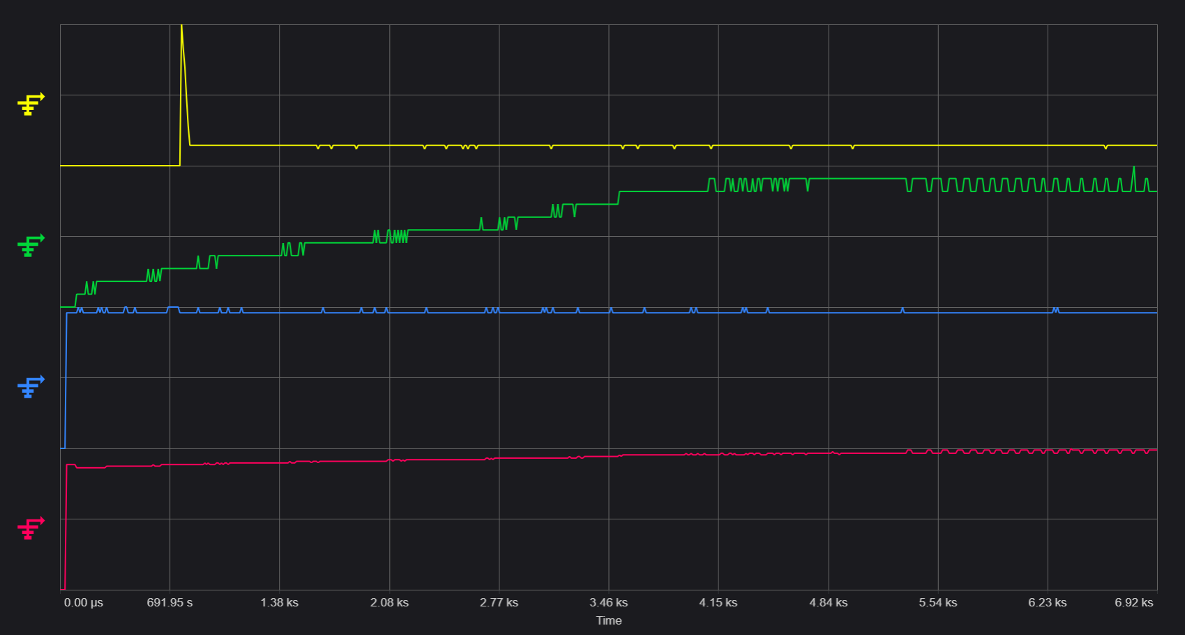
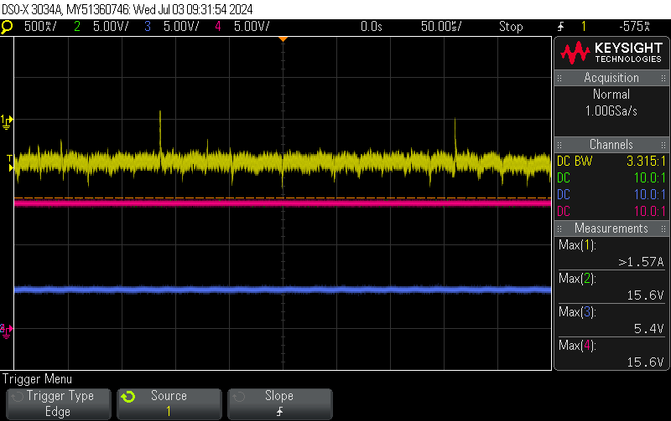
□ charging log with bq25798 (#PBA13, 20240703)
Osiloscope : Keysight MSOX3054A
Peak 2.9A
1.57A
CH1: IBAT
0.42A
16.6V
16.8V
17V
CH2: VBAT
16.0V
16.2V
16.4V
15.6V
15.8V
15.4V
CH3: PMID 5.2~5.4V
CH4: VSYS
800sec
240sec
700sec
3800sec
6100sec
500sec
850sec

