Slide 1

30W/15V
Flyback Converter
2020년 8월 14일
(13210) 경기도 성남시 중원구 사기막골로 80, 3층
Third floor, 80, Sagimakgol-ro, Jungwon-gu, Seongnam-si, Gyeonggi-do, Republic of Korea

Slide 2
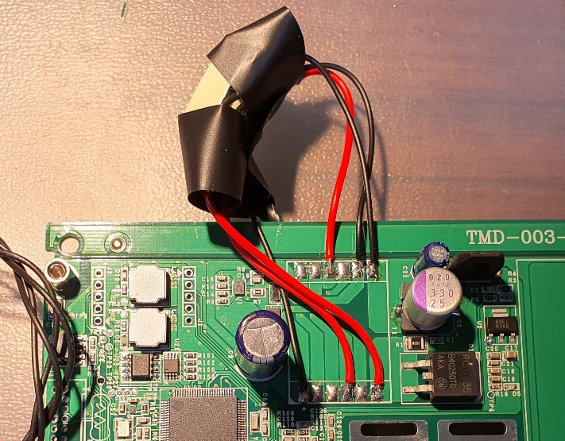
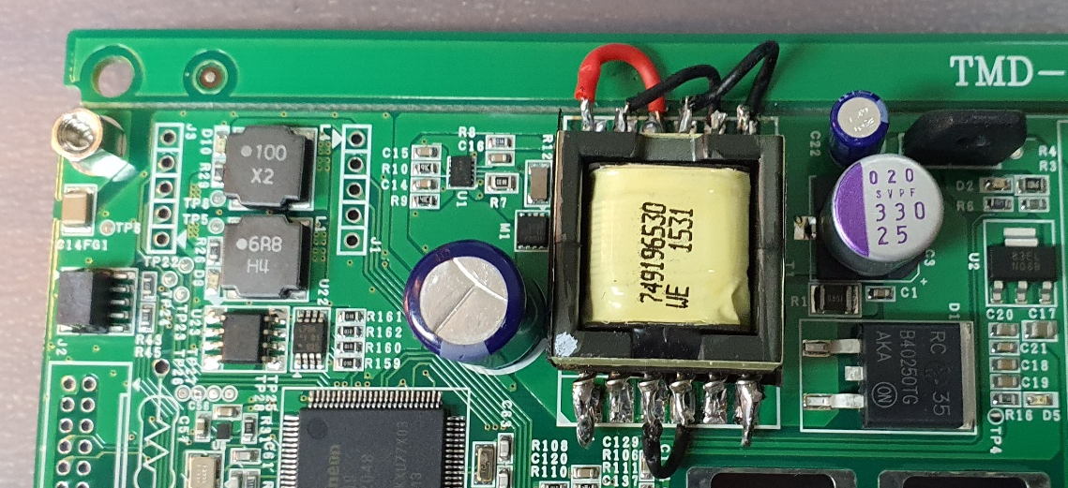
1. Specification
Transformer line is shortened.
< Transformer line change >

Slide 3
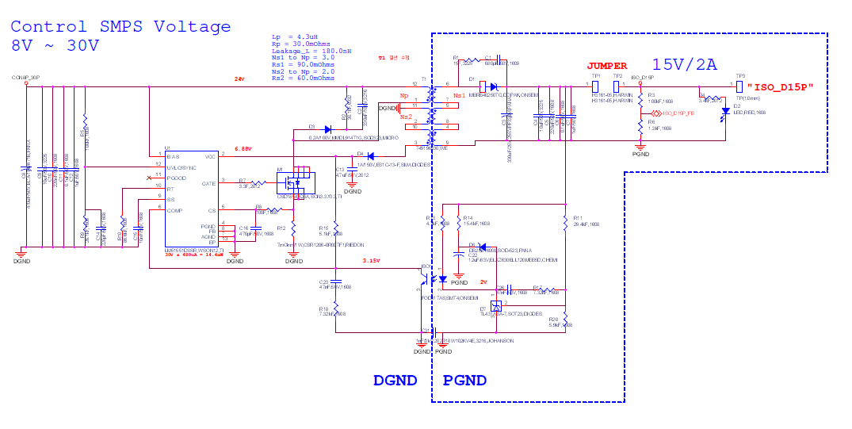
2. Schematic
Oscilloscope measurement location
CH4
CH2
CH1
CH3

Slide 4
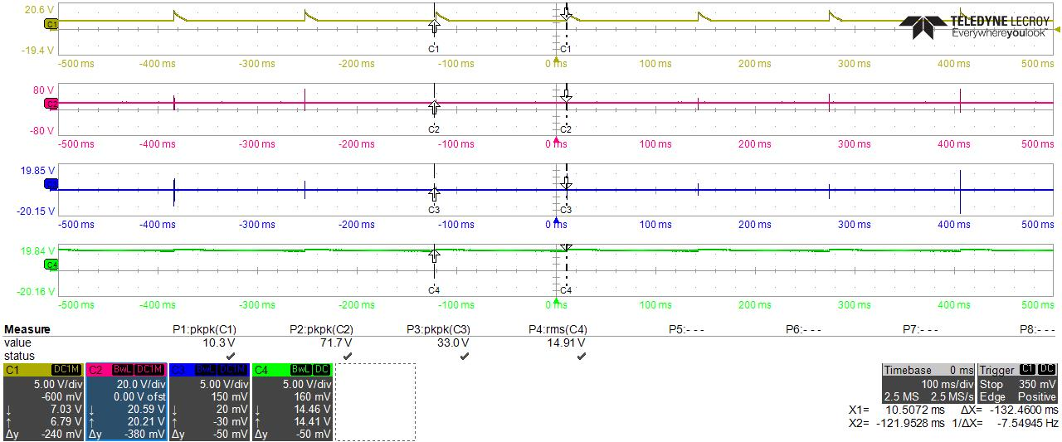
3. Experimental Result
No load condition

Slide 5
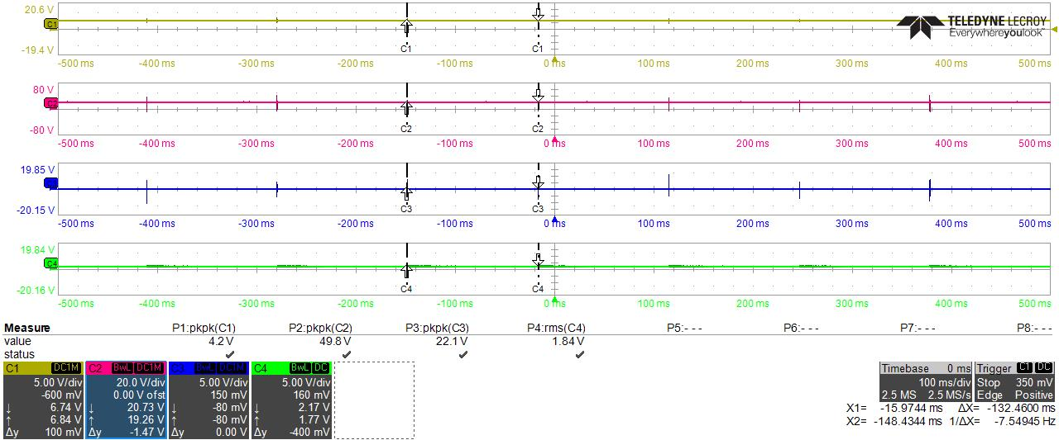
4. Key Waveforms
Under load condition

Slide 6
THANK YOU

