Slide 1

30W/15V
Flyback Converter
Sep. 27. 2020.
(13210) 경기도 성남시 중원구 사기막골로 80, 3층
Third floor, 80, Sagimakgol-ro, Jungwon-gu, Seongnam-si, Gyeonggi-do, Republic of Korea
www.ropem.co.kr

Slide 2
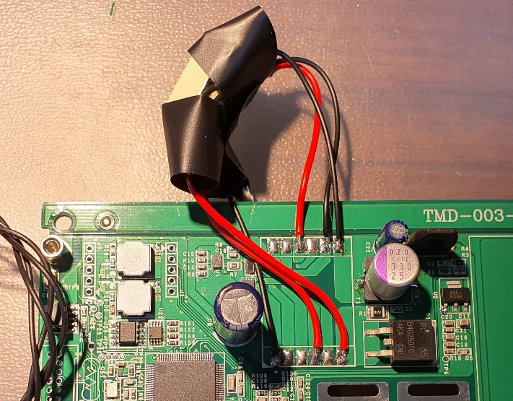
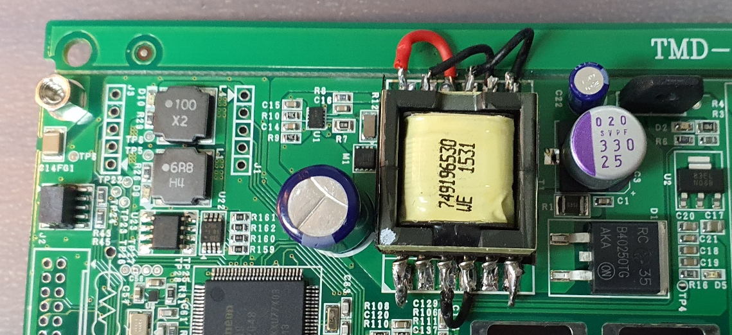
1. Specification
Transformer line is shortened.
< Transformer line change >

Slide 3
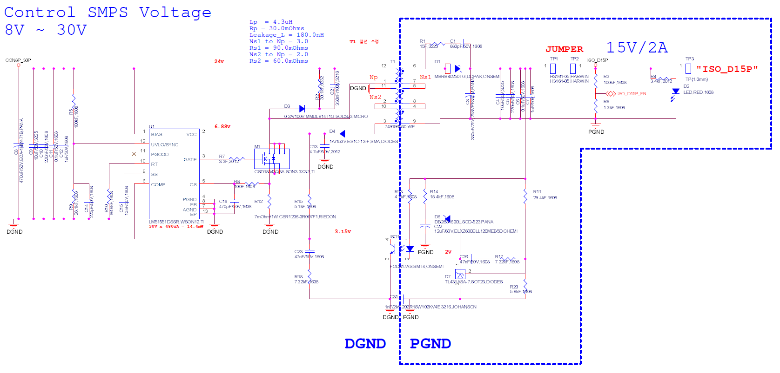
2. Schematic
Oscilloscope measurement location
CH4
CH2
CH1
CH3

Slide 4
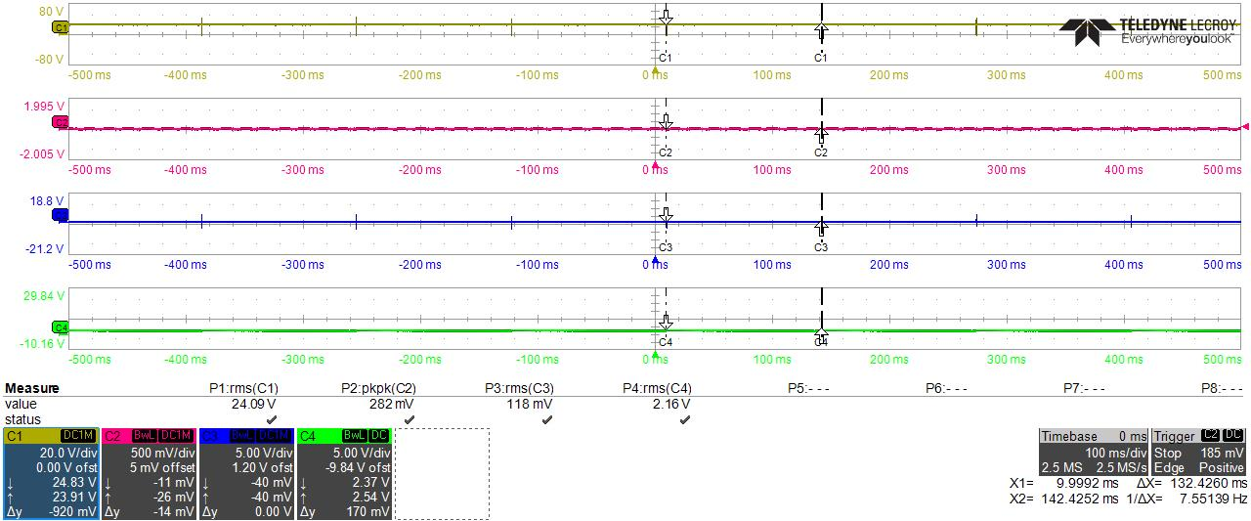
3. Experimental Result
Underload condition Total (Sep. 27. 2020.)
R17=R18=1.2kOhm
C26=C23=220nF
ALL WAVEFORM
CH1
CH2
CH3
CH4

Slide 5
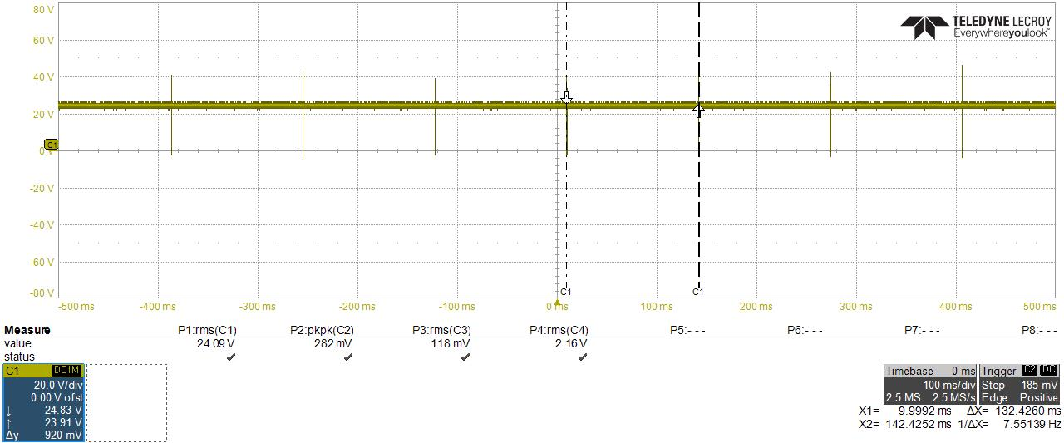
3. Experimental Result
Underload condition Total (Sep. 27. 2020.)
R17=R18=1.2kOhm
C26=C23=220nF
CH1 WAVEFORM (VCC)

Slide 6
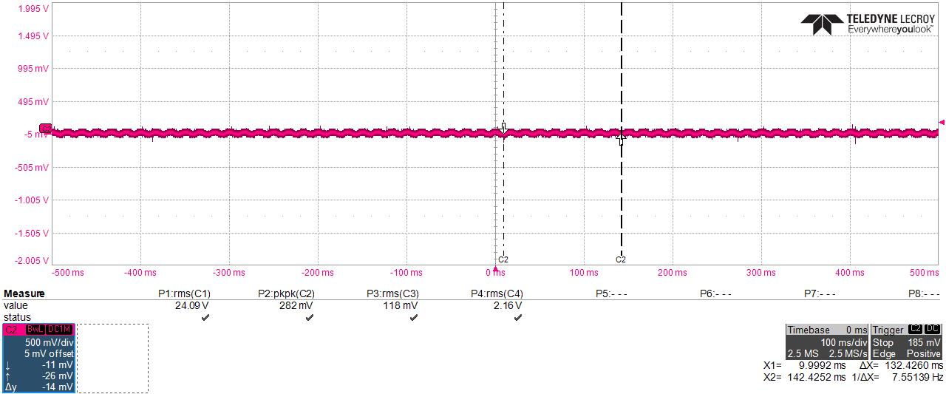
3. Experimental Result
Underload condition Total (Sep. 27. 2020.)
R17=R18=1.2kOhm
C26=C23=220nF
CH2 WAVEFORM (SNUBBER)

Slide 7
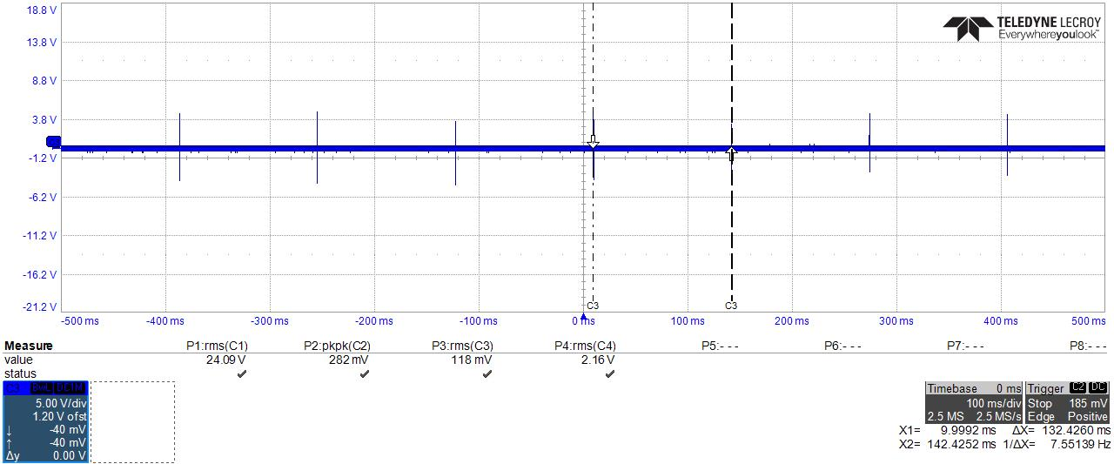
3. Experimental Result
Underload condition Total (Sep. 27. 2020.)
R17=R18=1.2kOhm
C26=C23=220nF
CH3 WAVEFORM (CS 5 PIN)

Slide 8
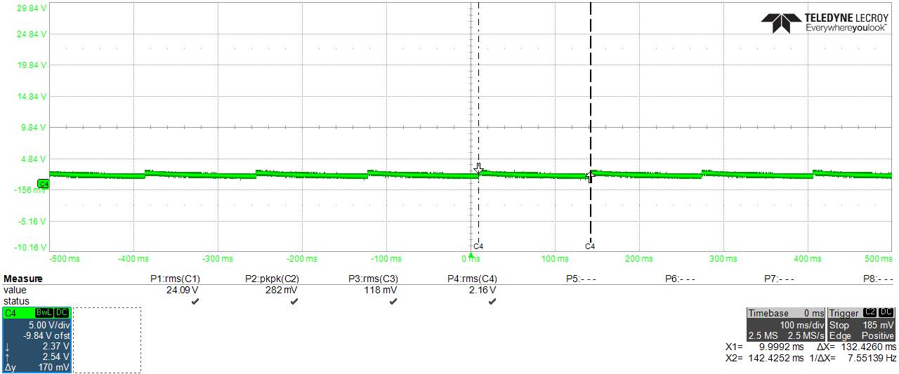
3. Experimental Result
Underload condition Total (Sep. 27. 2020.)
R17=R18=1.2kOhm
C26=C23=220nF
CH4 WAVEFORM (OUTPUT VOLTAGE)

Slide 9
THANK YOU

