Slide 1
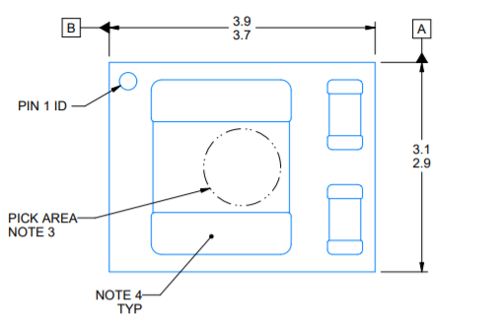
The top center of this package is measured to get Psi_JT?

