Slide 1
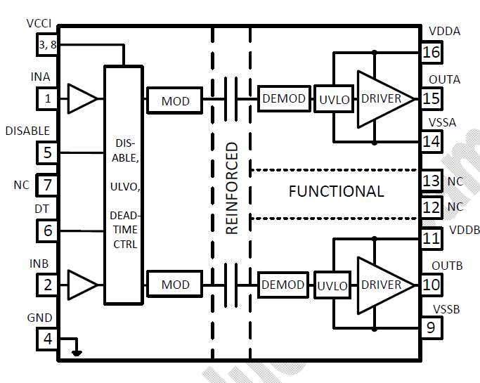
Grounding solution 1
Grounding solution 2
Grounding solution 3
Grounding solutions
GND
VSSA
15V
20V
15V
(V_{SSA}+25V) V
Bias power supply Reference
V_{SSA}
-5V
-10V
(V_{SSA}) V
V_{SSA}
V_{SSA}
The power supplies for V_{DDA} and V_{DDB} are independent and can be referenced to any voltage (-5V, -10V, examples shown above) as long as the following specs are satisfied.
Maximum specs should always be satisfied:
(V_{DDA}-V_{SSA}) and (V_{DDB}-V_{SSB}) should be < 30V; 25V recommended;
|V_{SSA}-V_{SSB}|≤1500V, Voltage applied in application is also limited by PCB traces Creepage and Clearance distances.
|V_{SSA}-GND| and |V_{SSB}-GND| is limited to 5kVrms in accordance to UL and 7kV peak in accordance to VDE, EN and IEC standards for reinforced insulation
  If the V_{SSA} and V_{SSB} are swinging with high dV/dt, then the performance will be related with CMTI.
VSSB
Grounding solution for channel B is the same with channel A

