Slide 1
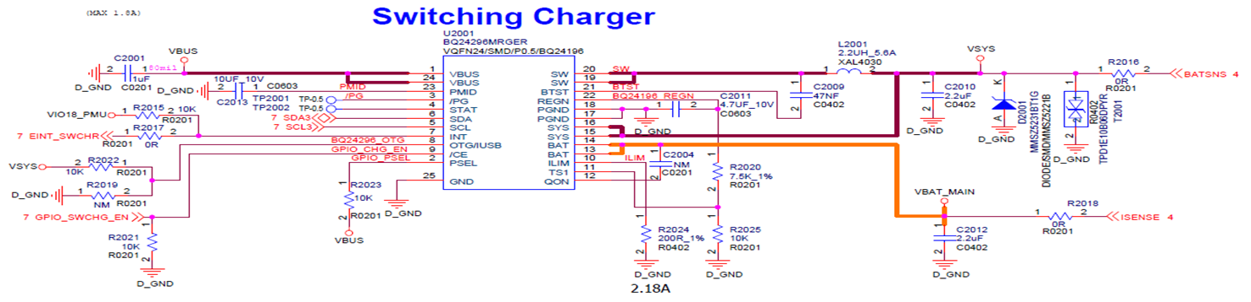
bq24296M circuit

Slide 2
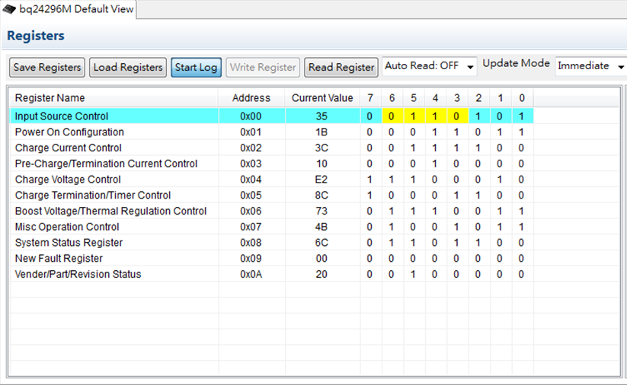
bq24296M setting
Vindpm = 4.36V, Vbat=4.4V

Slide 3
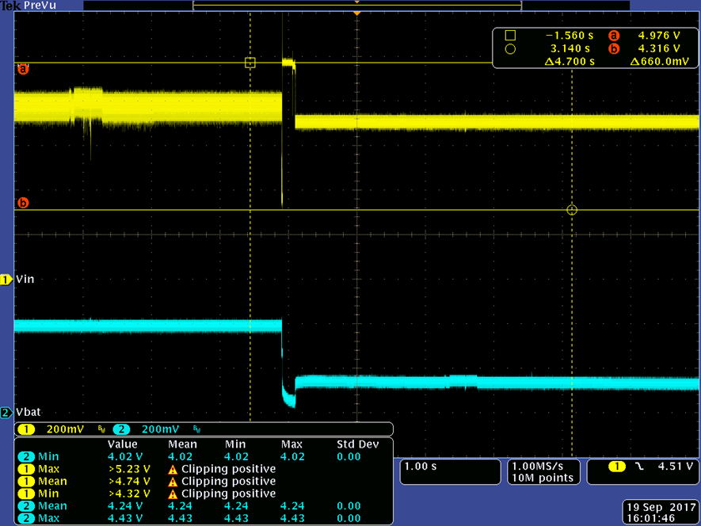
Battery is in CV mode, Vsys@1.5A
The Vbus min is 4.316V, but Ilim will change to 500mA(Default).

Slide 4
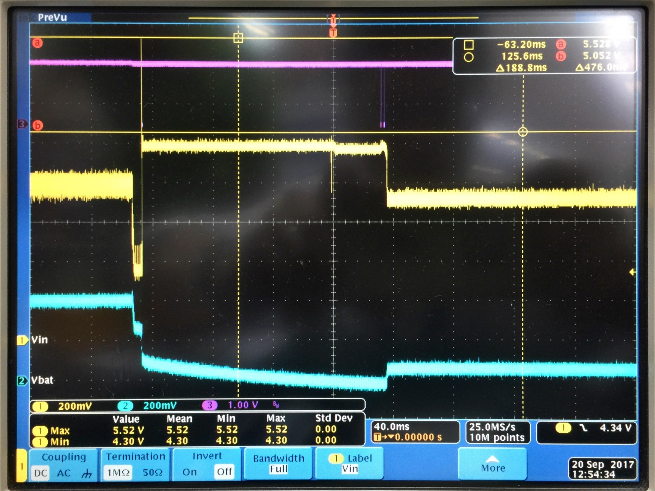
Zoom in, VINmax=5.528V

Slide 5
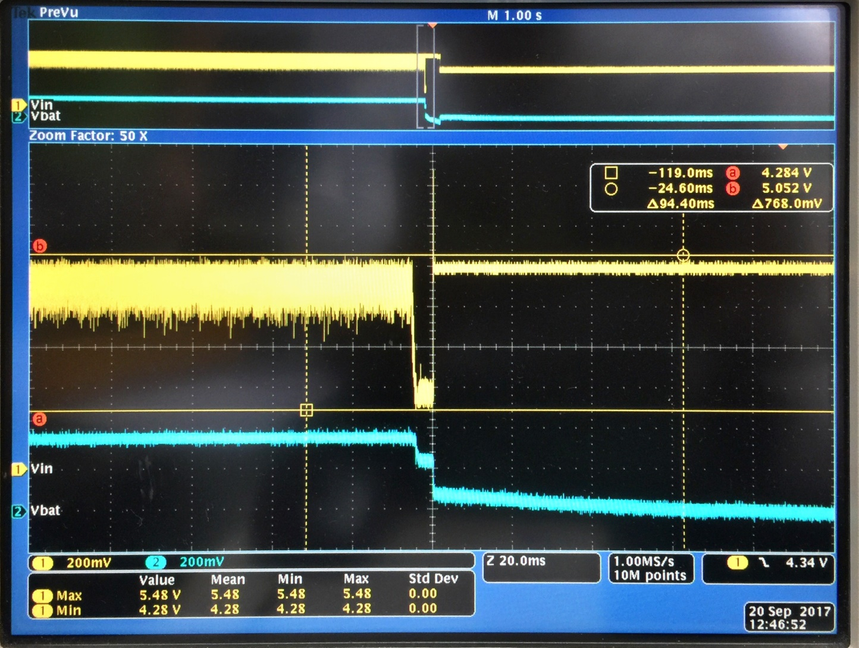
Zoom in, VINmin=4.284V

Slide 6
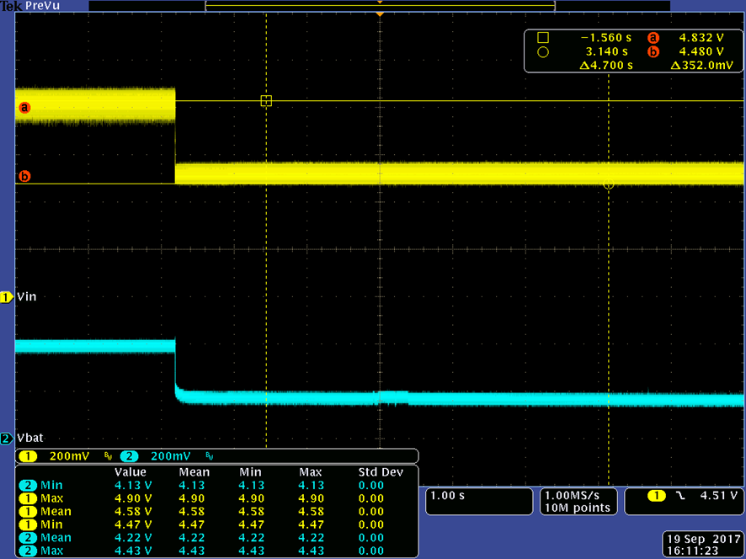
Change the VINDPM to 4.52V
Ilim will keep 1.5A.

