Slide 1
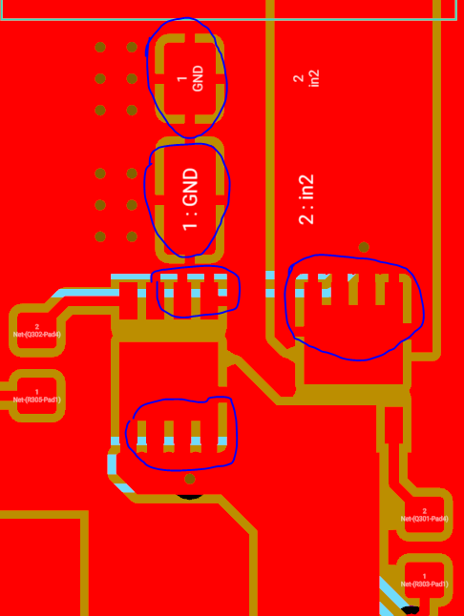
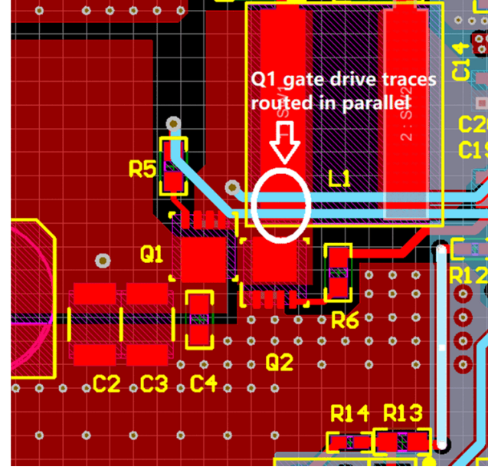
Use solid copper connection for input capacitor GND pads, MOSFET Drain and Source to reduce the SW1 switching spikes.

Slide 2
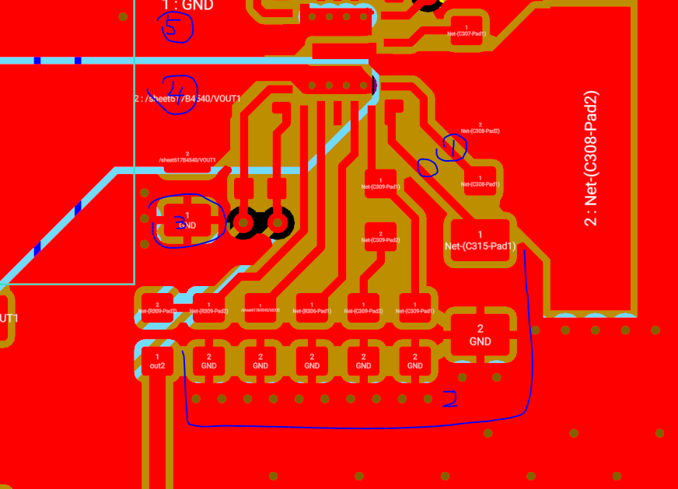
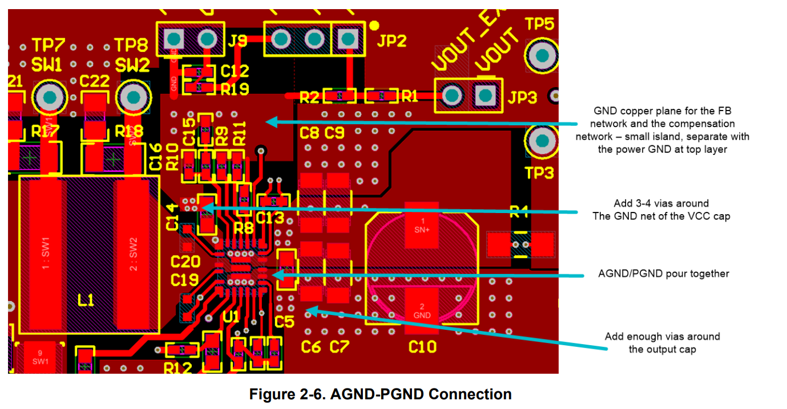
https://www.ti.com/lit/an/slvaer0b/slvaer0b.pdf?ts=1635511835892&ref_url=https%253A%252F%252Fwww.google.com%252F
Widen the VCC cap trace like EVM.
Separate the AGND plane with power GND plane. Use solid copper connection for these components.
Use solid copper connection for Cout.
Add some Vout vias. See below picture, there are some vias close to C5 upper pad.
Add some GND vias close to this ceramic cap GND pads. See vias close to C5.

Slide 3
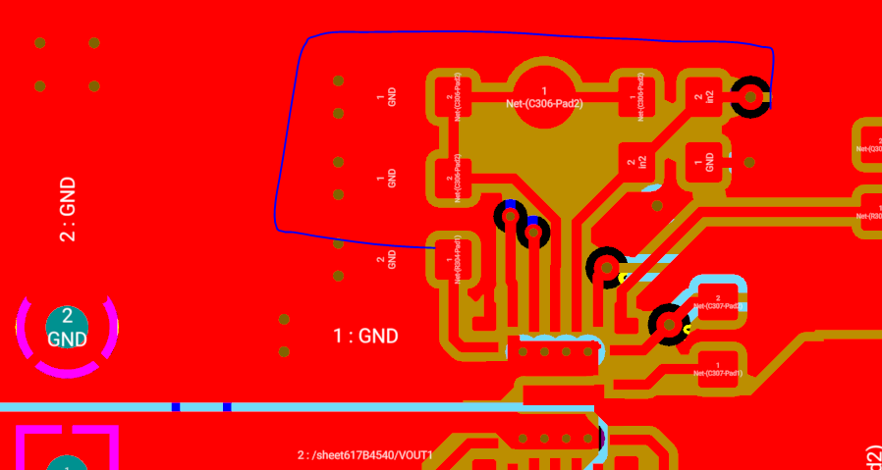
Separate the AGND plane with power GND plane to avoid noise effect on analog signal

