Slide 1
38 W LOAD UCC28056

Slide 2
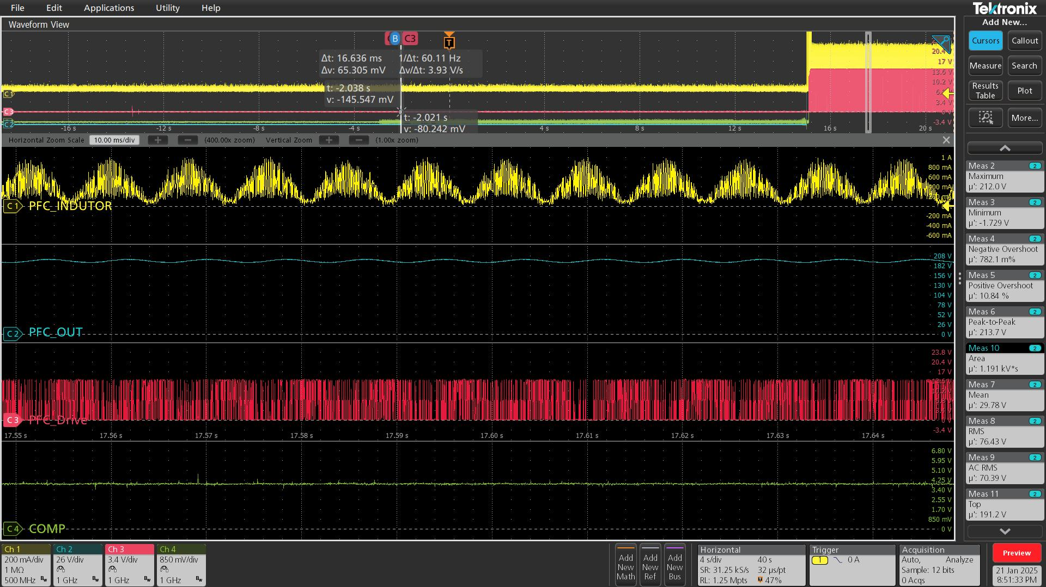
PFC Inductor, PFC out, PFC Drive, Comp

Slide 3
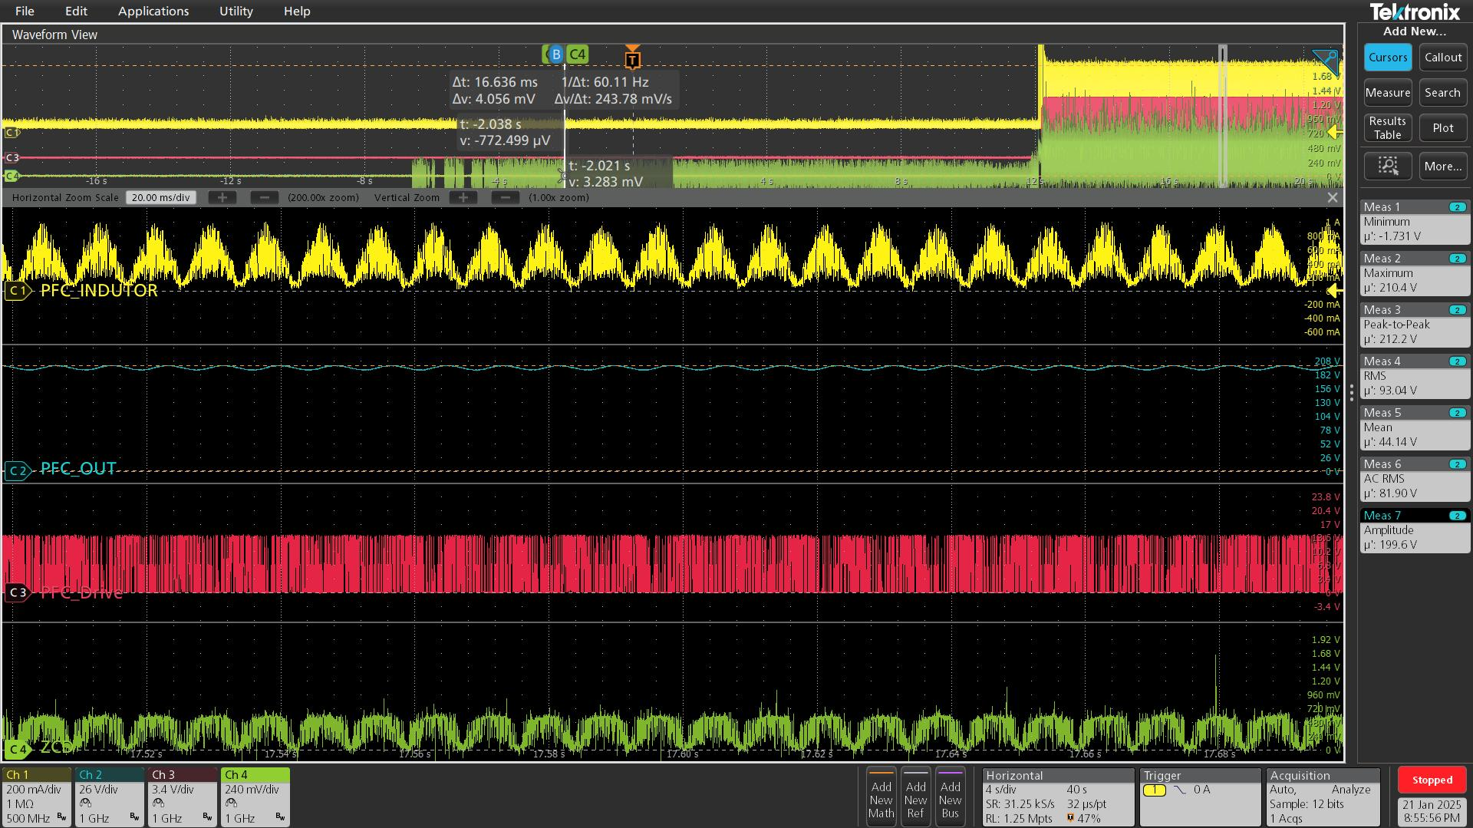
PFC Inductor, PFC out, PFC Drive, ZCD

Slide 4
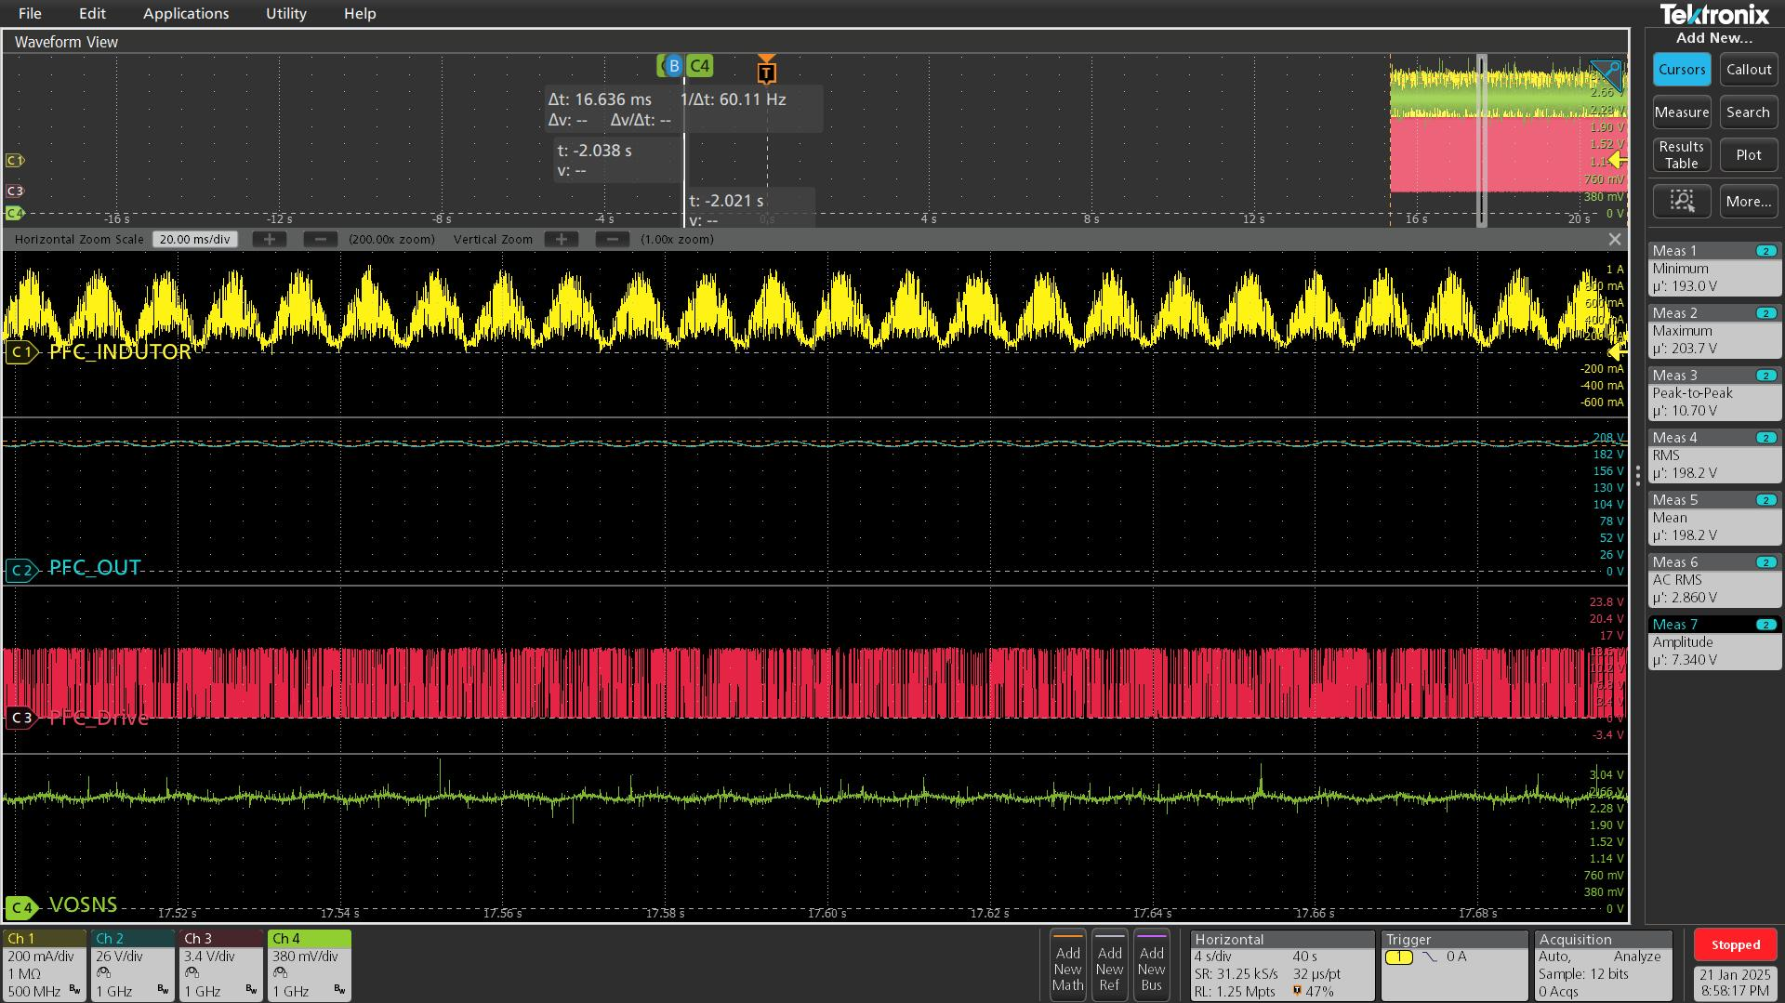
PFC Inductor, PFC out, PFC Drive, VOSNS

Slide 5
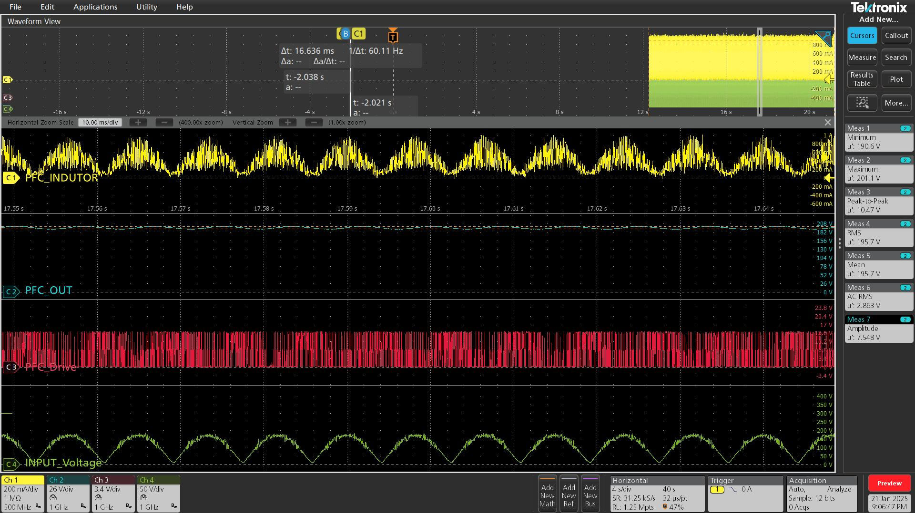
PFC Inductor, PFC out, PFC Drive, Input Voltage

