Slide 1
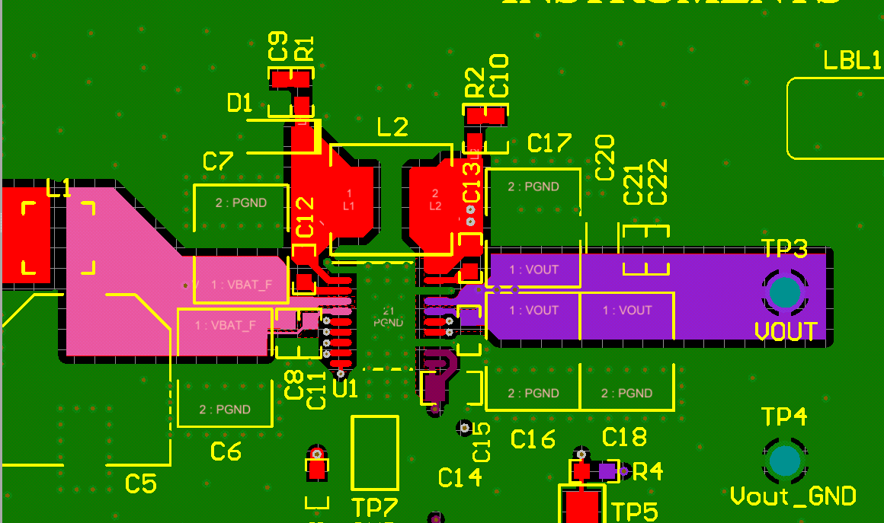
Top Layer
AGND and the PGND connected on top layer.
Input and output cap should very close to the IC. Please
follow the above picture

Slide 2
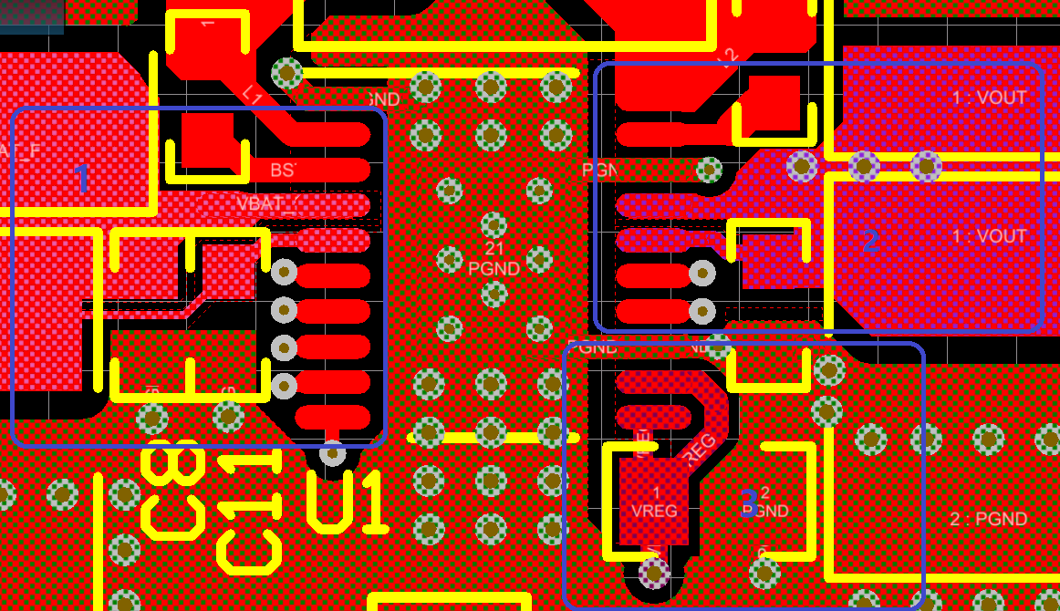
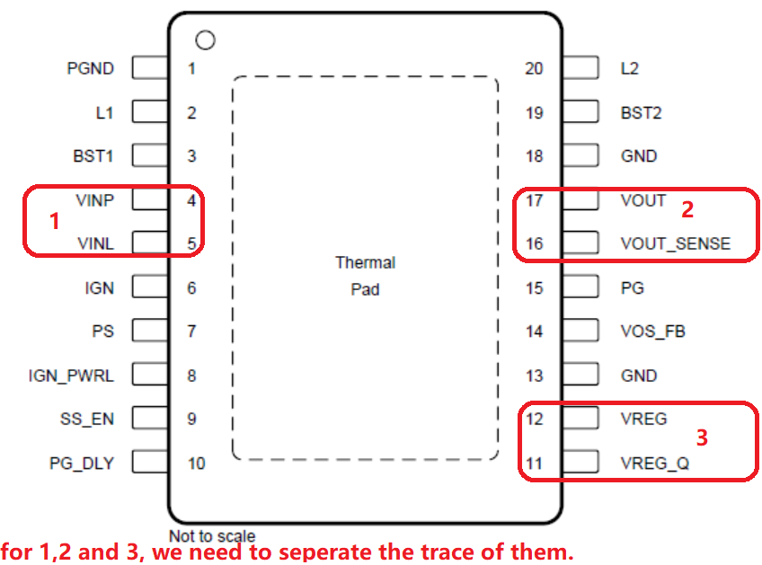

Slide 3
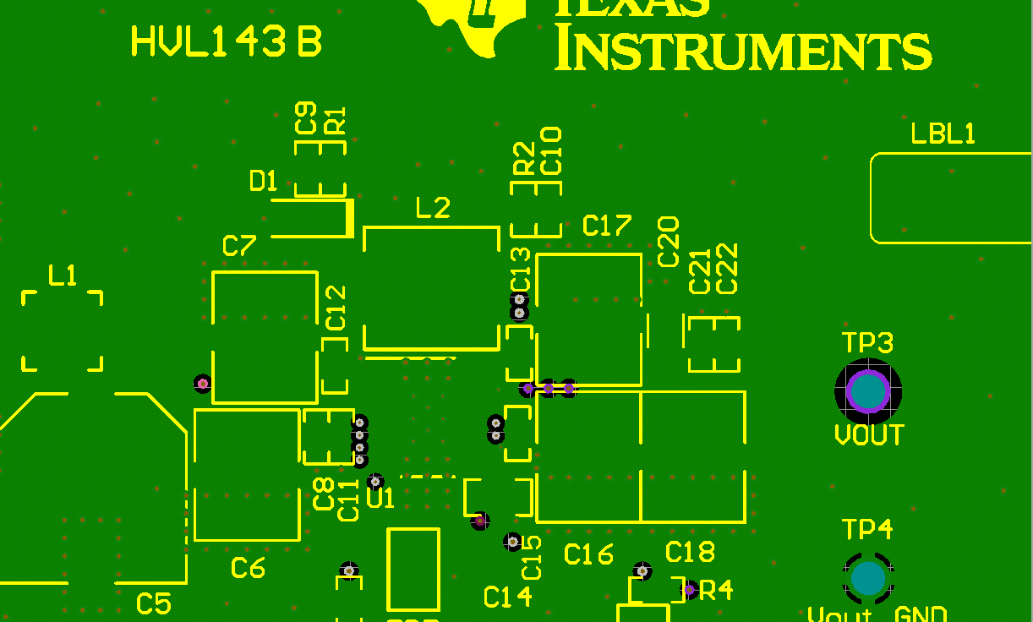
Inner Layer-1
Whole GND plane

Slide 4
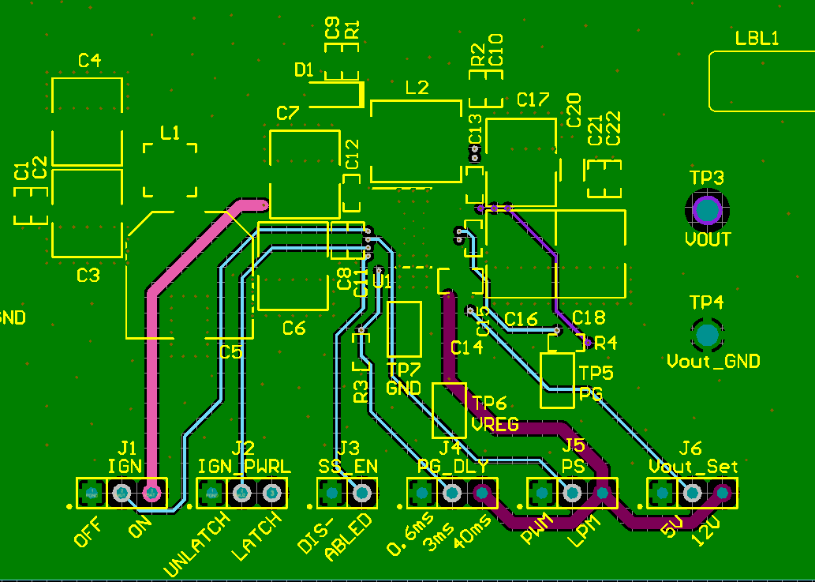
Inner Layer-2 –Test trace

Slide 5
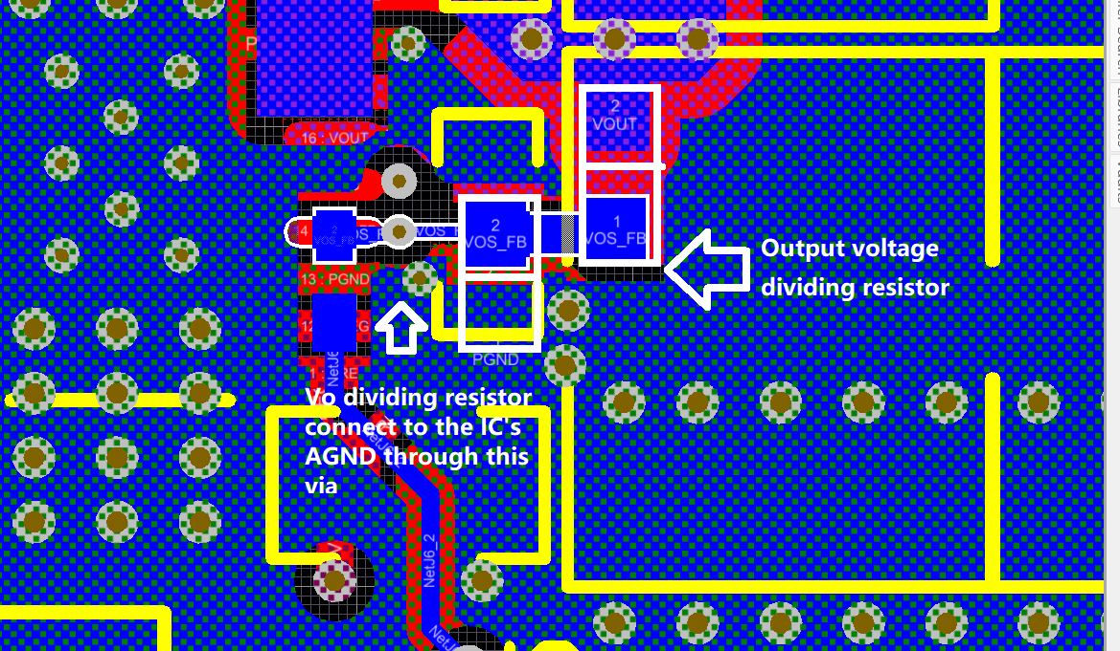
Output dividing resistor connection

