Slide 1
EIV issues confirm with TI

Slide 2
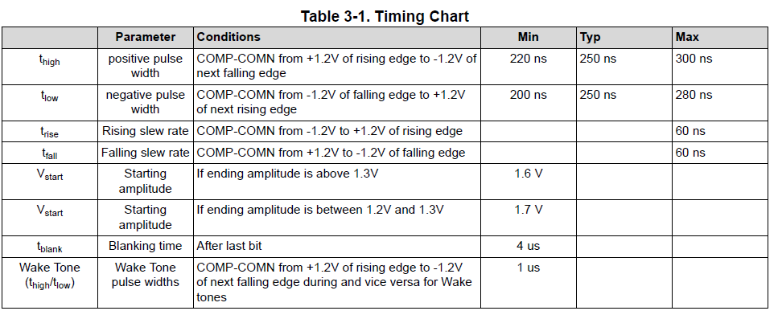
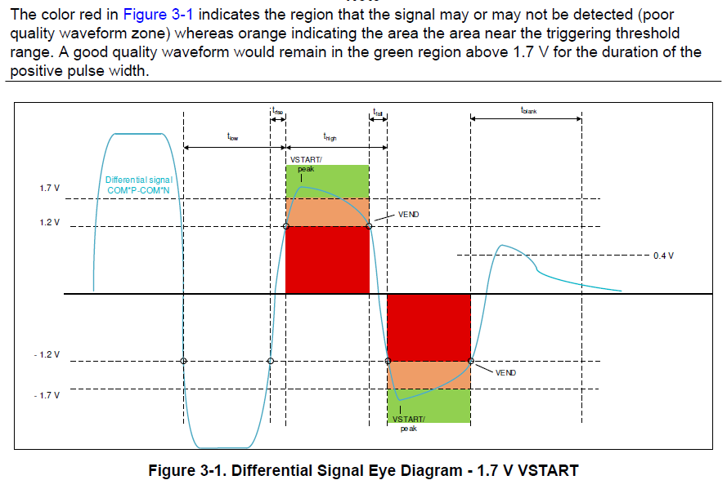
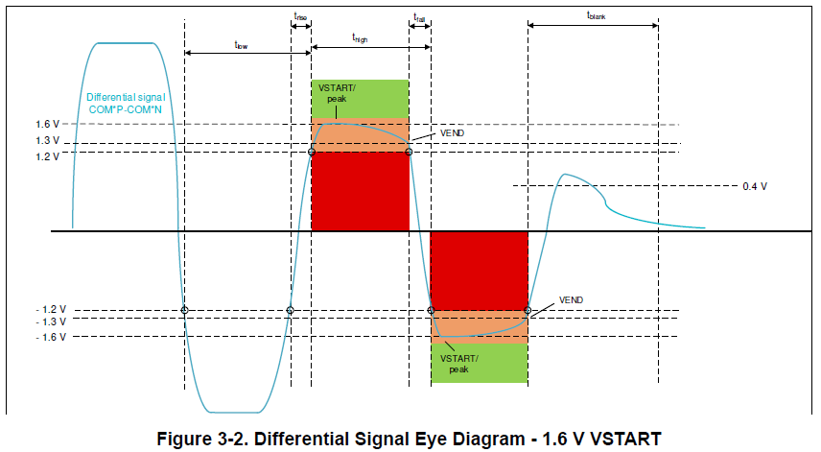
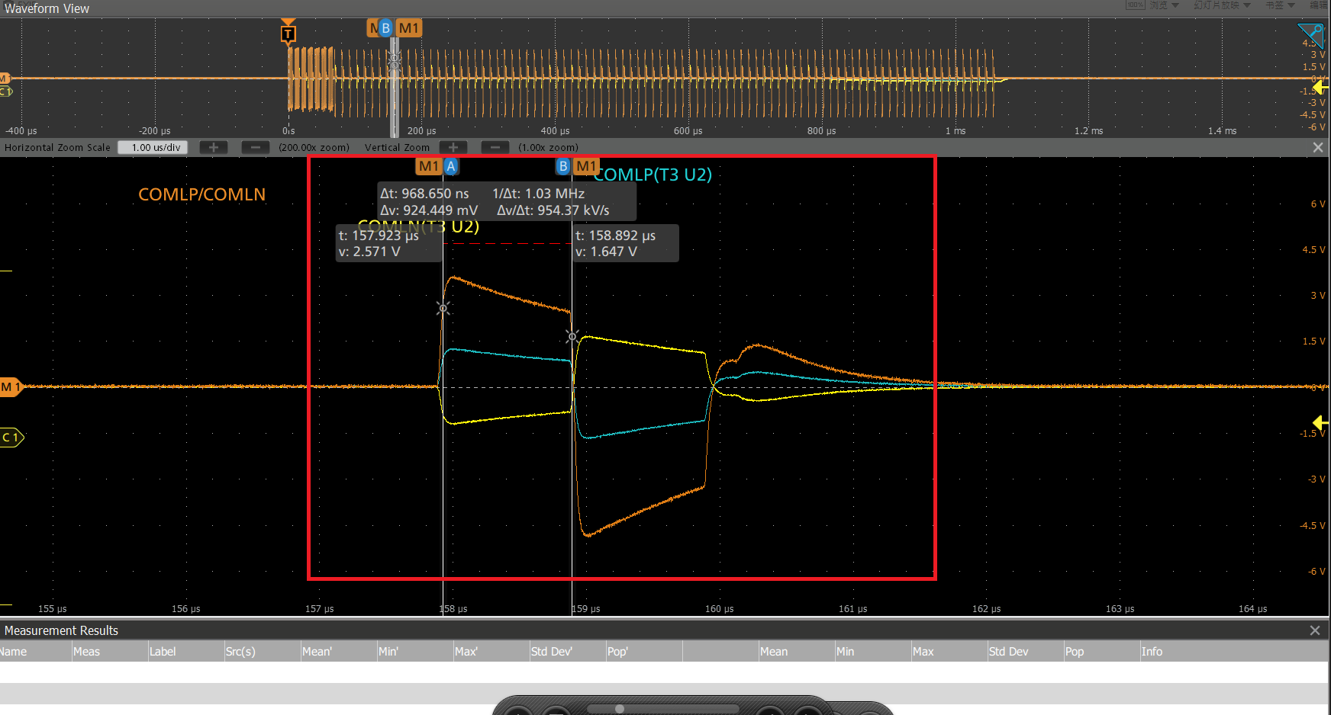
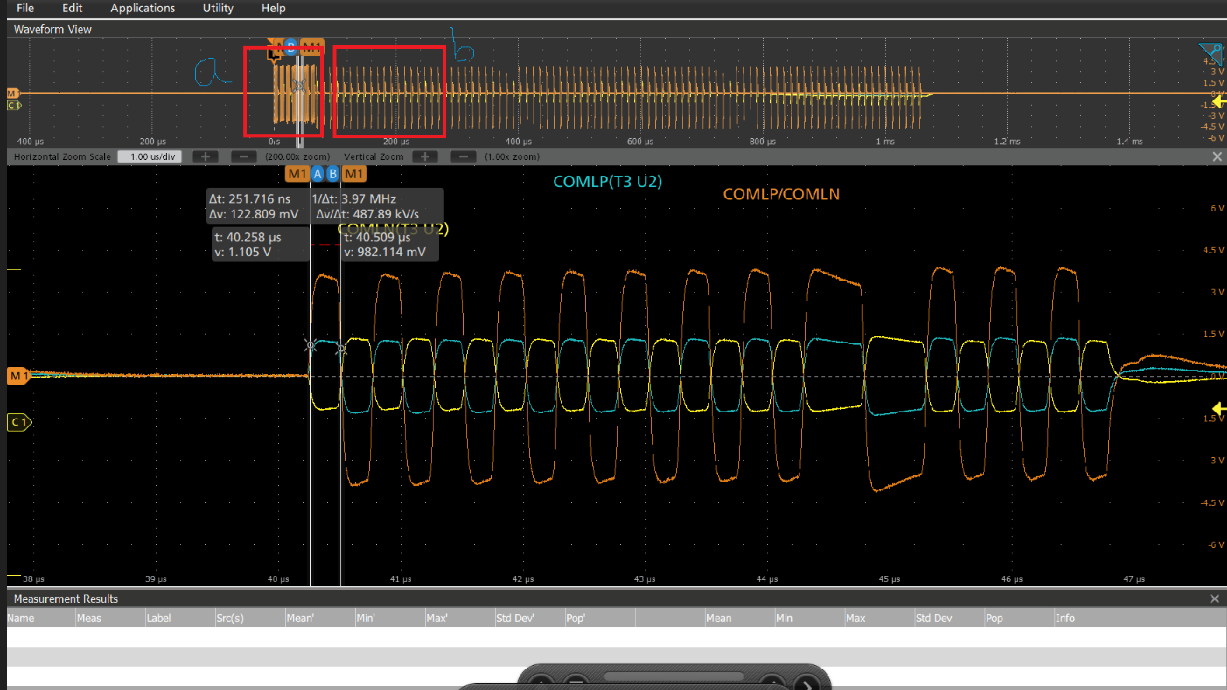
Daisy chain added 5 more parameters, multi-modal information, thoughts
Figure 1: BQ797xx_WF_Comm_AN_sluaaj2 - 28 related parameters (thigh, low, trise, tfall, tblank)
BQ797xx_WF_Comm_AN_sluaaj2 (8), we want to ask where these parameters should be measured, at location A or B? We feel that the waveforms we measured differ from those in the document. --- TI suggests measuring at tones and then comparing them with the spec.
Figure 2: Communication data (location a) Figure 3: Enlarged view of location b
+ 90 tones (location b)

Slide 3
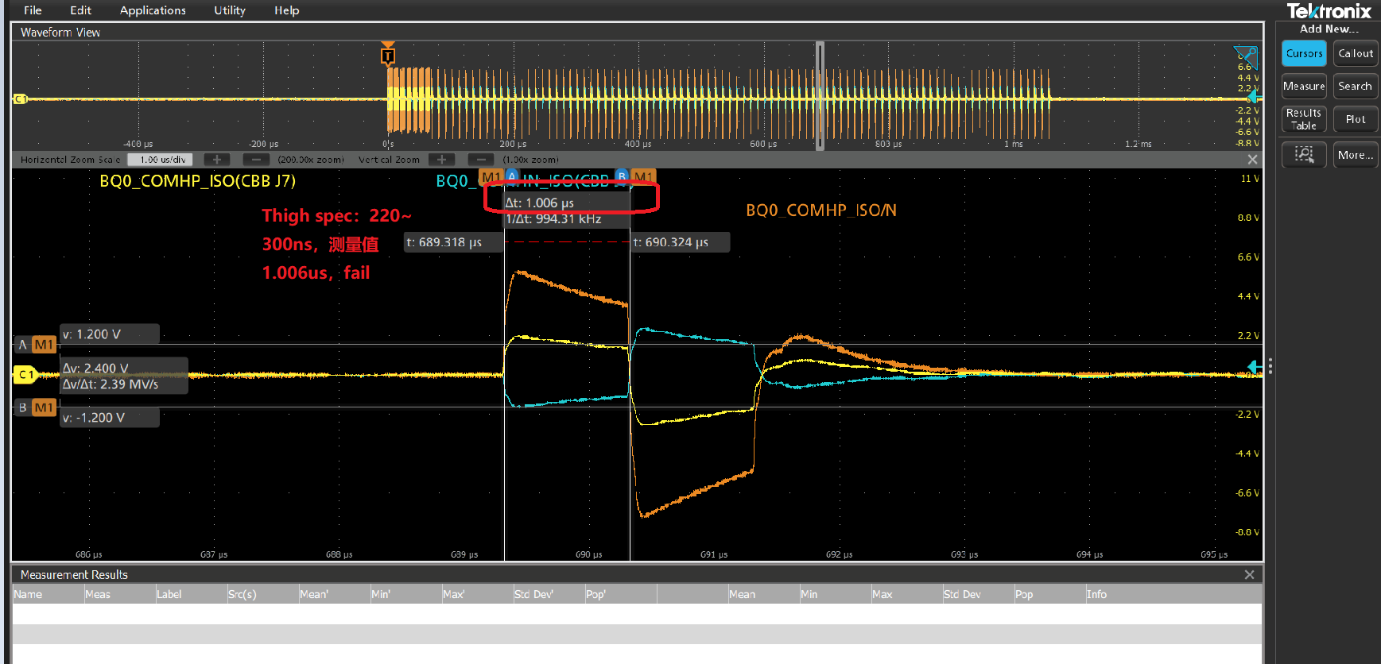
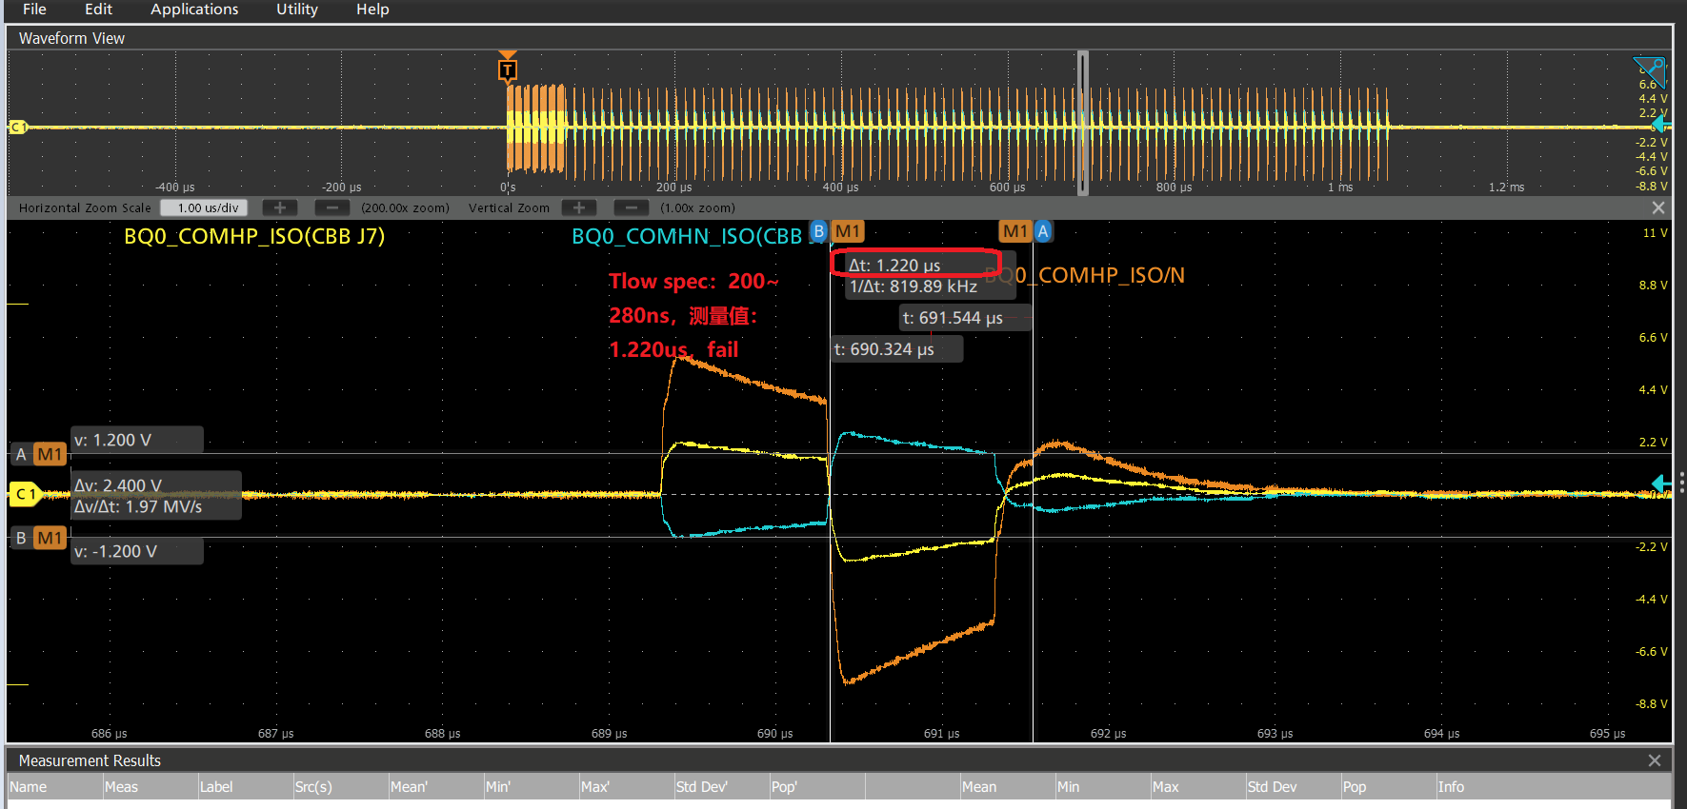
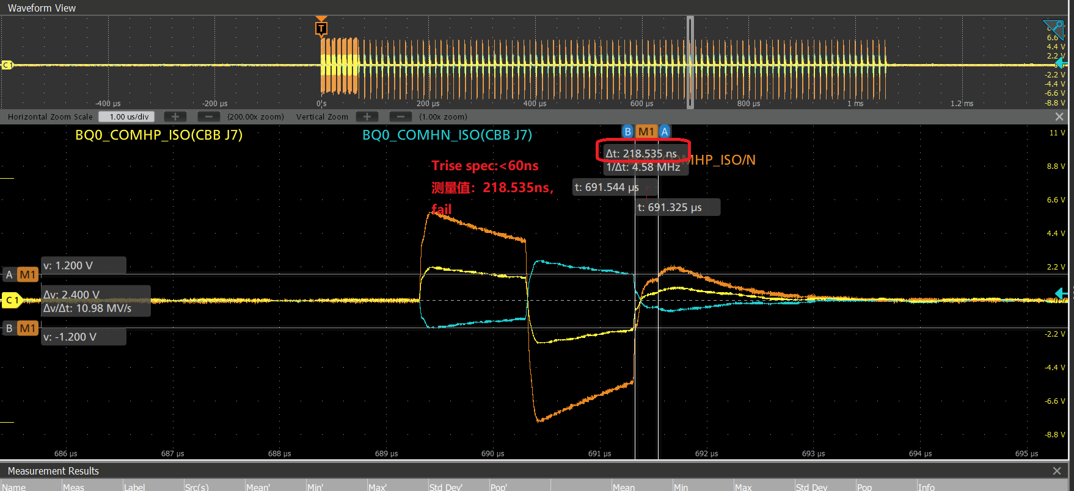
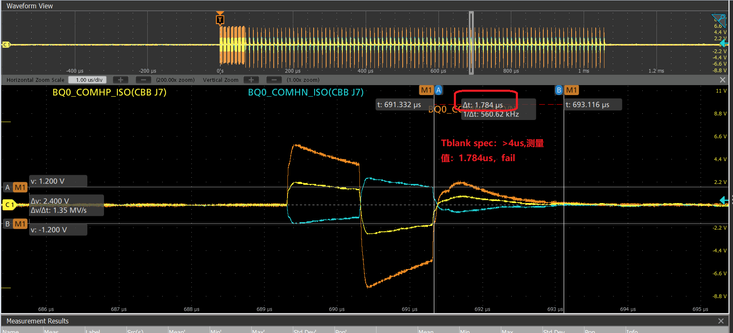
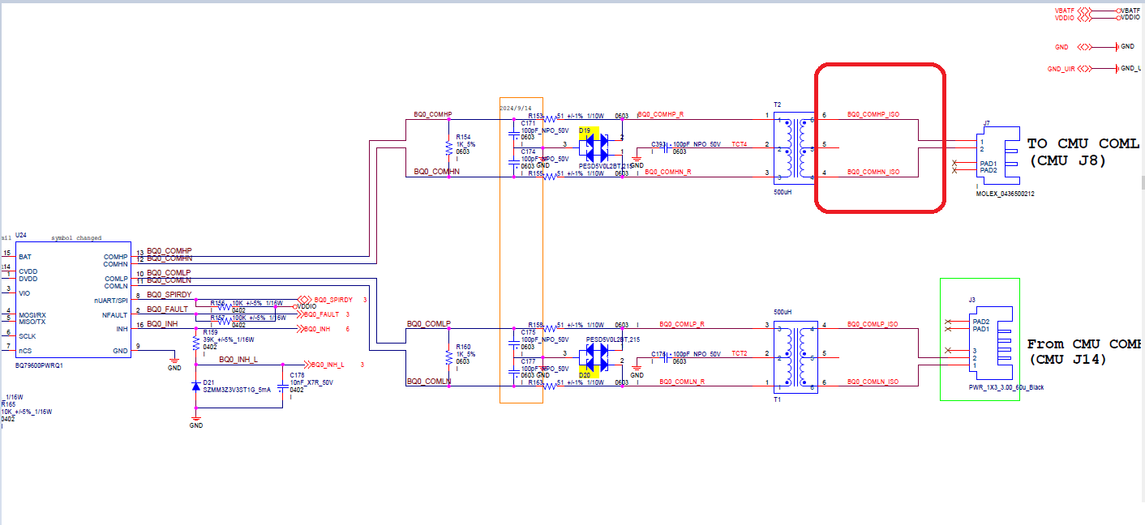
Actual waveform measurement results of EIV (Tones)
"Thigh value: 1.006us (Figure 1); Tlow value: 1.220us, fail (Figure 2); Trise value: 218.535ns (Figure 3); Tblank value: 1.784us (Figure 4); The measured signal is named BQ0_COMHP_ISO/BQO_COMHN_ISO, and the location is shown in Figure 5.“
Thigh Figure 1 Tlow Figure 2 Trise Figure 3
Tblank Figure 4 Signal point quantity Figure 5

Slide 4
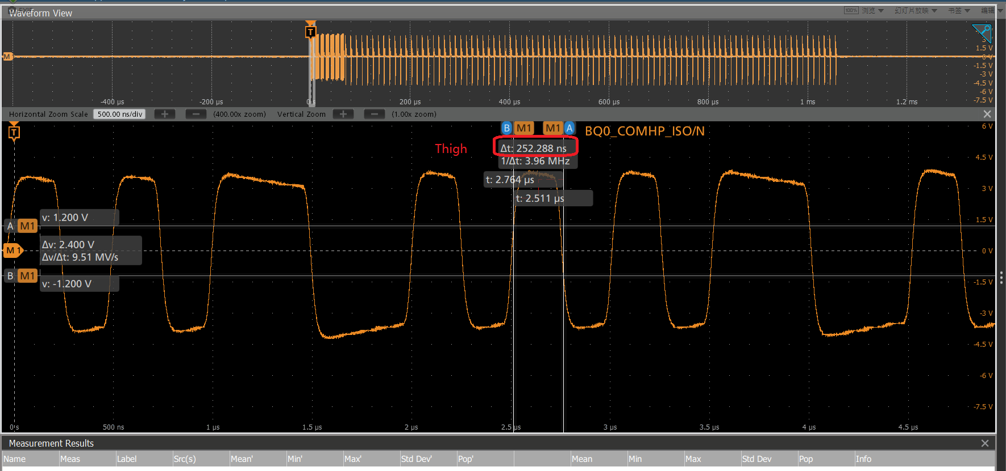
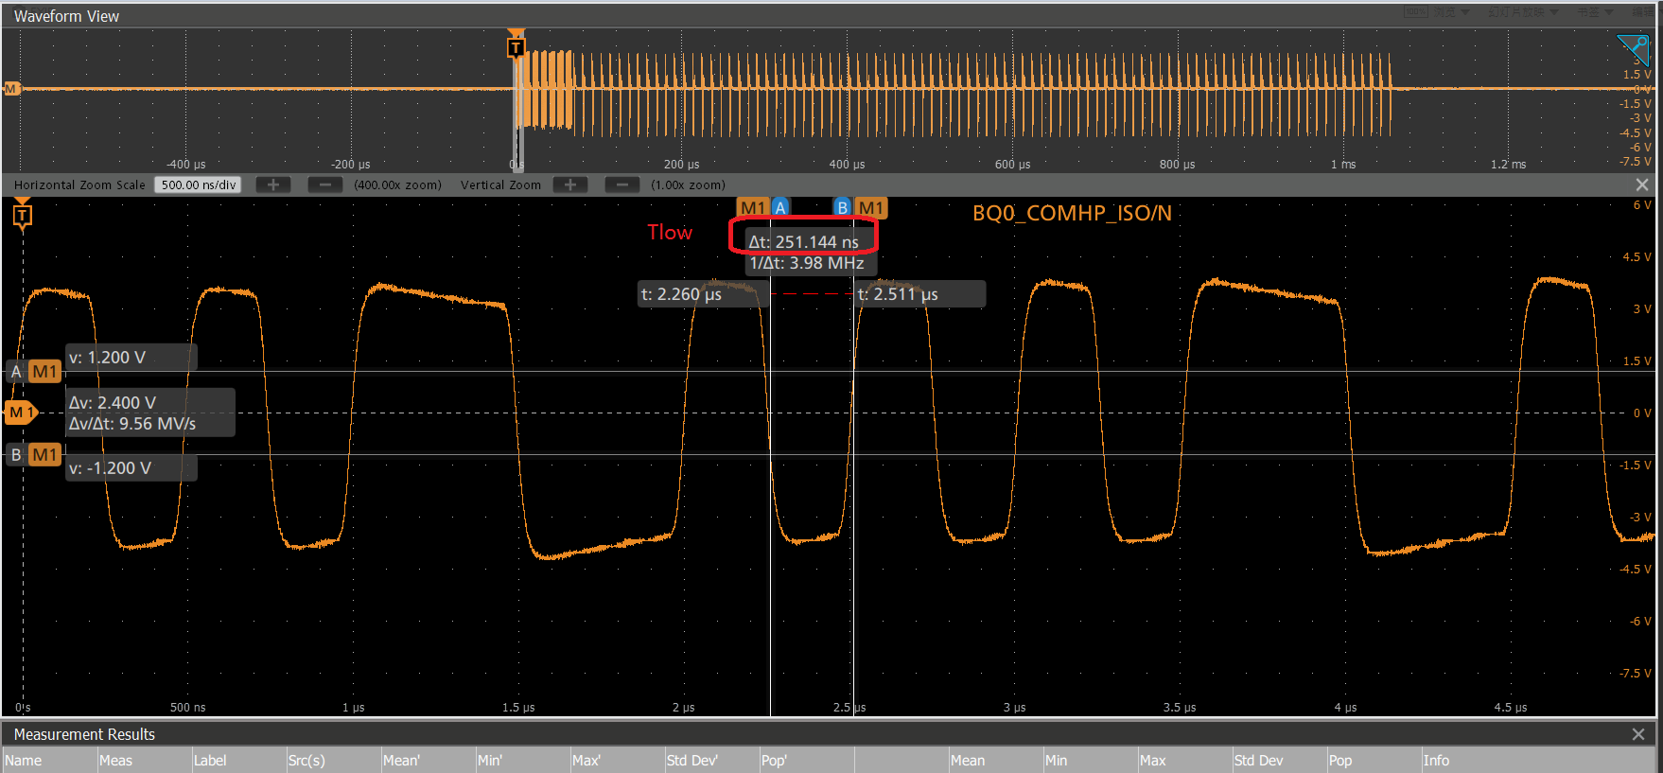
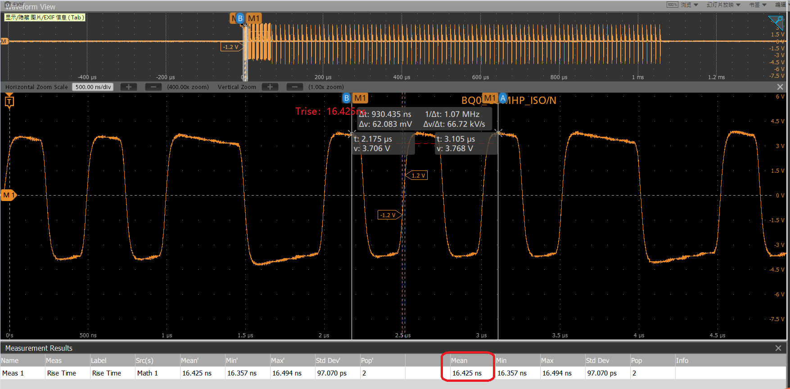
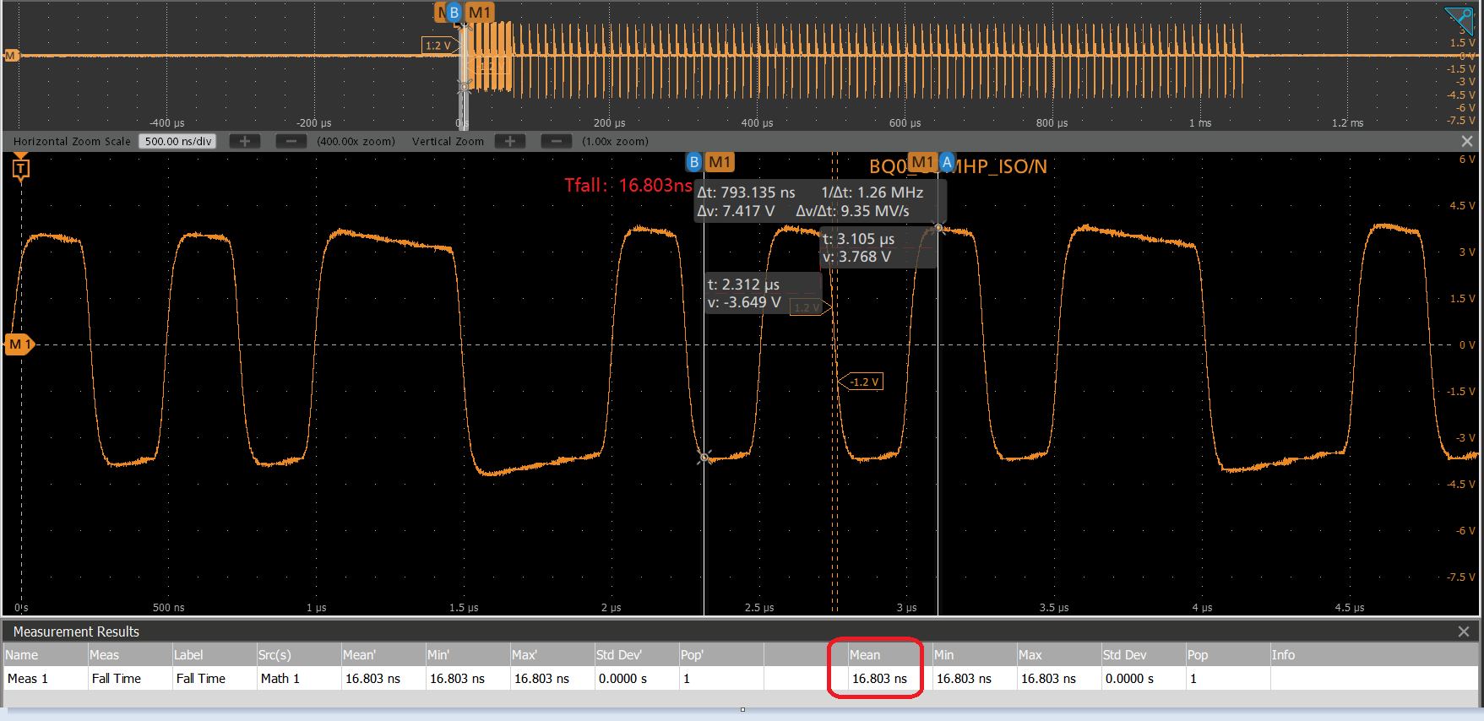
EIV actual waveform measurement results (at the balance point)
In the process of voltage fluctuation, there are significant variations in the waveform. The measurement results are different. The measurement results of Thigh, Tlow, Trise, and Tfall are pass, while Tblank is fail.
Thigh：252.288ns Tlow ：251.144ns Trise：16.425ns
Tfall：16.803ns

Slide 5
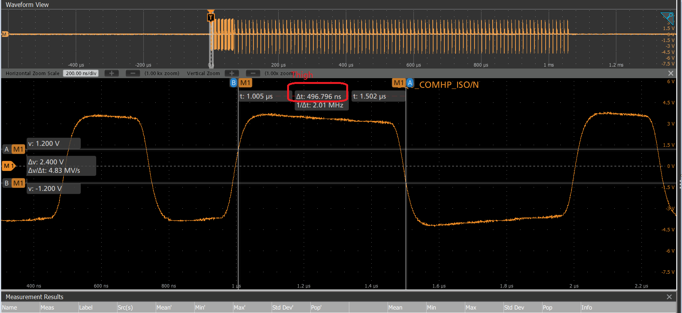
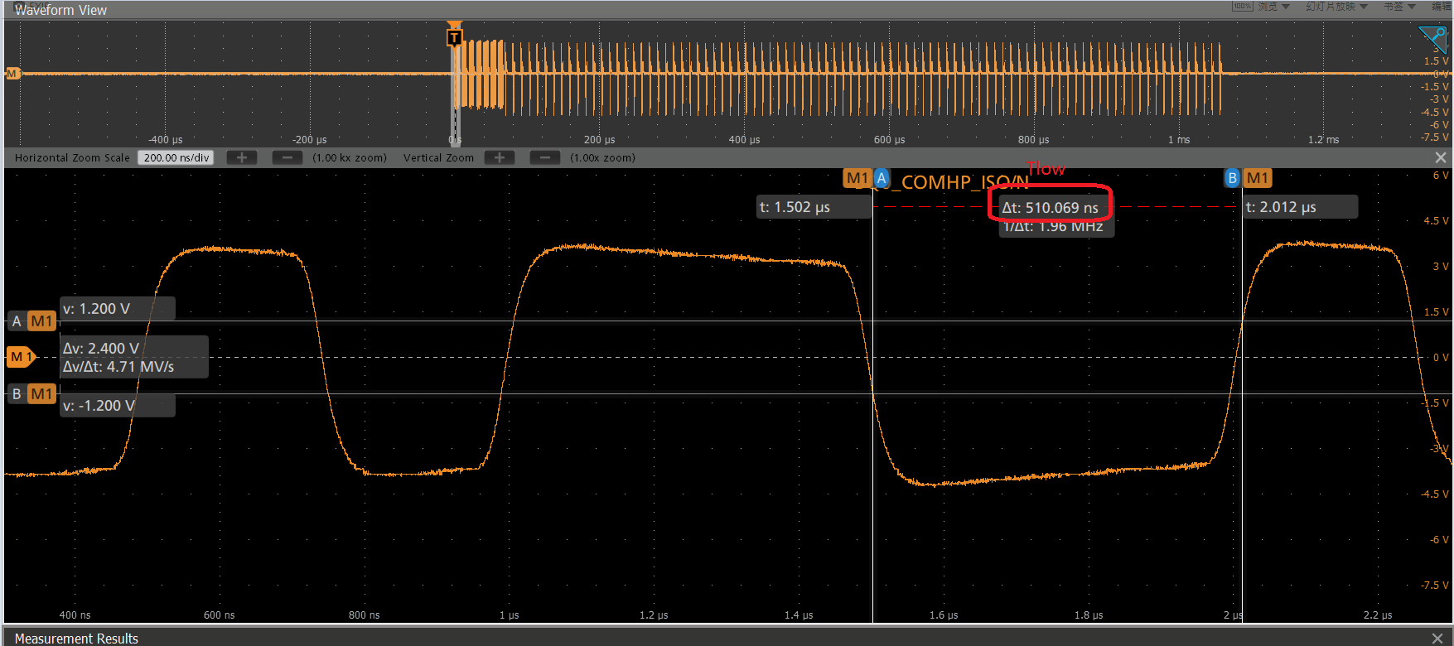
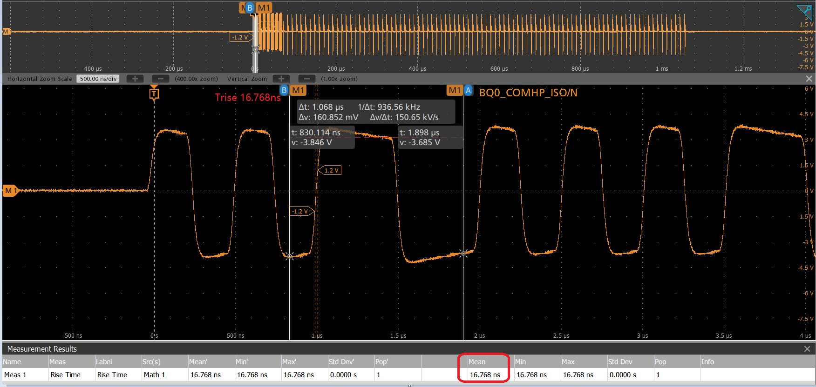
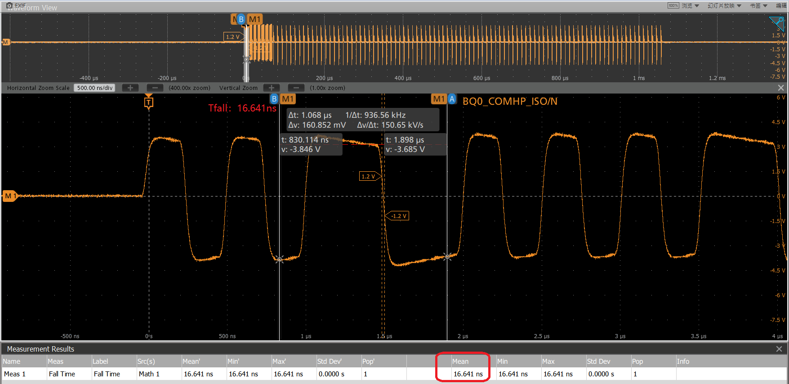
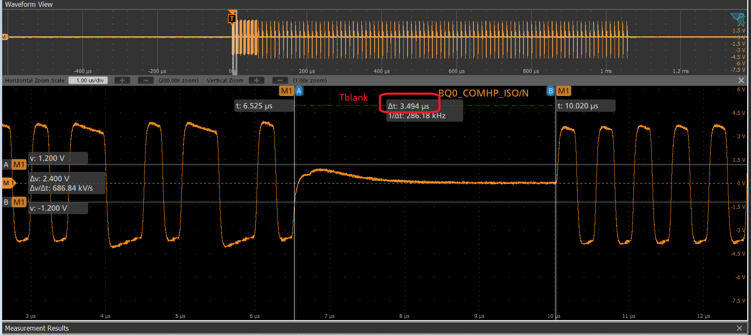
EIV actual waveform measurement results (at the balance point)
The handshake communication data has both narrow and wide waveforms, and the measurement results differ. For narrow waveforms, the measurements of Thigh, Tlow, Trise, and Tfall passed, while for wide waveforms, Trise and Tfall passed but Thigh, Tlow, and Tblank failed. The measured signals are named BQO_COMHP_ISO/BQO_COMHN_ISO, and their locations are the same. 1. Wide waveform:
Thigh：496.796ns Tlow ：510.069ns Trise：16.768ns
Tfall：16.641ns Tblankl：3.494us

Slide 6
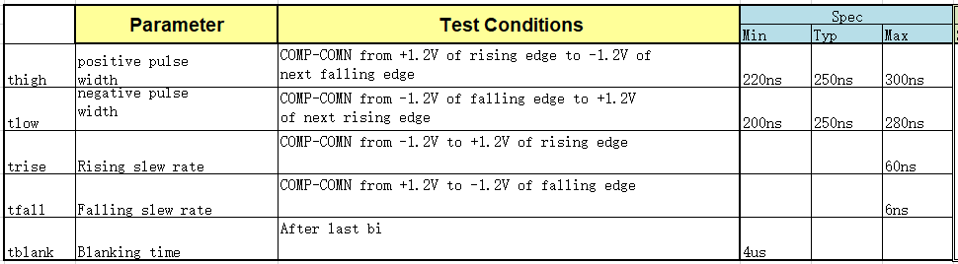
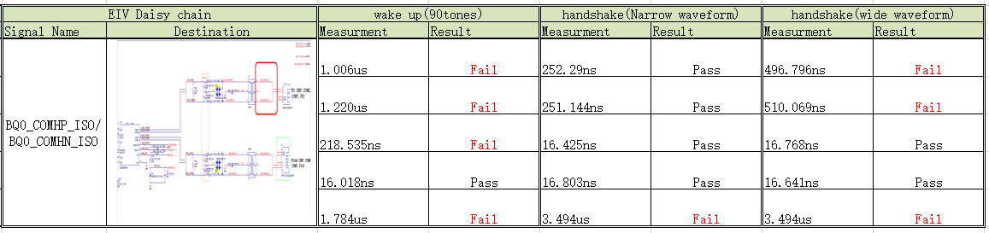
EIV measurement results
By using a certain method, the above waveform will be analyzed to obtain the parameters of Thigh, Tlow, Trise, Tfall, and Tblank.

