Slide 1
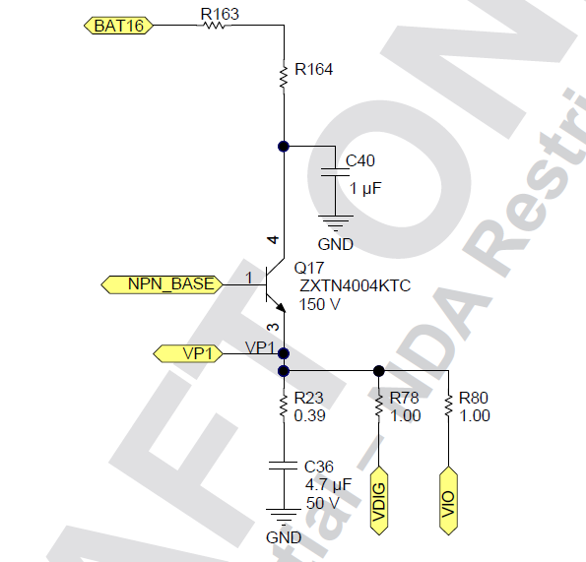
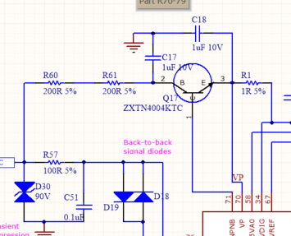
schematic
Missing R23-0.39. R23/C36 forms a compansation network to stabilize the regulator.

Slide 2
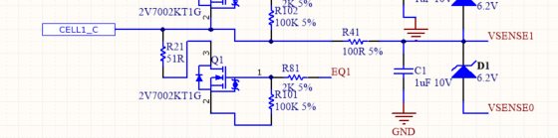
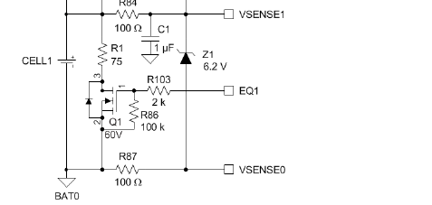
schematic
Look like missing R87 circuitry, which also causes VSENSE0 floating.
The voltage rating of All 1u caps(10V) are not enough, should be all 100V.

Slide 3
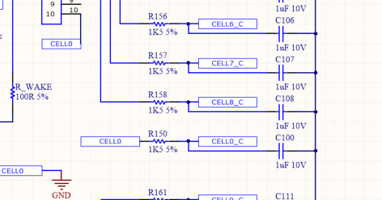
schematic
Cell0(bottomof battery stack) should be directly connected to GND.

