Slide 1
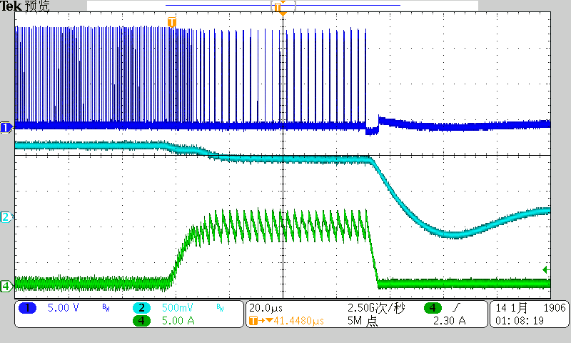
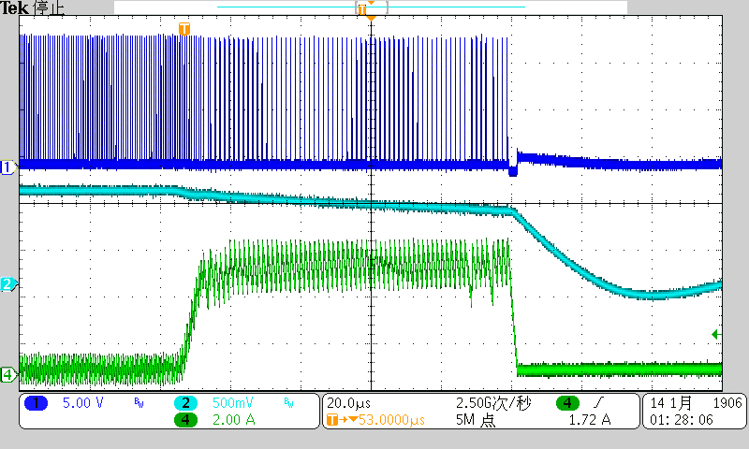
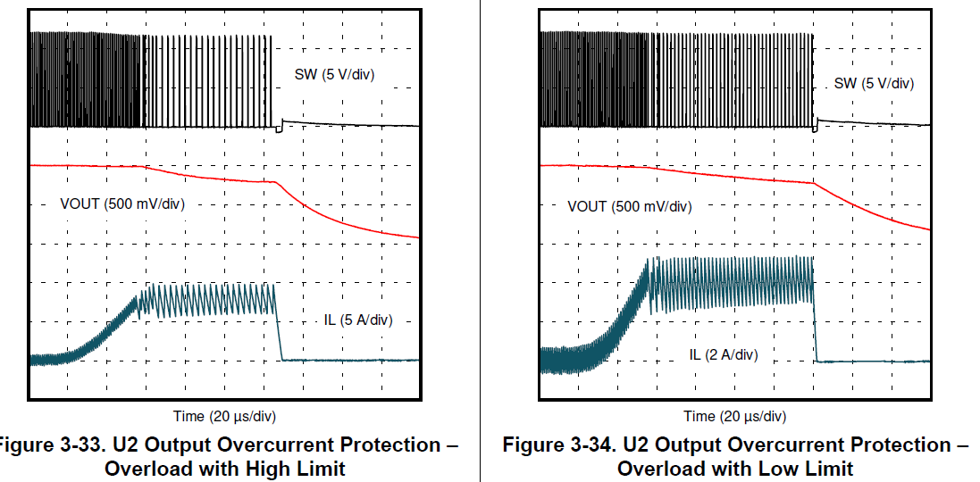
Fsw in high current limit is lower than in low limit when overload happens
SW(5V/div)
SW(5V/div)
Vout(500mV/div)
0.77V
Vout(500mV/div)
0.77V
IL(5A/div)
IL(2A/div)
Output Overcurrent Protection –Overload with High Limit
Output Overcurrent Protection –Overload with low Limit

