Slide 1
TPS26600 Parallel Operation
Venkata Nandam
Power Switches
Feb 2017

Slide 2
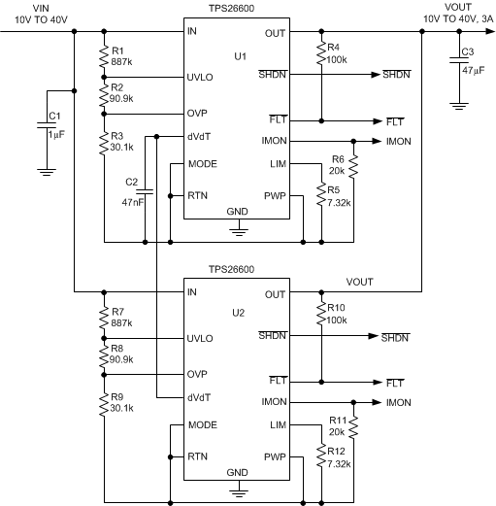
3A - TPS26600 eFuse Schematic

Slide 3
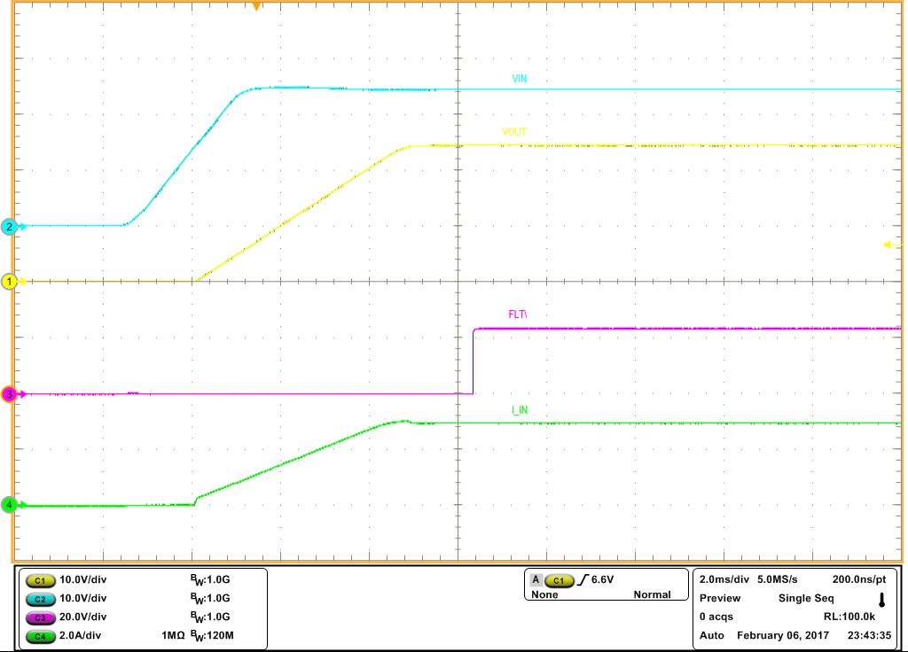
Turn on with VIN
Test Conditions : Vin=24V, 3A Resistive Load, Cout = 47uF
Output voltage soft starts in 5ms with 47nF dVdT cap
CH1 FLT\ is only shown here
eFuse total Input current

Slide 4
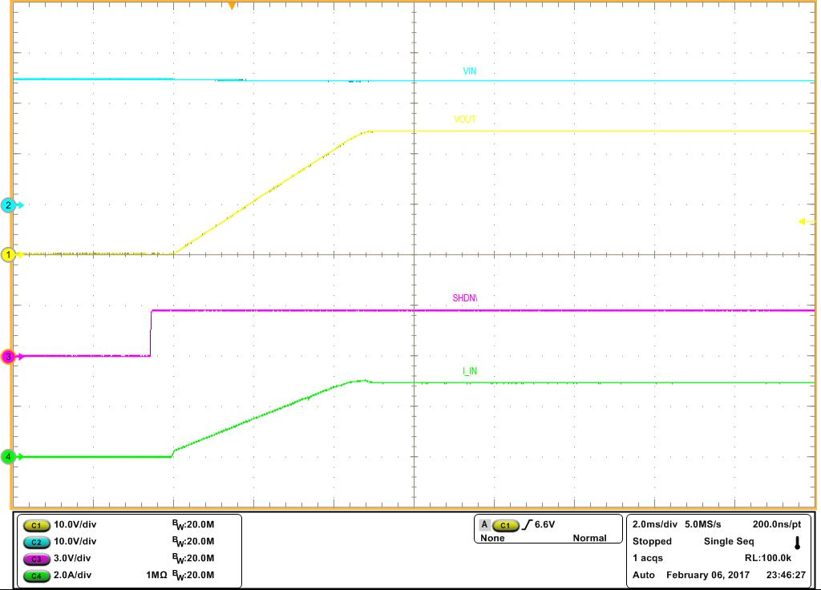
Turn on with SHDN\
Test Conditions : Vin=24V, 3A Resistive Load, Cout = 47uF
Output voltage soft starts in 5ms with 47nF dVdT cap
SHDN\ of CH1 used to start 3A eFuse (Another channel SHDN\ pin can also be used)
eFuse total Input current

Slide 5
Current Sharing During Steady State
Test Conditions : Vin=24V, 0-3A Constant Current Load, Cout = 47uF

Slide 6
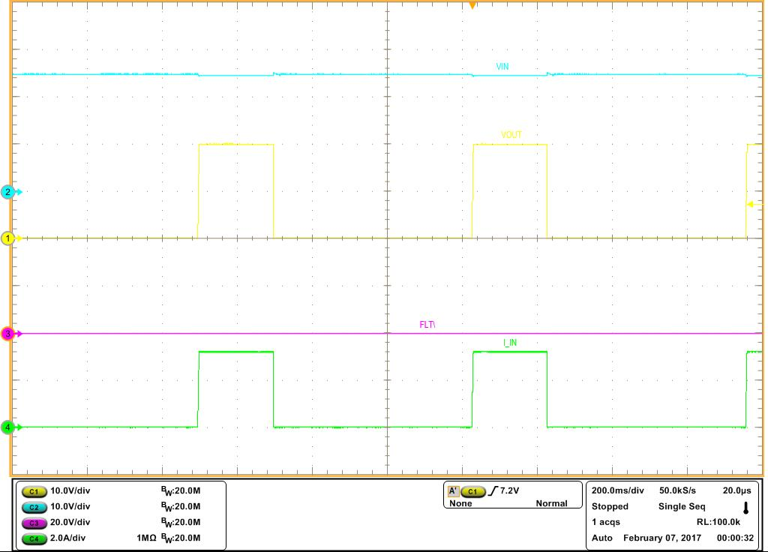
Over Load Response
Test Conditions : Vin=24V, 6Ω Resistive Load, Cout = 47uF
Output voltage drops due to load current regulation
Thermal shutdown auto-retry duration
eFuse total Input current regulates to 3.2A during over load

Slide 7
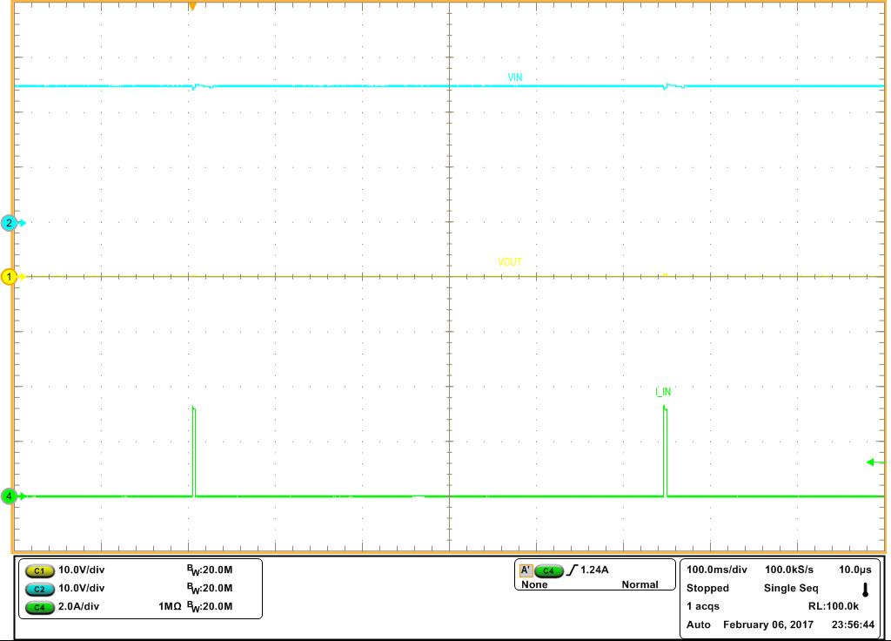
Output Continuous Short-circuit Response
Test Conditions : Vin=24V, 0Ω Resistive Load, Cout = 47uF
Output drops to zero due to
output continues short-circuit
Thermal shutdown auto-retry duration
eFuse total Input current regulates to 3.2A during short circuit

Slide 8
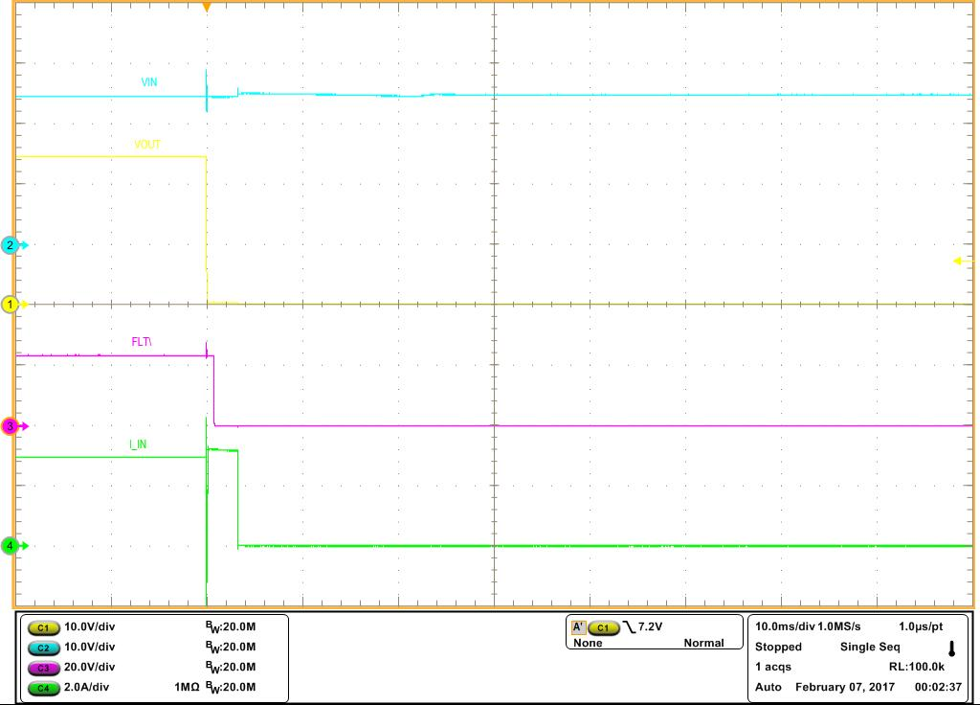
Response at the instance of Short-circuit
Test Conditions : Vin=24V, 0Ω Resistive Load, Cout = 47uF
Output immediately drops to zero due to
short-circuit
FLT\ of both channels asserts low to indicate fault
Total eFuse Input current regulates to 3.2A during short circuit

Slide 9
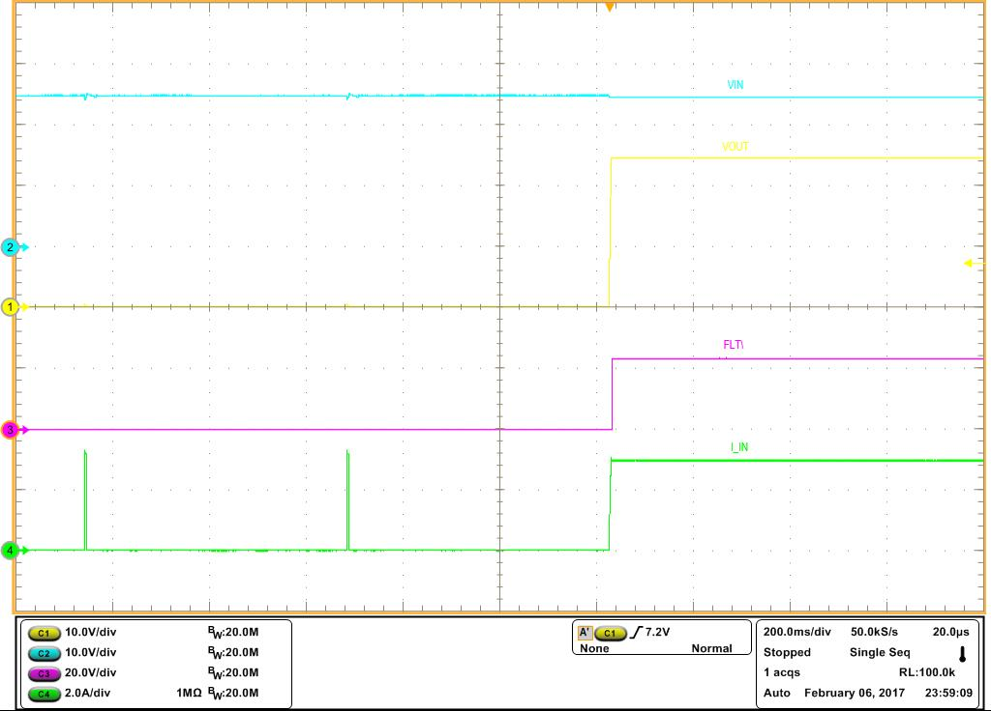
Recovery from Short-circuit Response
Test Conditions : Vin=24V, 0Ω Resistive Load, Cout = 47uF
Output soft starts
after short-circuit release
Thermal shutdown auto-retry duration
eFuse supports full load 3A during recovery

Slide 10
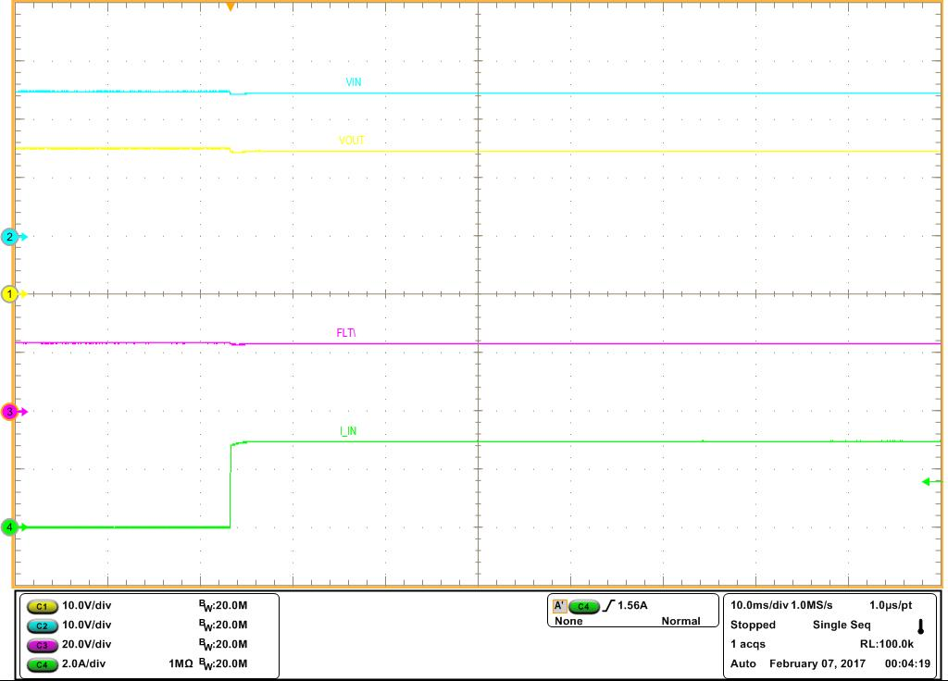
Load Step Response
Test Conditions : Vin=24V, 0A to 3A Resistive Load, Cout = 47uF
No output voltage drop
eFuse supports full load step from 0A to 3A

Slide 11
Resources
Achieve 20-A Circuit Protection and Space Efficiency Using Paralleled eFuses
http://www.ti.com/lit/an/slva836/slva836.pdf
Calculators, Spice models
http://www.ti.com/product/TPS2660/toolssoftware
Download EVM user’s guide
http://www.ti.com/tool/tps26600-02evm

