Slide 1
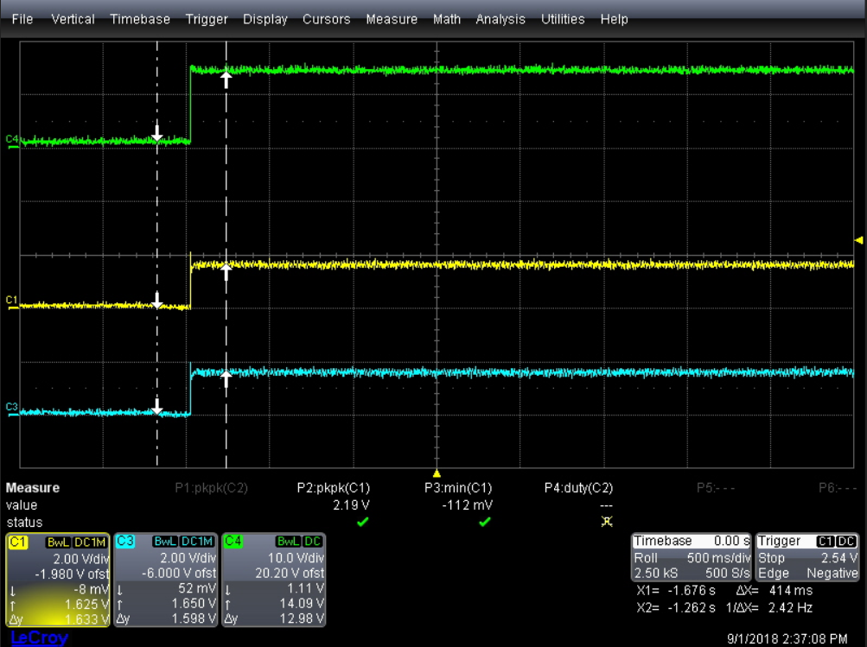
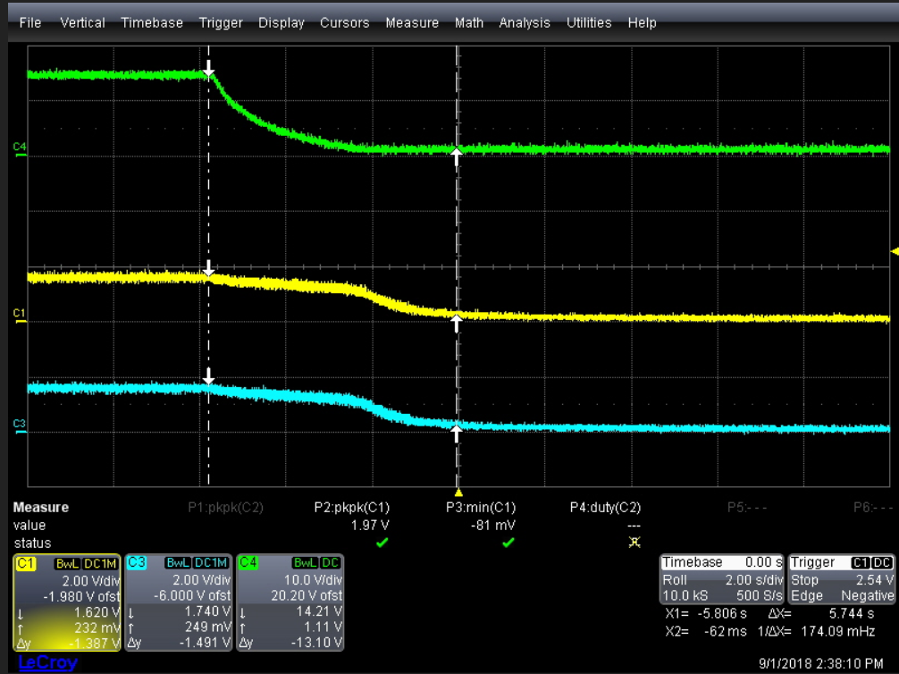
No.1: CHARGER OFF ➔ Turn ON (FET_EN OFF MODE )
PACK+
PACK+
Bq40z60 – DSG to FET(S)
CH3
CH1
DSG FET – VGS
NO.2 : CHARGER ON➔Turn OFF (FET_EN OFF MODE )
Test condition & step:
19V ON
Load : NO LOAD
Setup FET _EN = OFF
Turn ON Charger Form SBS CMD.
(See NO.1 Waveform)
5. Turn OFF Charger From SBS CMD.
(See NO.2 Waveform)

Slide 2
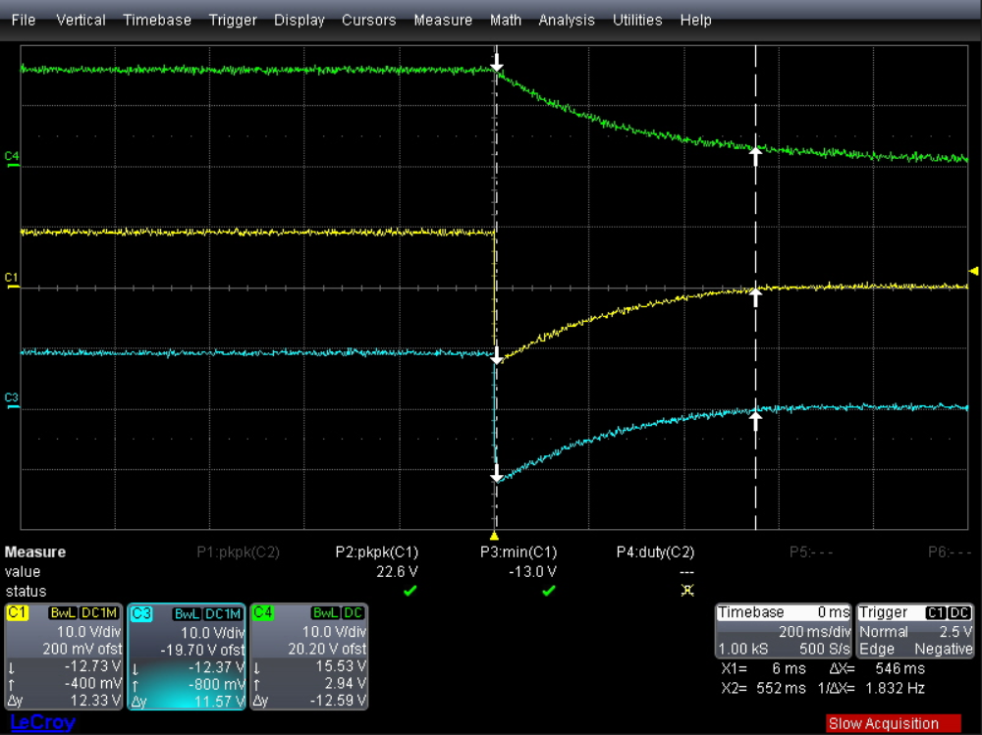
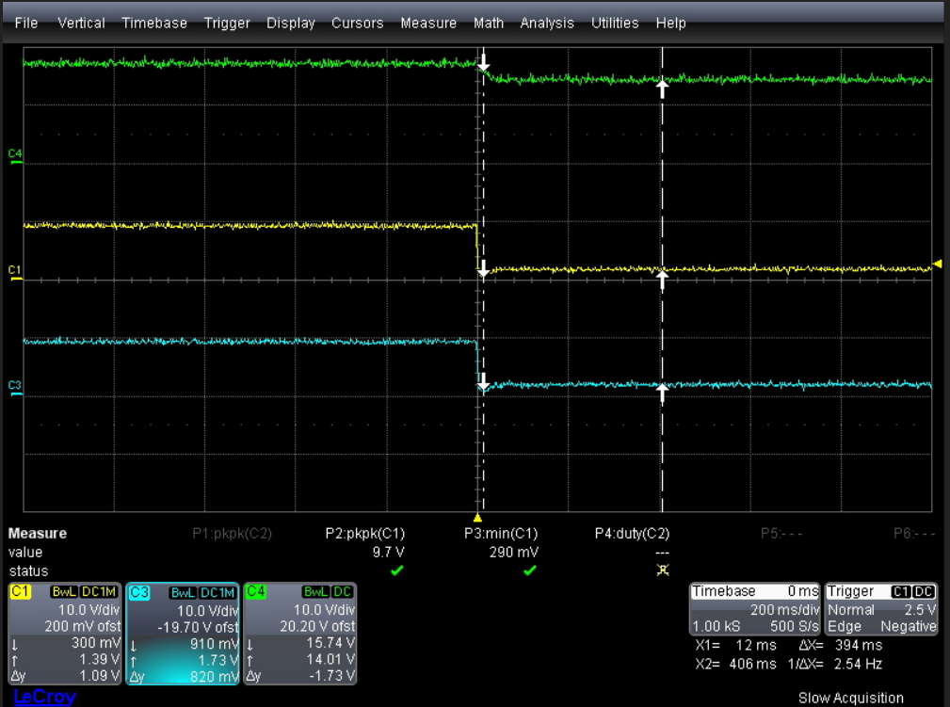
No.3: FET ON ➔ FET OFF (CHARGER OFF MODE)
CH3
CH1
NO.4 : FET ON ➔FET OFF (CHARGER ON MODE)
DSG FET
Not Turn OFF
Test condition & step:
19V ON
Load : NO LOAD
Setup Charger OFF mode From SBS CMD.
Turn ON FET_EN => Turn OFF FET_EN
(See NO.3 Waveform)
5. Setup Charger ON mode From SBS CMD.
6. Turn ON FET_EN => Turn OFF FET_EN
(See NO.4 Waveform)

Slide 3
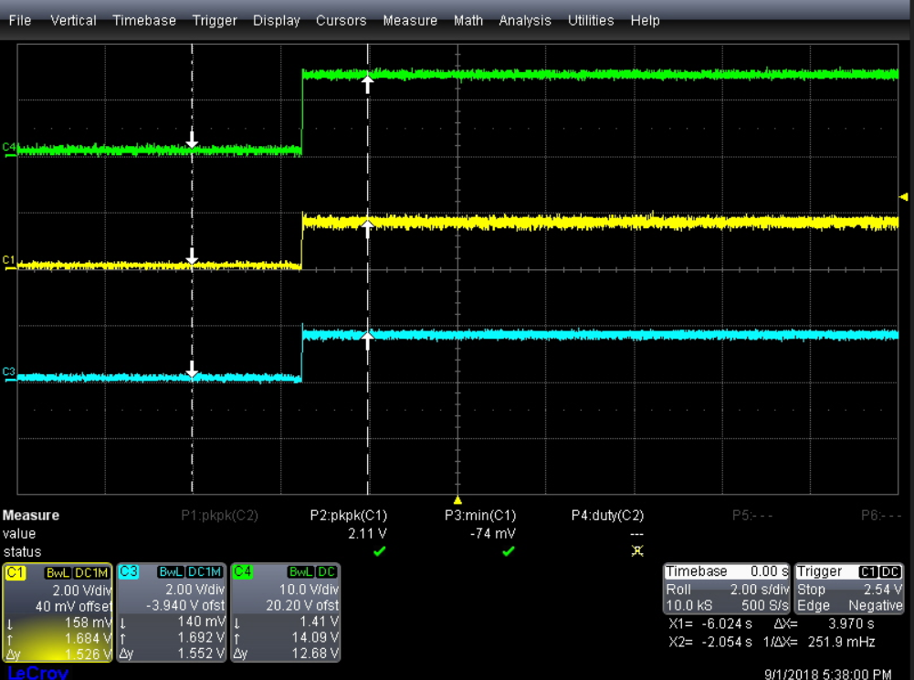
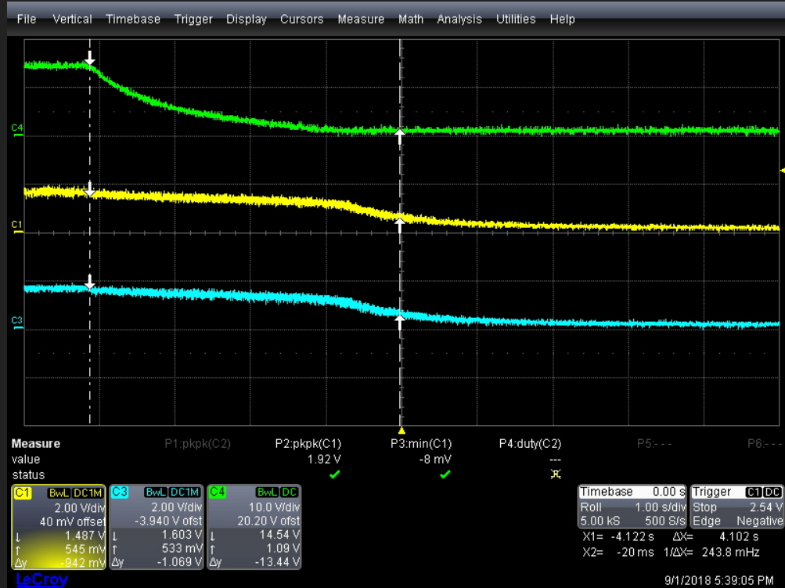
No.5: CHARGER OFF ➔ Turn ON (FET_EN OFF MODE )
PACK+
Bq40z60 – DSG to FET(S)
Change From Diode
To resistance
DSG FET – VGS
CH3
CH1
NO.6 : CHARGER ON➔Turn OFF (FET_EN OFF MODE )
Test condition & step:
19V ON
Load : NO LOAD
Setup FET _EN = OFF
Turn ON Charger Form SBS CMD.
(See NO.5 Waveform)
5. Turn OFF Charger From SBS CMD.
(See NO.6 Waveform)

Slide 4
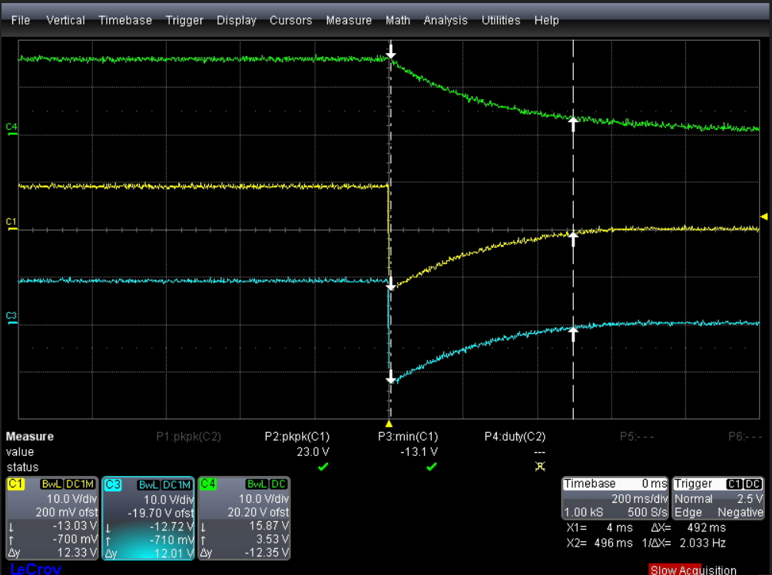
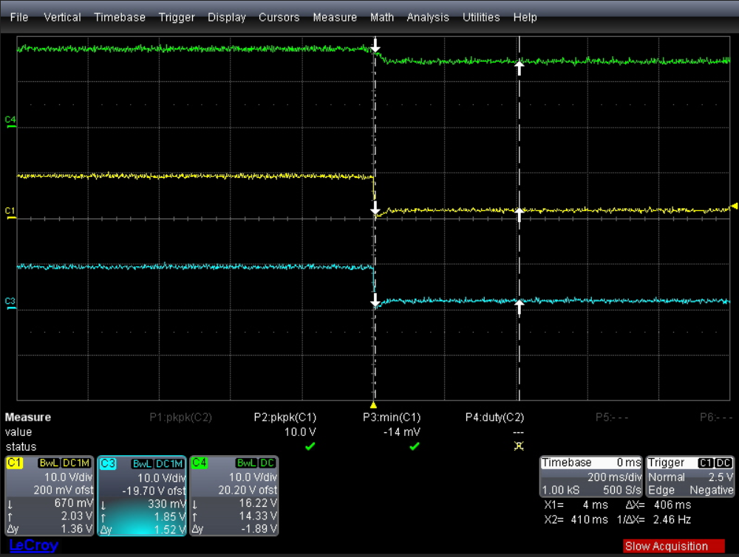
No.7: FET ON ➔ FET OFF (CHARGER OFF MODE)
Change From Diode
To resistance
CH3
CH1
NO.8 : FET ON➔FET OFF (CHARGER ON MODE)
DSG FET
Not Turn OFF
Test condition & step:
19V ON
Load : NO LOAD
Setup Charger OFF mode From SBS CMD.
Turn ON FET_EN => Turn OFF FET_EN
(See NO.7 Waveform)
5. Setup Charger ON mode From SBS CMD.
6. Turn ON FET_EN => Turn OFF FET_EN
(See NO.8 Waveform)

