Slide 1
PREPARED BY
Patrick Lu
2024/07/19

Slide 2
System diagram
System: 48 pixels ADB module
Sub-System: ADB module
System Element: Control ECU
System Element: Matrix
CANH
CANL
UART over CAN
CAN XCVR
RX / TX
TEMP
TEMP
USB
ADC
IC x 4
...
ADC
Controller
– PC
– MCU (option)
DIO
Fault MGMT
Error
Matrix manager #1
Matrix manager #4
DC / DC driver
5V
RX / TX
Sync CLK
24V
Max. 30W
PWM Dimming
PWM Dimming
Power board#1…# 4
LEDs #1~#48

Slide 3
IC comparison table
 | TI
Item | TPS92664-Q1 | TPS92665-Q1 | TPS92667-Q1 | TPS92662A-Q1
Switch | 16 switch in 4 groups | 16 switch in 4 groups | 16 switch in 4 groups | 12 switch in 4 groups
Communication | UART | UART | UART | UART
Clock | Internal oscillator LVDS transceiver Dual baud rate capable(500Kbps, 1Mbps Not required to route clock to other 664/665 devices for communications | Internal oscillator LVDS transceiver Only supports 1Mbps Not required to route clock to other 664/665 devices for communications | Internal oscillator LVDS, receiver only Dual baud rate capable(500Kbps, 1Mbps Must have clock from external source for communications | External crystal, clock wire between IC to share clock
PWM | 10bit | 10bit | 10bit | 10bit
Memory | Customer accessible MTP | N/A | N/A | External EEPROM
ADC | 8bit | 8bit | 8bit | 8bit
Package | PHP (HTQFP, 48) 7.00 mm × 7.00 mm | PHP (HTQFP, 48) 7.00 mm × 7.00 mm | PHP (HTQFP, 48) 7.00 mm × 7.00 mm | TQFP48 7x7mm
Protection | LED OPEN Detection and Protection LED SHORT Detection RESISTIVE FET Detection LEDx Switch Voltage Detection Single LED Short Detection Open LED Cable Detection LED Current Detection Fault Detection Strategy Driver Health Check | LED OPEN Detection and Protection LED SHORT Detection RESISTIVE FET Detection LEDx Switch Voltage Detection Single LED Short Detection Open LED Cable Detection LED Current Detection Fault Detection Strategy Driver Health Check | LED OPEN Detection and Protection LED SHORT Detection RESISTIVE FET Detection LEDx Switch Voltage Detection Single LED Short Detection Open LED Cable Detection LED Current Detection Fault Detection Strategy Driver Health Check | LED open/short LED
Function safety | system design up to ASIL B | N/A | N/A | PWM
EMC optimize |  |  |  | External crystal
system sync | Sync by external wire and software | Sync by external wire and software | Sync by external wire and software | Sync by external wire and software
Dynamic indicator | Must controlled by MCU/ECU | Must controlled by MCU/ECU | Must controlled by MCU/ECU | Must controlled by MCU/ECU
Power supply | 12V battery or 5V | 12V battery or 5V | 12V battery or 5V | 12V battery or 5V
Max input current | Switch pulse current, pulse duration = 20 μs, frequency = 400 Hz => MAX 10A Switch continuous current (power on-chip limited) => MAX 1.5A | Switch pulse current, pulse duration = 20 μs, frequency = 400 Hz => MAX 10A Switch continuous current (power on-chip limited) => MAX 1.5A | Switch pulse current, pulse duration = 20 μs, frequency = 400 Hz => MAX 10A Switch continuous current (power on-chip limited) => MAX 1.5A | 1.5A
RDSon | 150mΩ | 150mΩ | 150mΩ | 200mΩ
ASIL | system design up to ASIL B |  |  | NA
Primary IC clock frequency | 16MHz | 16MHz | 16MHz | 16MHz

Slide 4
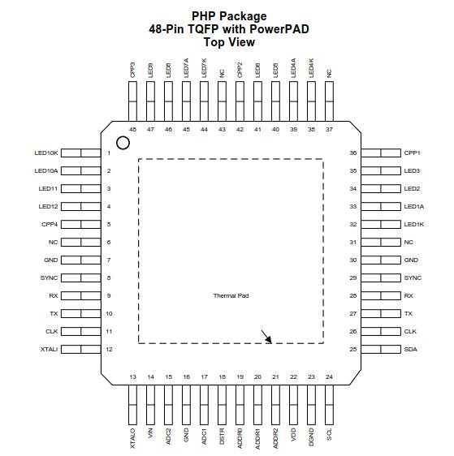
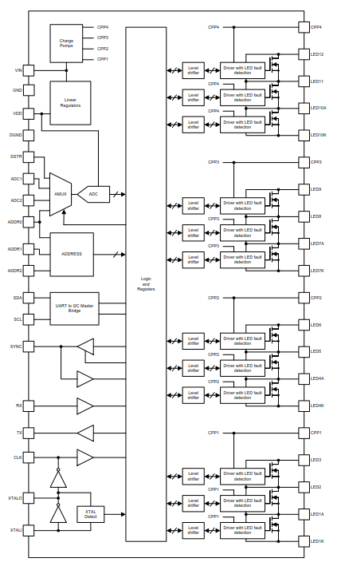

LED power planning
TPS92662A
48 | 47 | 46 | 45 | 44 | 43 | 42 | 41 | 40 | 39 | 38 | 37 | 36 | 35 | 34 | 33 | 32 | 31 | 30 | 29 | 28 | 27 | 26 | 25
1 | 2 | 3 | 4 | 5 | 6 | 7 | 8 | 9 | 10 | 11 | 12 | 13 | 14 | 15 | 16 | 17 | 18 | 19 | 20 | 21 | 22 | 23 | 24
Each string consists of 12 LEDs.
CN1
constant current(300mA@50Vdc)
1 | UCAN_L
2 | UCAN_H
3 | Cathond
4 | Anode #1 LED+
5 | Anode #2 LED+
6 | Cathond
7 | Anode #3 LED+
8 | Anode #4 LED-
9 | GND
10 | +5V
IC#1
constant current(300mA@50Vdc)
IC#2
constant current(300mA@50Vdc)
IC#3
constant current(300mA@50Vdc)
constant current(300mA@50Vdc)
IC#4

Slide 6
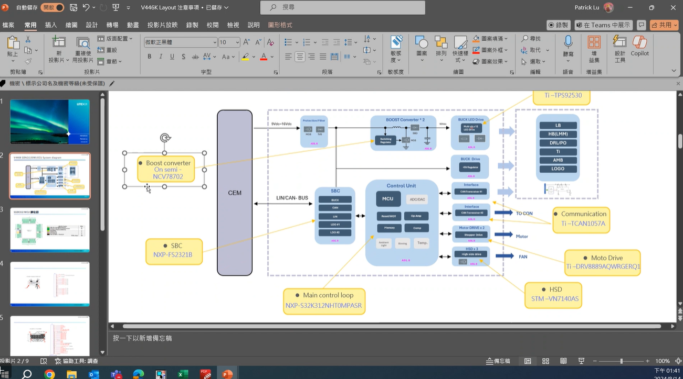
Notes:
130W 12 buck 4 boost 9-16 -> 50V 130/4

