Slide 1
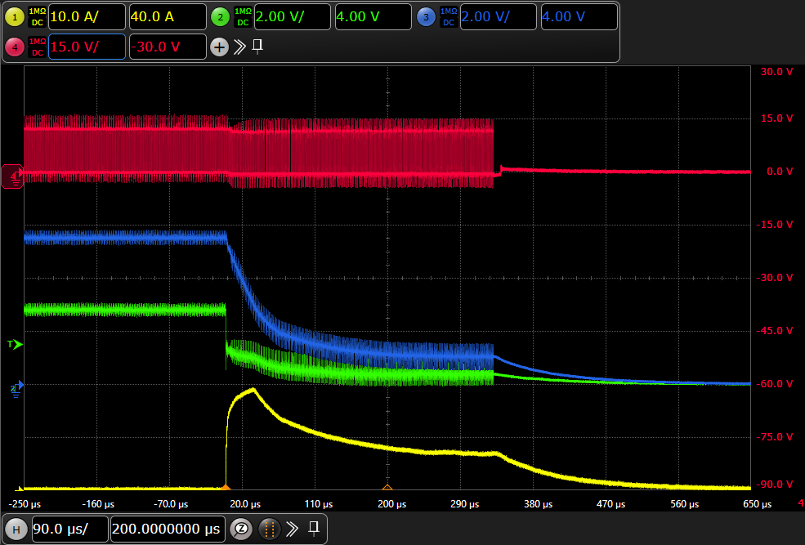









Why doesn’t $V_{DCDC}$ drop to 0V the moment a short circuit occurs?
From the moment the short circuit occur, the output voltage of DCDC gradually drops
And it take 330us to reach 0V. Why is that?
12V
TPS54429
$$V_{SW}$$
$$V_{DCDC}$$
L
$$V_{FB}$$
R:10kohm
5.5V
$$V_{SW}$$
R:1.6kohm
$$V_{DCDC}$$
2.8V
Drain
5.5V
FET
2.8V
$$V_{LDO}$$
Vout
$$V_{LDO}$$
330us
Gate
Source
2.8V
Short!!
GND
$$I_{load}$$
$$I_{load}$$
Discreate LDO
Discreate LDO is very simple circuit
It does not have short circuit protection
If short is occurred on load of LDO, DCDC’s OCP will work.

Slide 2
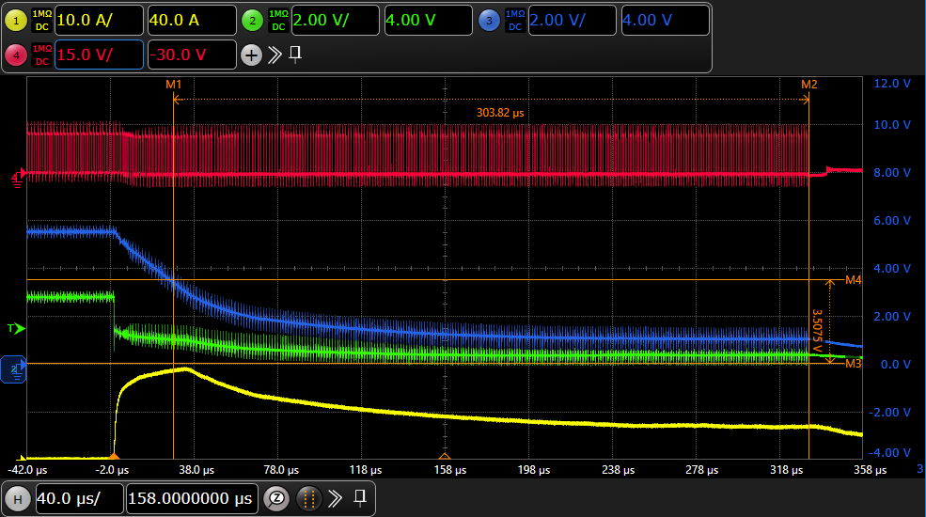





We guess the UVP circuit worked is that correct?
If short circuit occur until $V_{FB}$ becomes 65%, we guess UVP circuit begins working.
You can check the details about that bellow comment.
Page 8 : Over/Under Voltage Protection
Link: https://www.ti.com/jp/lit/gpn/tps54429
------
“When the feedback voltage becomes
lower than 65% of the target voltage,
the UVP comparator output goes high
and an internal UVP delay counter begins.
After 250 µs, the device latches off
both internal top and bottom MOSFET. ”
--------
$$V_{SW}$$
$$V_{DCDC}$$
UVP delay counter is working
$$V_{LDO}$$
65% $V_{FB}$
$$I_{load}$$

Slide 3
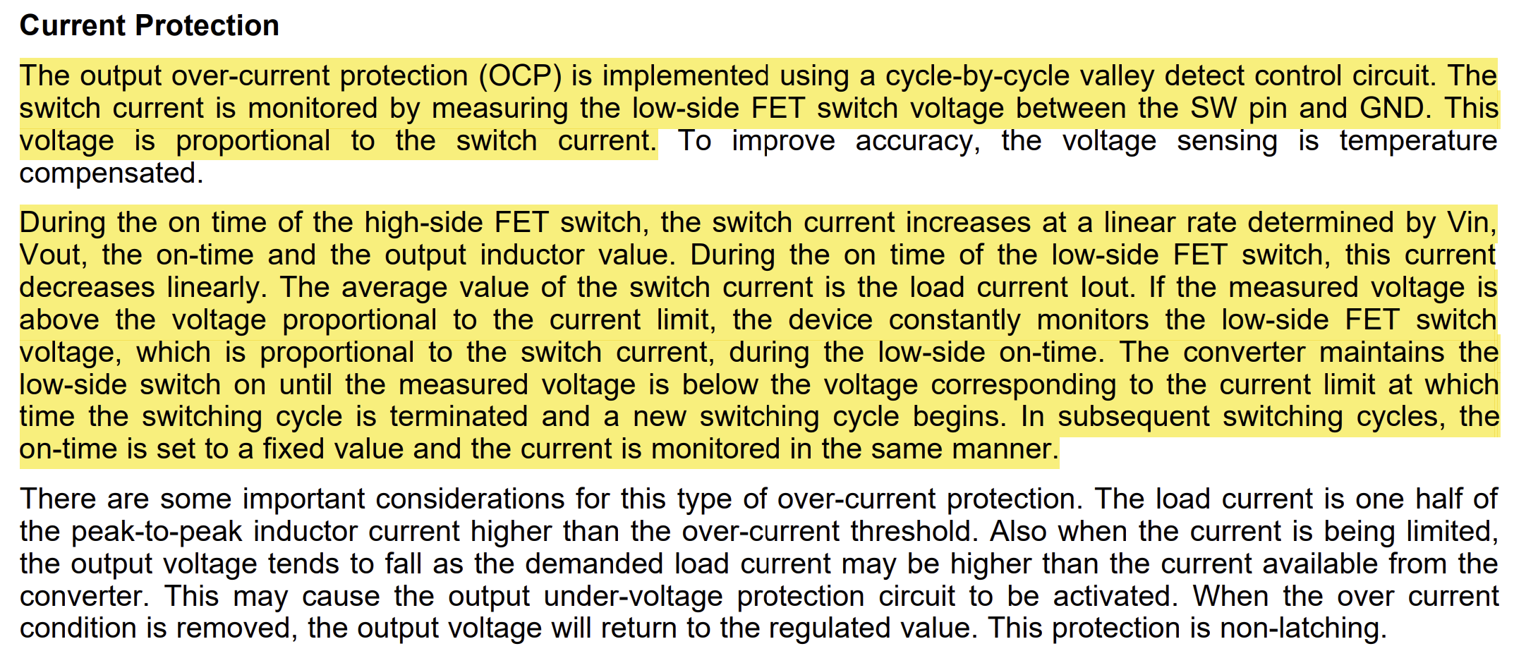
The converter follows cycle-by-cycle protection and hence it monitors the current in each cycle. During a short circuit event, the low side FET is kept constantly ON and the LS FET voltage is constantly monitored, which is proportional to the switch current.
As the LS FET is constantly ON, the O/P voltage begins to droop and at one point hits 65% of VFB voltage. Eventually UVP kicks in and latches both the FETs.
In case of overcurrent i.e. when the short is not there, the converter does not latch.
We can say that the OCP function is a non-latching fault and a short circuit is a latch-able fault.

