Slide 1
LM5168 verification for Fly-Buck solution
7/18/2023 Chen Yu

Slide 2
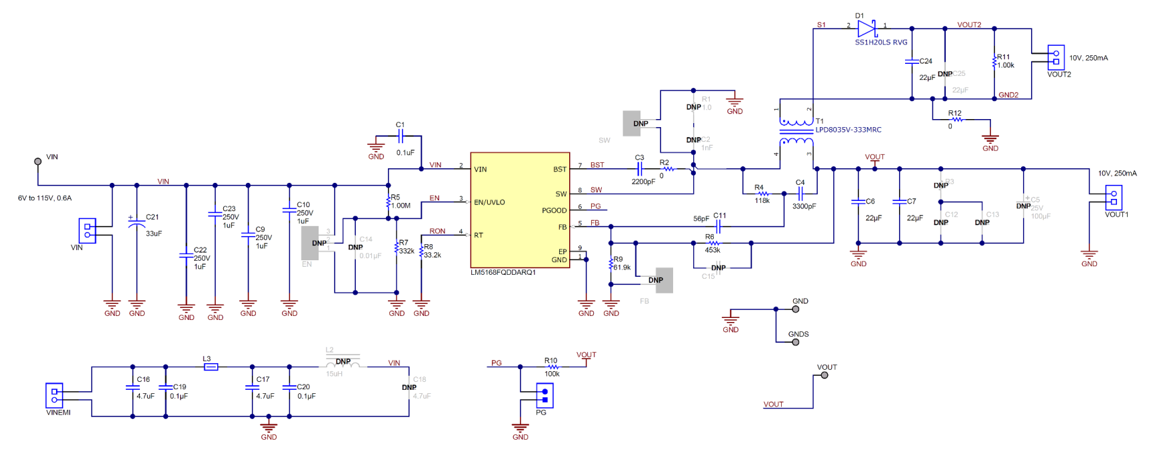
Schematic

Slide 3
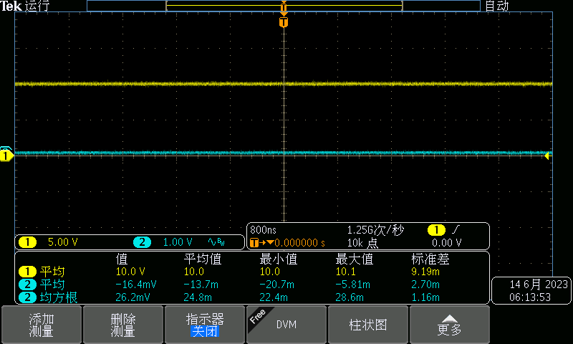
V_{o1}
V_{in}=24V I_{o1}=250mA
V_{in}=24V I_{o1}=0mA

Slide 4
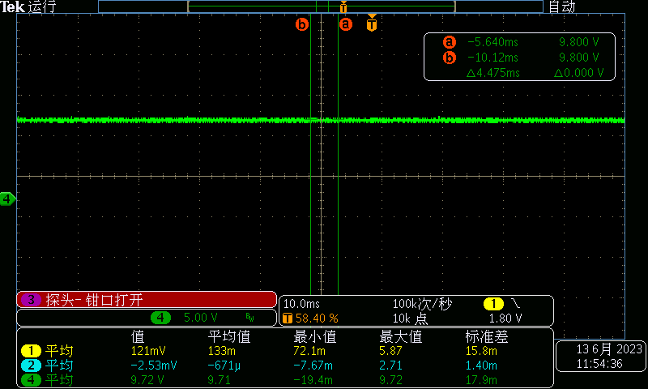
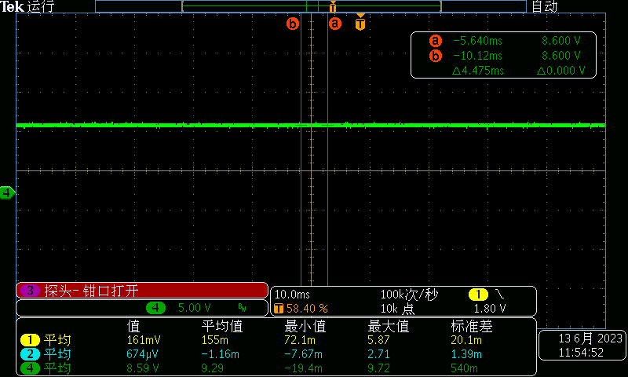
V_{o2}
V_{in}=24V I_{o2}=0A
V_{in}=24V I_{o2}=250mA

Slide 5
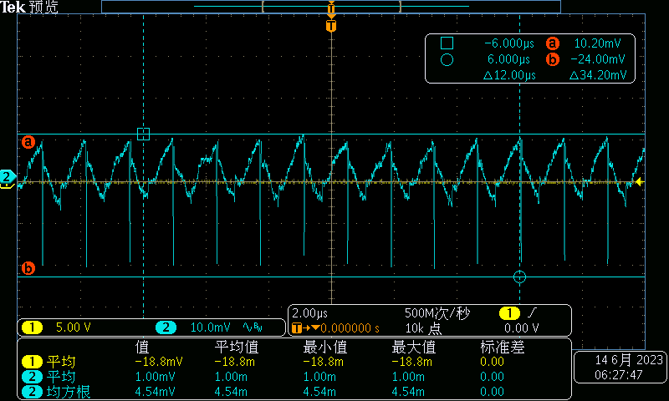
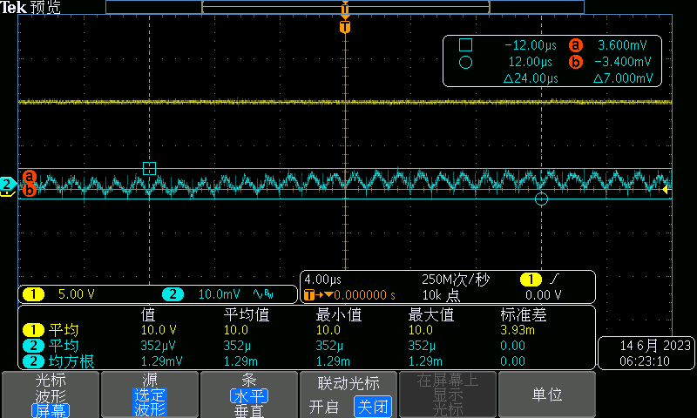
V_{o2} ripple V_{o1} ripple
V_{in}=24V I_{o2}=250mA I_{o1}=0mA
V_{in}=24V I_{o1}=250mA I_{o2}=0mA

Slide 6
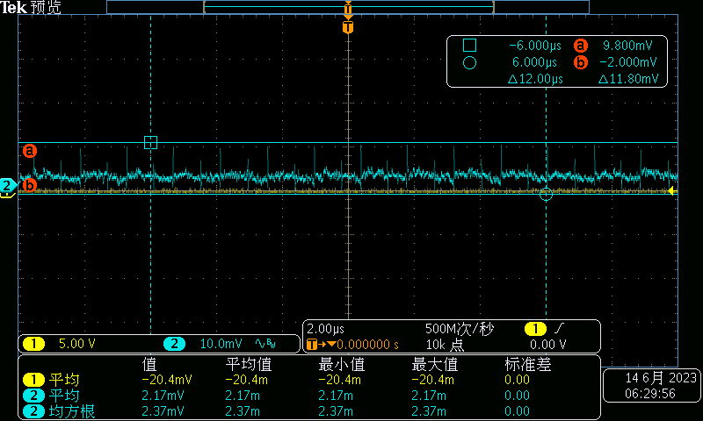
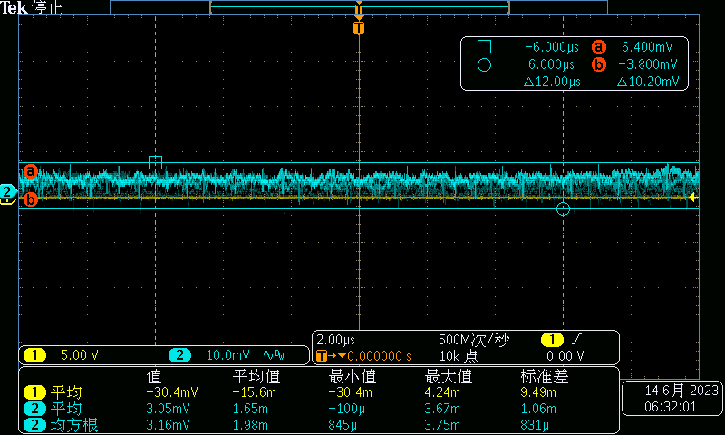
V_{o2} ripple V_{o1} ripple
V_{in}=24V I_{o2}=0mA I_{o1}=0mA
V_{in}=24V I_{o2}=0mA I_{o1}=0mA

Slide 7
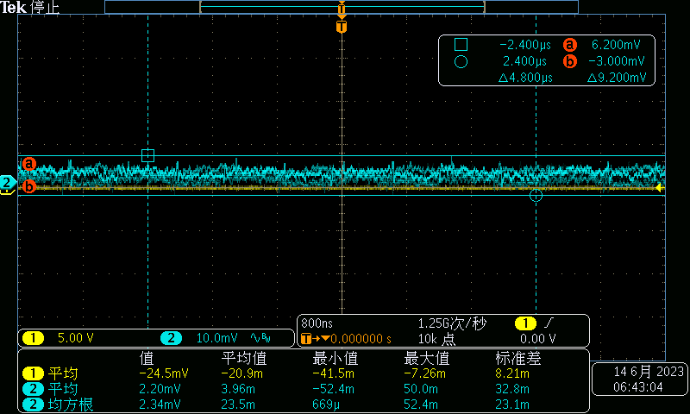
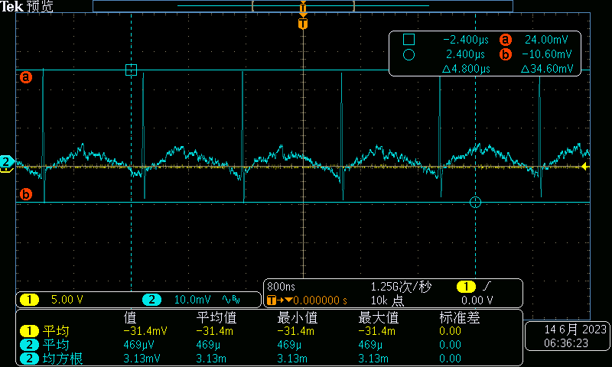
V_{o2} ripper V_{o1} ripper
I_{o1}=250mA I_{o2}=0mA
I_{o2}=250mA I_{o1}=0mA

Slide 8
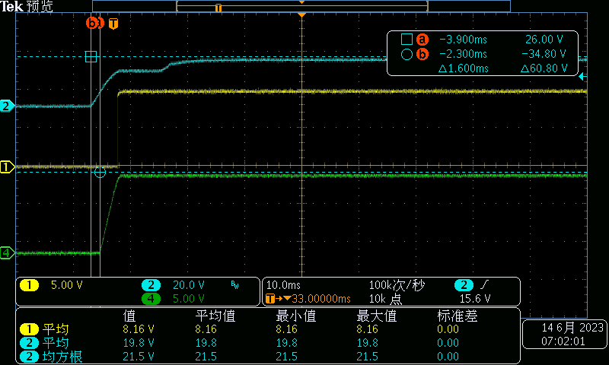
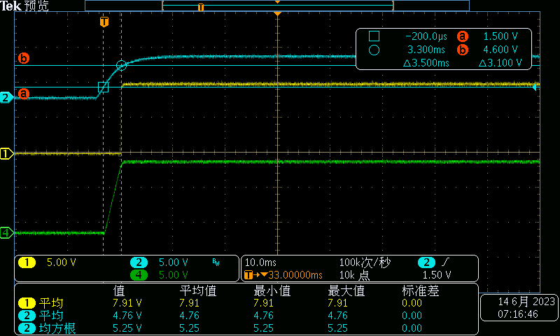
Power up
V_{in} EN
PG
V_{out}

Slide 9
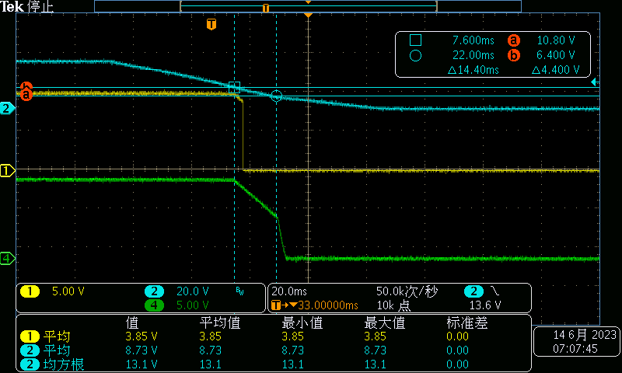
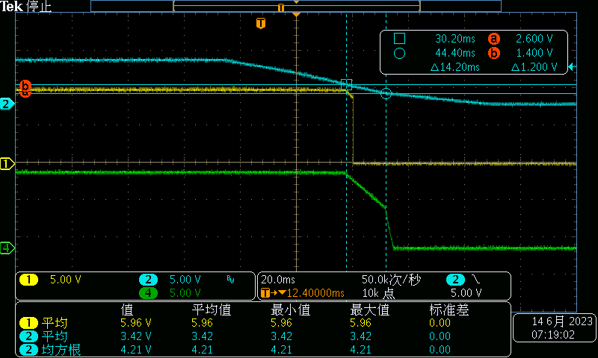
Power down
V_{in} EN
PG PG
V_{out} V_{out}

Slide 10
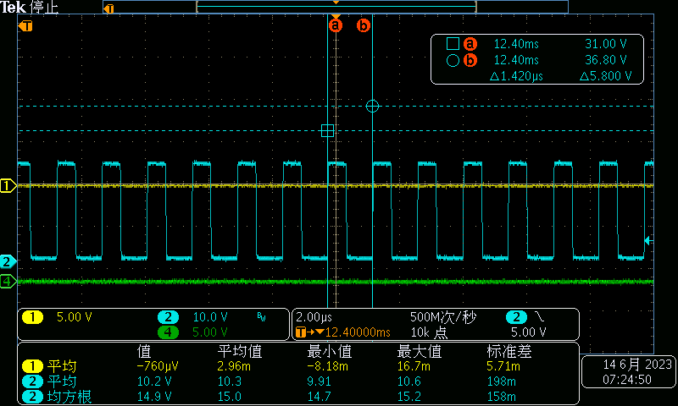
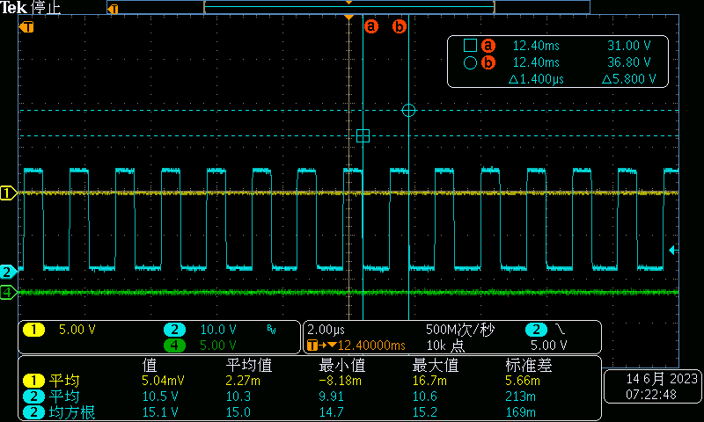
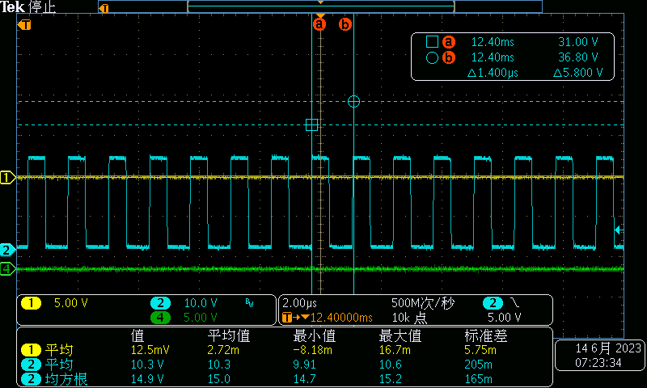
Sw 0mA 100mA 250mA
Fly-Buck The switching frequency is relatively stable

Slide 11
Thanks

