Slide 1
Main B’d Rev.A vs Rev.B
[QUESTION]
When TI Recommend Value was applied to REV.B with TPS40107, there is a strange symptom.
Input Power | TPS40170 Output Voltage Setting |  | Without Load | With Load
24V | REV.A | ~12[V] | 12V OK | 12V OK
24V | REV.B | ~6.4[V] | 6.6[V] OK | 6.6[V] OK
24V | REV.B | ~12[V] | 12[V] OK | 3[V] N.G
[PCB REV.B History]
Changed R/L/C value
Added Power/GND Via

Slide 2
Red circle = changed value
Main B’d Layer Rev.A Schematic

Slide 3
Red circle = changed value
Main B’d Layer Rev.B Schematic
(1005)523

Slide 4
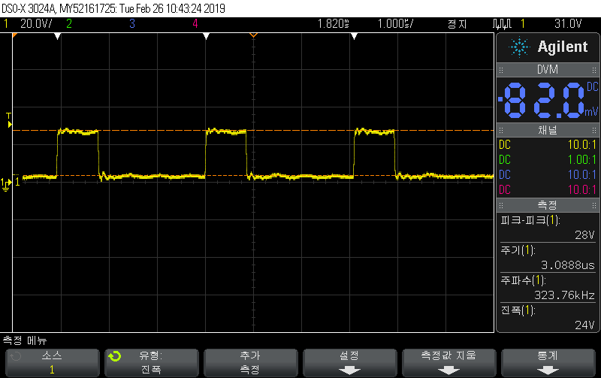
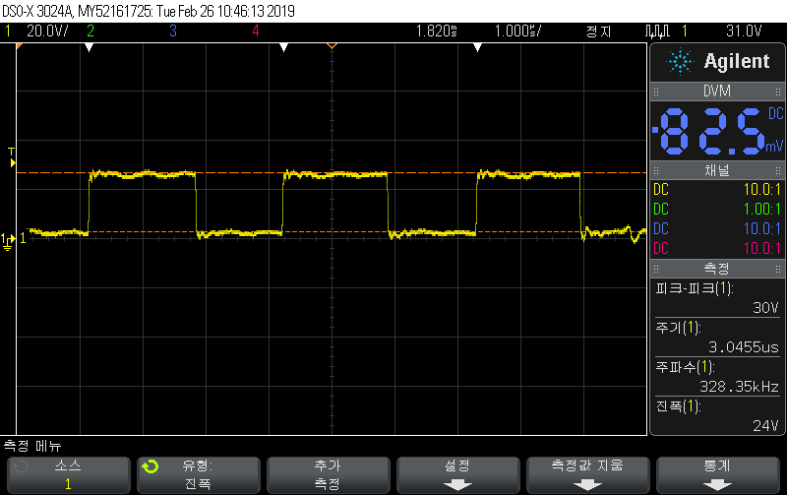
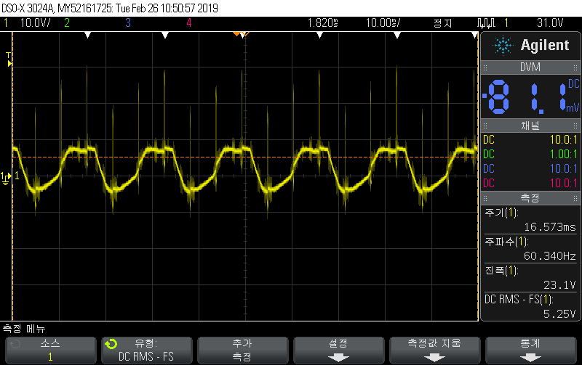
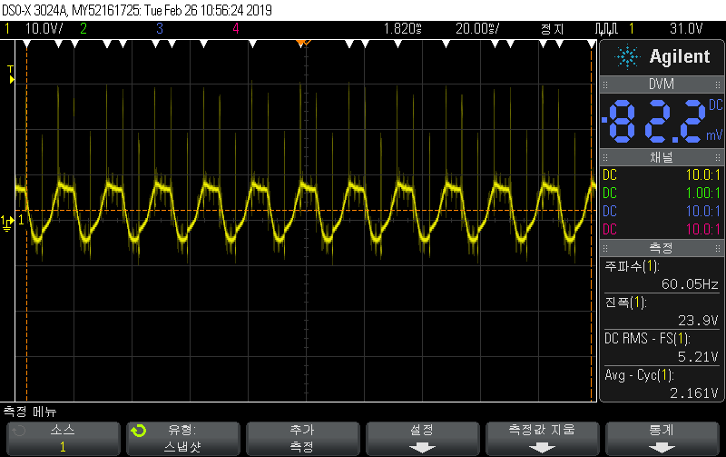
Scope shots of SW waveform
Vout = 6.4V or 12V
normal
Vout = 3.3V
abnormal

Slide 5
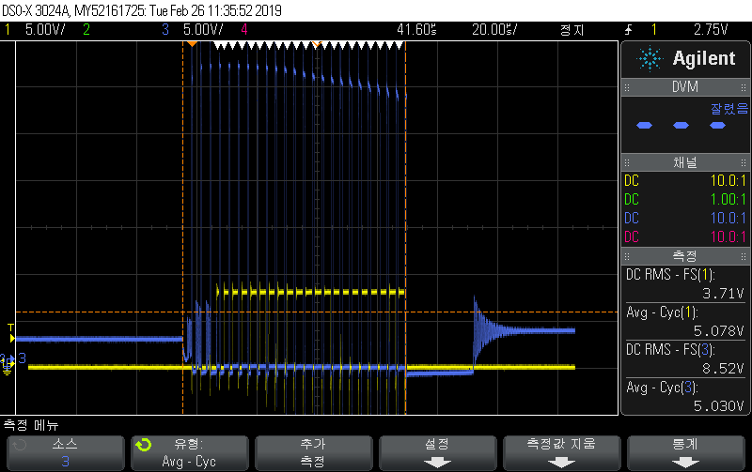
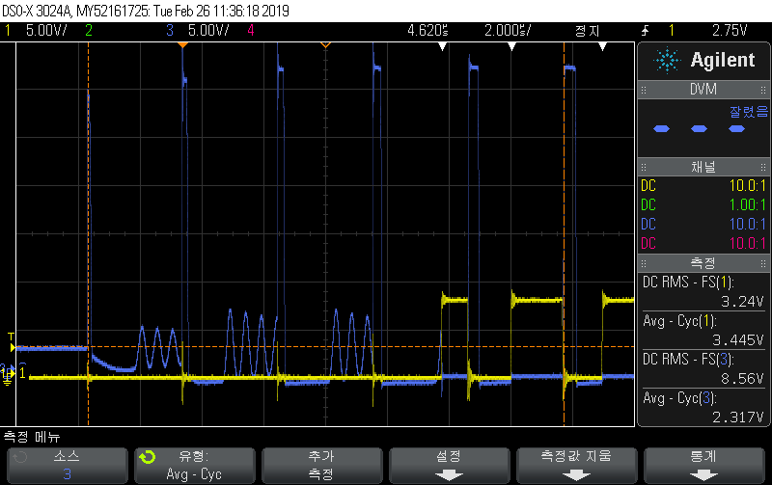
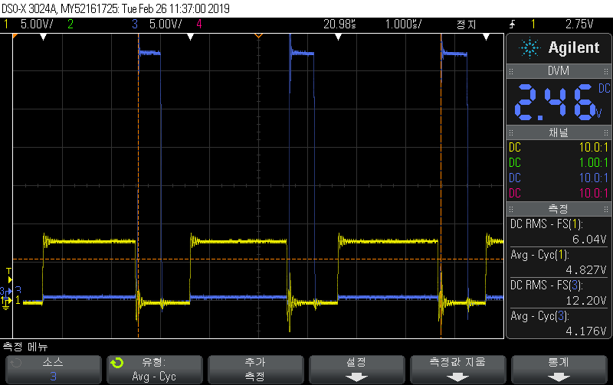
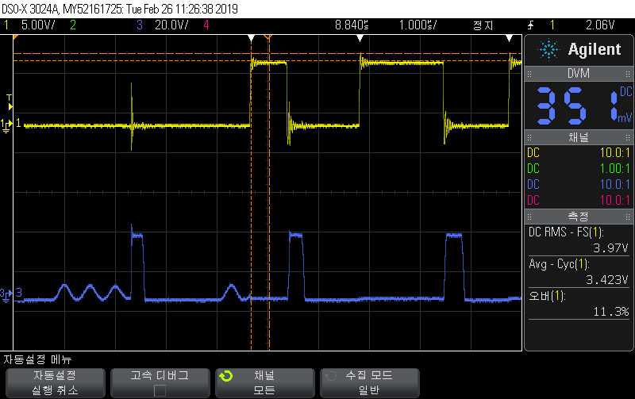
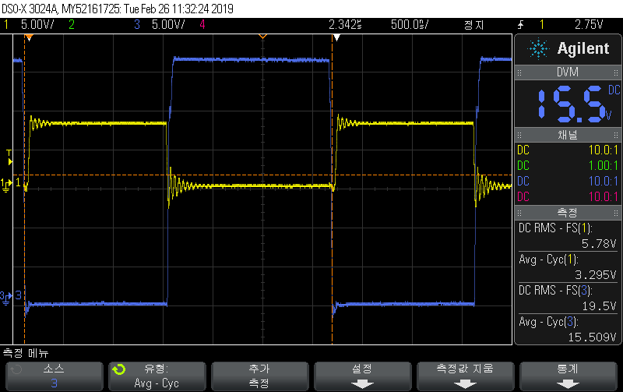
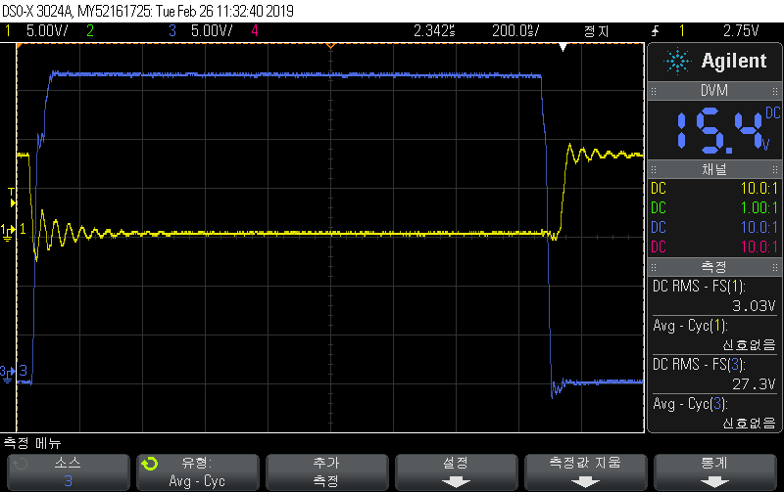
Blue Line = HDRV
Yellow Line = LDRV
Scope shots of the gate drive
Waveform when abnormal // Vout = 3.3V
Waveform when normal // Vout = 6.4V or 12V

Slide 6
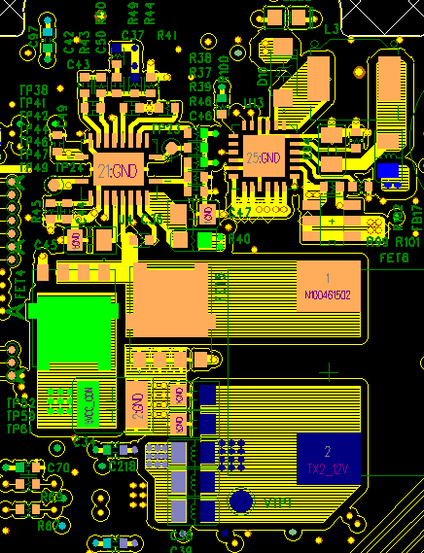
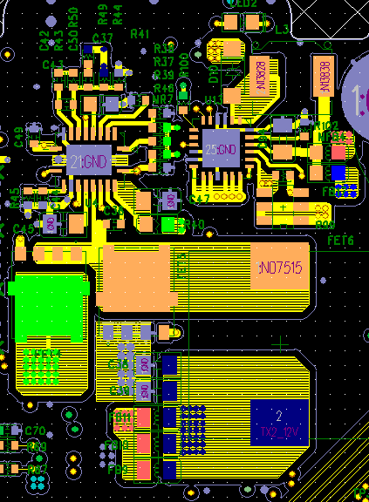
Main B’d Layer 1 (Top)
Rev.A
Rev.B

Slide 7
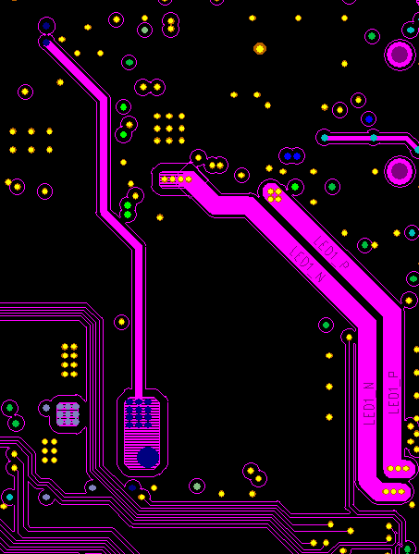
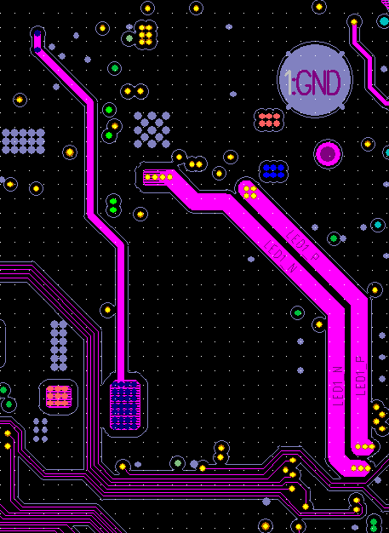
Main B’d Layer 3 (signal 1)
Rev.A
Rev.B

Slide 8
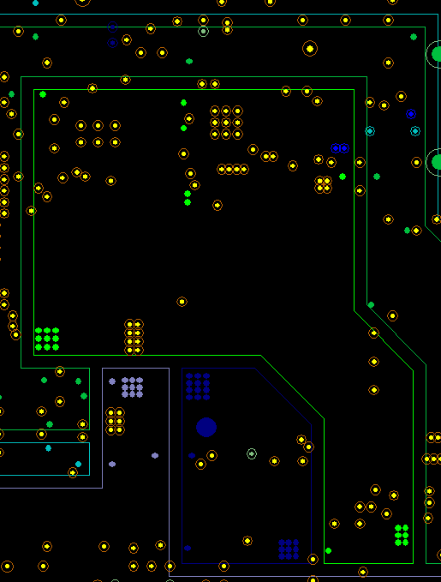
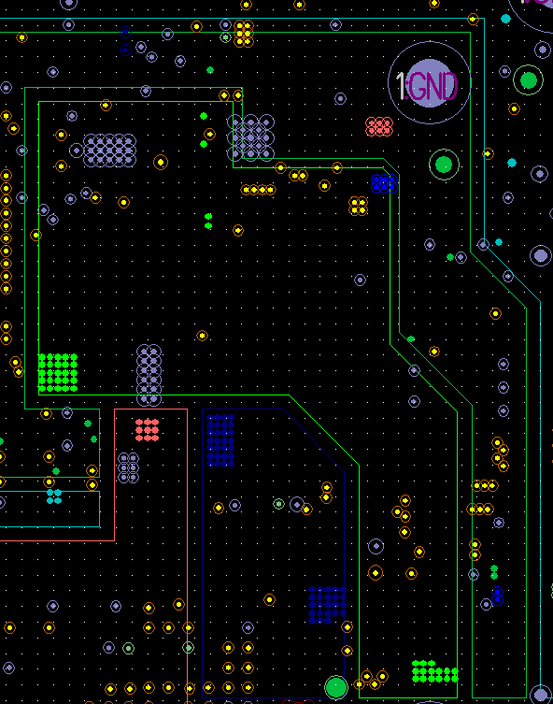
Main B’d Layer 4 (Pwr1)
Rev.A
Rev.B

Slide 9
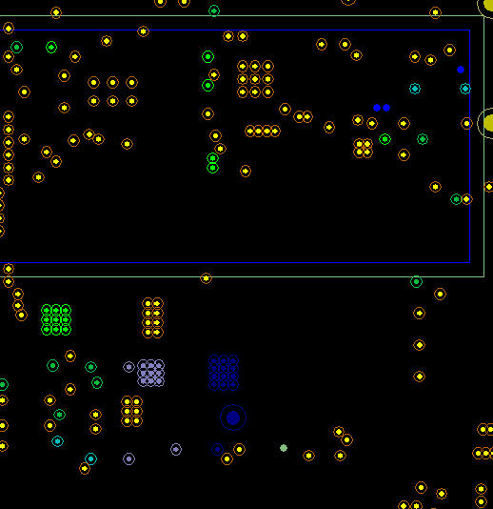
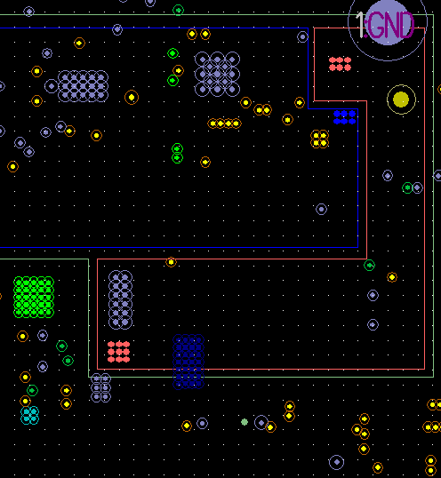
Main B’d Layer 5 (Pwr2)
Rev.A
Rev.B

Slide 10
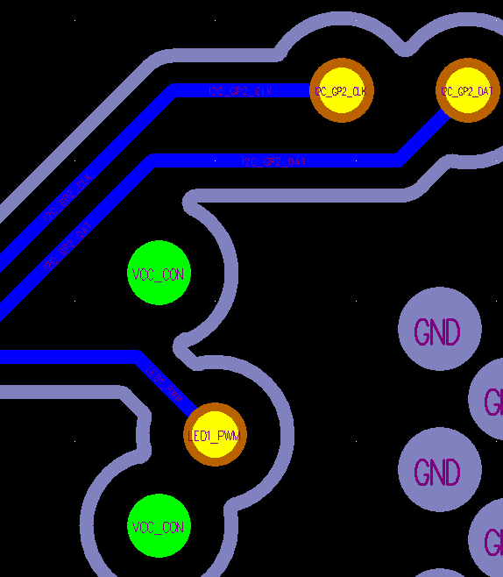
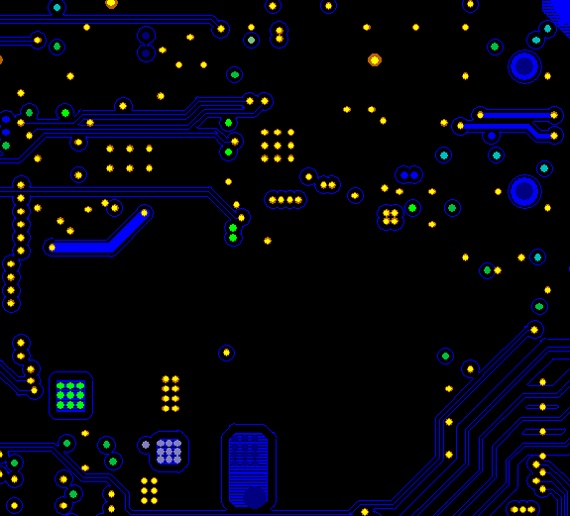
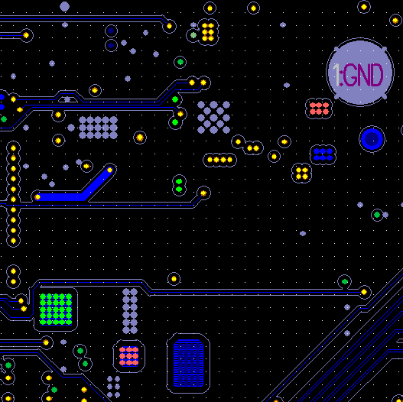
Main B’d Layer 6 (signal 2)
Rev.A
Rev.B

Slide 11
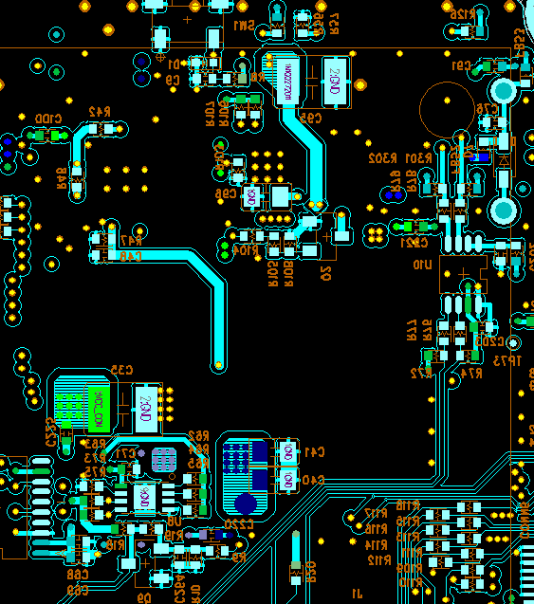
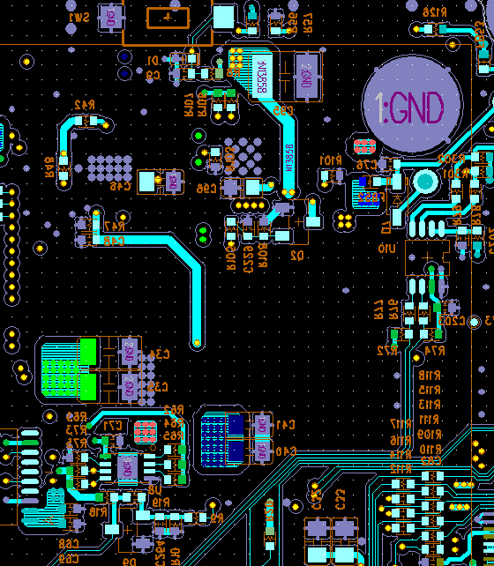
Main B’d Layer 8 (Bottom)
Rev.A
Rev.B

Slide 12
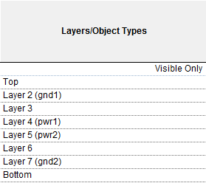
Appendix
PCB Layer configuration

