Slide 1
TPS54335A IBB application
Nancy
11/29/2022

Slide 2
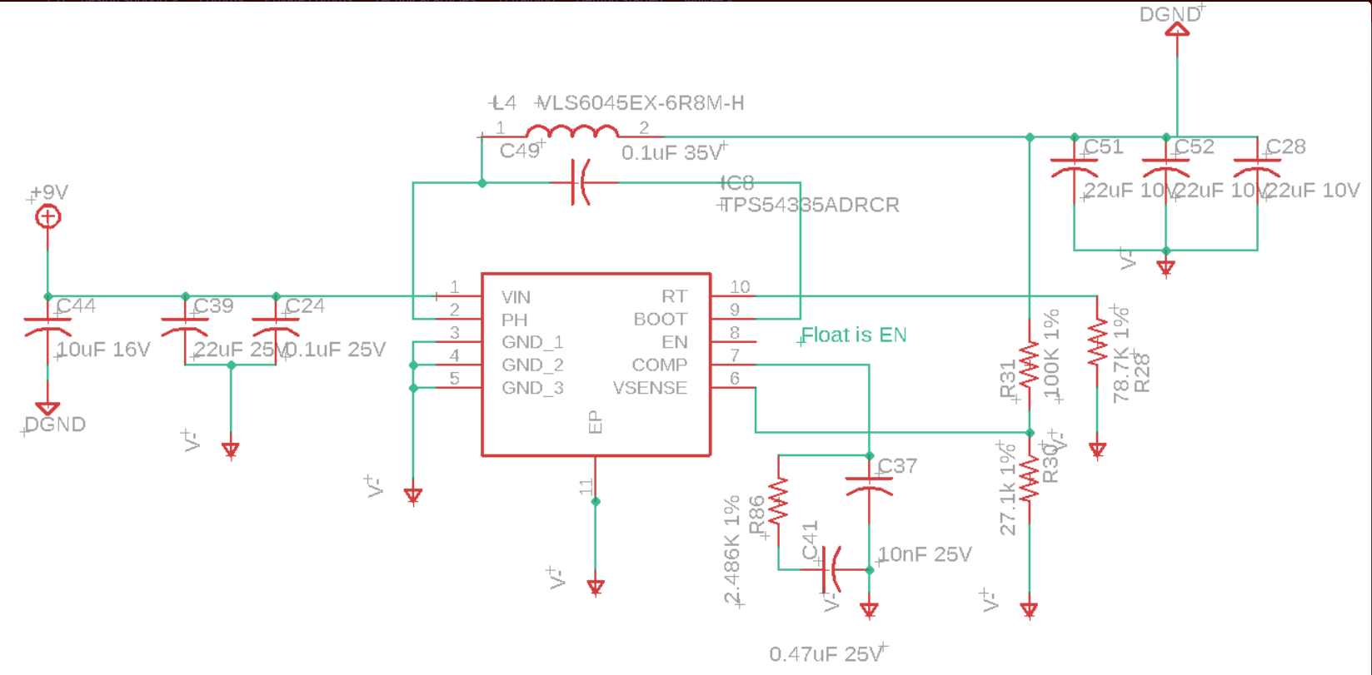
Connect input cap C39/C24 GND from V- to DGND. Same as C44. Or add a Schottky diode from –Vout to DGND. The reason is in next slide

Slide 3
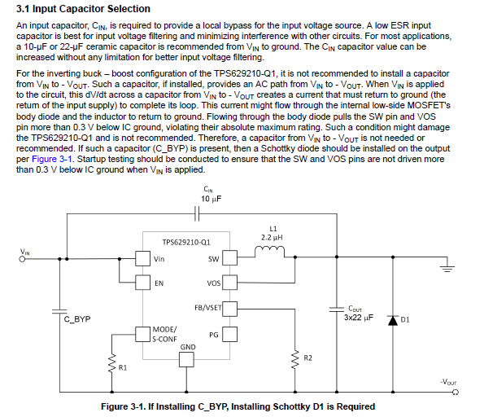
https://www.ti.com/lit/an/slvafc5/slvafc5.pdf?ts=1669732558169&ref_url=https%253A%252F%252Fwww.ti.com%252Fproduct%252FTPS629210-Q1%253FkeyMatch%253DTPS629210-Q1%2526tisearch%253Dsearch-everything%2526usecase%253DGPN

Slide 4
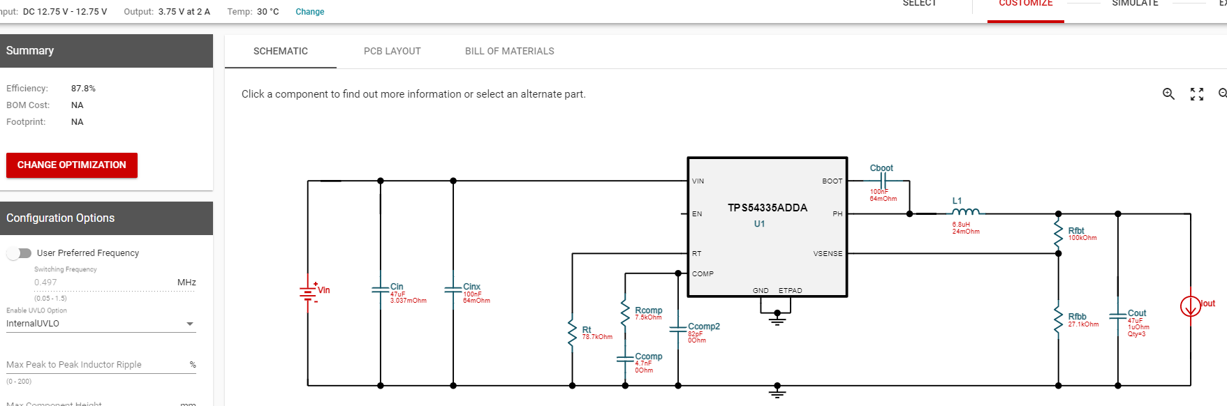
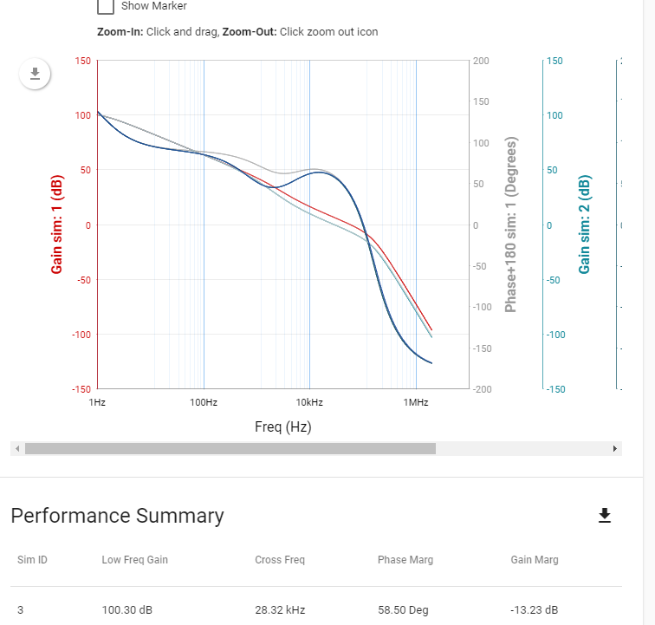
1. Change Rcomp/Ccomp/Ccomp2 as below, 2. Change 3x22uF to 3x47uF or larger

