Slide 1
Replacing TPS40425 with TPS40428

Slide 2
Summary
The TPS40428 is a Metal spin of the TPS40425 for customers who require the default start-up to be compatible with Smart Power stage. The default start-up for TPS40425 is DCR sense and Cisco is using it to power 80A and 100A power blocks.
There are few default registers changes between TPS40425 and TPS40428 since they are drive power stage vs power block. Also new bits were added in TPS40428 device.
To program TPS40428 device, you should start with config file for TPS40425 and edit couple of registers.
The updated file should be used to program TPS40428 device, then device will behave exactly like TPS40425.

Slide 3
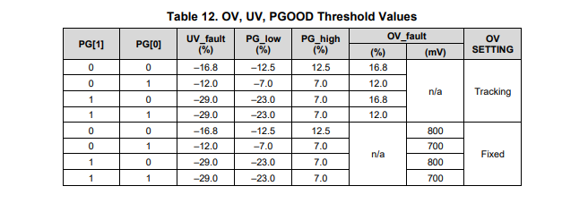
Default register differences TPS40425 vs TPS40428
Register | TPS40425 | TPS40428 | Comments
Current limits | Warn:27A Limit:30A | Warn:37A Limit:40A | Can be updated by programming file
Temp fault | Warn: 100C Limit:125C | Warn:125C Limit:145C | Can be updated by programming file
Power good Threshold | 00 ( see table below) | 01 | Can be updated by programming file
MFR_21 | EN_Smart power stage= 0 EN_TSNS_FLT=0 | EN_Smart power stage= 1 EN_TSNS_FLT=1 | Can be updated by programming file
MFR_16: bit 15 | 0 (default) | 1(Default ):Power good delay=2ms 0 : No Power good delay | Can be updated by programming file
MFR_16: bit 13 | Ch2_EN_1P6_HIZ=1 (This is hard coded in TPS40428) | Fix OVP_EN=1 Fixed OVP(Default) Fix OVP EN=0 Tracking OVP | Need to set this bit to 0. TPS40425 only has tracking OVP. TPS40428 has both Fixed or tracking OVP
MFR_16: Bit 12 | Ch1_EN_1P6_HIZ=1 (This is hard coded in TPS40428) | DIS_SSPB=1 : To improve pre-bias startup(Default) Dis_SSPB=0 : TPS40425 default | This bit should be set at 0 to get similar performance as TPS40425
MFR_16:Bit 11:8 | Test Lock out bits :0 (read only) | Test Lock out bits :1 (read only) | This causes readback error while programming
TPS40428
TPS40425

Slide 4
Step1: Update Device Code
Open existing TPS40425 “programing script.csv” files in notepad or notepad++ . Please do not open the file in excel since it will loose formatting.
Register | Remove these lines | Replace with | Comments
Device_CODE Register 0xFC | ReadWord,0x2C,0xFC,0xC300 | ReadWord,0x3E,0xFC,0xE001 | Updating device code from TPS40425 to TPS40428
Search for register “0xFC “
Change the data value to 0xE001

Slide 5
Step 2: Update Register 0xE0
Register | Remove these lines | Replace with | Comments
MFR_16 –Register 0xE0 | WriteWord,0x2C,0xE0,0x1330 ReadWord,0x2C,0xE0,0x1330 | WriteWord,0x2C,0xE0,0x1301 ReadWord,0x2C,0xE0,0x1301 | Changing FIX OVP Enable =0 and Dis_SSPB=0 and test lock bit=1;
Search for 0xE0
Change to Data value to 0x1301

Slide 6
Test Data

Slide 7
Results-Startup
TPS40425 Rise time 1.7ms
TPS40428 Risetime 1.6ms

Slide 8
Transient 0A to 12.5A
TPS40425 Pk-Pk=26.78mV
TPS40428 Pk-Pk=25.62mV

Slide 9
Bode
TPS40425 @50A
Crossover 53K , PM=56.75deg, GM=20.55dB
TPS40428@50A
Crossover 48.32K , PM=56deg, GM=20dB

