Slide 1
Battery gauge system design overview-process flow, tools and configuration
Battery Management Deep Dive Training
October 17-19, 2017
Onyx Ahiakwo

Slide 2
Agenda
Introduction
General Production Flow
Production Flow: Impedance Track Flash gauges
Production Flow: Impedance Track ROM gauges
Production Flow: CEDV gauges
Production Tools: Hardware and Software
  GDK
  Advanced bqMtester
  BqEVSW
  bqStudio
  bqMtester Software
  bqProdution
  bqHiProduction

Slide 3
Introduction
TI’s fuel gauges can be seen as a sub-system consisting of a micro-controller, analog front ends (AFE), voltage , current and temperature measurement components and communication components.
A series of steps are required to successfully design battery packs using these gauges
We will be reviewing the general flow required to go into production.
The production flow can be different depending on
  algorithm,
  type of device
  gauge-memory type.
A high level overview of the different tools available to facilitate the going to production will be discussed.

Slide 4
General production flow for TI’s guages
1. Identify the gauge based on application
2. Calibrate the voltage, current , temperature measurements, cc offset and board offset if available
3. Configure the data memory parameters referencing the technical reference manual(TRM)
4. Perform a learning cycle based on gauge type
5. Extract golden file
6. Evaluate accuracy at room and low temperature with actual load profile
7. Optimize for low temperature performance if necessary
8. Program golden file on multiple units
9. Perform calibration on each unit ( this step can be omiited if high measurement accuracy isn’t required by using averaged calibration values from 10 boards in the golden file calibration parameters)
10. Put device into ship mode

Slide 5
Production flow: Algorithm
Impedance Track
  IT
  IT-Lite
  IT-DVC
  CEDV
ROM gauges

Slide 6
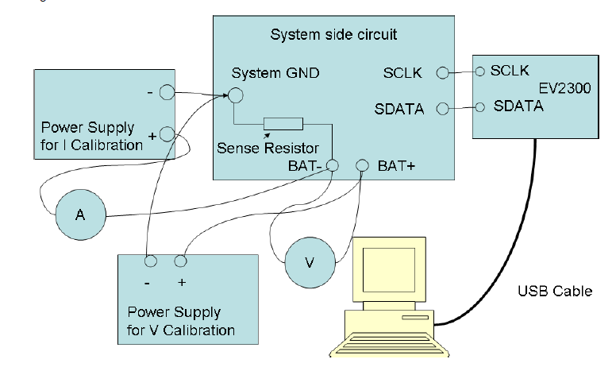
Production Flow: Impedance Track- Flash Gauges
Identify the gauge based on application
- Determine if system or pack-side IT gauge.
- Use system side gauge if the battery is detachable and pack-side if the battery and the gauge will always be attached together.
2. Calibrate the voltage, current , temperature measurements, cc offset and board offset if available
- Set up the environment as shown
- Use bqstudio to perform V,I,T
and cc-offset and board offset
calibration

Slide 7
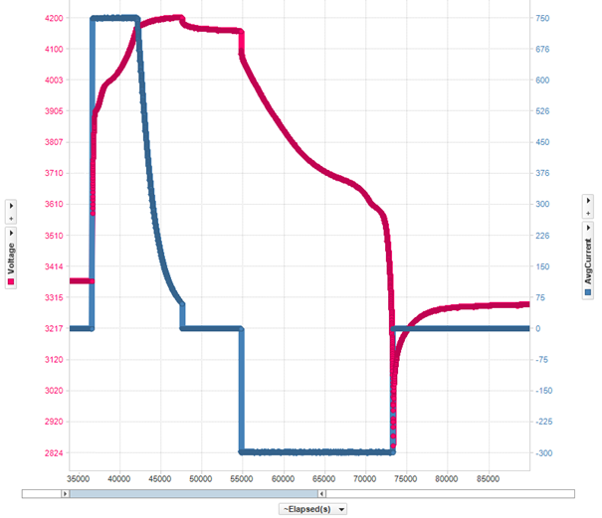
Production Flow: Impedance Track- Flash Gauges cont’d
3. Configure the data memory parameters referencing the technical reference manual(TRM)
a. Identify the chem id of the battery
Perform a relax-discharge-
relax test while logging V,I,T
with bqstudio
Upload results to online tool
gpcchem
Program the best chemid
returned on device using bqstudio
Relax >2hrs
Discharge to empty
@ >=C/10 or <= C/5
Relax >5hrs

Slide 8
Production Flow: Impedance Track- Flash Gauges cont’d
b. Configure the data flash parameter prior to learning. At minimum configure the following
Taper current. Values between C/10 and C/20 should be used.
Discharge current threshold. This should be less than taper current
Charge current threshold. This should be less than taper current.
Quit current. This determines the gauge’s relaxation state. This value should be less that dsg and chg current thresholds and less than or equal to C/20.
Design capacity: Rated Nominal capacity of the cell
Design voltage: Rated Nominal voltage of the cell
Charge voltage for the different temperature levels
Terminate voltage: minimum voltage stated in cell data sheet that the cell can be discharged to

Slide 9
Production Flow: Impedance Track- Flash Gauges cont’d
4. Perform a learning cycle
- Issue a IT enable command (0x21). Then Issue a reset command (0x41)
- Discharge to empty (terminate voltage) using a constant current value between C/5 and C/7
Rest for 5 Hours
Charge the battery to full( charge voltage specified in DS of cell) and make sure you taper to a value below the taper current in DF
Rest for 2 hours ( Qmax will update at this point). Update status will go from 04 to 05 for pack side gauges while for system side gauge it will go from 00 to 01.
Discharge to empty using the same discharge rate as before.
Rest for 5 hours.
At the end of discharge, update status will change to 06 for pack side gauge and 02 for system side gauge

Slide 10
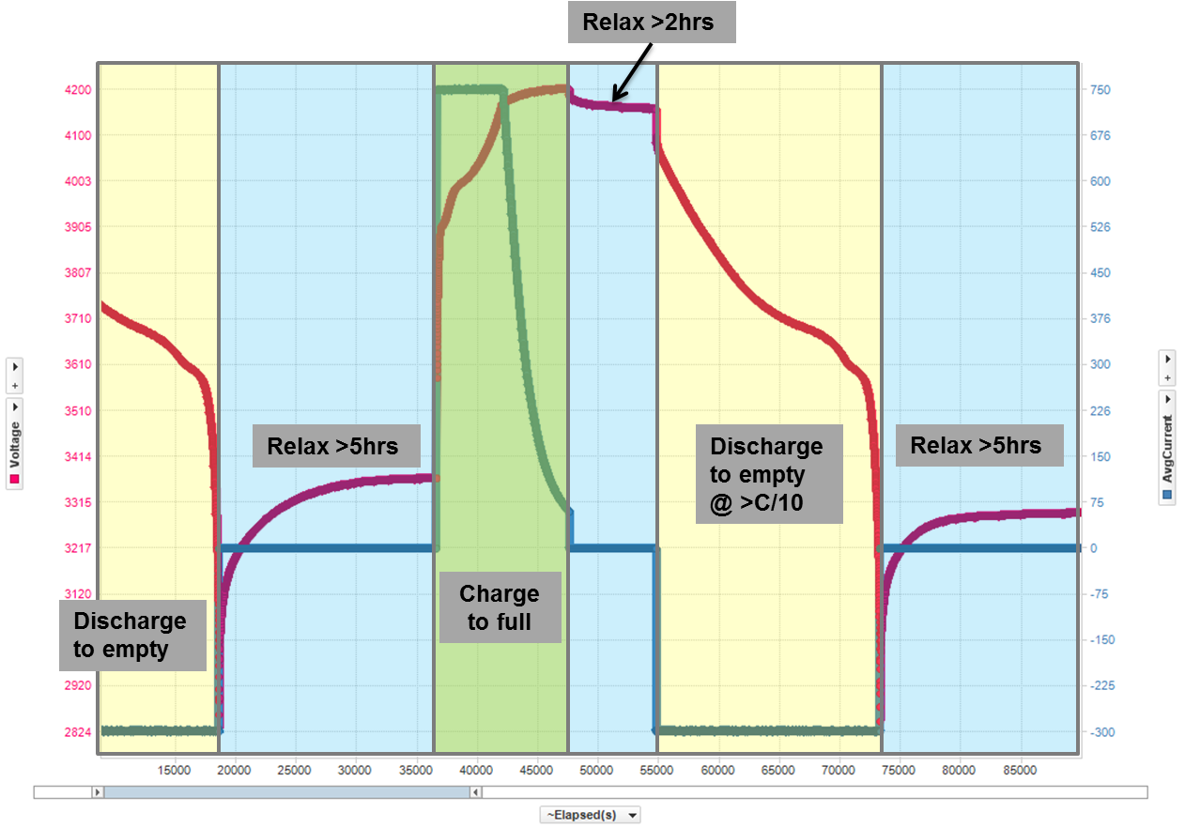
Graphical Representation of the learning cycle
Production Flow: Impedance Track- Flash Gauges cont’d

Slide 11
Production Flow: Impedance Track- Flash Gauges cont’d
5. Extract golden file
The golden file is extracted using bqstudio.
It could be srec which is a standard motorolla format file
It could be flashstream file:bqfs or dffs. Bqfs contains the instruction flash and data flash while dffs contains only the data flash parameters.
6. Evaluate accuracy at room and low temperature with actual load profile
Coulomb count the passed charge from full to empty to get the true FCC
Calculate the remaining capacity by subtracting the sum of the charge out battery from the true FCC
Calculate the true SOC by dividing the remaining capacity by the true FCC and compare that to what the gauge reports.
Notes:
6. See blog below for full details on evaluating gauge accuracy.
https://e2e.ti.com/blogs_/archives/b/fullycharged/archive/2016/11/04/how-accurate-is-your-battery-fuel-gauge-part-2-2

Slide 12
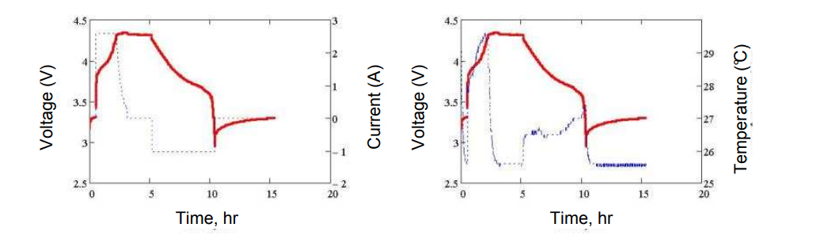
Production Flow: Impedance Track- Flash Gauges cont’d
7. Optimize for low temperature performance if necessary if not skip to point 8
Run a charge-relax-discharge profile as before at the lowest temperature the application is expected to perform in
Extract your gg file having the default chem id values (note: This shouldn’t be the learned values
Submit the room temp log file from before , cold temp log file, gg file and a config.txt file to gpcRb online tool
Program the returned .chemdat12 or .chem file using bqstudio and evaluate for accuracy
Notes:
GPCrb tool: http://www.ti.com/tool/GPCRB?keyMatch=gpcrb&tisearch=Search-EN-Everything
8. For parsing flaststream files on the gauge. see app note:
http://www.ti.com/lit/an/slua801/slua801.pdf

Slide 13
Production Flow: Impedance Track- Flash Gauges cont’d
8. Extract a new golden file and program on multiple units
Some devices support flashstream (bqfs, dffs) formats. Code can be written to parse the flashstream files to the gauge.
All flash gauges support srec. You can write code to program the srec on your gauge or use our multi-cell tool bqproduction with bqMtester for programming mutliple boards. Note: bqproduction only supports mult-icell devices.

Slide 14
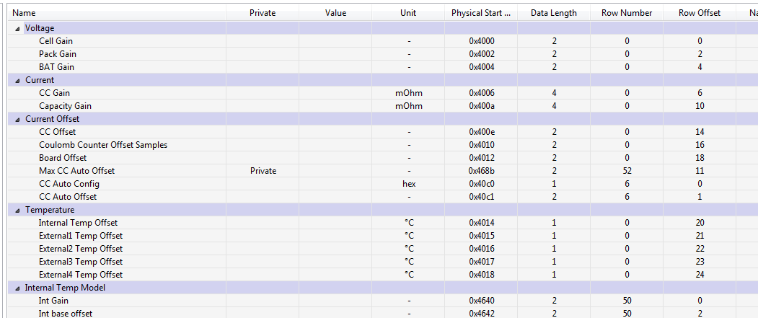
Production Flow: Impedance Track- Flash Gauges cont’d
9. Perform calibration on each unit ( this step can be omitted if high measurement accuracy isn’t required by using averaged calibration values from 10 boards in the golden file calibration parameters)
10.Enable IT and put device into ship mode (low power mode for storage)

Slide 15
Production Flow: Impedance Track- ROM gauges
1. Identify the gauge based on application. Note: all TI Rom gauges are system side
2. Calibrate the voltage, current , temperature measurements, cc offset and board offset if available
- Note: Some ROM gauges don’t have a current sense resistor, or have the sense resistor internal in the chip so there will be no current calibration
3. Configure the data memory parameters referencing the technical reference manual(TRM)
4. Perform a learning cycle based (not necessary)
5. Extract golden file (gmfs, otfs)
6. Evaluate accuracy at room and low temperature with actual load profile
7. Optimize for low temperature performance if necessary
8. Program golden file on multiple units and make provisions in your host to store gmfs file, Qmax, and resistance updates
9. Perform calibration on each unit ( this step can be avoided if high measurement accuracy isn’t required by using averaged calibration values from 10 boards in the golden file calibration parameters)
10. Put device into ship mode (hibernate mode)

Slide 16
Production Flow: Impedance Track- ROM gauges cont’d
Steps 1,2,6,7,9,10 are identical to the production flow for Flash based Impedance track gauges.
3. Configure the data memory parameters referencing the technical reference manual(TRM)
It is very important to run the gpcchem tool to make sure the default hardcoded chem ids are a match.
You select the flavor of device based on the results gpcchem returns.
They are relatively easy to configure gauges.
On most ROM IT gauge's there are 4 Main parameters to configure
- Design capacity
- Design Energy
- Terminate Voltage
- Taper rate: Design capacity/(0.1 * taper current)

Slide 17
Production Flow: Impedance Track- ROM gauges cont’d
4. Learning cycle.
- Not required for ROM gauges because it is expected they will learn in the field
- If learning has to be performed, the process is similar to flashed based gauges.
- Main Differences are as follows:
- IT is enabled by default. No need to send IT enable command
- A hard reset (0x41) isn’t required other wise the gauge will return to default settings
  Update status needs to be set to 02 before learning starts.
Update status transitions from 02 to 01 to 00 which indicates learning is successful

Slide 18
Production Flow: Impedance Track- ROM gauges cont’d
5. Extract golden file (gmfs, otfs)
Rom gauges use gmfs files because they do not have flash.
The gmfs file is programmed on volatile memory which gets resets to the default hardcoded settings if a reset or POR occurs
Some ROM gauges have one time programmable memory that allows settings to be permanently programmed. Such gauges use .otfs for programming.

Slide 19
Production Flow: Impedance Track- ROM gauges cont’d
8. Program golden file on multiple units and make provisions in your host to store gmfs file, Qmax, and resistance updates
Given the ROM gauges have volatile memory, the host needs to have non-volatile memory to store the gmfs file containing application settings should a POR on the guage occur.
Also, the host needs to periodically store the resistance tables and the qmax values so as to write these values back to the gauge should a POR occur to maintain gauge accuracy.

Slide 20
Production Flow: Compensated End of Discharge Voltage (CEDV)
1. Identify the gauge based on application
2. Calibrate the voltage, current , temperature measurements, cc offset and board offset if available
3. Configure the data memory parameters referencing the technical reference manual(TRM)
4. Perform a learning cycle based on gauge type
5. Extract golden file
6. Evaluate accuracy at room and low temperature with actual load profile
8. Program golden file on multiple units
9. Perform calibration on each unit ( this step can be avoided if high measurement accuracy isn’t required by using averaged calibration values from 10 boards in the golden file calibration parameters)
10. Put device into ship mode

Slide 21
Production Flow: Compensated End of Discharge Voltage (CEDV) Cont’d
Steps 1 and 2 , 5-10 are identical to Impedance track.
3. Configure the data memory parameters referencing the technical reference manual(TRM). Most important parameters are:
- EDV2, EDV1 and EDV0 corresponding to 7%, 3% and 0% SOC at room temp.
Taper current. Values between C/10 and C/20 should be used.
Discharge current threshold. This should be less than taper current
Charge current threshold. This should be less than taper current.
Quit current. This determines the gauge’s relaxation state. This value should be less that dsg and chg current thresholds and less than or equal to C/20.
Design capacity: Rated Nominal capacity of the cell
Design voltage: Rated Nominal voltage of the cell
Charging voltage

Slide 22
Production Flow: Compensated End of Discharge Voltage (CEDV) Cont’d
4. Perform a learning cycle.
6 different cycles are required for this test while logging V, I, T.
Discharge from full to empty using the typical high rate of your application at room temperature (25ºC)
Discharge from full to empty using the typical low rate of your application at room temperature (25ºC)
Discharge from full to empty using the typical high rate of your application at high temperature your application will see(typically 50ºC is used)
Discharge from full to empty using the typical low rate of your application at high temperature your application will see(typically 50ºC is used)
Discharge from full to empty using the typical high rate of your application at low temperature your application will see(typically 0ºC is used)
Discharge from full to empty using the typical high rate of your application at low temperature your application will see(typically 0ºC is used)
Submit the files to gpccedv
Program the returned 7 CEDV coefficients (EMF, C0,R0, T0, R1, TC, C1) in the gauge
Notes:
GPCCEDV Tool: http://www.ti.com/lit/ug/sluub45a/sluub45a.pdf

Slide 23
Production tools- Hardware and Software
GDK
Advanced bqMtester
bqEVSW
bqStudio
bqMtester
bqHiProduction
bqproduction

Slide 24
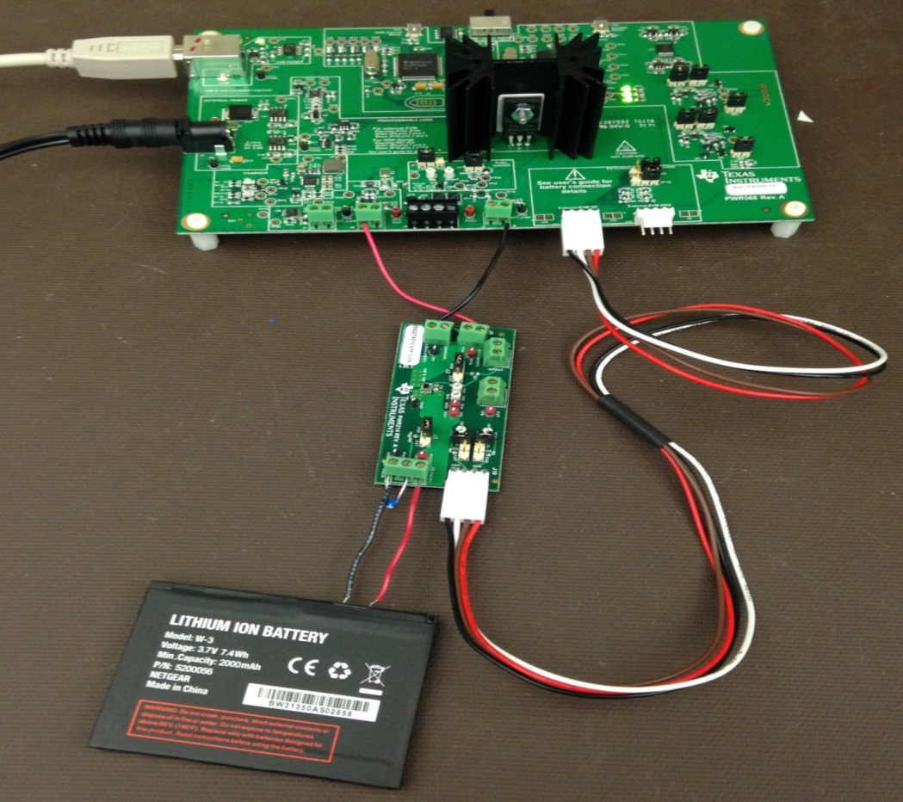
Production Tools Hardware:
Gauge Development Kit (GDK)
Features
Automated cycling for 1s Cells with customizable profiles
  Pulsed loads
  Constant current/power loads
Programmable Load
Programmable Charger
On board fuel gauge (bq27421-G1A)
External EVM connection to evaluate other I2C compatible single cell fuel gauges
Data logging for evaluation of cycling

Slide 25
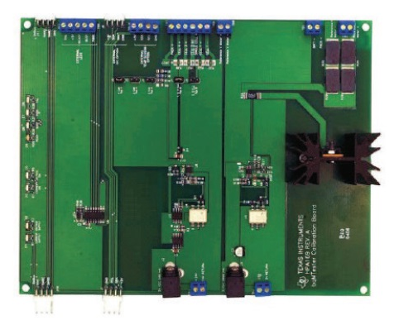
Production Tools Hardware:
Advanced BqMester
Features
- Programs and calibrates multi-cell smart battery modules based on the following devices: bq306x and bq28xxx, bq40xx, and the Impedance Track™ devices bq20z4x, bq20z6x, bq20z7x, bq20z80, and bq20z9x,bq28zxx, bq40zxx
Calibrates coulomb counter offset, voltage, temperature, and current
Programs serial number, date, Pack lot code
Works with bqMtester Software and bqproduction

Slide 26
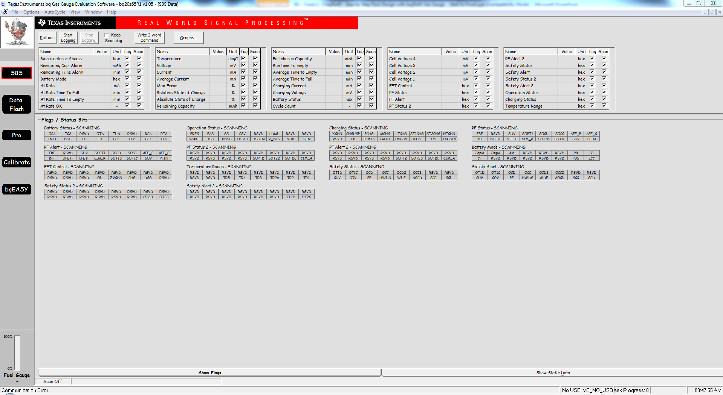
Production Tools :bqEVSW
Features
Chem id programming
Configuration of data flash
Logging of registers and data flash
Gauge calibration
gg file exporting
senc extraction and programming
.rom and .dfi file extraction and programming
Facilates full evaluation of TI’s gauges

Slide 27
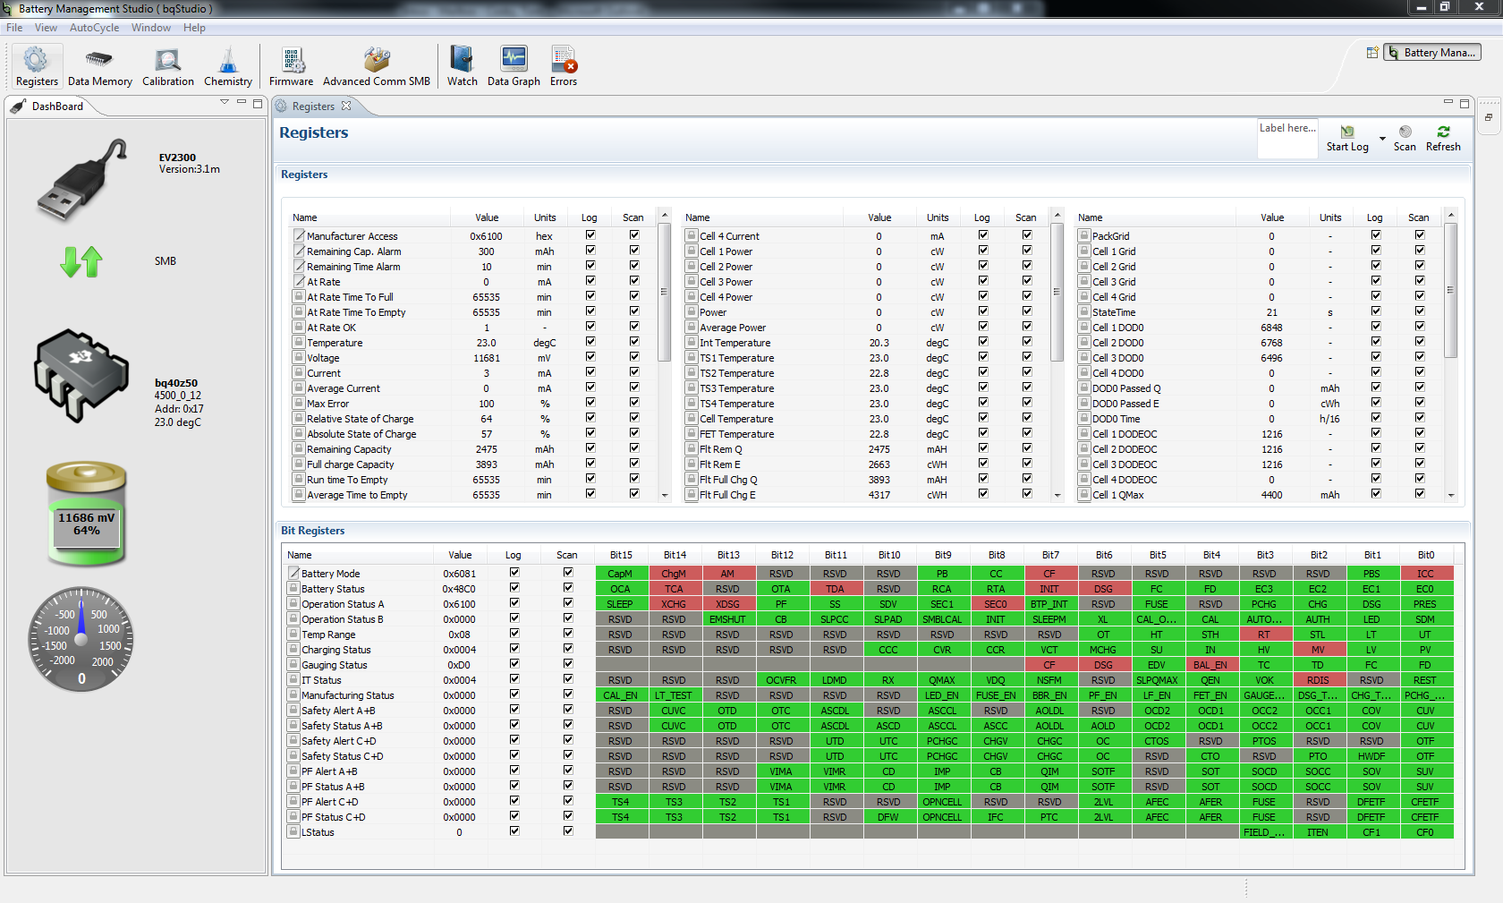
Production Tools :bqStudio
Features
bqEVSW replacement
Allows full evaluation of TI’s gauges

Slide 28
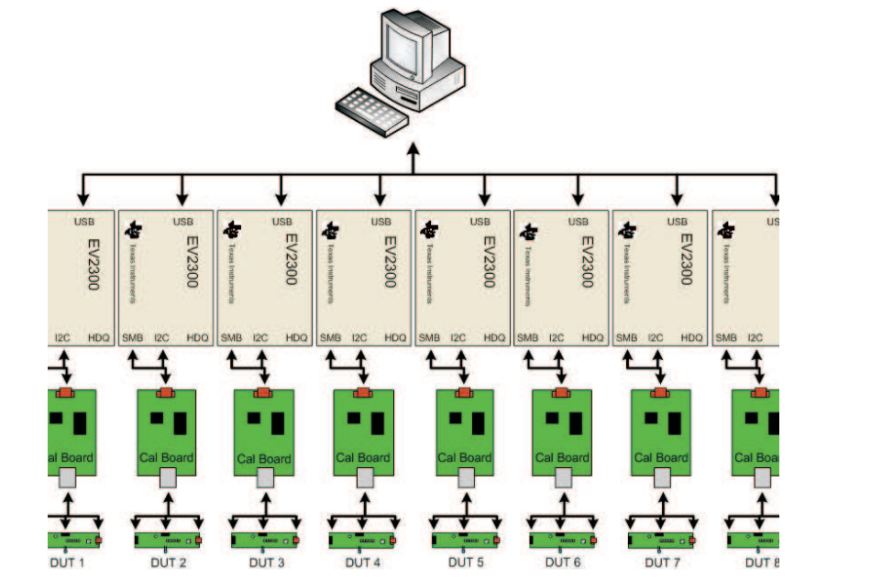
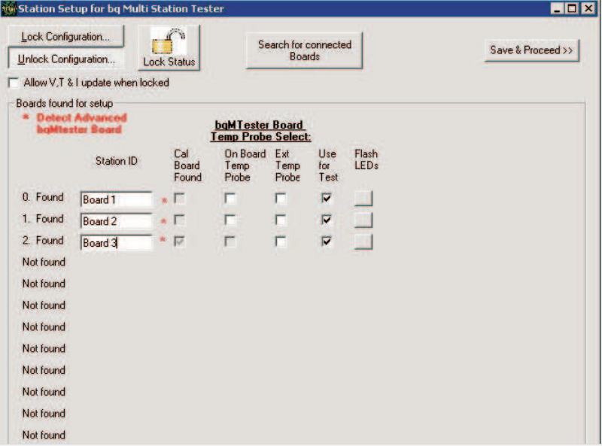
Production Tools : bqMtester Software
Legacy software for use with the advanced bqMtester hardware
Facilitates mass production/programming of legacy device like the bq20XXX, bq30XXX

Slide 29
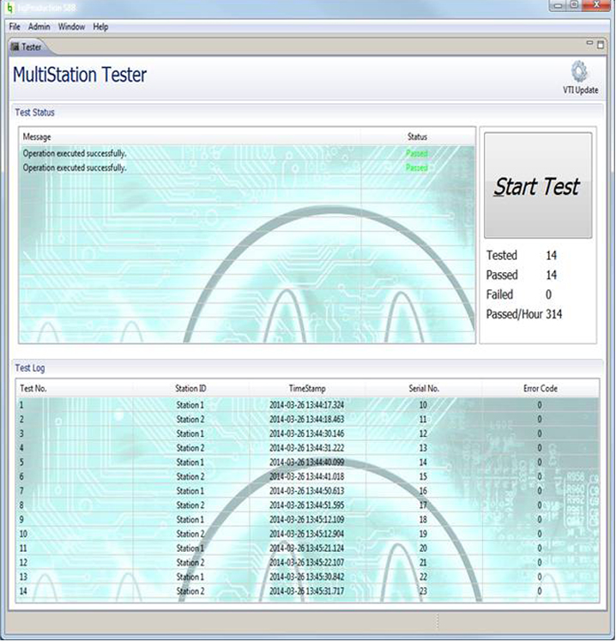
Production Tools : bqproduction
Supports bq28z610, bq40zxx family of devices, such as bq40z60 and bq40z50-r1
Works with Advanced bqMTester hardware
Control multiple stations from a single graphical user interface
Run up to 12 stations in parallel from a single computer
Calibration and test automation unique serial number assignment/programming
Date of manufacture programming calibration limits filter to detect anomalies
Uses industry standard Motorola srec format golden image programmer

Slide 30
Production Tools : bq-Hi-Production
Calibration and test automation of bq34z100, bq34110 and bq78350
Control multiple stations from a single graphical user interface
Calibration and test automation Unique Serial number assignment/programming
Uses industry standard Motorola srec format golden image programmer

Slide 31
Conclusion / Summary
The general production flow for TI’s gauge was outlined
The differences in algorithm and gauge type alters the general production flow
The different tools that facilitate mass production was discussed.
While going to production can be demanding, following the procedure can get your designs out the door quickly.

Slide 32
Questions?

