Slide 1
Patch Bundle Mode Walkthrough

Slide 2
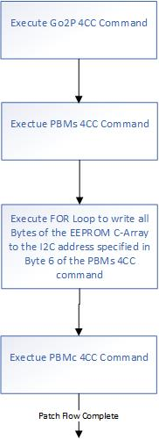
Patch Bundle Mode Flowchart
Use Go2P command to force PD controller to patch mode (PTCH) if PD controller is not in PTCH mode
Use PBMs command to start patch burst mode download sequence
Downloading the configuration to the specified I2C address
Use PBMc command to end the patch loading sequence and change device into “APP” mode

Slide 3
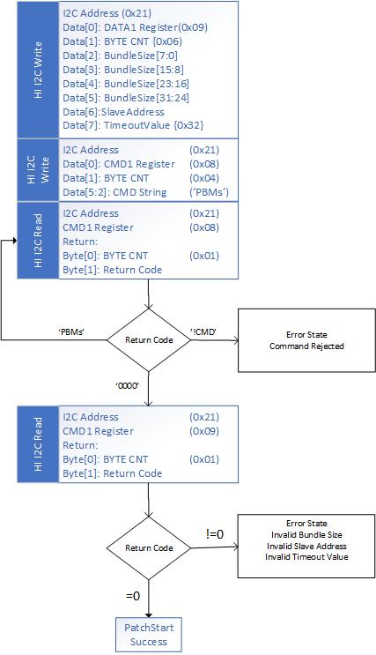
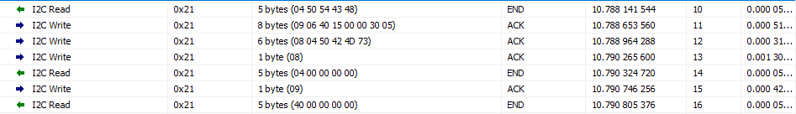
PBMs Pseudo Code with I2C Log Example (Address 0x21)

Slide 4
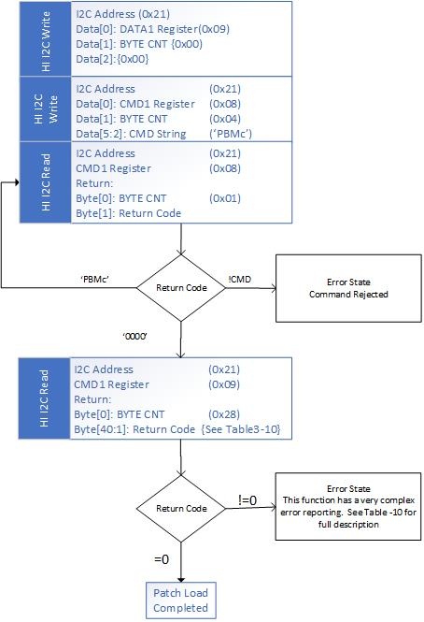
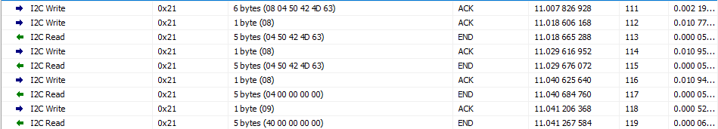
PBMc Pseudo Code with I2C Log Example (Address 0x21)

