Slide 1
Automotive Hotrod and Wettable Flanks Packaging Advancements
Perry Tsao
Systems and Applications Manager
SVA-PPS-PRS (Performance Regulator Solutions)

Slide 2
Agenda
Overview of Automotive Hotrod and Wettable Flanks
Performance benefits of Automotive Hotrod
Layout techniques to minimize EMI
Best practices for thermal layout of Hotrod devices

Slide 3
Automotive Hotrod and Wettable Flanks

Slide 4
PACKAGE COMPARISON
STD. WB QFN
WCSP
FCOL QFN
Board
Board
Board
Hotrod
Courtesy of ALPS

Slide 5
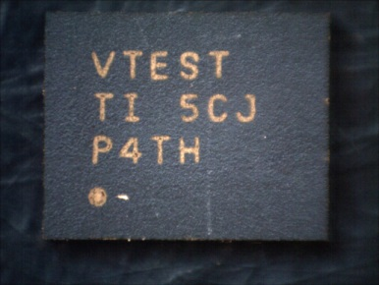
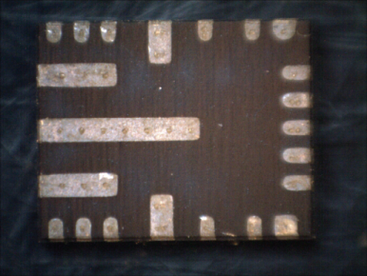
LM53625 / LM53635 Viper Package
Package is 4mm x 5mm 22 pin QFN Flip Chip On Lead (HotRod) Technology.

Slide 6
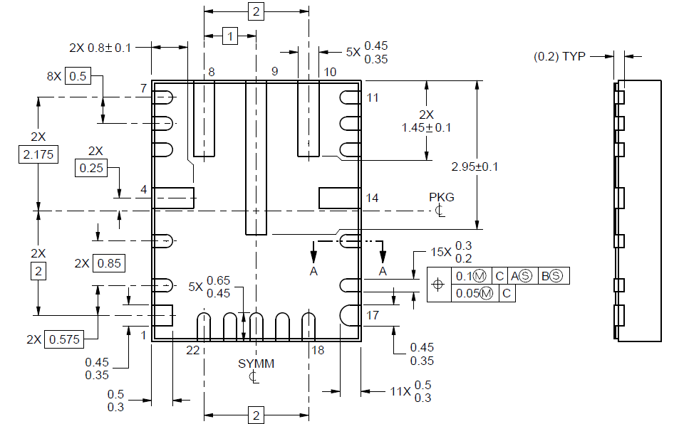
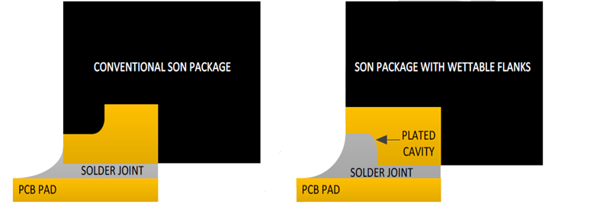
Wettable flanks
Wettable flanks guarantees visible side-wetting at good solder joints
Enables 100% Automotive Visual Inspection assembly processes
Dual plated punched process with notch on underside of the package.
Leadframe is punched out then re-plated.

Slide 7
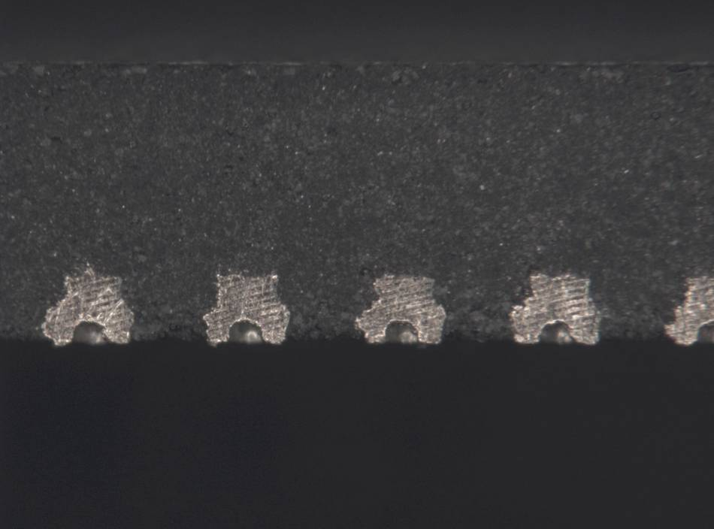
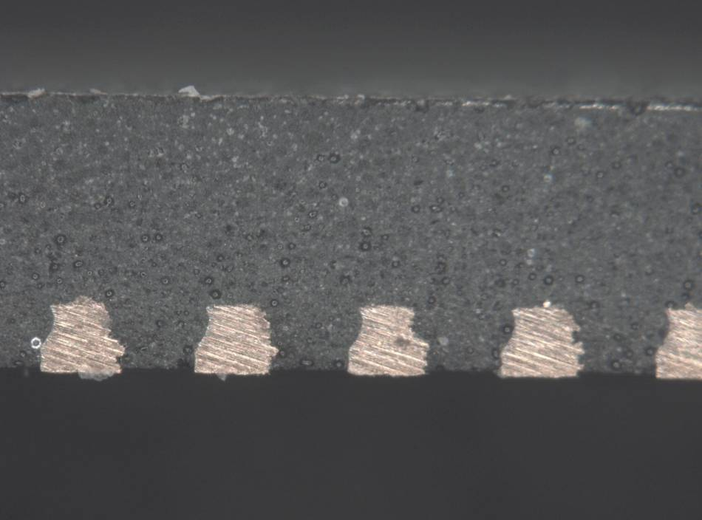
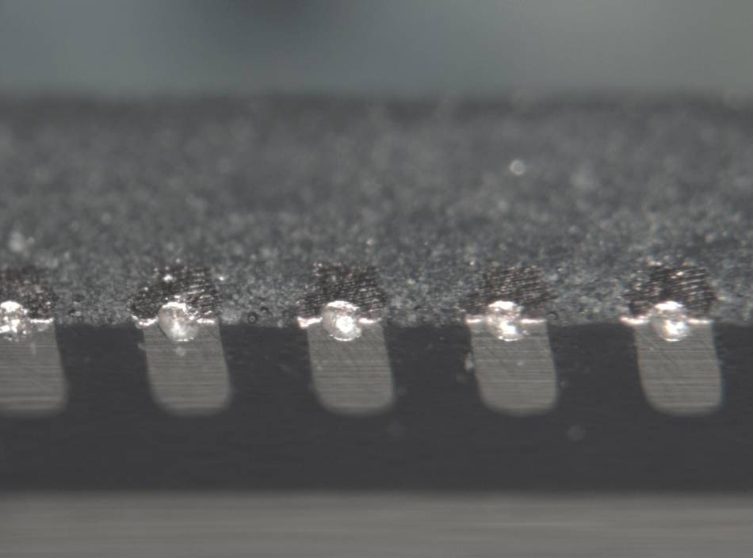
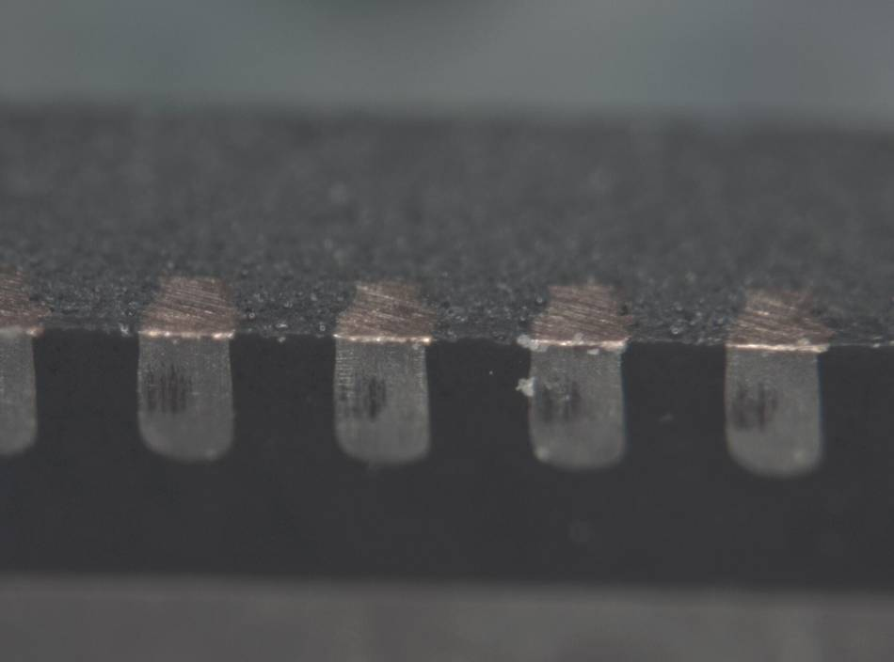
Images of QFN Slotted & Standard Leads
Slotted Leads – side view
Standard Leads – side view
Plated Slot
Slotted Leads – Bottom view
Standard Leads – Bottom view

Slide 8
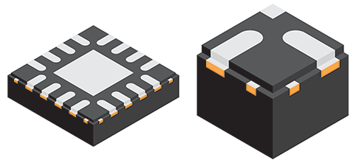
Wettable flanks with step-cut and re-plating
Step-cut

Slide 9
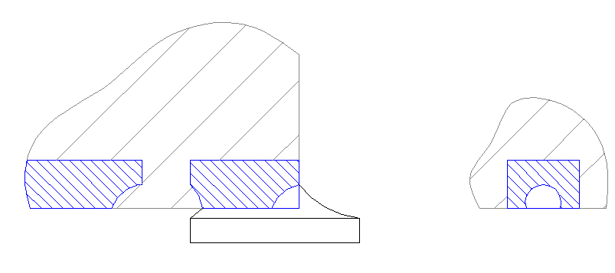
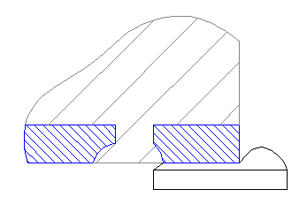
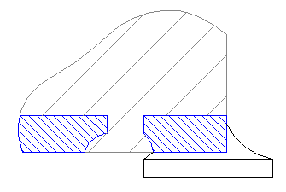
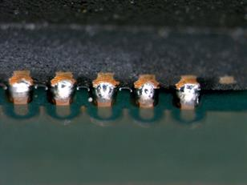
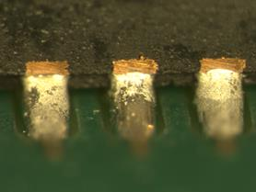
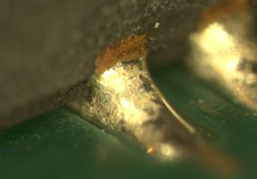
Finished Product: Side Solder Fillet (SSF) on QFN
Standard QFN – poor solder fillet
Good Solder Fillet with step-cut wettable flanks

Slide 10
Why do we need Automotive Hotrod?

Slide 11
Why do we need Automotive Hotrod?
Reduced Rds_on
Smaller size
Reduced parasitics => less switch node ringing => lower EMI

Slide 12
LM53625/35 Leadframe design
Note Symmetry for VIN/PGND around SW node
0.6mm spacing between HV and LV pins
FB away from noisy signals and shielded by AGND
Wettable Flanks shown by notch
TI Confidential NDA Restrictions

Slide 13
Layout for EMI

Slide 14
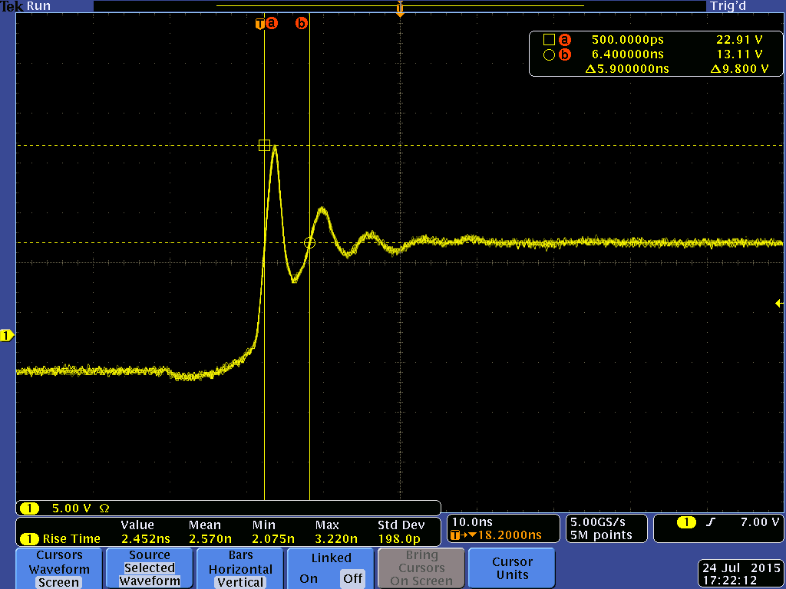
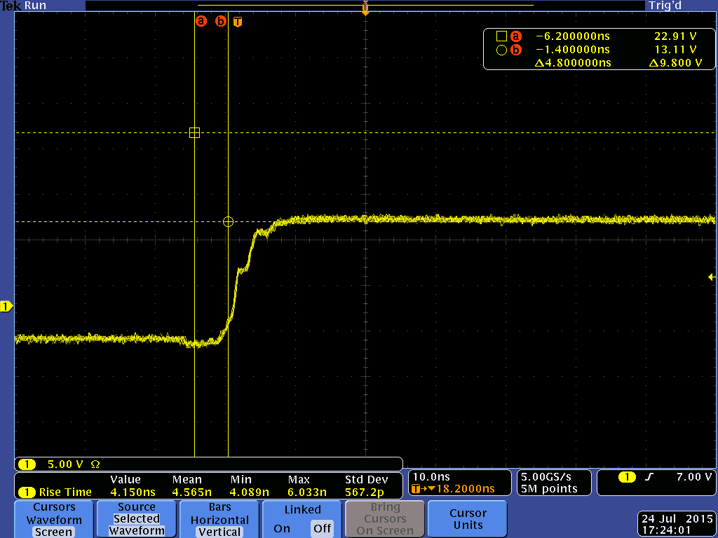
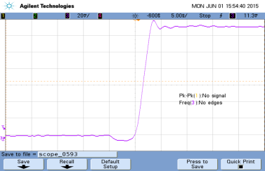
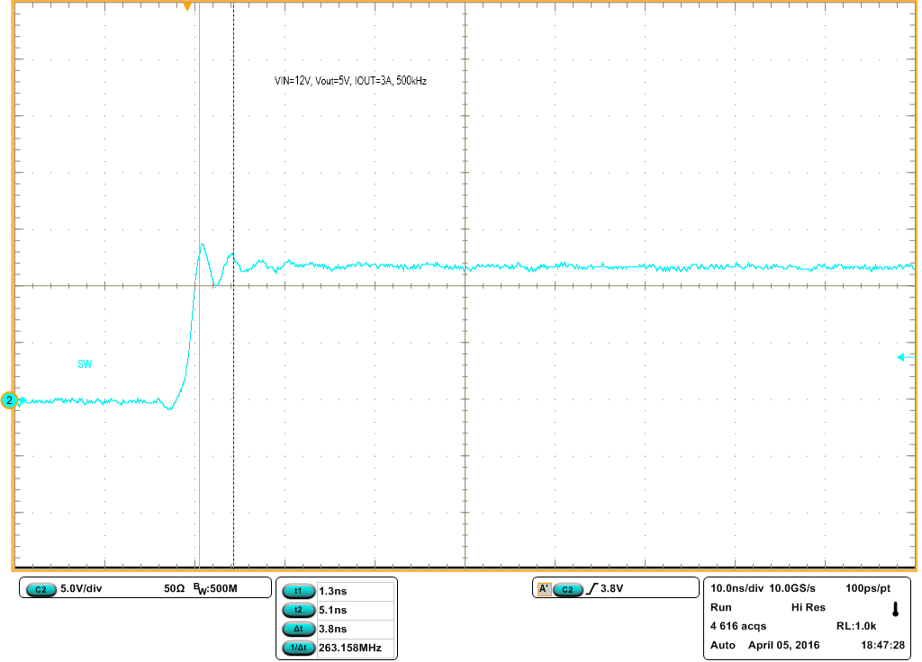
Which switch node am I?
FCOL
TSSOP Wirebond
LM53635
FCOL Hotrod
QFN Wirebond
FCOL

Slide 15
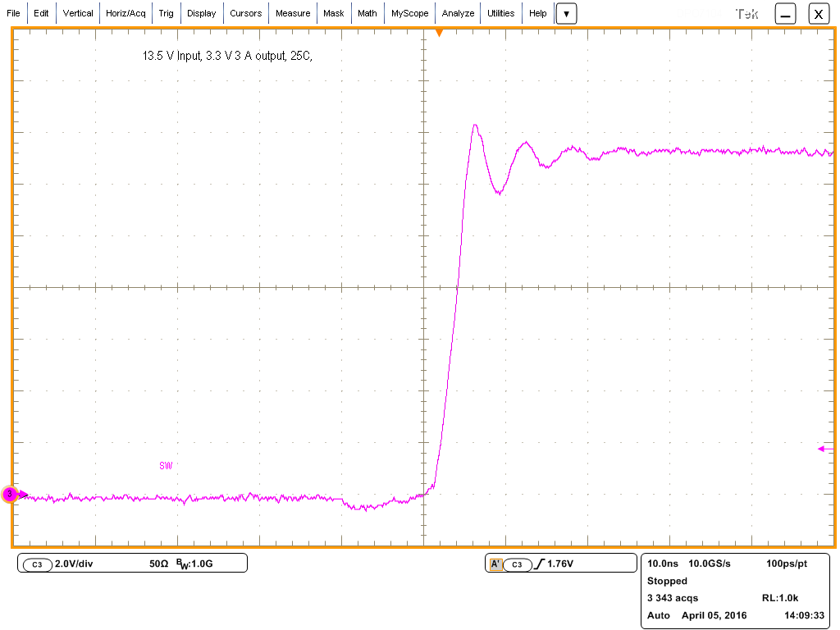
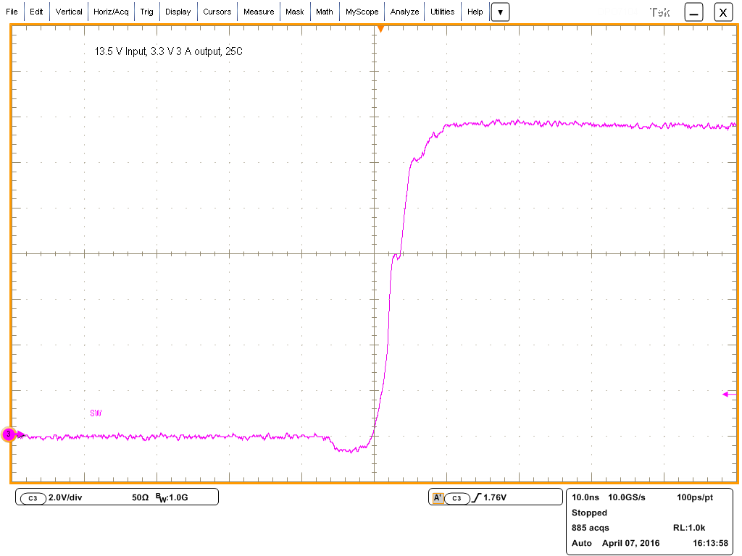
Not all switchers are equal: Switch Node Ringing
Competitor
VIN=13.5, IOUT=3A
Measured with 10ns / div, 2V/div Ringing observed at about 200MHz
LM53635
VIN=13.5, IOUT=3A
Measured with 10ns / div, 2V/div
Minimal ringing

Slide 16
Parallel input and output cap placement
Parallel capacitance loops minimize inductance
Minimizes switch node ringing
Minimizes output ripple
Make Mid-layer 1 as GND (keep close to top layer). Keep Mid-Layer1 GND intact underneath switch node

Slide 17
4 – Layer PCB EVM Stack-Up
LM53635x
GND
GND
SW
GND
Copper
2 oz.
1 oz.
1 oz.
2 oz.
0.4 mil
2.8 mil
10mil
1.4 mil
32 mil
1.4 mil
10 mil
2.8 mil
0.4 mil
Top Solder
Top Layer1
Dielectric1
Mid Layer2
Dielectric3
Mid Layer3
Dielectric2
Bottom Layer4
Bottom Solder
Dielectric1
Core
GND
Vias 8mil
Dielectric2

Slide 18
AGND Layout to minimize noise coupling
Do not bridge AGND pin to PGND under the chip!
If possible, connect AGND with PGND after VCC and BIAS caps

Slide 19
Thermals and layout

Slide 20
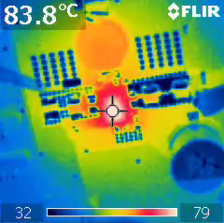
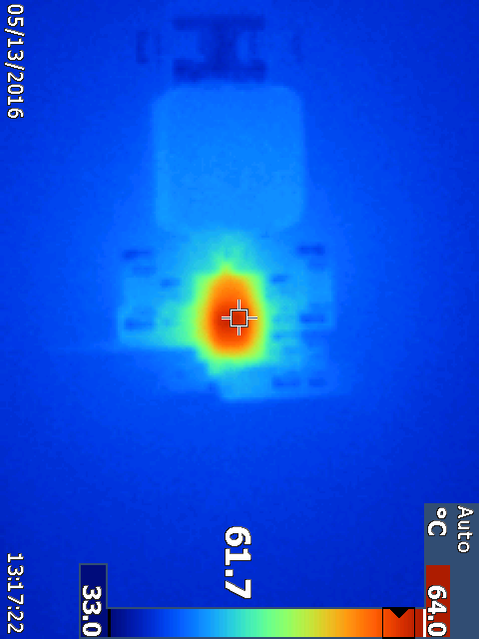
Thermal performance
Which Layout is better?
L
IC
Both boards measured at 13.5V VIN, 5V,3A VOUT
TI Confidential NDA Restrictions

Slide 21
Inductor hot. Not connected well to output copper
Thermal performance
Thermal “edges” caused by signal traces cutting top layer
L
IC
Both boards measured at 13.5V VIN, 5V,3A VOUT
TI Confidential NDA Restrictions

Slide 22
Thermal layout
Place numerous vias under the package for thermal relief.
Vias are also placed around CIN and GND areas for further thermal relief

Slide 23
Summary
Automotive Hotrod and Wettable Flanks
Big performance advantages with EMI and Efficiency
Qualified and ready to use!

Slide 24
Thank you
Silicon Valley Analog - Performance Regulator Solutions
Perry Tsao – Systems and Applications Manager
perry,tsao@ti.com

