Slide 1
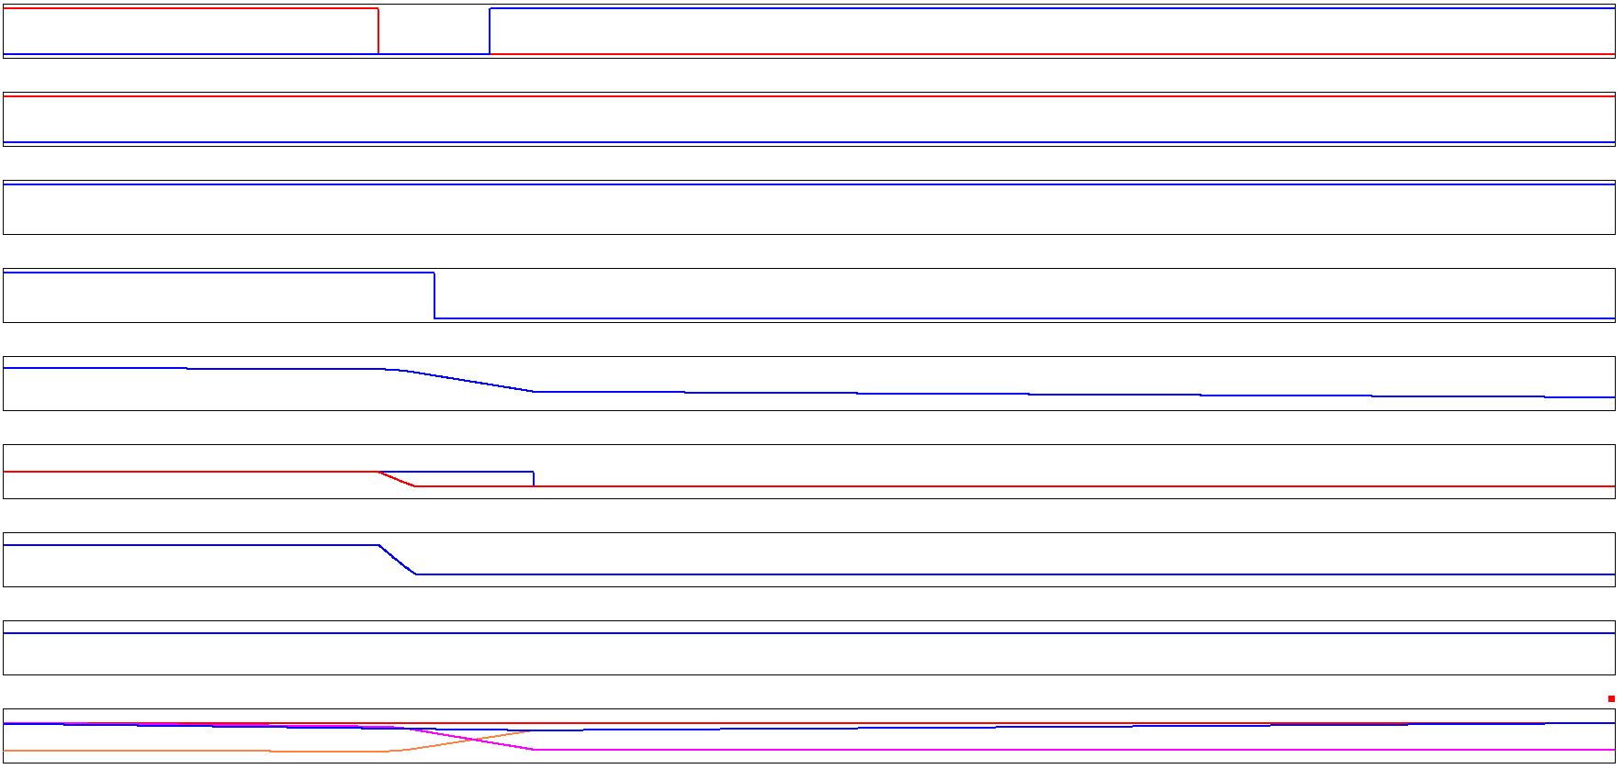
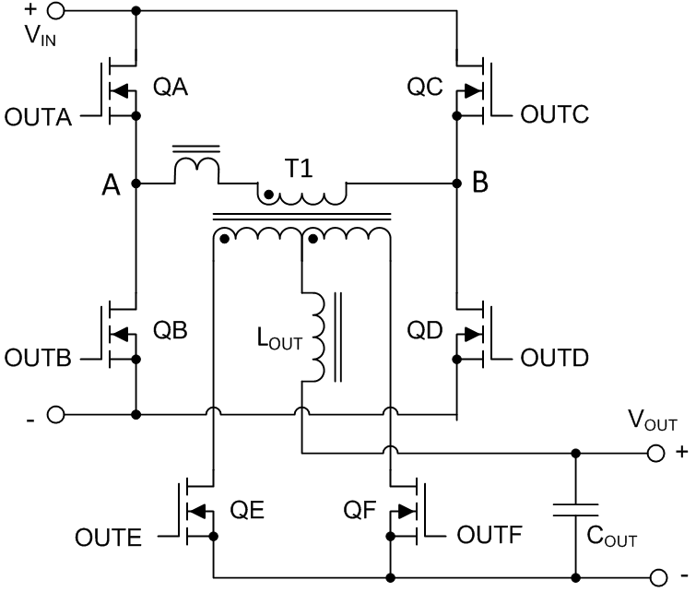

PA transition: 1
OUTA
OUTB
DELAB – allows time for node A transition
QA turns off
Initially
QA, QC, QE, QF are ON: others are OFF
T1 Pri and T1 Sec are s/c, V_{XFMR} = 0V
Then
QA turns OFF
Resonant transition at Node A. L_Leak and C_stray
OUTC
OUTD
OUTE
xfmr is s/c, L_lk energy drives transition
Slower than Node B transition, because less energy available.
OUTF
$$E= \frac{1}{2}{L_{Leak}\left[I_{mag_{pk}}+I_{LOUT}\frac{N_{s}}{N_{p}}\right]}^{2}$$
0A
V_XFMR
I_PRI
I_PRI starts to change direction.
V_PRI
V_XFMR
V_PRI
V_PRI is zero because sec is s/c.
0V
Leakage Inductance
I_PRI charges Node A to GND where it is clamped by body diode of QB. V_Xfmr appears across leakage inductance
V_A
0V
V_B
0V
I_OUT I_LOUT
I_QE I_QF
0A
I_QE increasing, I_QF decreasing
TI Information – Selective Disclosure
1

Slide 2
PA transition: 2
OUTA
OUTB
QC, QE, QF are ON: others are OFF
QA is OFF
Resonant transition is finished BUT Pri current is still reversing and Iout is moving out of QF and into QE
OUTC
OUTD
OUTE
OUTF
QF turned off after DELAF, QF current moves into body diode, sec remains s/c
0A
di/dt is V_XFMR / L_leak. Current reverses
V_XFMR
I_PRI
V_PRI
V_PRI is zero because sec is s/c. V_Xfmr appears across leakage inductance
0V
V_XFMR
V_PRI
Leakage Inductance
V_A
V_A clamped by body diode of QB.
0V
0V
V_B
I_OUT I_LOUT
I_QE I_QF
0A
TI Information – Selective Disclosure
2

Slide 3
PA transition: 3
OUTA
OUTB
QB turns on at 0V (ZVS)
QC, QE, QF are ON: others are OFF
T1 is short circuited by QE & QF so V_{XFMR} = 0V
Output current supplied by Lout
I_PRI is changing direction
QB current is initially in the body diode, must turn it on before I_Pri goes through zero and reverses.
I_Lout current moving out of QE and into QF
OUTC
OUTD
OUTE
OUTF
0A
di/dt is V_XFMR / L_leak. Current reverses
V_XFMR
I_PRI
V_PRI
V_PRI is zero because sec is s/c. V_Xfmr appears across leakage inductance
0V
V_XFMR
V_PRI
Leakage Inductance
V_A
0V
0V
V_B
I_OUT I_LOUT
I_QE I_QF
0A
TI Information – Selective Disclosure
3

Slide 4
PA transition: 4
OUTA
OUTB
QB turns on at 0V (ZVS)
QA, QC, QE, QF are ON: others are OFF
T1 Primary is short circuited, V_{XFMR} = 0V
T1 Sec is short circuited by QE & QF
Output current supplied by Lout
QA turns QB: turns ON
OUTC
OUTD
OUTE
OUTF
0A
Primary current reversal complete
V_XFMR
I_PRI
V_PRI
V_XFMR
V_PRI
0V
V_PRI increases to Vin as sec s/c released
Leakage Inductance
V_A
0V
0V
V_B
I_QF reaches zero, body diode turns off. Sec s/c is released. V_PRI increases to Vin
I_OUT I_LOUT
I_QE I_QF
0A
TI Information – Selective Disclosure
4

Slide 5

PA transition: Summary
OUTA
OUTB
DELAB – allows time for node A transition
Transition takes less time at higher currents. Controller can reduce the delay DELAB time at higher currents – Adaptive Delays
Remember, conditions for the positive going PA leg transition are the same as those for the negative going PA transition.
PA = Passive/Active
Resonant transition
Slower than AP transition, More difficult to achieve ZVS across load range because less energy available.
OUTC
OUTD
OUTE
$$E= \frac{1}{2}{L_{Leak}\left[I_{mag_{pk}}+I_{LOUT}\frac{N_{s}}{N_{p}}\right]}^{2}$$
OUTF
0A
V_XFMR
I_PRI
Neg and Pos going PA transitions are identical (just change polarity and swap QE and QF)
V_PRI
V_XFMR
V_PRI
0V
V_A
0V
0V
V_B
I_OUT I_LOUT
I_QE I_QF
0A
TI Information – Selective Disclosure
5

Slide 6
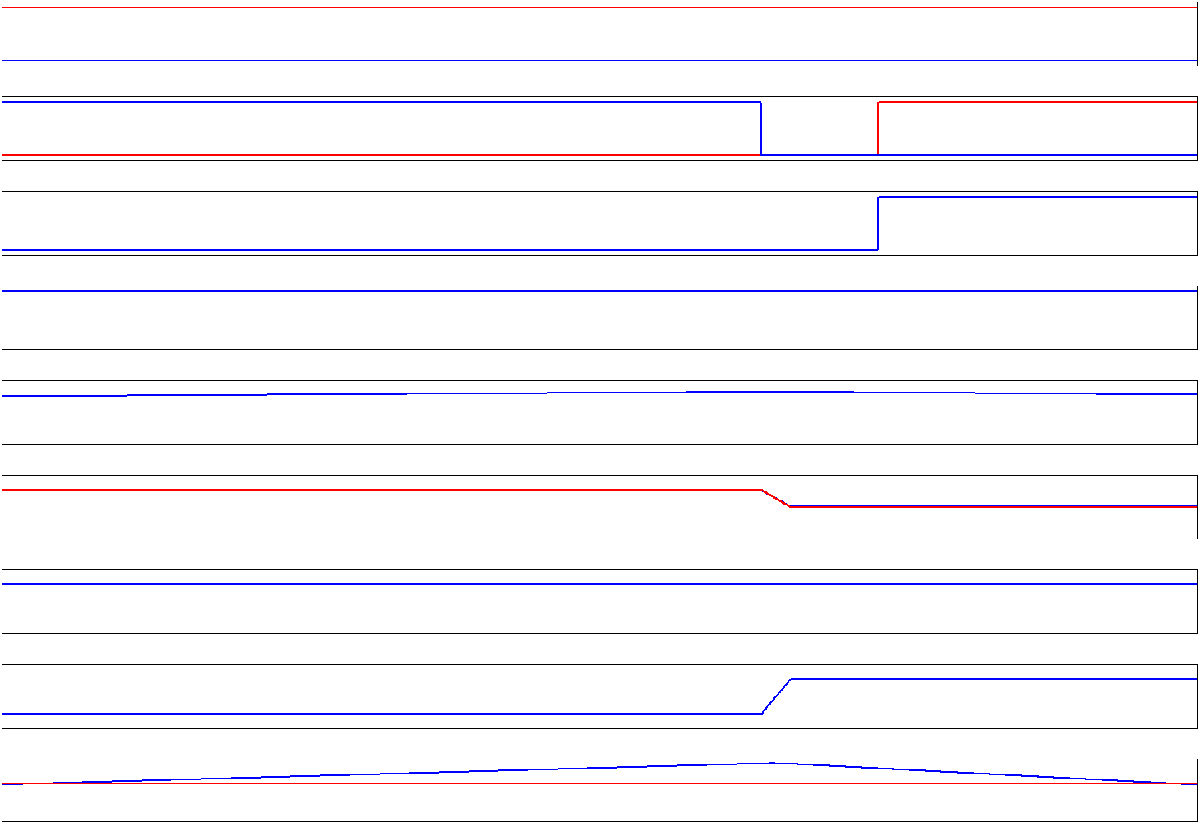

AP transition: 1
OUTA
OUTB
QD turns off
Initially
QA, QD, QF are ON: others are OFF
Then
QD turns OFF
Linear transition at Node B
OUTC
OUTD
DELCD – allows time for node B transition
OUTE
$$E= \frac{1}{2}{L_{Leak}\left[I_{mag_{pk}}+I_{LOUT}\frac{N_{s}}{N_{p}}\right]}^{2}\text{+ }\frac{1}{2}L_{OUT}{\left(\frac{N_{p}}{N_{s}}\right)}^{2}\text{∗}{\left(I_{LOUT}\frac{N_{s}}{N_{p}}\right)}^{2}\text{+ }\frac{1}{2}L_{mag}{I_{mag_{pk}}}^{2}$$
OUTF
xfmr is not s/c. Faster than Node A transition, because more energy available.
0A
I_PRI
V_XFMR
V_PRI
0V
V_XFMR
V_PRI
Xfmr windings are not s/c. V_XFMR ≈ V_PRI.
V_A
0V
I_PRI charges Node B to Vin where it is clamped by body diode of QC.
0V
V_B
I_OUT I_LOUT
>0A
TI Information – Selective Disclosure
6

Slide 7
AP transition: 2
OUTA
OUTB
Initially
QA, QD, QF are ON: others are OFF
Then
QC and QE turn on at same time
I pri continues to flow in Pri, QA, QC loop
I_OUT supplied by Lout.
Current flows asymmetrically in T1 Sec – previous slides
OUTC
OUTD
QC and QE turn on at same time: Xfmr is s/c
OUTE
OUTF
0A
I_PRI
I_PRI does not change direction.
V_XFMR
V_PRI
0V
V_XFMR
V_PRI
Xfmr windings are s/c when QE turns on.
V_A
0V
V_B
Node B is clamped by body diode of QC.
0V
I_OUT I_LOUT
>0A
I_LOUT continues to flow in same SR (QE or QF).
TI Information – Selective Disclosure
7

Slide 8
AP transition: Summary
OUTA
OUTB
DELCD – allows time for node B transition
Transition takes less time at higher currents. Controller can reduce the delay DELCD time at higher currents – Adaptive Delays
Remember, conditions for the positive going AP leg transition are the same as those for the negative going AP transition.
AP = Active/Passive
Resonant transition
Faster than PA transition, Easier to achieve ZVS across load range because moreenergy available.
OUTC
OUTD
OUTE
$$E= \frac{1}{2}{L_{Leak}\left[I_{mag_{pk}}+I_{LOUT}\frac{N_{s}}{N_{p}}\right]}^{2}\text{+ }\frac{1}{2}L_{OUT}{\left(\frac{N_{p}}{N_{s}}\right)}^{2}\text{∗}{\left(I_{LOUT}\frac{N_{s}}{N_{p}}\right)}^{2}\text{+ }\frac{1}{2}L_{mag}{I_{mag_{pk}}}^{2}$$
OUTF
0A
I_PRI
V_XFMR
Neg and Pos going AP transitions are identical (just change polarity and swap QE and QF)
V_PRI
0V
V_XFMR
V_PRI
V_A
0V
0V
V_B
I_OUT I_LOUT
>0A
TI Information – Selective Disclosure
8

Slide 9
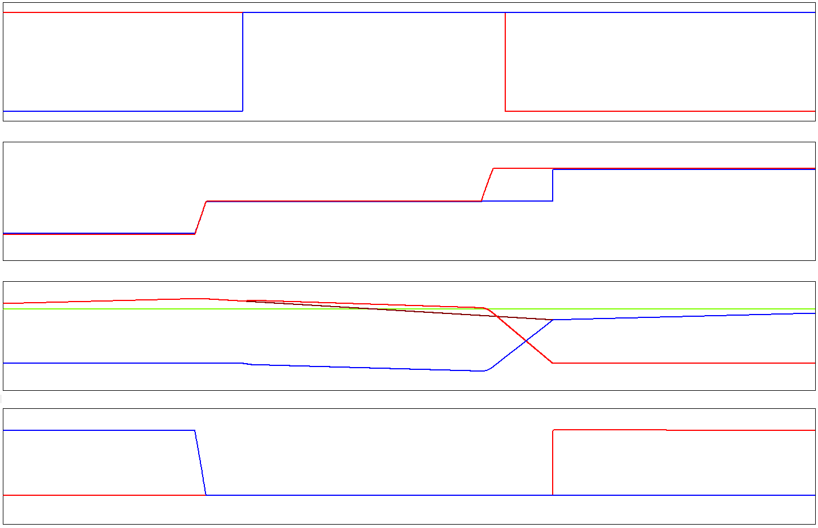
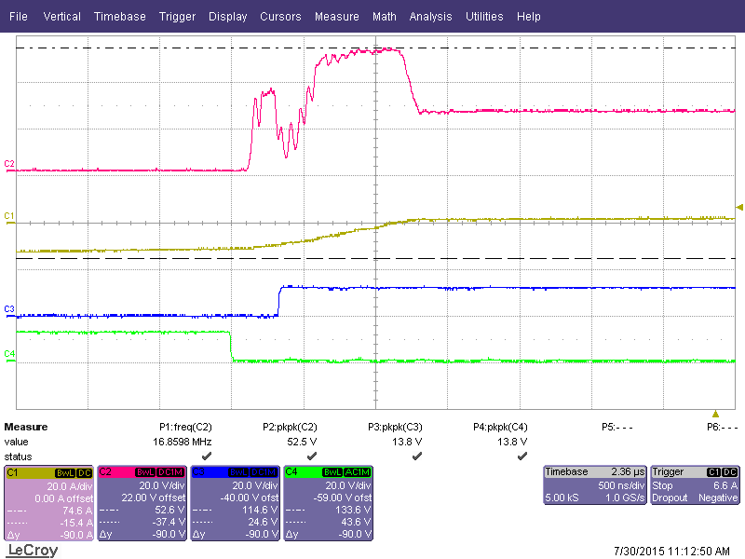
SR Transitions:
PA = Passive/Active
Current has to transfer out of one SR into the other.
Takes time – current ramps up in one and down in the other.
SRs always switch with zero volts.
SR turns off before current goes negative (VERY important)
DELBE associated with positive transition at PA leg
DELAF associated with negative transition at PA leg
DELBE = DELAF
OUTE
OUTF
QE turns off after DELBE
0V
QB turns off
0V
V_PRI
V_XFMR
QE body diode conduction
SR current will go negative and be carried in Channel if SR not turned off. Destructive voltage spike if SR turned off with neg current
I_LOUT
I_OUT
I_QE
I_QF
Note unequal current sharing , I_QE and I_QF
See: Timing Diagram: 3
0A
Yel: I_LOUT
Red: Vds SR
Blu: OUTC
Grn: OUTF
V_QE
V_QF
QE current will go negative* if channel not off by here
0V
* Negative current means from drain to source.
TI Information – Selective Disclosure
9

Slide 10
SR Transitions:
PA = Passive/Active
DELBE (and DELAF) – allow time for node transition.
Ideally SR turned OFF after Pri ZVS and before SR current goes negative (from drain to source).
Turning OFF too soon, increased body diode conduction
Turn OFF too late, reversed current in MOSFET, avalanching and MOSFET destruction likely.
Transition takes more time at higher currents. Controller can increase the delay time at higher currents to reduce body diode conduction time – Adaptive Delays
Remember, conditions for the positive going PA leg transition are the same as those for the negative going PA transition
OUTE
OUTF
QE turns off after DELBE
0V
QB turns off
0V
V_PRI
V_XFMR
QE body diode conduction
I_LOUT
I_OUT
I_QE
I_QF
Note unequal current sharing , I_QE and I_QF
See: Timing Diagram: 3
0A
V_QE
V_QF
QE current will go negative* if channel not off by here
0V
TI Information – Selective Disclosure
10

Slide 11
SR Transitions:
AP = Active/Passive
SRs see ZVS at AP transition
SR turn on is co-incident with primary side switch
OUTD/OUTF and OUTC/OUTE
Primary of transformer is S/C by OUTD/OUTB or OUTA/OUTC
Secondary of transformer is S/C by OUTE and OUTF
Transition takes more time at higher currents. Controller can increase the delay time at higher currents – Adaptive Delays
Remember, conditions for the positive going PA leg transition
OUTE
OUTF
OUTF and OUTD turn on at same time
0V
0V
V_PRI
V_XFMR
I_LOUT
I_OUT
I_QE
I_QF
0A
V_{DS} is 0 at SR turn-on
V_QE
V_QF
0V
TI Information – Selective Disclosure
11

Slide 12
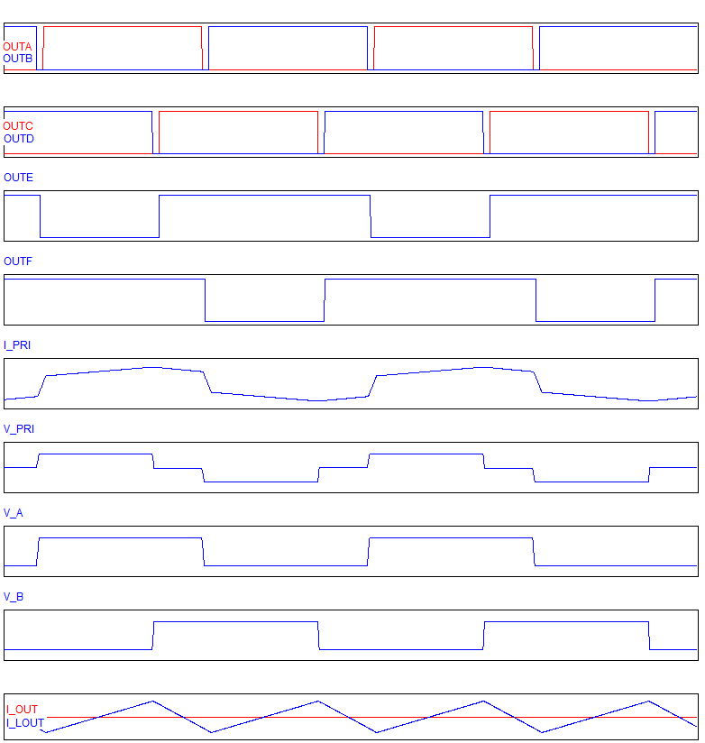
Duty cycle loss:
Energy is transferred from primary to secondary during the transformer ‘ON’ time (green).
The energy needed to drive the load current during the transformer ‘OFF’ time is supplied by the output inductor.
The time needed to achieve the ZVS transition in the PA leg (Node A or Left hand leg) adds to the ‘OFF’ time. And sets a maximum duty cycle.
There is a trade off between this time and the leakage inductance needed to achieve ZVS. Not a critical problem at 100kHz but will be come worse as frequency increase.
0A
0V
0V
0V
>0A
TI Information – Selective Disclosure
12

