Slide 1
TPS63802 Voltage Dropout when 2Amp

Slide 2
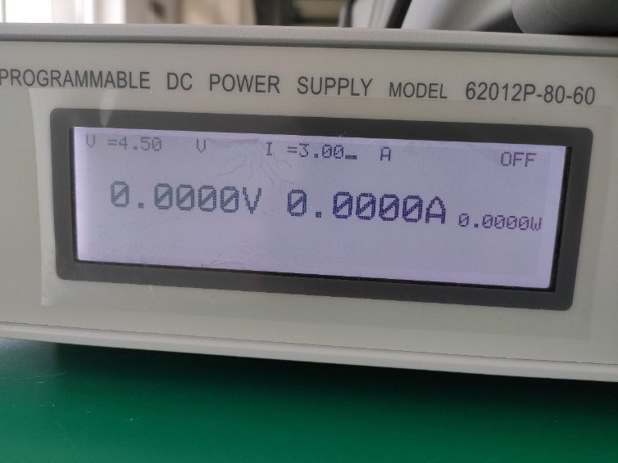
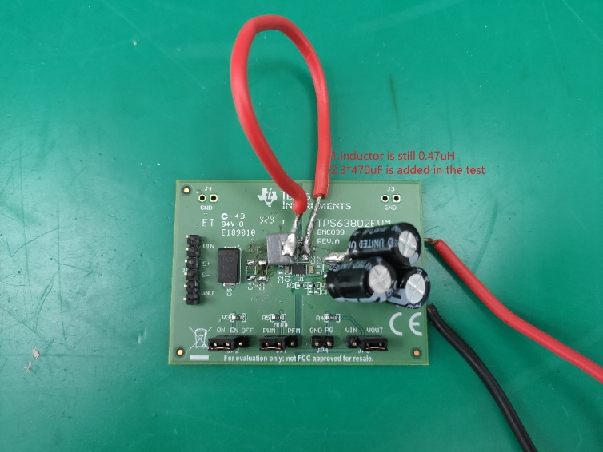
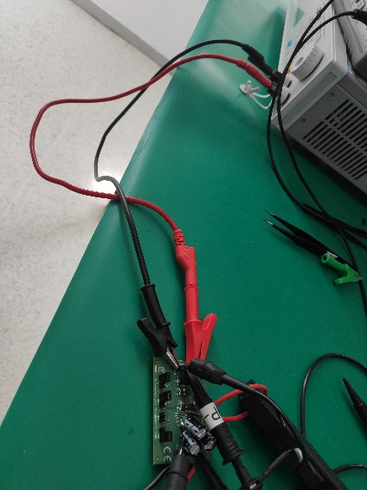
Test condition
DC source
Cable from source to board
EVM board
Notes:
When studying a converter schematic prior to PCB layout, it’s often convenient to highlight the high current traces, the high dv/dt circuit nodes, and the noise-sensitive nets as shown in this slide. This example shows a voltage-mode controlled regulator intended for noise-sensitive communications applications that uses TI’s LM5145 100V synchronous buck controller.
Various noise reduction features integrated in the LM5145 include external clock synchronization, internal oscillator. Pulse skipping at light loads is inhibited during synchronization or when the SYNCIN pin is pulled low to reduce noise and RF interference. For added reliability, the LM5145 is rated for negative SW and gate drive transients of -5V up to 20ns duration.

Slide 3
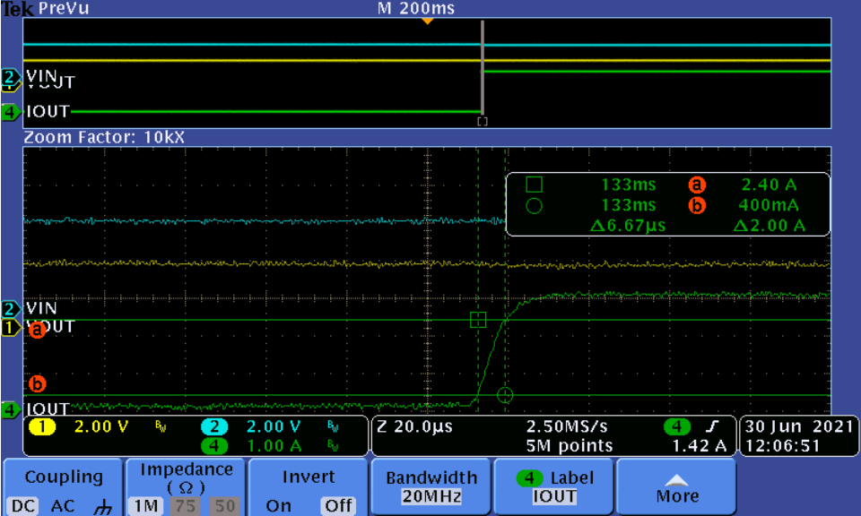
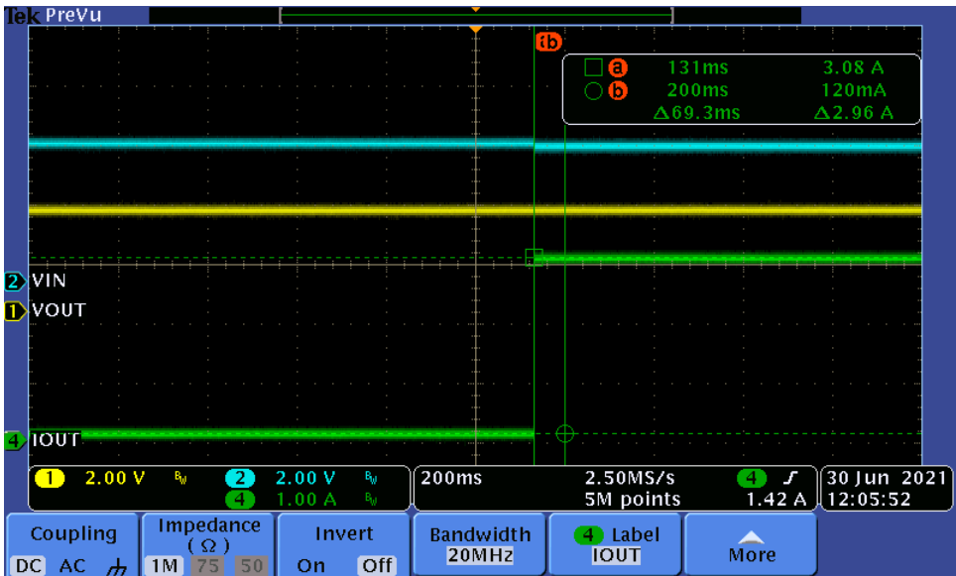
Test results transient from 100mA to 3A with 0.3A/us
Zoom In
Result:
Almost without dropout of input and output
Notes:
When studying a converter schematic prior to PCB layout, it’s often convenient to highlight the high current traces, the high dv/dt circuit nodes, and the noise-sensitive nets as shown in this slide. This example shows a voltage-mode controlled regulator intended for noise-sensitive communications applications that uses TI’s LM5145 100V synchronous buck controller.
Various noise reduction features integrated in the LM5145 include external clock synchronization, internal oscillator. Pulse skipping at light loads is inhibited during synchronization or when the SYNCIN pin is pulled low to reduce noise and RF interference. For added reliability, the LM5145 is rated for negative SW and gate drive transients of -5V up to 20ns duration.

Slide 4
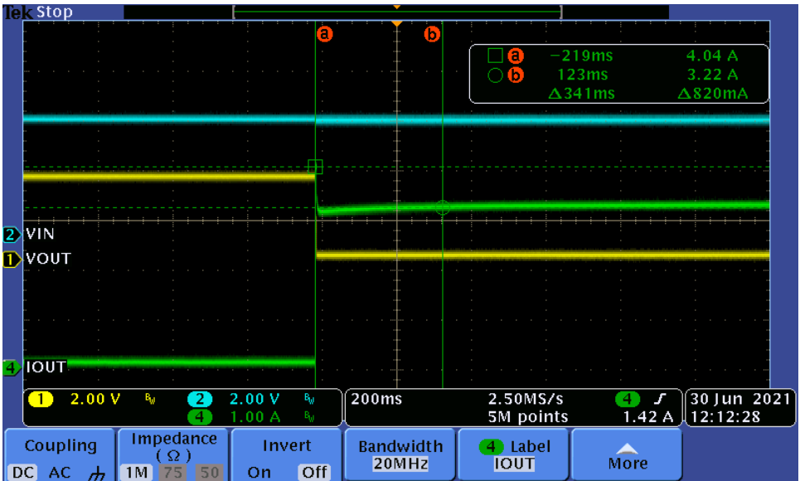
Test results transient from 100mA to 4A with 0.3A/us
Result:
Voltage drop for current limit, but input voltage is stable.
Notes:
When studying a converter schematic prior to PCB layout, it’s often convenient to highlight the high current traces, the high dv/dt circuit nodes, and the noise-sensitive nets as shown in this slide. This example shows a voltage-mode controlled regulator intended for noise-sensitive communications applications that uses TI’s LM5145 100V synchronous buck controller.
Various noise reduction features integrated in the LM5145 include external clock synchronization, internal oscillator. Pulse skipping at light loads is inhibited during synchronization or when the SYNCIN pin is pulled low to reduce noise and RF interference. For added reliability, the LM5145 is rated for negative SW and gate drive transients of -5V up to 20ns duration.

Slide 5
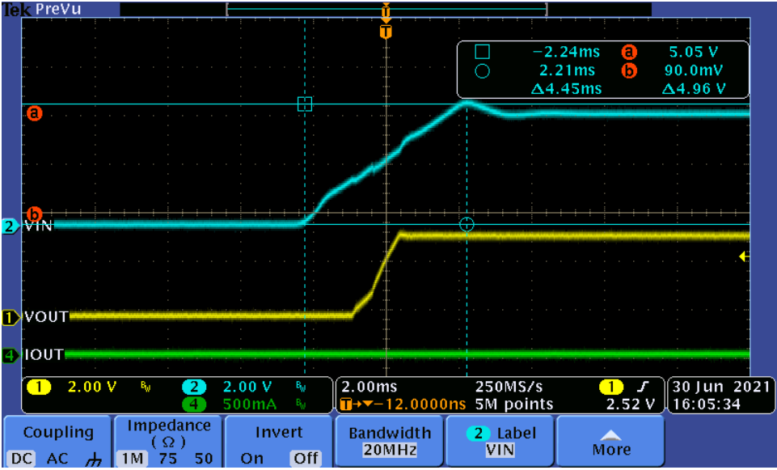
Test results start up by power Iout=0
Notes:
When studying a converter schematic prior to PCB layout, it’s often convenient to highlight the high current traces, the high dv/dt circuit nodes, and the noise-sensitive nets as shown in this slide. This example shows a voltage-mode controlled regulator intended for noise-sensitive communications applications that uses TI’s LM5145 100V synchronous buck controller.
Various noise reduction features integrated in the LM5145 include external clock synchronization, internal oscillator. Pulse skipping at light loads is inhibited during synchronization or when the SYNCIN pin is pulled low to reduce noise and RF interference. For added reliability, the LM5145 is rated for negative SW and gate drive transients of -5V up to 20ns duration.

Slide 6
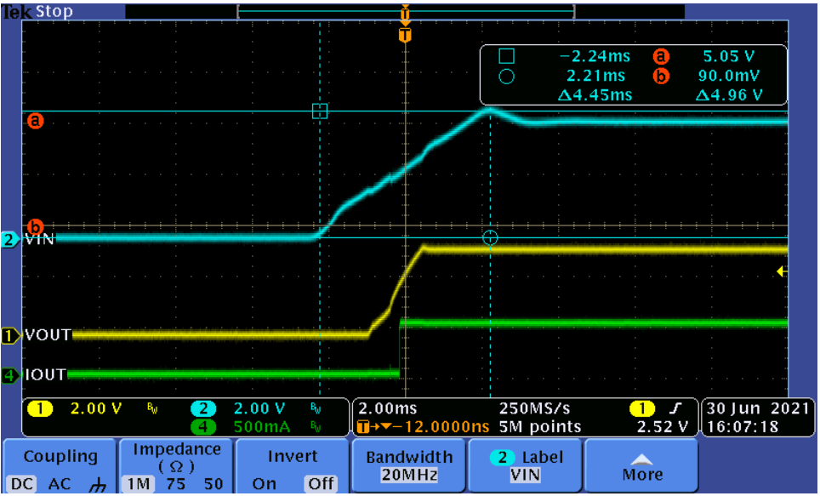
Test results start up by power Iout=0.5
Notes:
When studying a converter schematic prior to PCB layout, it’s often convenient to highlight the high current traces, the high dv/dt circuit nodes, and the noise-sensitive nets as shown in this slide. This example shows a voltage-mode controlled regulator intended for noise-sensitive communications applications that uses TI’s LM5145 100V synchronous buck controller.
Various noise reduction features integrated in the LM5145 include external clock synchronization, internal oscillator. Pulse skipping at light loads is inhibited during synchronization or when the SYNCIN pin is pulled low to reduce noise and RF interference. For added reliability, the LM5145 is rated for negative SW and gate drive transients of -5V up to 20ns duration.

Slide 7
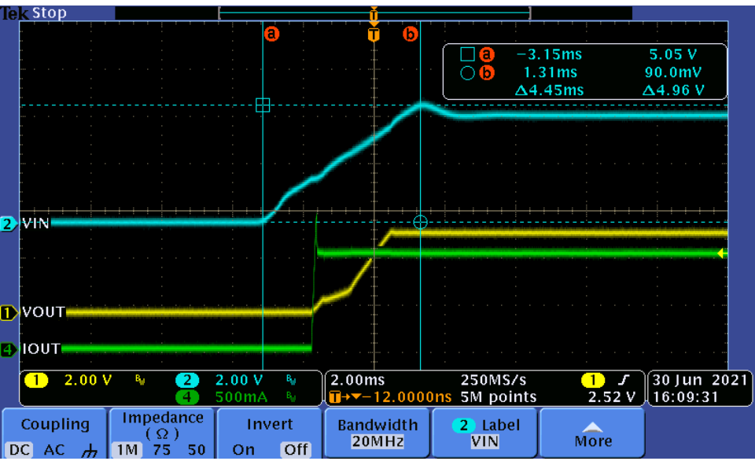
Test results start up by power Iout=1
Notes:
When studying a converter schematic prior to PCB layout, it’s often convenient to highlight the high current traces, the high dv/dt circuit nodes, and the noise-sensitive nets as shown in this slide. This example shows a voltage-mode controlled regulator intended for noise-sensitive communications applications that uses TI’s LM5145 100V synchronous buck controller.
Various noise reduction features integrated in the LM5145 include external clock synchronization, internal oscillator. Pulse skipping at light loads is inhibited during synchronization or when the SYNCIN pin is pulled low to reduce noise and RF interference. For added reliability, the LM5145 is rated for negative SW and gate drive transients of -5V up to 20ns duration.

Slide 8
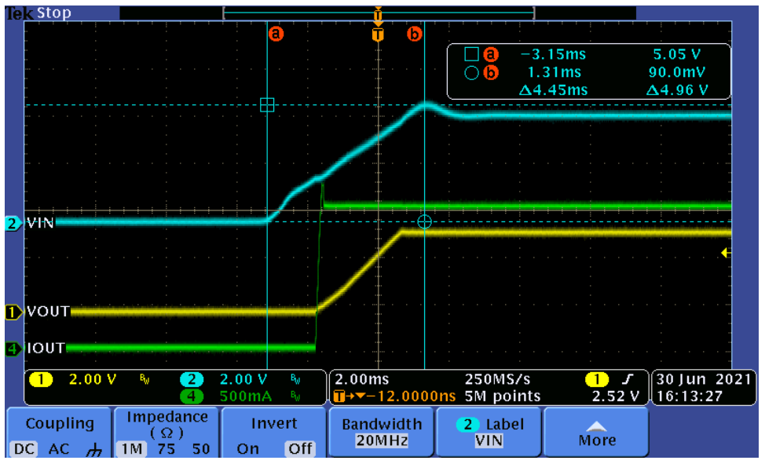
Test results start up by power Iout=1.5
Notes:
When studying a converter schematic prior to PCB layout, it’s often convenient to highlight the high current traces, the high dv/dt circuit nodes, and the noise-sensitive nets as shown in this slide. This example shows a voltage-mode controlled regulator intended for noise-sensitive communications applications that uses TI’s LM5145 100V synchronous buck controller.
Various noise reduction features integrated in the LM5145 include external clock synchronization, internal oscillator. Pulse skipping at light loads is inhibited during synchronization or when the SYNCIN pin is pulled low to reduce noise and RF interference. For added reliability, the LM5145 is rated for negative SW and gate drive transients of -5V up to 20ns duration.

Slide 9
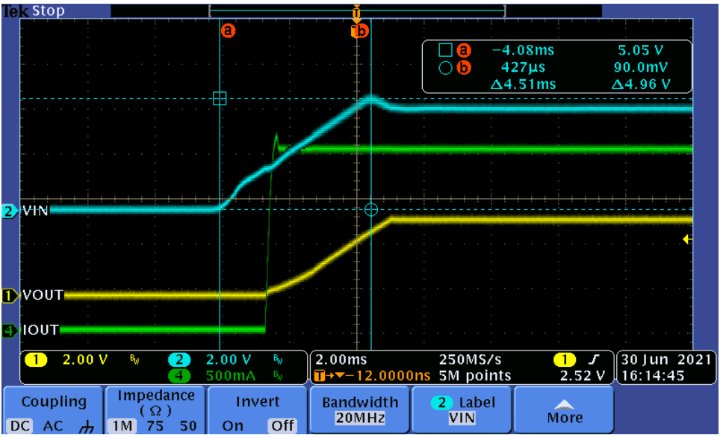
Test results start up by power Iout=2
Notes:
When studying a converter schematic prior to PCB layout, it’s often convenient to highlight the high current traces, the high dv/dt circuit nodes, and the noise-sensitive nets as shown in this slide. This example shows a voltage-mode controlled regulator intended for noise-sensitive communications applications that uses TI’s LM5145 100V synchronous buck controller.
Various noise reduction features integrated in the LM5145 include external clock synchronization, internal oscillator. Pulse skipping at light loads is inhibited during synchronization or when the SYNCIN pin is pulled low to reduce noise and RF interference. For added reliability, the LM5145 is rated for negative SW and gate drive transients of -5V up to 20ns duration.

Slide 10
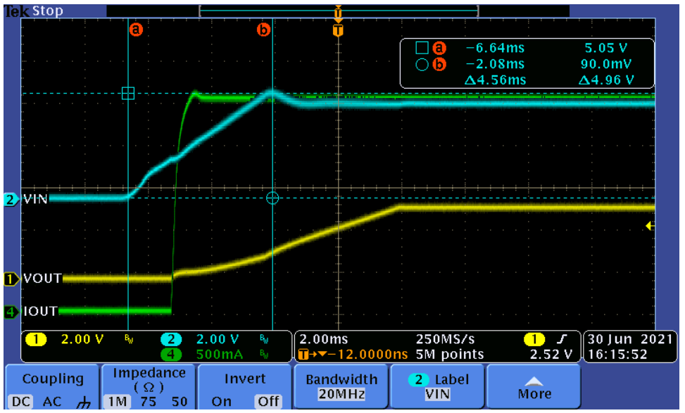
Test results start up by power Iout=2.5
Notes:
When studying a converter schematic prior to PCB layout, it’s often convenient to highlight the high current traces, the high dv/dt circuit nodes, and the noise-sensitive nets as shown in this slide. This example shows a voltage-mode controlled regulator intended for noise-sensitive communications applications that uses TI’s LM5145 100V synchronous buck controller.
Various noise reduction features integrated in the LM5145 include external clock synchronization, internal oscillator. Pulse skipping at light loads is inhibited during synchronization or when the SYNCIN pin is pulled low to reduce noise and RF interference. For added reliability, the LM5145 is rated for negative SW and gate drive transients of -5V up to 20ns duration.

Slide 11
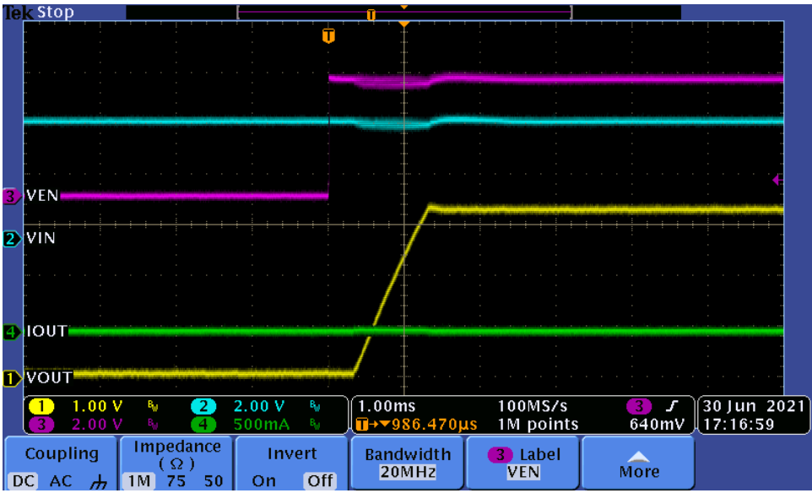
Test results start up by EN Iout=0
Notes:
When studying a converter schematic prior to PCB layout, it’s often convenient to highlight the high current traces, the high dv/dt circuit nodes, and the noise-sensitive nets as shown in this slide. This example shows a voltage-mode controlled regulator intended for noise-sensitive communications applications that uses TI’s LM5145 100V synchronous buck controller.
Various noise reduction features integrated in the LM5145 include external clock synchronization, internal oscillator. Pulse skipping at light loads is inhibited during synchronization or when the SYNCIN pin is pulled low to reduce noise and RF interference. For added reliability, the LM5145 is rated for negative SW and gate drive transients of -5V up to 20ns duration.

Slide 12
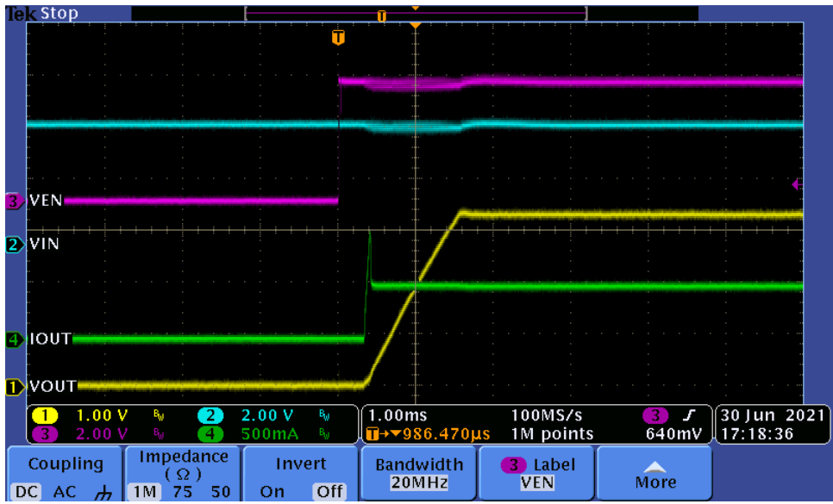
Test results start up by EN Iout=0.5
Notes:
When studying a converter schematic prior to PCB layout, it’s often convenient to highlight the high current traces, the high dv/dt circuit nodes, and the noise-sensitive nets as shown in this slide. This example shows a voltage-mode controlled regulator intended for noise-sensitive communications applications that uses TI’s LM5145 100V synchronous buck controller.
Various noise reduction features integrated in the LM5145 include external clock synchronization, internal oscillator. Pulse skipping at light loads is inhibited during synchronization or when the SYNCIN pin is pulled low to reduce noise and RF interference. For added reliability, the LM5145 is rated for negative SW and gate drive transients of -5V up to 20ns duration.

Slide 13
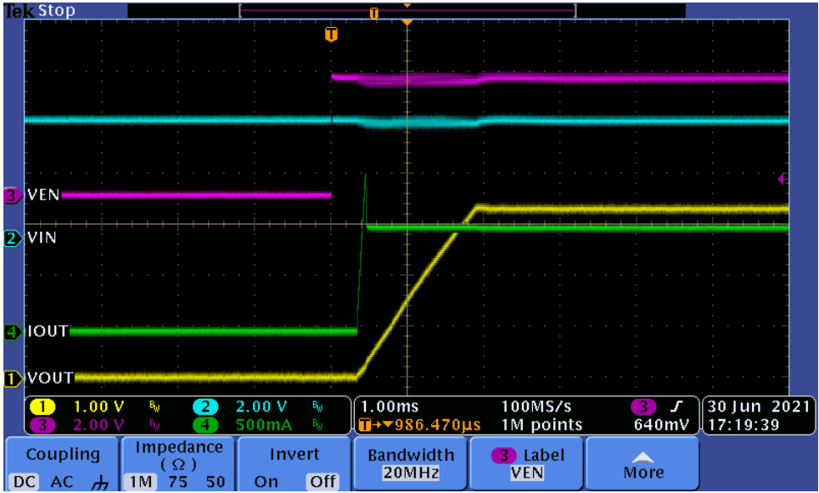
Test results start up by EN Iout=1
Notes:
When studying a converter schematic prior to PCB layout, it’s often convenient to highlight the high current traces, the high dv/dt circuit nodes, and the noise-sensitive nets as shown in this slide. This example shows a voltage-mode controlled regulator intended for noise-sensitive communications applications that uses TI’s LM5145 100V synchronous buck controller.
Various noise reduction features integrated in the LM5145 include external clock synchronization, internal oscillator. Pulse skipping at light loads is inhibited during synchronization or when the SYNCIN pin is pulled low to reduce noise and RF interference. For added reliability, the LM5145 is rated for negative SW and gate drive transients of -5V up to 20ns duration.

Slide 14
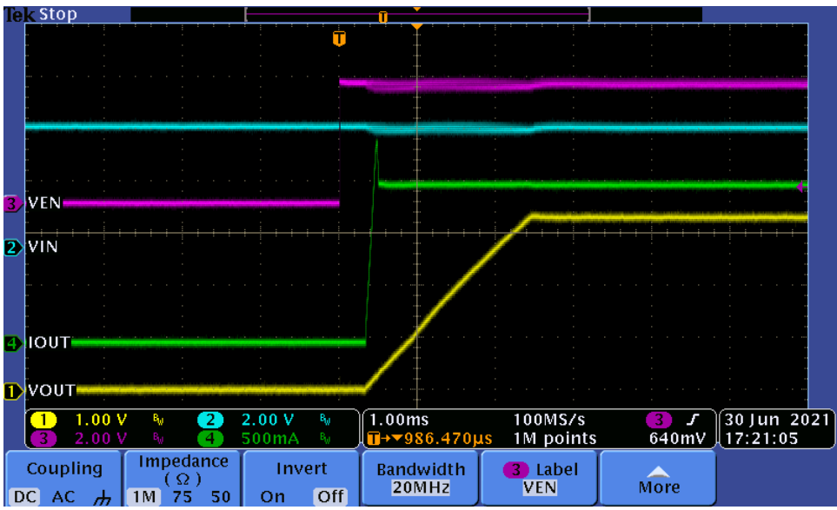
Test results start up by EN Iout=1.5
Notes:
When studying a converter schematic prior to PCB layout, it’s often convenient to highlight the high current traces, the high dv/dt circuit nodes, and the noise-sensitive nets as shown in this slide. This example shows a voltage-mode controlled regulator intended for noise-sensitive communications applications that uses TI’s LM5145 100V synchronous buck controller.
Various noise reduction features integrated in the LM5145 include external clock synchronization, internal oscillator. Pulse skipping at light loads is inhibited during synchronization or when the SYNCIN pin is pulled low to reduce noise and RF interference. For added reliability, the LM5145 is rated for negative SW and gate drive transients of -5V up to 20ns duration.

Slide 15
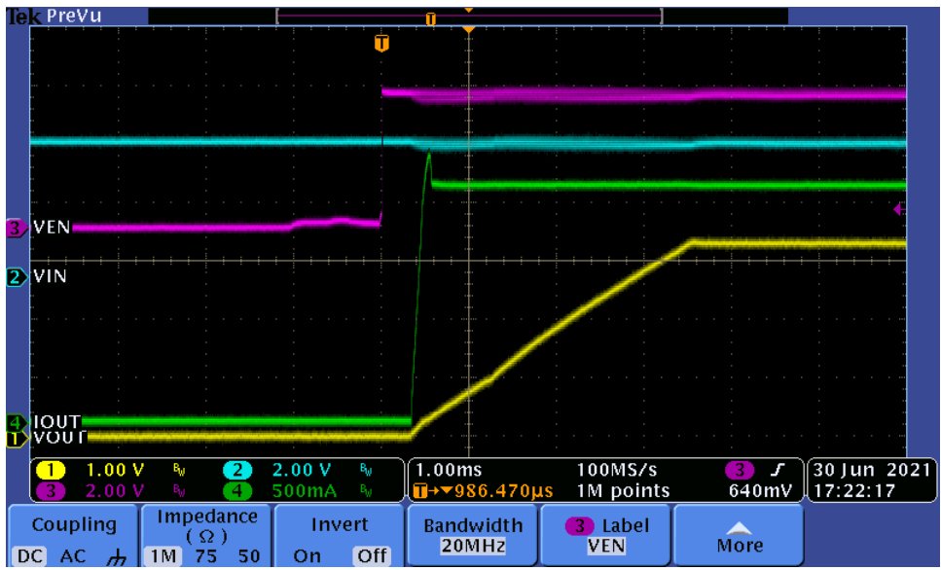
Test results start up by EN Iout=2
Notes:
When studying a converter schematic prior to PCB layout, it’s often convenient to highlight the high current traces, the high dv/dt circuit nodes, and the noise-sensitive nets as shown in this slide. This example shows a voltage-mode controlled regulator intended for noise-sensitive communications applications that uses TI’s LM5145 100V synchronous buck controller.
Various noise reduction features integrated in the LM5145 include external clock synchronization, internal oscillator. Pulse skipping at light loads is inhibited during synchronization or when the SYNCIN pin is pulled low to reduce noise and RF interference. For added reliability, the LM5145 is rated for negative SW and gate drive transients of -5V up to 20ns duration.

Slide 16
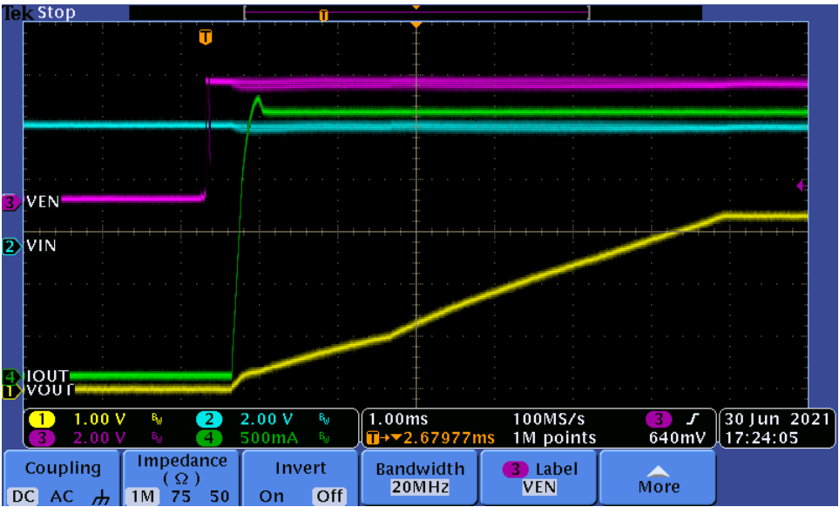
Test results start up by EN Iout=2.5
Notes:
When studying a converter schematic prior to PCB layout, it’s often convenient to highlight the high current traces, the high dv/dt circuit nodes, and the noise-sensitive nets as shown in this slide. This example shows a voltage-mode controlled regulator intended for noise-sensitive communications applications that uses TI’s LM5145 100V synchronous buck controller.
Various noise reduction features integrated in the LM5145 include external clock synchronization, internal oscillator. Pulse skipping at light loads is inhibited during synchronization or when the SYNCIN pin is pulled low to reduce noise and RF interference. For added reliability, the LM5145 is rated for negative SW and gate drive transients of -5V up to 20ns duration.

Slide 17
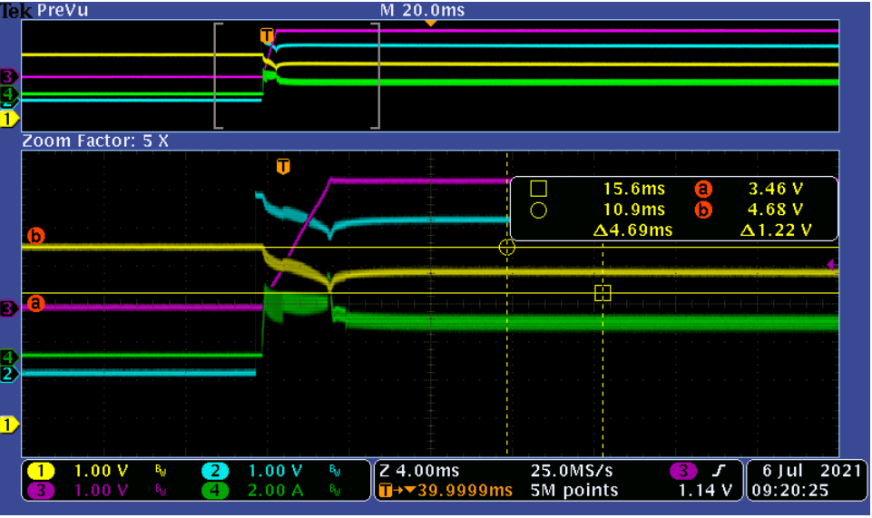
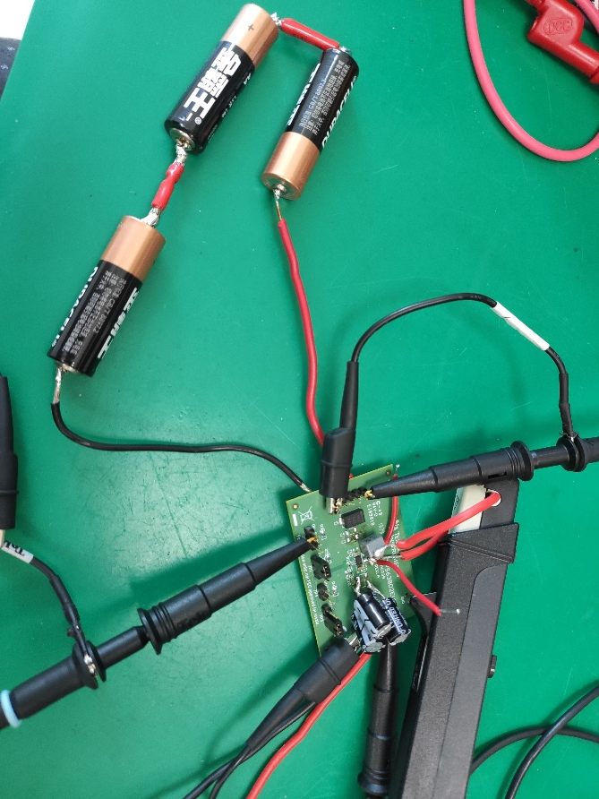
Test results start up by EN Iout=2 power by 3*AA battery
CH1:Input CH2:EN CH3:Output CH4:IL
Notes:
When studying a converter schematic prior to PCB layout, it’s often convenient to highlight the high current traces, the high dv/dt circuit nodes, and the noise-sensitive nets as shown in this slide. This example shows a voltage-mode controlled regulator intended for noise-sensitive communications applications that uses TI’s LM5145 100V synchronous buck controller.
Various noise reduction features integrated in the LM5145 include external clock synchronization, internal oscillator. Pulse skipping at light loads is inhibited during synchronization or when the SYNCIN pin is pulled low to reduce noise and RF interference. For added reliability, the LM5145 is rated for negative SW and gate drive transients of -5V up to 20ns duration.

