Slide 1

Load Share Control using the UCC29002
Colin Gillmor: colingillmor@ti.com
TI Information – Selective Disclosure

Slide 2
Load Share Control using the UCC29002
Part 1: Parallel Operation
Part 2: Introduction to the UCC29002
Part 3: How does the UCC29002 work
Part 4: Using the UCC29002
Differences between the UCC29002 and UCC29002/1
Part 5: Accuracy
Part 6: Typical Application
TI Information – Selective Disclosure

Slide 3
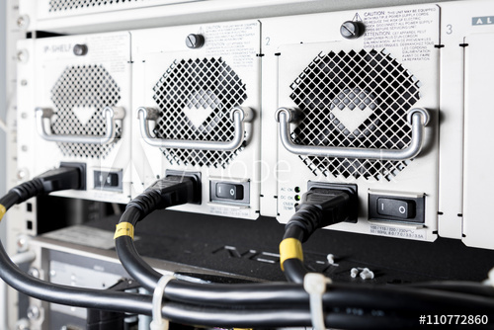
Parallel Operation: How is it done ?
Several Options exist
Operation in Current Limit
Droop Regulation with Vo Trimming
Master / Slave
Democratic Master / Slave –
  Loadshare Bus
  Using the UCC29002
“Power Module” = PSU
Multiple Power Modules feed a Single Load
TI Information – Selective Disclosure

Slide 4
Load Sharing
Parallel Operation for N+1 redundancy –
Improved Reliability
Improved Lifetime
Longer mean time between failures
Improved system availability
Cooling
Losses distributed over a number of sources
Load may be too big for a single PSU
System expansion
Easy to add extra modules
“Power Module” = PSU
Multiple Power Modules feed a Single Load
TI Information – Selective Disclosure

Slide 5
Load Sharing
Load-sharing is: Equal current in all Modules
I_{O1} = I_{O2} = I_{O3}
Example: 60A Load, With Load-sharing
3 Modules in parallel, (each with I_{LIMIT} = 33A)
60A = 20A + 20A + 20A
If a Module fails: 60A = 30A + 30A +0A – load is shared
ΔI_{O} = 10A (20A increases to 30A)
Example: 60A Load, Without Load-sharing
60A = 33A + 20A + 7A
33A = current limit, 7A = light load
If a Module fails: 60A = 33A + 27A – load is not shared
ΔI_{O} = 20A (7A to 27A)
Multiple Power Modules* feed a Single Load
TI Information – Selective Disclosure

Slide 6
Load Regulation
Basic system has:
A Voltage Source V_{O}
V_{L} reduces as the load increases (Load Regulation)
Load regulation line
V_{L} / I_{L}
Typical Load Regulation Spec
  140mV 0A to 100A (0.5%)
  1kW, 24Vout
Current Limit
TI Information – Selective Disclosure
6

Slide 7
Current Sharing, Two Sources
Both sources supply current into a single load
Current will not share equally
Load regulation lines differ (slope and offset)
Operating points differ, I_{O1} ≠ I_{O2}
Vo at No Load = Offset
Load regulation lines V_{O} / I_{O}
Load Reg =Slope
V_{O1} = V_{O2} = V_{L}
Extreme case:
One source goes into I_{Lim}
Other source supplies rest of current
I_{O1} ≠ I_{O2}
How do we get I_{O1} = I_{O2} ?
TI Information – Selective Disclosure
7

Slide 8
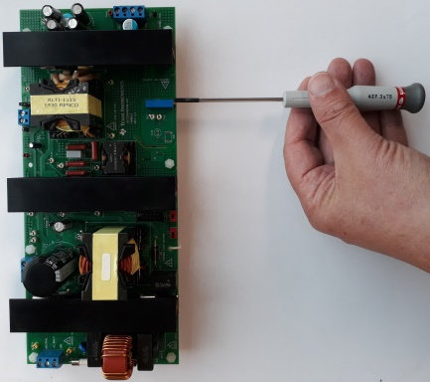
Current Sharing, Two Sources
Adjust the output voltage of the Modules
Current shares equally but only at one load
Load regulation lines
V_{O} / I_{O}
Trim V_{O1} or V_{O2} so that I_{O1} = I_{O2}
I_{O1} = I_{O2}
TI Information – Selective Disclosure
8

Slide 9
Current Sharing, Two Sources
If Load changes
Current sharing is lost
Re-trim required
Open Loop system – no feedback
Load regulation lines
V_{O} / I_{O}
When Load Changes
V_{L} changes and I_{O1} ≠ I_{O2}
Currents at Lighter Load
Very Busy Hands !
TI Information – Selective Disclosure
9

Slide 10
Current Sharing, Two Sources
Problems
Trimming works only at a single load
If the load changes then the operating point changes and the currents may not be the same
Re-Trimming necessary (or accept poor load-sharing)
Load regulation lines
V_{O} / I_{O}
Re-Trim V_{O1} or V_{O2} so that I_{O1} = I_{O2}
Currents at Lighter Load
Very Busy Hands !
TI Information – Selective Disclosure
10

Slide 11
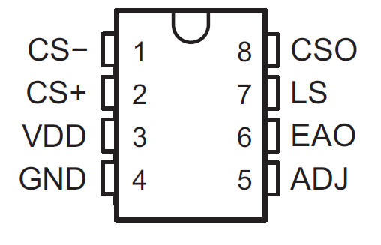
Current Sharing, Two Sources
Solution
Need an automatic method
UC29002 and UCC29002/1
Use Remote Sensing lines to trim V_{O}
UCC29002
  Continuous, Automatic Trimming
Matched Currents
at all Loads*
Load regulation lines
V_{O} / I_{O}
UCC29002
TI Information – Selective Disclosure
11

Slide 12
Load Share Control using the UCC29002
Part 1: Parallel Operation, Load Regulation and Load Sharing
Part 2: Introduction to the UCC29002
Part 3: How does the UCC29002 work
Part 4: Using the UCC29002
Differences between the UCC29002 and UCC29002/1
Part 5: Accuracy
Part 6: Typical Application
TI Information – Selective Disclosure

Slide 13
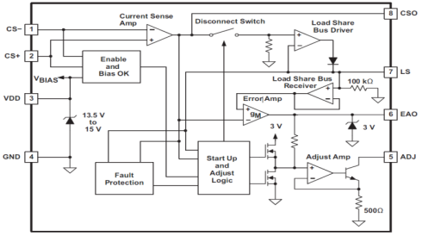
The UCC29002 - Concept
Each UCC29002 controls one Module
I_{DEM}* signal generated on LS Bus by Master UCC29002 (Auto Selected)
Slaves adjust Modules so that I_{O} = I_{DEM}
UCC29002 uses I_{ADJ} to adjust V_{O}
Current Sensing Resistors measure I_{O}
Block Diagram
*Voltage on LS bus is a current demand signal
TI Information – Selective Disclosure

Slide 14
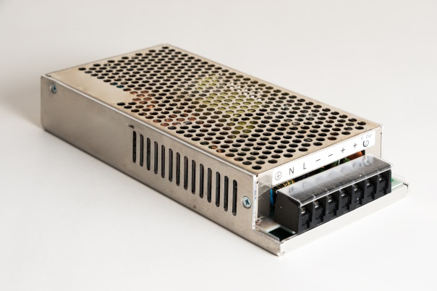
The Modules
Modules must
Have Remote sense capability or Vo adjust terminal
Have Pre-biased load capability
Must be able to start-up when V_{LOAD} is already present
Must not be able to sink current
ORing diode will prevent this
Use one load share controller per module
TI Information – Selective Disclosure

Slide 15
Remote Sensing
Separate connection to the Load: S+ and S-
I_{SNS} is zero
V_{S+} = V_{L} : V_{S1} = 0V.
Load regulation point is at V_{L} not V_{O}
Module regulates voltage from S+ to S-
Compensates for voltage drops in R_{EXT}* on both Positive and Negative lines
Sensing on both Positive and Negative
Compensates for voltage drops in both lines
I_{SNS} = 0
Vout Regulation point
R_{EXT}* = PCB traces, Cables, Connectors etc
TI Information – Selective Disclosure

Slide 16
Load Share Control using the UCC29002
Part 1: Parallel Operation, Load Regulation and Load Sharing
Part 2: Introduction to the UCC29002
Part 3: How does the UCC29002 work
Part 4: Using the UCC29002
Differences between the UCC29002 and UCC29002/1
Part 5: Accuracy
Part 6: Typical Application
TI Information – Selective Disclosure

Slide 17
I_{O} Sensing and V+ Adjust
Add a Current Sense Resistor R_{CS}
VR_{ADJ} = I_{ADJ} * R_{ADJ}
V_{L} = VR_{ADJ} + VS+
Change I_{ADJ} to adjust V_{L}
V_{L} increases by V across R_{ADJ}
V_{L} can increase only – trim up only
ADJ is a current sink
Current Sense Amplifier Output
CSO = LS Bus Voltage (Master controller)
CSO < LS Bus Voltage (Slave controller)
High Side Sensing is also possible
(EA+ = EA-)
TI Information – Selective Disclosure
17

Slide 18
Master / Slave
Slaves use I_{ADJ} to force I_{O_Slave} = I_{O_Master}
Diodes reverse biased in Slave controllers:
V_{CSO_Slave} < V_{LS Bus}
The Master controller is the one where V_{CSO} is highest
(equivalent to highest I_{O} and V+).
The LS_Driver in the Master UCC29002 forward biases the diode so that:
V_{LS Bus} = V_{CSO_Master} and I_{ADJ_Master} = 0
Master/Slave role is dynamic, can change if Master fails for example
TI Information – Selective Disclosure
18

Slide 19
Load Share Control using the UCC29002
Part 1: Parallel Operation, Load Regulation and Load Sharing
Part 2: Introduction to the UCC29002
Part 3: How does the UCC29002 work
Part 4: Using the UCC29002
Differences between the UCC29002 and UCC29002/1
Part 5: Accuracy
Part 6: Typical Application
TI Information – Selective Disclosure

Slide 20
Designing with the UCC29002:
Design procedure is outlined in the data sheet
There is a MathCad calculator on the product page at http://www.ti.com/product/UCC29002/toolssoftware
TI Information – Selective Disclosure

Slide 21
Typical Application
High Side Current Sensing
One UCC29002 is the Master and controls the voltage on the LS Bus
UCC29002 on Module with highest Vo becomes the Master controller. Master does not trim Vo of its module
Selection of Master is automatic and dynamic
Master role may move to other controllers in the system
  If: Module Vout shifts with temperature or ageing for example
Master sets the I_{DEM} signal onto the LS Bus
The other UCC29002 become slaves
Slaves use ADJ pin to trim Vo
I_{O_Slave} = I_{O_Master}
TI Information – Selective Disclosure

Slide 22
High Side or Low Side Current Sense
Current Sense can be High Side or Low Side
The EVM and the Ref Design use High Side sensing
PMP10099: – 12Vout
EVM: 1V < Vout < 15V
Normally Low side is a better choice.
Works for both low and high output voltage applications
Most customers use Low Side
During testing, it is easier to measure the voltage drop across the shunt resistor if it is on the low side.
I’d recommend Low Side sensing
High Side
Low Side
TI Information – Selective Disclosure

Slide 23
Low Side Current Sense with V+ sensing only
There are voltage drops in the current sensing (R_{CS}) and external PCB resistances (R_{EXT}) which means that V_{LS_M} not necessarily equal to V_{LS_S}
Usually the errors are small enough to ignore – next slide
TI Information – Selective Disclosure

Slide 24

Low Side Current Sense with V+ sensing only
Voltage drops in the current sensing (R_{CS}) and external PCB resistances (R_{EXT})
means that V_{LS_M} not necessarily equal to V_{LS_S}
Usually the errors are small enough to ignore
The voltage drop from GND_M to GND_S is
Usually the gain is fairly high (80) and the imbalance is dominated by differences in R_{CS} rather than in R_{EXT}
If R_{CS} and R_{EXT} are identical then the current sharing will be affected only by differences in the UCC29002 current amplifier gain (A_{M} and A_{S}).

Slide 25
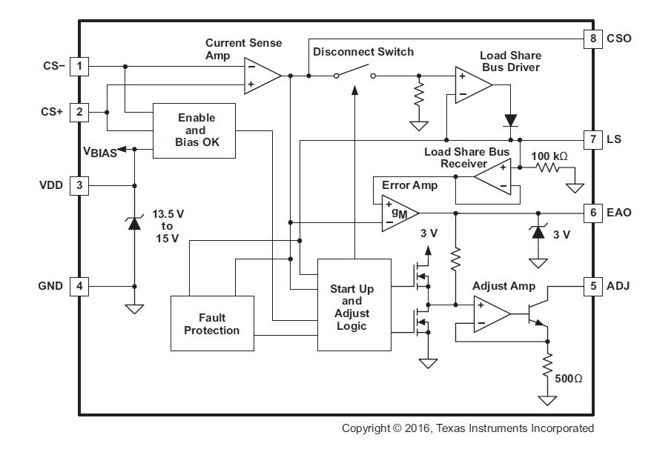
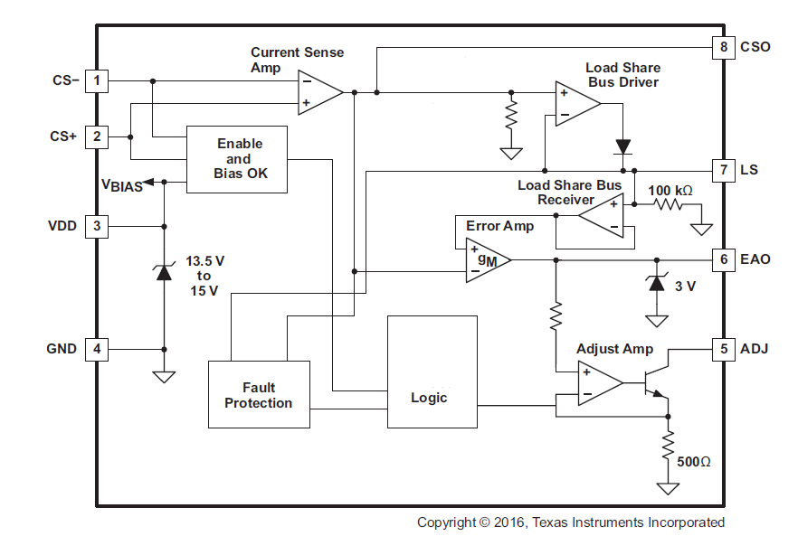
UCC29002 or UCC29002/1
UCC29002 includes ‘Start-Up and Adjust Logic’ block
Disconnect Switch initially set to OPEN
I_{ADJ} is set to maximum until Io reaches 80% of level set by LS bus
Disconnect Switch is then closed
Faster start-up than UCC29002/1
Output voltage overshoots possible at start-up
UCC29002/1 has no ‘Start-up and Adjust Logic’ block
I_{ADJ} starts at zero (no adjustment of Vout)
Load Sharing established more slowly
Output voltage overshoots much less likely
The UCC29002/1 is a better choice for most applications
TI Information – Selective Disclosure
Notes:
In the UCC39002 and UCC29002, during start-up, the load share driver amplifier is disabled by the disconnect switch and the adjust amplifier is forced to sink the maximum current through the adjust resistor. This operating mode ensures that the module controlled by the UCC39002 will be able to quickly engage in sharing the load
current since its output will be adjusted to a sufficiently high voltage immediately at turnon. Both the load share driver and the adjust amplifiers revert to normal operation as soon as the measured current exceeds 80% of the average per module current level represented by the LS bus voltage.
The UCC29002 and UCC29001 does not have this logic at start up. In this way, the UCC2900x does not adjust the output of the module to its maximum adjustment range at turn on and engages load sharing at more moderate rate.

Slide 26
UCC29002/1 block Diagram
Load Share Bus Driver
LS = CSO in Master*
Output is Low in Slave (diode reverse biased)
Current Sense Amplifier
Differential Amplifier
Minimum Gain = 3
Input is V_{CS}
Output is A(V_{CS}+V_{IO})
Low Offset is critical
V_{IO} < ±100μV
Disconnect Switch
Open if V_{CS+} ≈ 0.5V < V_{CS-}
Closed otherwise
Load Share Bus Receiver
Unity gain buffer for LS Bus
100kOhm loads LS Bus
Error Amp
Inputs: LS and CAO
Output controls I_{ADJ}
ADJ Amp
Puts V_{EAO} voltage across 500 Ω
Sets I_{ADJ} = V_{EAO} / 500 Ω
Other Blocks
Enable
VDD Clamp
Fault
Logic
MOSFET
ON if V_{CS+} ≈ 0.5V < V_{CS-}
Master controller is the one where V_{CSO} is highest
The LS_Driver in Master forward biases the diode
The LS_Driver in Slave reverse biases the diode
TI Information – Selective Disclosure

Slide 27
VDD and ADJ pin
4.575V < VDD < 13.5 (15V AbsMax)
VEAO +1V < VADJ < VDD
FET protects ADJ pin from voltages > VDD
FET may not be needed if VDD < 13.5V BUT check for transient conditions at system turn-on and turn-off. Especially if VDD is from a separate supply
ADJ pin is a current sink
I_{ADJ} = I_{SNS} + I_{R_ADJ}
R_{INT} appears in parallel with R_{ADJ}
Normally R_{INT} >> R_{ADJ}
Note: sometimes diodes are used
TI Information – Selective Disclosure

Slide 28
LS pin
LS
0 V < V_{LS} < VDD – 1.7V
0 < I_{LS} < -1mA
Internal 100 kΩ to GND on each IC
Load on the LS bus is n x 100k in parallel
Limits the number of modules the device can control –
Load Share Amplifier is internally compensated (15kHz pole).
We recommend that the user does not put any filter capacitance on the LS line
Voltage on the Master LS pin is A * R_{CS} * I_{O}
A is the current amplifier gain
Voltage on Slave LS pin is approx the same
TI Information – Selective Disclosure

Slide 29
Current Amplifier pins, CS+ and CS-
CS-, CS+
-0.3 V < V_{CS+} < VDD+0.3V
-0.3 V < V_{CS-} < VDD+0.3V
Amplifier gain must be 3 or greater
Load Share controller will disconnect from the sharing system if V_{CS-} is more than 500mV positive of V_{CS+}
TI Information – Selective Disclosure

Slide 30
Pin Voltage Limits:
CSO
-0.3 V < V_{CSO} < VDD & < 11.8V
V_{CSO} depends on gain and inputs
CS-, CS+
-0.3 V < V_{CS+} < VDD+0.3V
-0.3 V < V_{CS-} < VDD+0.3V
LS
0 V < V_{LS} < VDD – 1.7V
0 < I_{LS} < -1mA
100 kΩ to GND
VDD
4.575V < VDD < 13.5V
Recommended range
EAO
0V < V_{EAO} < 3.5V
ADJ
V_{EAO}+1V < V_{ADJ} < VDD
0 A < I_{ADJ} < 4.55mA
I_{ADJ} = V_{EAO} / 500 Ω
V_{ADJ} must NEVER exceed VDD
Vos can increase significantly
Turn-on and Turn-off
TI Information – Selective Disclosure

Slide 31
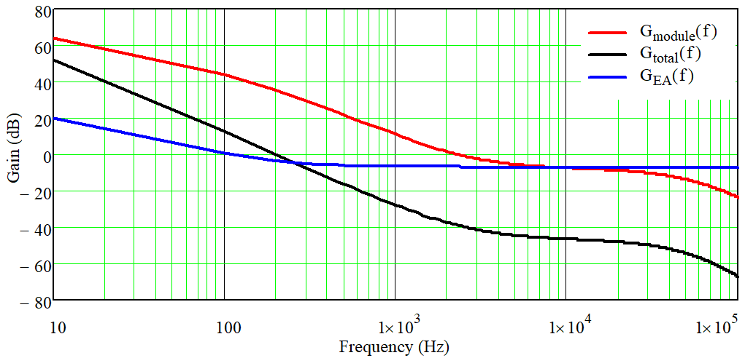
Control Loop
Module
There are two control loops:
Avoid interactions between loops:
Close the loop around the UCC29002 at least 1 decade below loop crossover of module
Load-Share loop is slow: may take 100ms to recover fully from a transient
RC at EAO sets UCC29002 bandwidth
Measure Loop bandwidth of Power Module
Ask Module manufacturer
Measure bandwidth (Bode Plot)
Estimate bandwidth from transient response
Composite response (G_{total})
UCC29002
TI Information – Selective Disclosure
31

Slide 32
Load Share Control using the UCC29002
Part 1: Parallel Operation
Part 2: Introduction to the UCC29002
Part 3: How does the UCC29002 work
Part 4: Using the UCC29002
Differences between the UCC29002 and UCC29002/1
Part 5: Accuracy
Part 6: Typical Application
TI Information – Selective Disclosure

Slide 33
UCC29002: Load Share Accuracy
RELATIVE Accuracy is the goal
Io_1 = Io_2 = Io_3 ….
Symmetrical layout
Vos of Current Amplifier < 100uV
V_{ADJ} must NEVER exceed VDD
  Vos can increase significantly and permanently
  Load Share accuracy will get worse.
  Turn-on and Turn-off
Relative Accuracy most important when Io is high
Module power is highest at high power
Relative Accuracy worse at lower currents (offsets)
Absolute currents are determined by the Load
Io_1 + Io_2 + Io_3 +….= I_Load
VERY, VERY important
TI Information – Selective Disclosure
33

Slide 34
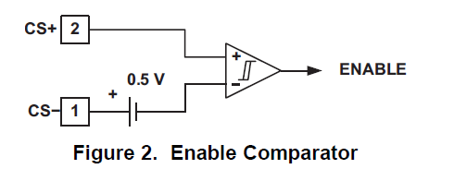
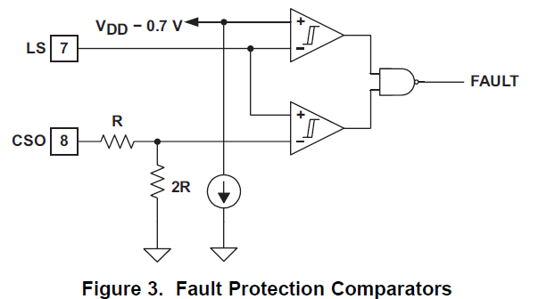
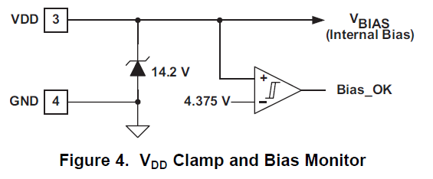
UCC29002: Other things to know
The UCC29002 is not a Hot-swap controller
Use products such as TPS23523 instead
To disconnect a module
Remove it from LS bus
Pull V_{CS-} > 500mV positive of V_{CS+}
Opens the disconnect switch
Fault Protection
Load Share bus short to GND
VDD Clamp
Clamp is a zener emulator
Needs 0.1uF < CVDD < 1uF for stability
TI Information – Selective Disclosure
34

Slide 35
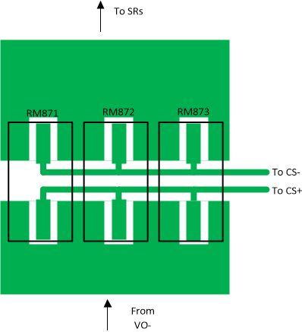
Load Share Control Current share resistor layout
TI Information – Selective Disclosure
35

Slide 36
Load Share Control using the UCC29002
Part 1: Parallel Operation
Part 2: Introduction to the UCC29002
Part 3: How does the UCC29002 work
Part 4: Using the UCC29002
Differences between the UCC29002 and UCC29002/1
Part 5: Accuracy
Part 6: Typical Application
TI Information – Selective Disclosure

Slide 37
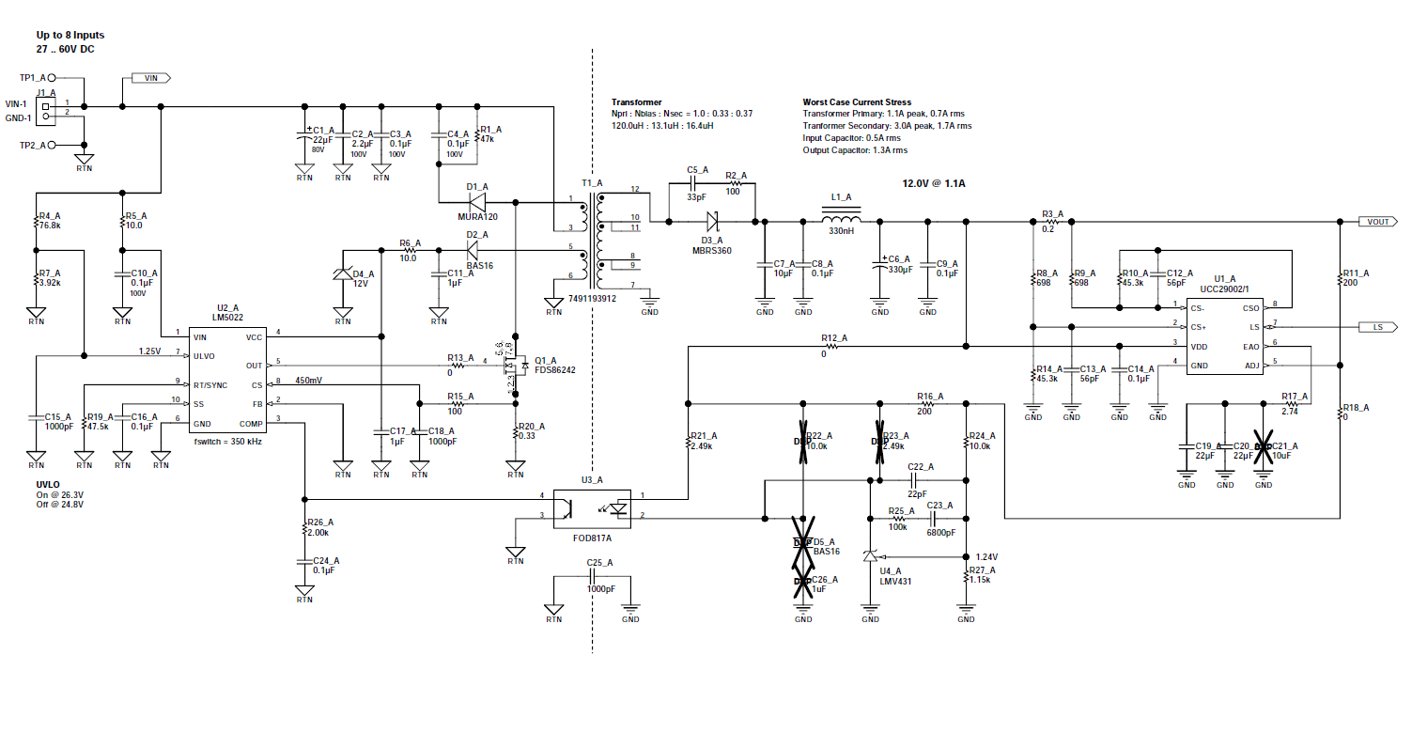
PMP10099
TI Information – Selective Disclosure
37

Slide 38
Load Share Control using the UCC29002
Thank you for your attention
Any Questions ?
Colin Gillmor: colingillmor@ti.com
TI Information – Selective Disclosure

Slide 39


