Slide 1
TPS62903 Layout Review
Nancy
11/15/2021

Slide 2
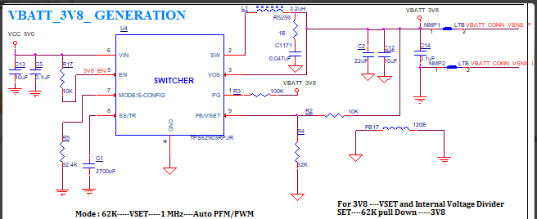
New schematic:
Move snubber to the lest side of inductor. It should be on SW, not Vout.
Remove FB17, we don’t recommend separate AGND and PGND. The GND of input and output must be shortest loop connected together. Please make sure adding FB17 is working properly before changing the layout.
Increase C13 from 10uF to 22uF, Change C5 from 0.1uF to 22uF. 10V or 16V voltage rating

Slide 3
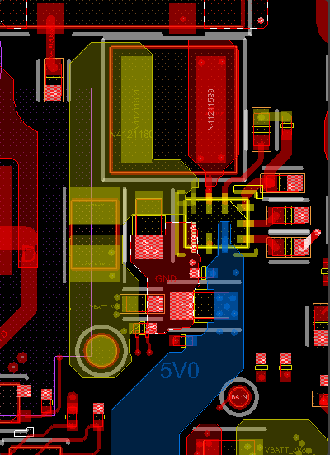
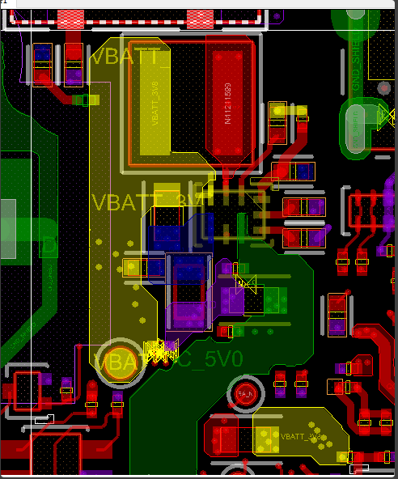
Update one:
Remove FB17. The GND of input and output must be shortest loop connected together.
Recommend go back to left side placement
Follow datasheet layout example
First sent image:
The placement looks good.
Please remove 5 vias on the copper of switching node. This may cause issue.
Why add those vias?
C13/C5 must close to Vin pin

Slide 4
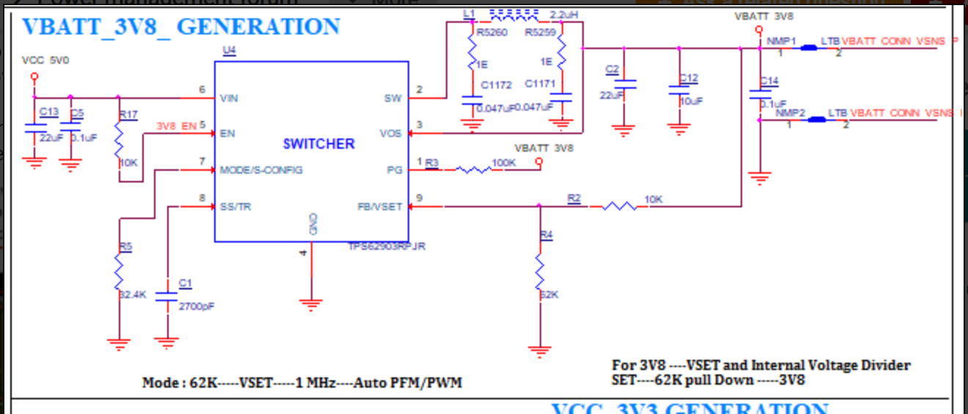
Delete R5259 and C1171 which are no need
Nopop R2 since it is in internal Feedback

Slide 5
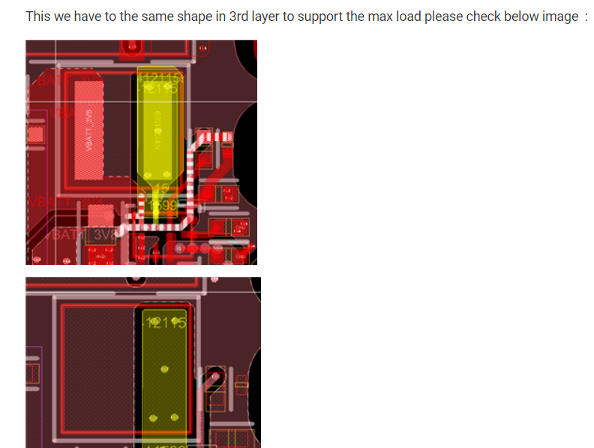
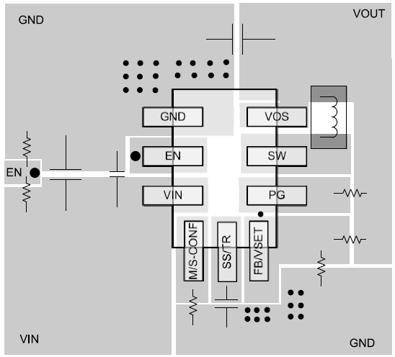
Switching node only needs top layer for 3A application. Please see the layout example in the datasheet on the right side. You can enlarge the SW copper at pin2 area a little bit. Other layer should be GND underneath SW area.

Slide 6
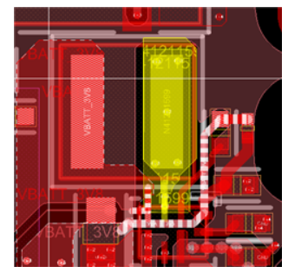
The highlighted feedback trace may couple the switching node noise in the inner layer. Please change that layer
from switching node copper to GND copper
Feedback trace should be connected to the Pad of output cap for less noise (after output cap filter)

