Slide 1
LMZ12001 PSpice for TI Simulation
TI
3/20/2023

Slide 2
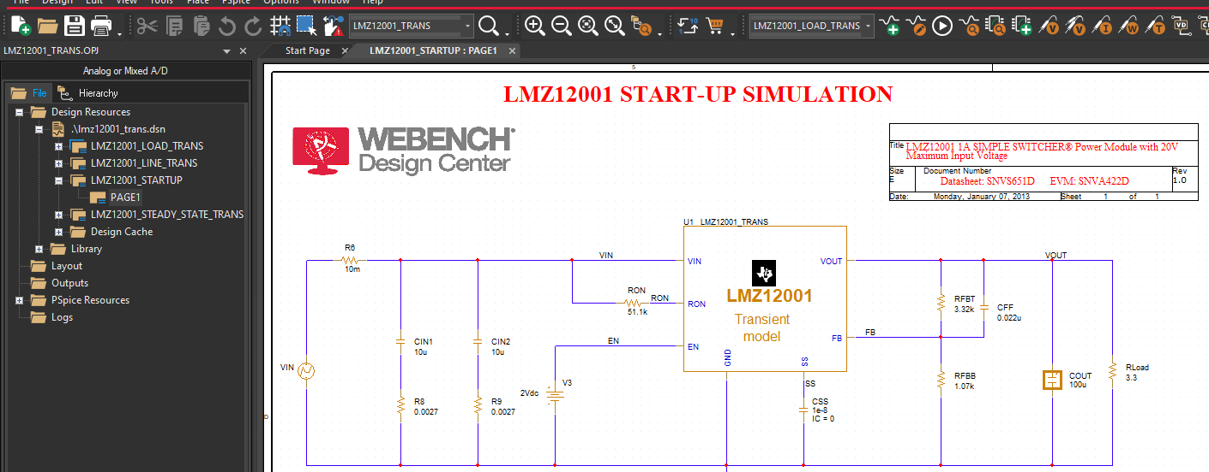
For example: you want to simulate LMZ12001_STEADY_STATE_TRANS

Slide 3
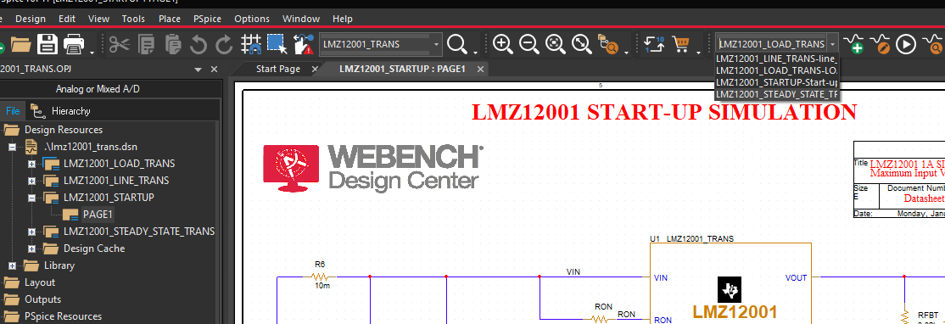
Go to simulation profile---select LMZ12001_STEADY_STATE_TRANS

Slide 4
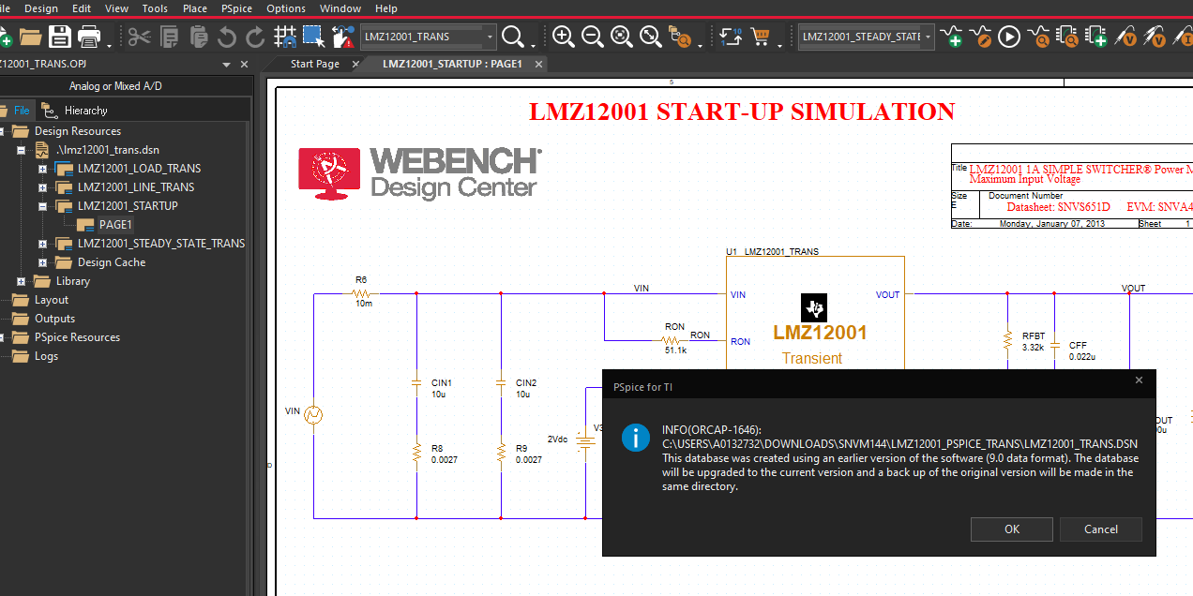
Go to simulation profile---select LMZ12001_STEADY_STATE----Click ok

Slide 5
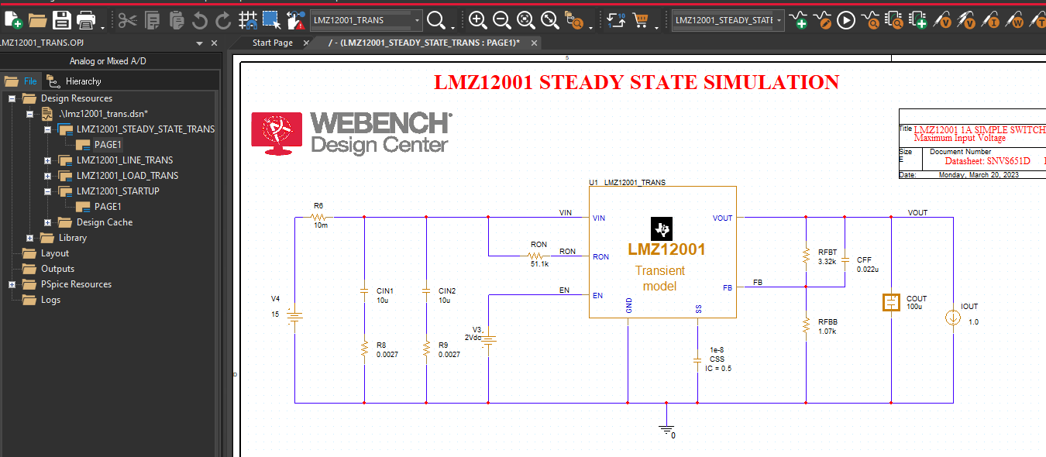
Then the LMZ12001_STEADY_STATE TRANS moves to the top(that means in the simulation hierarchy)----double click PAGE1 to see schematic

Slide 6
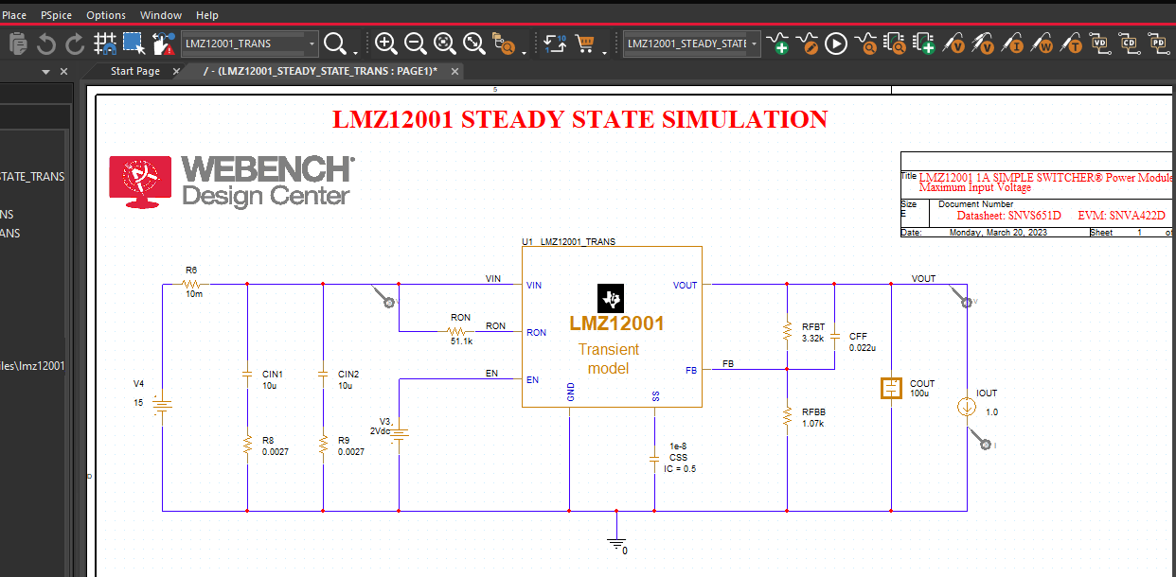
Add 3 markers----Click RUN

Slide 7
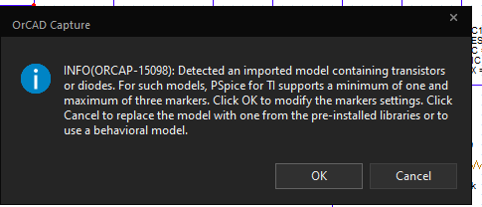
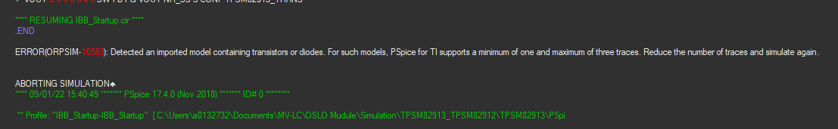
If you have below errors with snvm144.zip, please add 3 marker (could not be higher than 3), then you can run simulation.

Slide 8
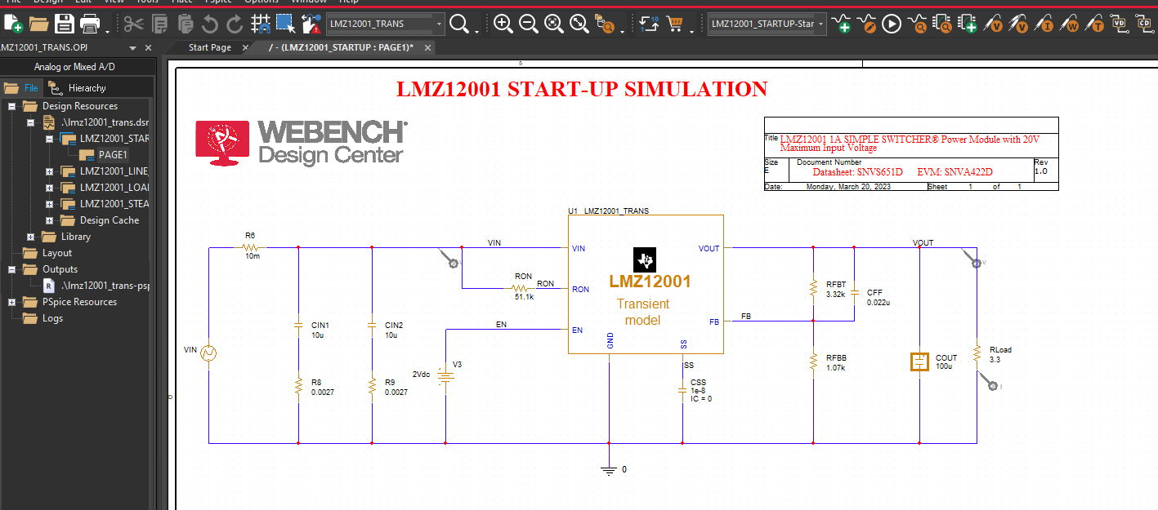
Add 3 markers as below.

Slide 9
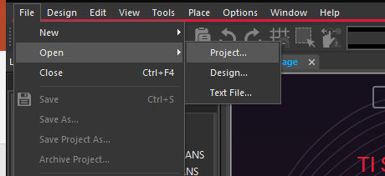
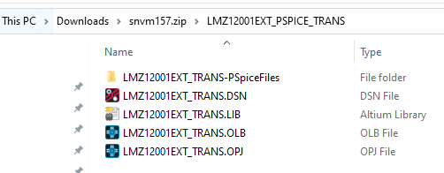
Download a new snvm157.zip file. Launch PSpice for TI----Go to file---open project

Slide 10
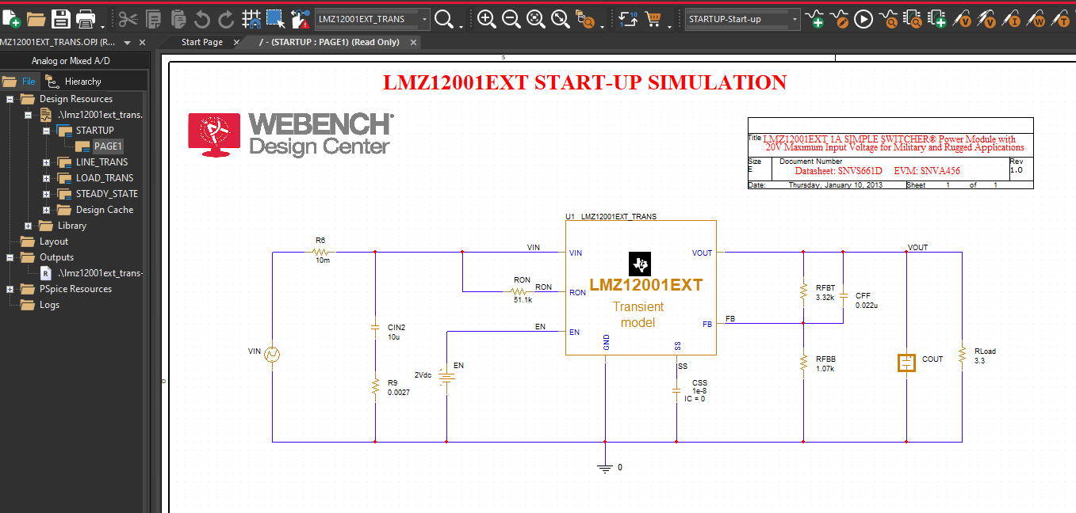
Under LMZ12001_trans.dsn folder---STARTUP----then double click PAGE1---you will see schematic

Slide 11
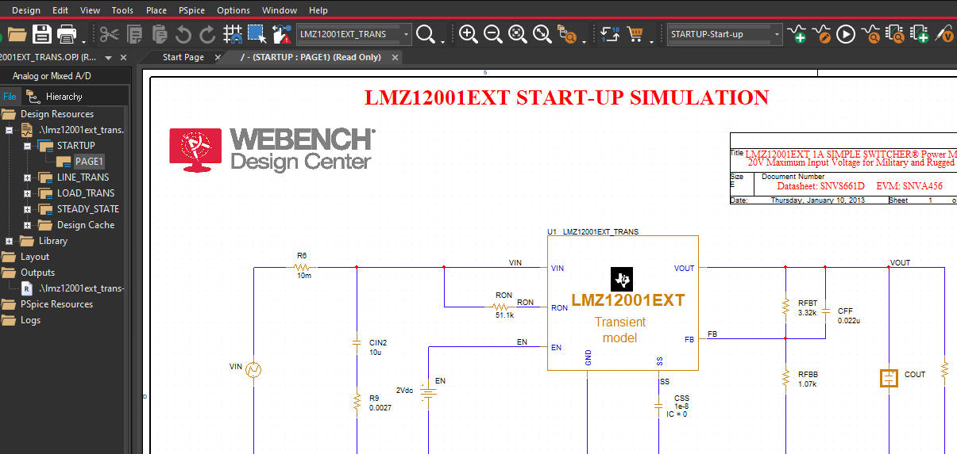
Make sure STARTUP-Start-up simulation profile is selected-----click run simulation

Slide 12
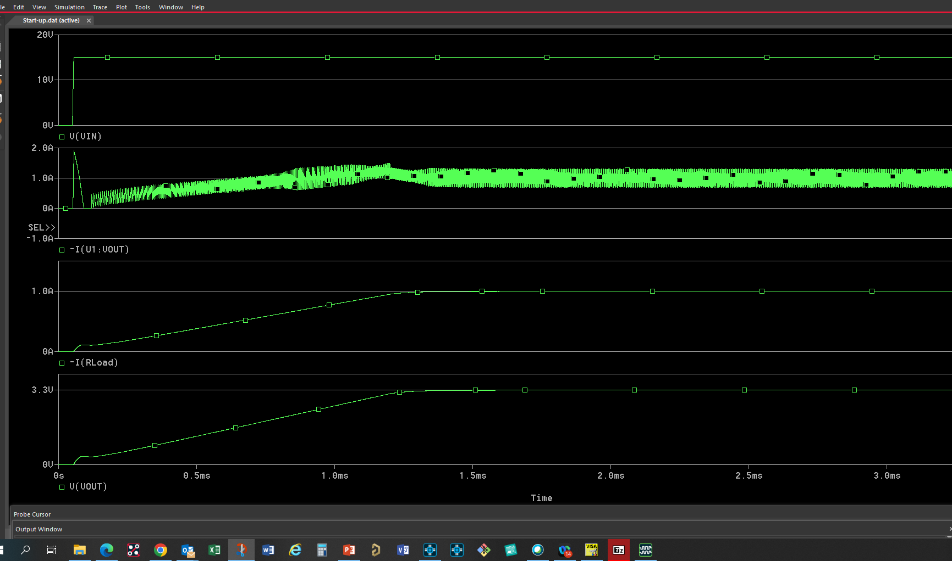
Then you will see the simulation in simulation window.

