Slide 1
UCD90xxx Quick Guide
Yihe Hu
October 2019

Slide 2


UCD90XXX’s Advantages
There are many solutions for sequencing based on the # of rails and flexibility required
The goal of our sequencer portfolio is to make them as flexible as possible without the complexity of having to build a custom software solution
UCD90xxx
Digital Sequencers
HW/SW Design Complexity
“Home Grown” MCU, FPGA,
or CPLD
Plus
No S/W to manage
INV Fault logging
E-scope for easy monitor and debug
improved Rower Reliability
PMBus Telemetry Capability
Thermal Management
LM388xx
Analog Sequencers
Cascaded PGoods & enables
Ready to use, no configuration programming
No external component for 3ch
Small
Low Iq
Cascading solution
Voltage Supervisors
Discrete logic and delay circuits
# of Rails

Slide 3
UCD90XXX Selection Guide
 | UCD90320/ UCD90320U*** | UCD90160A | UCD90120A | UCD90124A | UCD9090A | UCD9081
# Rails Sequenced | 32 | 16 | 12 | 12 | 10 | 8
# of Monitor Inputs | 24 + 8(digital) | 16 | 13 | 13 | 11 | 8
ADC Ref Accuracy | External | 0.5% Internal | 0.5% Internal | 0.5% Internal | 0.5% Internal | External
Voltage Margining* | 24 | 10 | 10 | 10 | 10 | N/A
Fan Control* | N/A | N/A | N/A | 4 | N/A | N/A
ACPI Sleep State Control | Yes | Yes | Yes | Yes | Yes | No
Fault Pins | 4 | 1 | N/A | N/A | 1 | N/A
GPI Fault responses | Y | Y | N | N | Y | N
Num Profiles(AVID) | Up to 4 | 1 | 1 | 1 | 1 | 1
Current and Temp Monitor Scaling | Yes | No | Yes | Yes | Yes | No
NV Fault Logs | 100 | 18 | 16 | 12 | 26 | 8
Other NV Logging | Blackbox, Peaks, Resets, RTC | Peaks, Resets, Run-time clock | Peaks, Resets, Run-time clock | Peaks, Resets, Run-time clock | Peaks, Resets, Run-time clock | N/A
Max GPI/GPO* | 32/16 | 8/16 | 8/12 | 8/12 | 8/10 | 0/4
Internal Temp Sensor | Yes | No | Yes | Yes | Yes | No
Communication and Programming I/F ** | PMBus/I2C | PMBus/I2C, JTAG | PMBus/I2C, JTAG | PMBus/I2C, JTAG | PMBus/I2C, JTAG | I2C
Watchdog Timer | Yes | Yes | Yes | Yes | Yes | No
Package Type (size, mm) | 169-ball BGA (12x12, 0.8 pitch) | 64-pin QFN(9x9) | 64-pin QFN(9x9) | 64-pin QFN (9x9) | 48-pin QFN (7x7) | 32-pin QFN (5x5)
* Table shows the max number of each feature supported by each device. For example, the UCD90124 has 12 PWM pins used as any combination of margining, PWM, fan control, or GPIO up to the max listed. See data sheets for details.
** JTAG interface is for programming only.
***: ULA package and SEU detection

Slide 4
Target Hardware Design
UCD90xxx
Rail #1
GPIO1
EN
VOUT
GPIO2
GPIO3
Rail #2
EN
VOUT
MON1
MON2
Rail #3
MON3
EN
VOUT

Slide 5
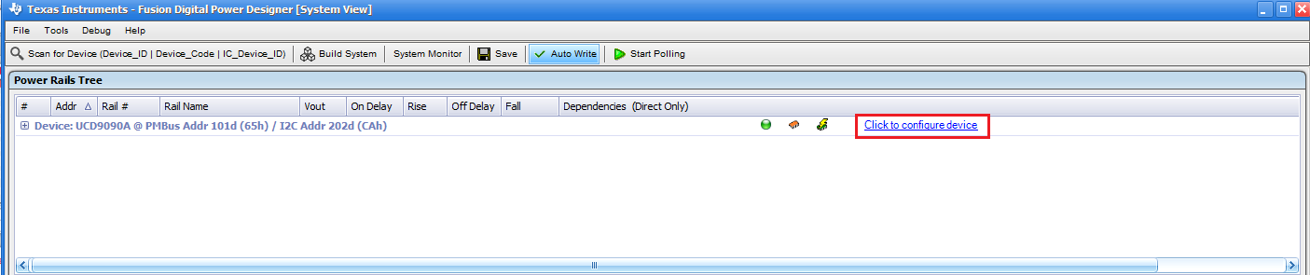
Launch Fusion GUI
Click the “Click to Configure Device” to launch individual device GUI to configure

Slide 6
Monitoring Configuration

Slide 7
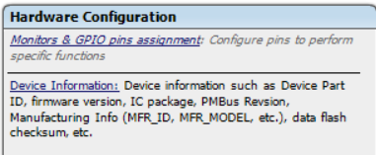
UCD90xxx Configuration
Click “Hardware Configuration” → Click “Monitors & GPIO pins assignment”

Slide 8
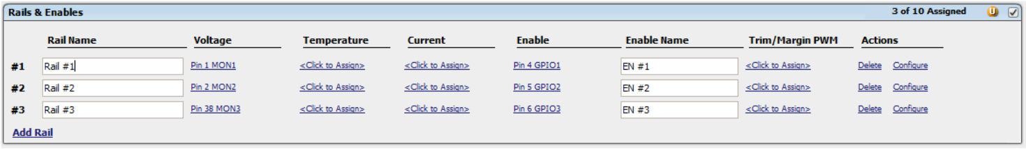
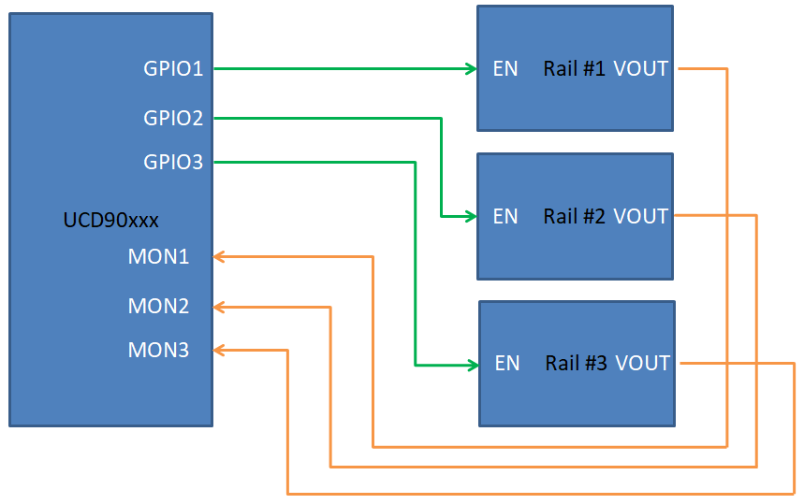
UCD90xxx Configuration
Add Rail: Add new power rail to configure
Rail Name: The name of the rail to match schematics
(ps: Rail name could not be stored into NVM)
Voltage: Select a MON pin to monitor rail
Enable: Select a GPIO pin as rail’s ENABLE
Trim/Margin: select a PWM pin as Margining
Configure：The polarity and margin settings

Slide 9
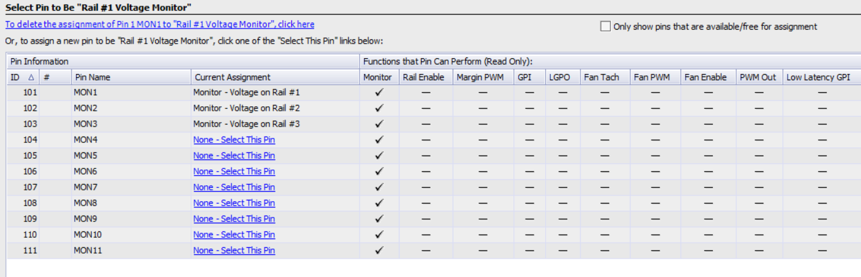
UCD90xxx Configuration
Click the pin link to change or delete the assigned pin as shown below.
选取

Slide 10
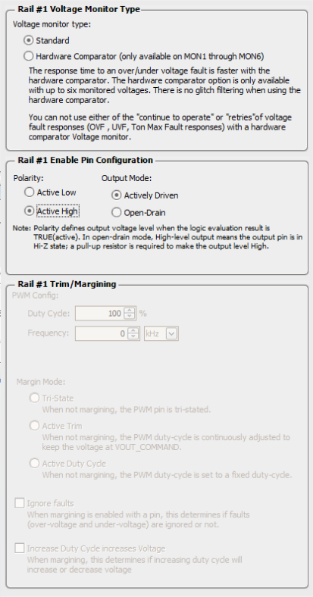
UCD90xxx Configuration
Voltage Monitor type：
  Standard(slow response)
  Hardware comparator(fast response)
Polarity of the ENABLE pin

Slide 11
UCD90xxx Configuration
The icon ”U” indicate that the changes has been not save.
Clicking the “U” icon will Undo the changes
After the changes are done, click “Write to Hardware” to save the new setting,
Click “Store RAM to Flash” to store the new settings into Flash permanently(not available under offline mode)
Ps: If “Store RAM to Flash” is not clicked, after power cycle or reset，the new settings are gone and the old settings are restored.
Ps: NVM has 20K cycles

Slide 12
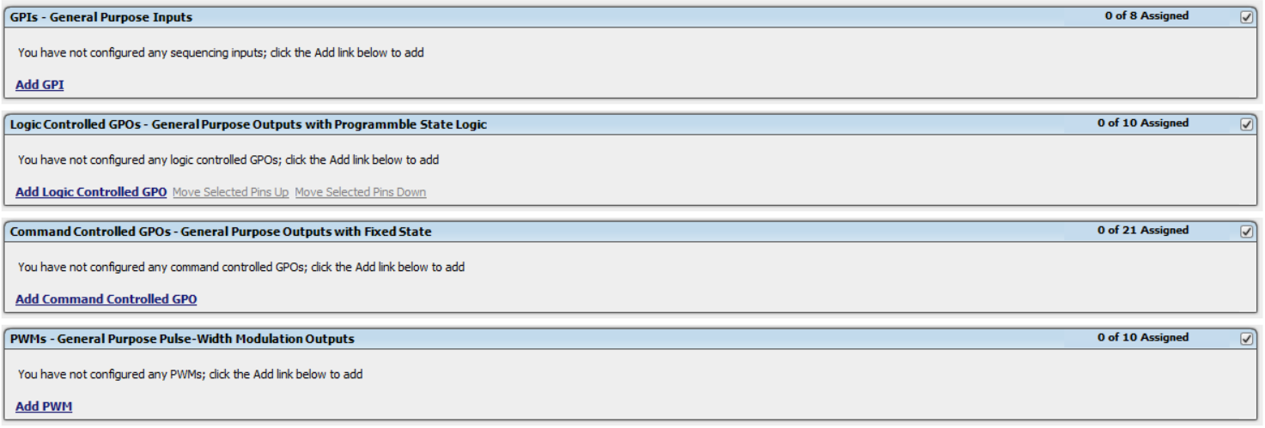
UCD90xxx Configuration
Configuring GPIs, Logic GPO (LGPOs), Command GPOs, and PWMs
are very similar like configuring rails.

Slide 13
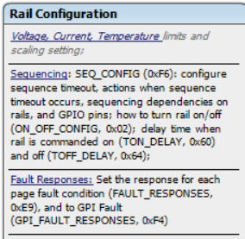
UCD90xxx Voltage settings
Click “Rail Configuration” → Click “Voltage, Current, Temperature”

Slide 14
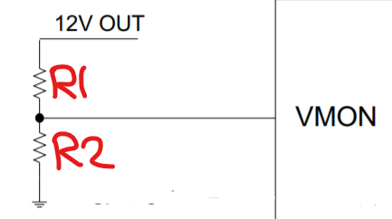
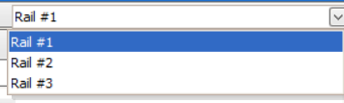
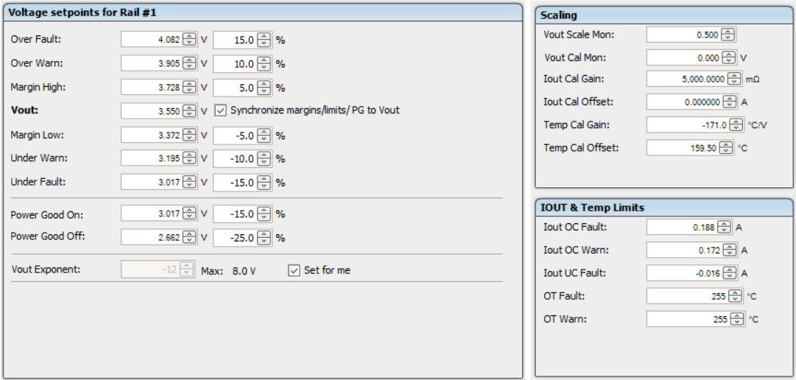
UCD90xxx Voltage Settings
Input the target voltage
Input the fault/warning/PG thresholds
Click the drop down menu at the top right corner to switch rails
If the input voltage is bigger than the ADC Reference,
a external voltage divider is required, the ratio [R2/(R1+R2)]
Is required to input
3
2
4
1

Slide 15
Sequencing Configuration

Slide 16
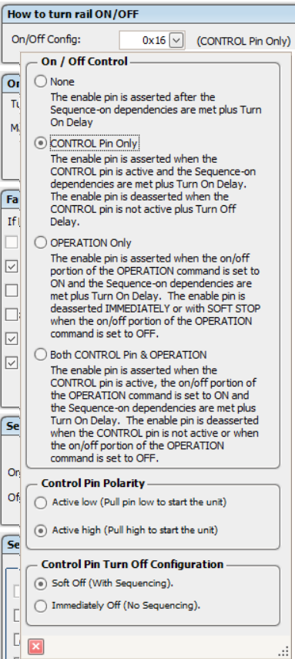
UCD90xxx Sequencing Control
Sequencing State machine is controlled by the condition of the ON/OFF_CONFIG from each rail. When the condition of the ON/OFF_CONFIG is met to turn on, the state machine starts otherwise it stops state machine
Select: Rail Configuration->Sequencing-> ON/OFF Config
There are four options to choose:
None
It means that state machine start as soon as device finishes its initialization. Under this mode, the only way to turn of the rails is via fault responses of the rails.
Control Pin Only
The state machine is up to the PMBUS_CTRL signal. When the signal is ASSERTED, the state machine starts to turn on the rails otherwise turns off the rail. This signal is a level triggered.
OPERATION Only
  Application issues OPERATION command to start or stop the state machine.
  If PIN SLECTED RAIL STATE feature is enabled, the state machine is up to the states of the assigned GPIs. Please refer https://training.ti.com/fusion-power-designer-pin-selected-rail-states?context=1136655-1139495-1136557
  Either condition works.
BOTH CONTROL & OPERATION
When both conditions are met, the state machine starts to turn on rails. Otherwise the state machine starts to turn off rails.

Slide 17
UCD90xxx Sequencing setting
The following slides demonstrate how to configure to
achieve below sequencing requirements:
  The power on sequencing: Rail#1 → Rail#2 → Rail#3
  The power down sequencing: Rail#3 → Rail#2 → Rail#1

Slide 18
UCD90xxx Sequencing setting
Click “Rail Configuration” → Click “Sequencing”

Slide 19
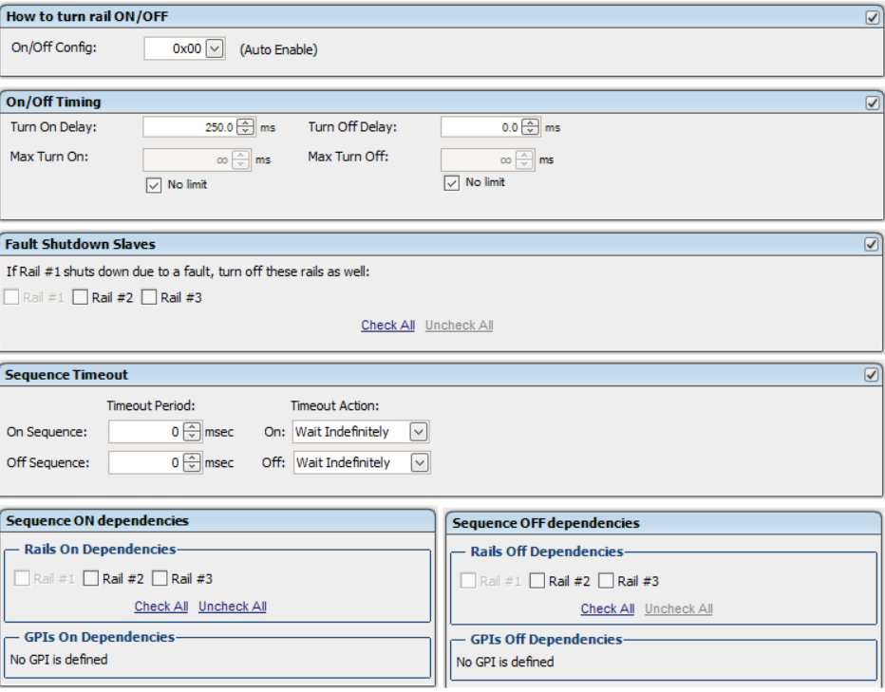
UCD90xxx Power On Sequencing

Slide 20
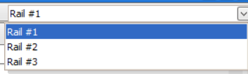
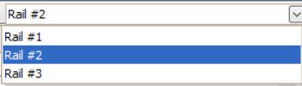
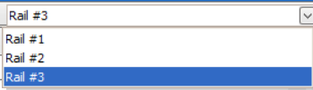
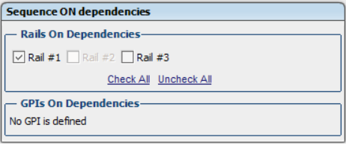
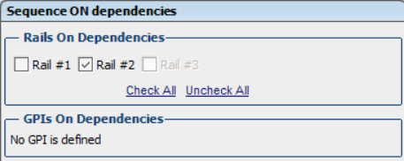

UCD90xxx Power On Sequencing
Select individual rail from the top right corner menu
No dependencies selected. When UCD90xxx finishes its initialization, it asserts Rail#1’s ENABLE to turn Rail#1 ON since On/Off Config is set to AUTO Enable.
Select Rail#1，When Rail#1 reaches Power Good ON，UCD90xxx asserts Rail#2’s Enable to turn Rail#2 ON
Select Rail#2，When Rail#2 reaches Power Good ON，UCD90xxx asserts Rail#3’s ENABLE to turn Rail#3 turn ON

Slide 21
UCD90xxx Power Down Sequencing

Slide 22



UCD90xxx Power Down Sequencing
Select the individual rail from the top right corner drop down menu
Select Rail #3。When rail#2 is asked to turn off， UCD90xxx de-asserts the Rail#2’s ENABLE only if Rail#3 is below Power Good OFF threshold
Select Rail #2，When rail#1 is asked to turn off, UCD90xxx de-asserts the rail#1’s ENABLE only if
Rail#2 is below Power Good OFF threshold.
No selection. When rail#3 is asked to turn off,
UCD90xxx deasserts Rail#3’s ENABLE to turn Rail#3 OFF
A rail is asked to turn off when either condition is met:
1. The condition matches ON/OFF CONFIG to turn off the rail( Rail with Auto ENABLE mode can only be off due to #2 and #3)
2. The rail has fault and the fault response is set to shutdown.
3. The rail is set as fault shutdown slave of other rail which is asked for shutdown due to a fault

Slide 23
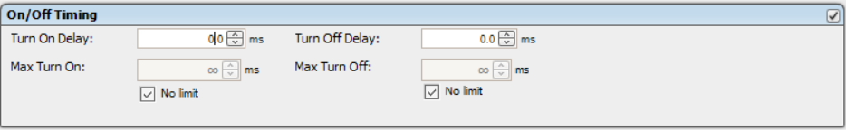
UCD90xxx Sequencing Flow Chart
Output Rail
Enable Signal
ON/OFF Config
Sequences ON dependencies
Turn ON
Delay
Soft Start
Output Rail
Disable Signal
Regulation
Sequences OFF dependencies
Turn OFF
Delay
Ramp Down

Slide 24
UCD90xxx Sequencing Control
UCD90xxx
EN
Power IC
Vout
In the real system，the delay/timing used at UCD90xxx must be from application’s design,
UCD90xxx can not control turn on delay and soft start time for the power supply
Turn On
Turn Off
ON/OFF_CONFIG
EN
TON
Delay
TOFF
Delay
Vout
MAX
TURN OFF
Soft start
(MAX TURN ON)

Slide 25
Configure Fault Response

Slide 26
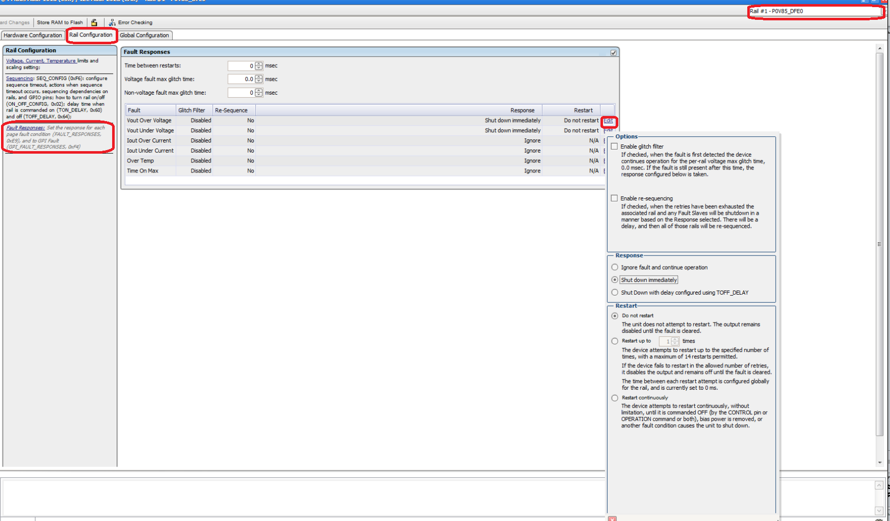
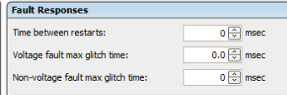
Fault Response Settings
Select different rail from drop down menu
Retry(restart) interval
Glitch filter for voltage Fault
Glitch Filter for non-voltage Fault

Slide 27
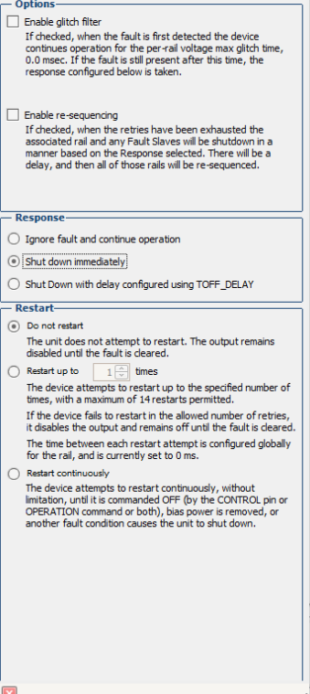
Fault Response Settings
Enable the glitch filter
Enable re-sequencing（If retry/restart is selected，re-sequencing takes effect only after the retry/restart is exhausted. ）
Ignore fault（if this is selected, the rest settings are ignored）
Shutdown immediately(ignore delay or dependencies)
Shutdown with delay
(for the salve rails of the faulted rail, they are always off based on the delay)
No retry/restart
Retry/restart 1-16 times based on interval
Retry continuously based on interval(re-sequencing is not possible under this setting)

Slide 28
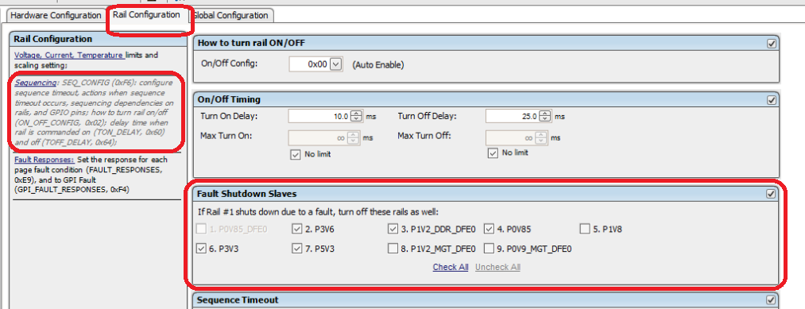
Fault Shutdown Slaves
Fault shutdown slave is to shutdown other rails when the desired rail has fault if the fault response of the desired rail is set to not ignore the fault.
The advantage is to reduce the number of fault logged by the device. For example, if VIN has fault, the other rails will report the own fault later. But if other rails are configured as fault shutdown slaves of VIN rail, device will shutdown other rails before they reports fault to save the fault log space.
Fault shutdown slaves rails are always off based on own’s delay and dependencies.

Slide 29
Fault Shutdown Slaves
Fault shutdown slaves: when a given rail has fault, device will shutdown the faulted rail plus the selected fault shutdown slaves.
The fault response of the faulted rail can be set to IGNORE, otherwise, the slaves will not be off.
The slave rails are always off based on its off delay and dependencies.

Slide 30
Retry(restart) and Re-sequencing
Retry(restart) is only applied on the faulted rail and it does not impact other rails. When faulted rail is retry, the remain rails are intact which are not going to be off when retry is ongoing.
Re-sequencing mean: when a given rail has fault, re-sequencing shall shutdown the faulted rail + related rails(set as fault shutdown slave) and turn these rails back on. If the faulted rail has retry, the re-sequencing will not start until retry is exhausted. All re-sequencing rails must be under POWER_GOOD_OFF to start the re-sequencing.

Slide 31
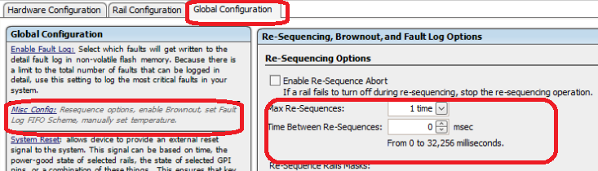
Resequencing Configuration
Enable resequencing option at the fault response
Select the rails that need be re-sequencing when the current rail has fault
Configure proper interval and number

Slide 32
Configure Margining

Slide 33
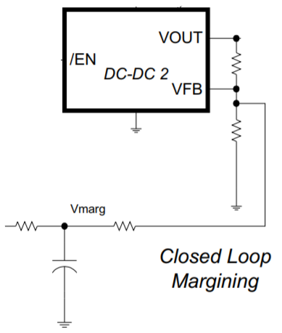
Hardware Design
UCD90xxx
Rail#1
GPIO1
R1
MON1
R2
EN
VOUT
R
Ring
FPWM1
C
EN
VOUT

Slide 34
Margining Configuration
Click “Hardware Configuration” → Click “Monitors & GPIO pins assignment”

Slide 35
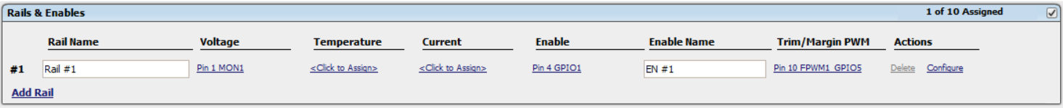
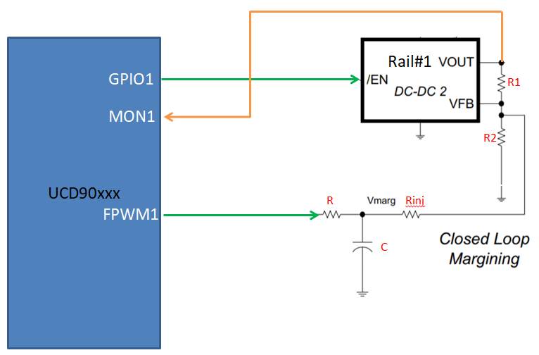
UCD90xxx 配置宣告
Add Rail: Add new power rail to configure
Rail Name: The name of the rail to match schematics
(ps: Rail name could not be stored into NVM)
Voltage: Select a MON pin to monitor rail
Enable: Select a GPIO pin as rail’s ENABLE
Trim/Margin: select a PWM pin as Margining
Configure：The polarity and margin settings

Slide 36
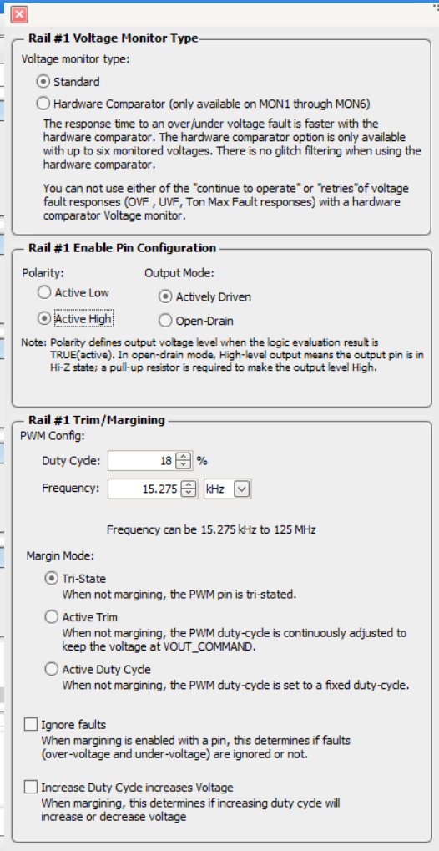
UCD90xxx Margining Setting
Duty Cycle:
Initial Duty Cycle, which is equal to Vref/3.3 。
Frequency:
PWM frequency
Click “Configure” to
See the pop up menu
Tri-State: (recommended)
When there is no margining, PWM pin is High impedance
Active Trim
Where there is no margining, FPWM continues outputting PWM signal to adjust the voltage
Active Duty Cycle
When there is no margining，FPWM outputs PWM signal with fixed duty 和Frequency
Ignore the fault during the margining
The correlation between duty cycle and voltage

Slide 37
UCD90xxx Margining
Click “Rail Configuration” → Click “Voltage, Current, Temperature”

Slide 38
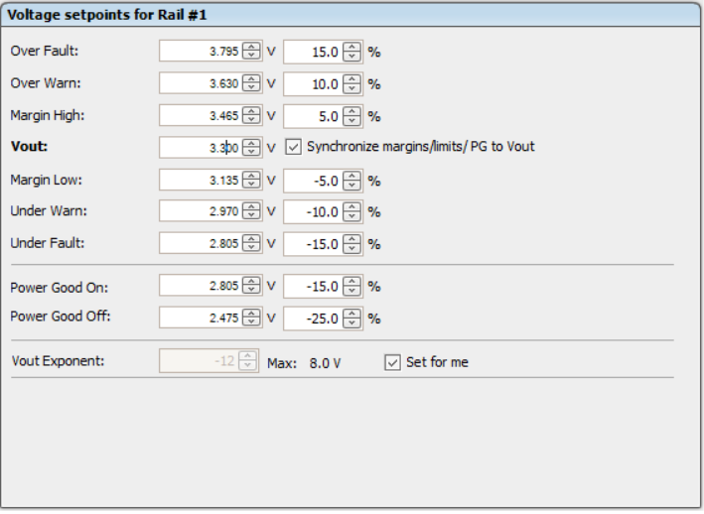
UCD90xxx Margining Value
Set Margining high/low thresholds

Slide 39
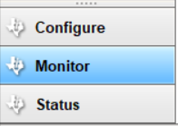
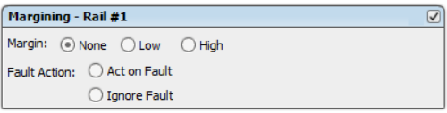
UCD90xxx Margining operation
Click “Monitor” (bottom left) → Margining – Rail #1
Click Margin: None, Low, and High for margining
ps: If the given rail does not reach POWER_GOOD_ON and its ON/OFF_CONFIG and sequencing on dependency are not met，the margining is disable.

Slide 40
UCD90xxx Margining Design
Please refer Application note to understand the design and principles http://www.ti.com/lit/an/slva845a/slva845a.pdf
The excel spreadsheet will help to calculate the parameter http://www.ti.com/lit/zip/slvc676

Slide 41
Files and Programming

Slide 42
Files and Programming
Project file（.xml）: configuration file containing single device，it modifies the operation memory on the fly
PMBus Write Script file(.csv)。It is the PMBus version of the Project file。It packs the configuration inside the project file with proper PMBUs command protocol. It modifies the operation memory on the fly.
System file(.tifsp). Configuration file containing multiple device. It modifies the operation on the fly.
Data flash file(.hex)。Raw data stored inside the chip. It accesses the flash directly without touching operation memory.
Data flash script file(.csv)。Interpret the data flash hex file and pack the data with recognized PMBus command. It accesses the data flash directly without touching operation memory.
Recommend I2C/PMBus interface to programming with either data flash hex or data flash script file.

Slide 43
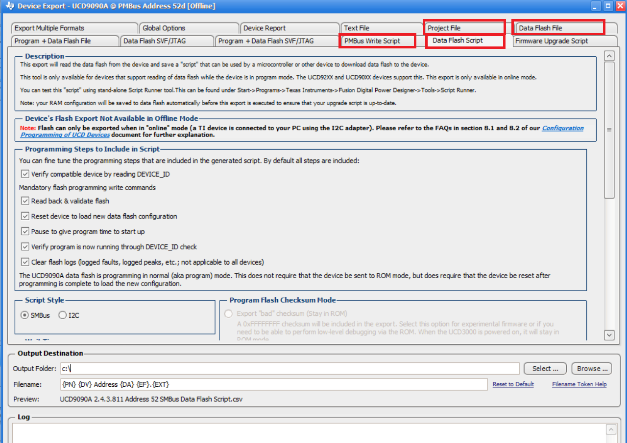
Files Export
File-》Export

Slide 44
UCD90XXX Collaterals
UCD90xxx Family Frequently Asked Questions and Answers
http://www.ti.com/lit/pdf/slua815
UCD90xxx Sequencer Schematics Guidelines
http://www.ti.com/lit/pdf/slvub50
Fusion Digital Power Designer GUI 7.0 for the UCD90xxx Sequencer
http://www.ti.com/lit/pdf/slvub51
Improvements to UCD9090A and UCD90160A
http://www.ti.com/lit/pdf/slva908
Design Voltage Margining Circuit for UCD90xxx Sequencer and System Manager
http://www.ti.com/lit/pdf/slva845
UCD90xxx Voltage Margining Circuit Design Tool
http://www.ti.com/lit/zip/slvc676
How to Cascade multiple UCD90xxx Sequencer
http://www.ti.com/lit/pdf/slva902
UCD90XXX Fusion GUI Training Video
      https://training.ti.com/fusion-digital-power-designer

