Slide 1
Driving inductive loads using power switches
Smart high side switch provides
Driving, protecting, and diagnosing loads
Cameron Phillips(APP – PSIL – PS)
2019

Slide 2
Detailed agenda
  What is an inductive load?
  Deep dive inductive load analysis
  Energizing an inductive load
  Disconnecting an inductive load: design considerations
  Different methods for safe driving an inductive load
  Clamp across the FET
  Clamp across the load
  Freewheeling Diode
  Smart high side switches driving inductive load
  Driving relay example: TPS1H100 single channel
  Driving relays & resistors example: TPS4H160 quad channels
  Lab results
Summary

Slide 3
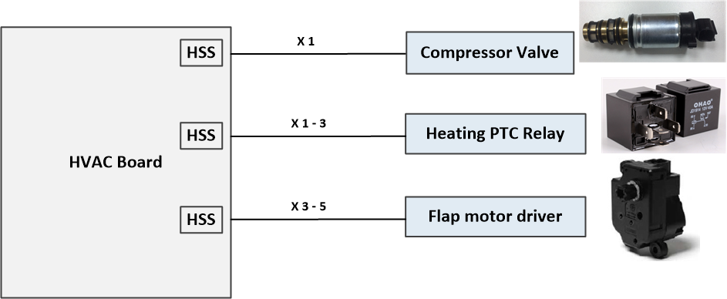
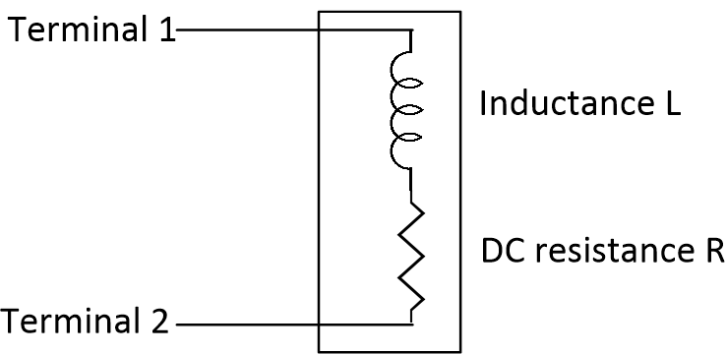
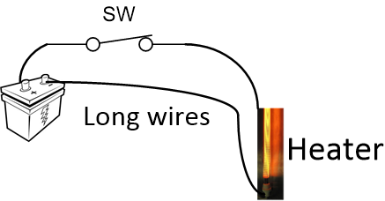
What is an inductive load?
Inductive loads are typically found as solenoids, relays, valves, etc in systems and are commonly seen in both automotive and industrial applications. The current is in the range of 0.1A to 10A and Inductances in the range of 0.1μH to 2000 mH
Stored energy in long harness wire, connecting voltage source to a resistive load, should be taking in consideration especially at high load current
 | Wire length (10 meters)
 | resistance (mΩ) | inductance (μH)
18 gauge | 209.48 | 19.65
16 gauge | 131.75 | 19.18

Slide 4
  Deep dive inductive load analysis

Slide 5
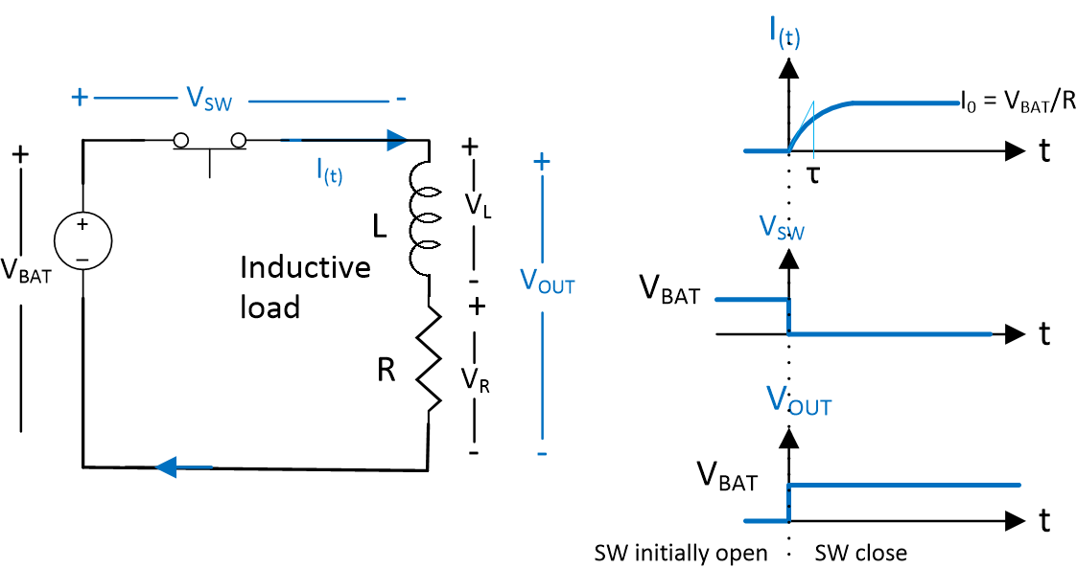



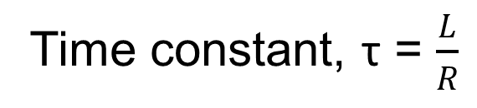
Basics: energizing an inductive load, or “ON state”
Instantaneous current
I_{(t)} = I₀ (1 - $e^{\frac{−t}{τ}}$)
Time constant, τ = $\frac{L}{R}$
Steady state current
I₀ =$\frac{VBAT}{R}$
Stored energy
E = $\frac{1}{2}L(\frac{Vbat}{R}$)²
The stored energy is dissipated when the switch is open
Systems Fail because they do not anticipate the energy

Slide 6
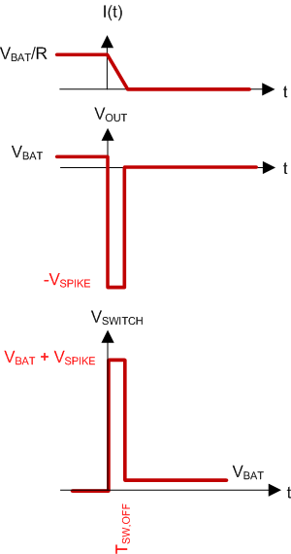
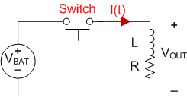
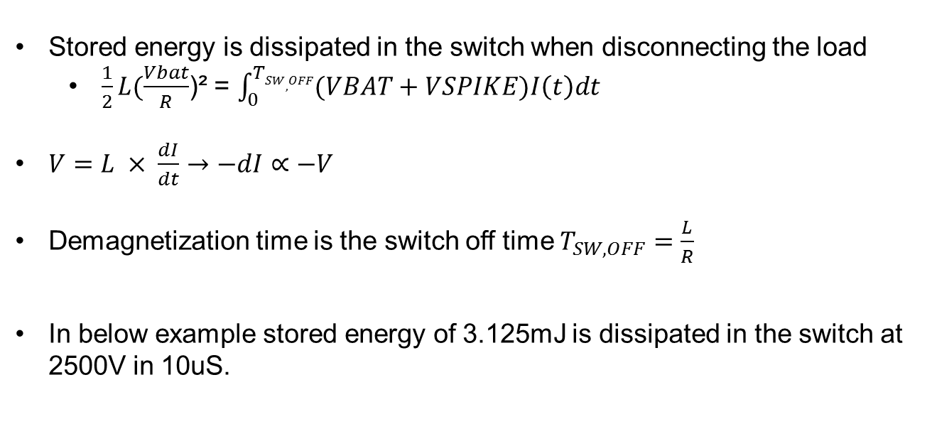
Disconnecting an Inductive load without a clamp
Stored energy is dissipated in the switch when disconnecting the load
  $\frac{1}{2}L(\frac{Vbat}{R}$)² = $\int_{0}^{TSW,OFF}{(VBAT+VSPIKE)I\left(t\right)dt }$
$V=L × \frac{dI}{dt}→−dI∝−V$
Demagnetization time is the switch off time $T_{SW,OFF}=\frac{L}{R}$
In below example stored energy of 3.125mJ is dissipated in the switch at 2500V in 10uS.
Damage!
Voltage spike of 2500V is way above the BVDSS limit and will damage the FET. It may also damage upstream components in the system.
Obviously something has to clamp the voltage to keep it at a safe operating point.
 | DC Resistance | Inductance | V_{BAT} | On State Current (V_{BAT}/R) | Off state current | Stored Magnetic Energy | T_{SW,OFF} | VOUT | VSW
NO clamp | 48Ω | 100mH | 12V | 250mA | 0mA | 3.125mJ | 10us | 2500 V | 2512 V
Damage!

Slide 7



Safely de-energizing an inductive load with different type of clamp
Clamping the voltage spike means reducing the peak voltage and dissipate the energy safely.
Three safe methods for de-energizing an inductive load and clamp the voltage spike:
  Clamp across the FET
For detailed calculation, please visit Driving inductive load section
  Clamp across the load
  Freewheeling diode across the load

Slide 8
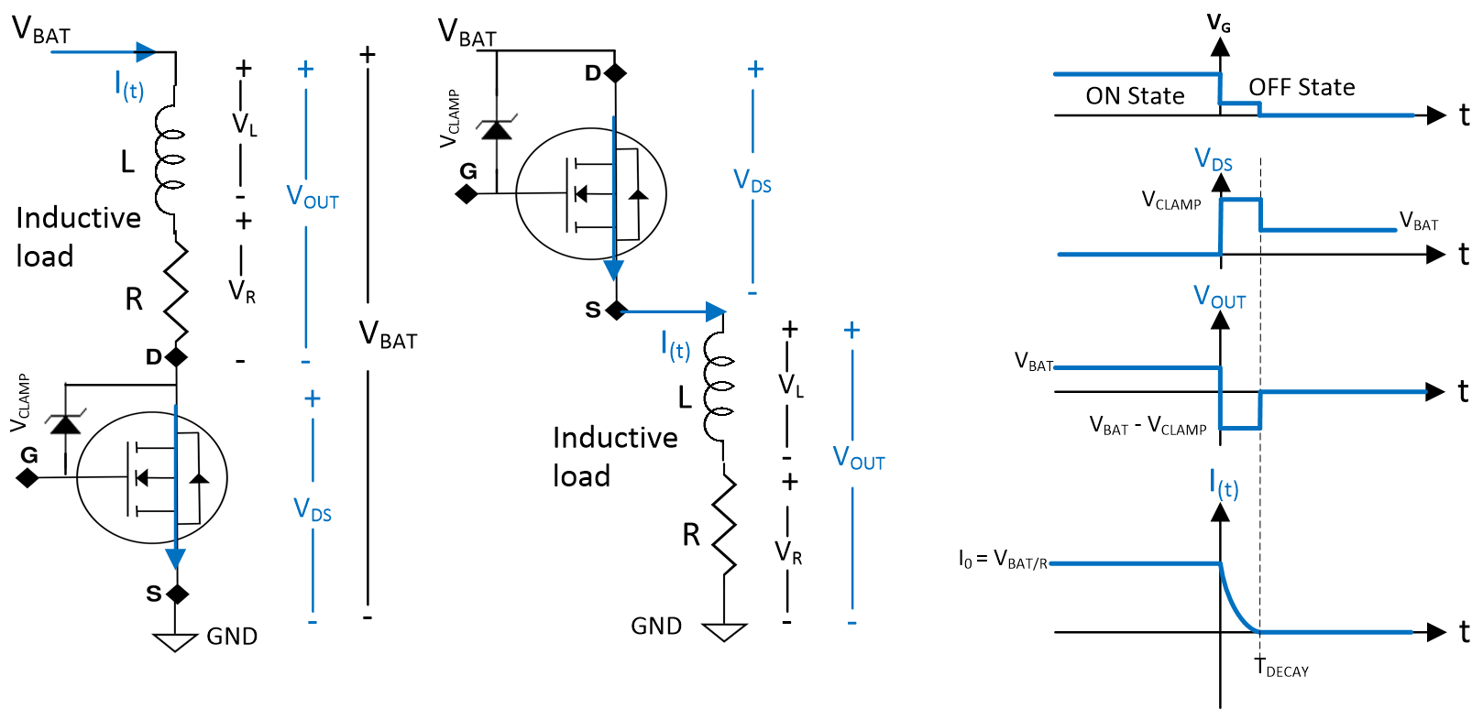

Clamp Across the FET
Waveform when Switch turns off:
Clamp is biased and creates a small voltage at the gate and puts the FET in linear region
Voltage across the load
  V_{OUT} = V_{BAT} - V_{CLAMP}
Voltage across the Switch
  V_{DS} = V_{CLAMP}
Demagnetization time T_{DECAY} is logarithmic function inversely proportional to clamp voltage
Demagnetization energy (dissipated in the FET)
E_{demag} $=\frac{1}{2}$ L ($\frac{VBAT}{R}$ )² $\frac{VCLAMP}{VCLAMP − VBAT}$
  Simplified formula valid when V_{CLAMP} > 3 V_{BAT}
Safe
The stored energy is dissipated in the FET and not in the clamp
This can easily be integrated with the FET
For detailed calculation, please visit Driving inductive load section

Slide 9
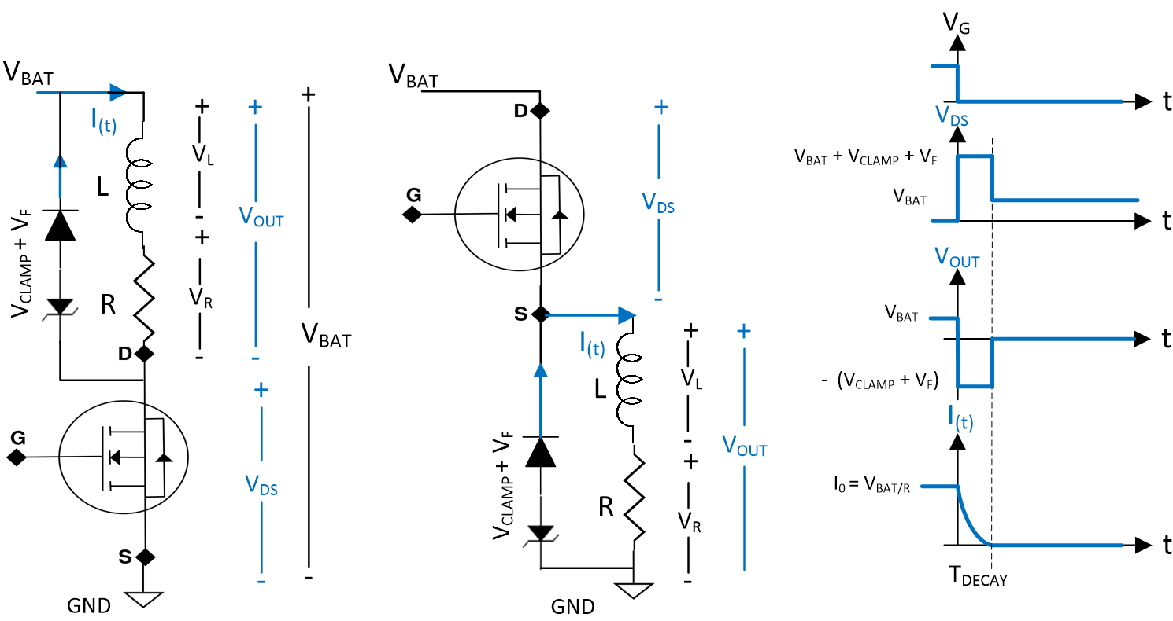

Clamp Across the Load
Waveform when switch turns off:
Demagnetization current I_{(t)} decays from initial value I₀ to final 0
Voltage across the load
  V_{OUT} = – (V_{CLAMP} + V_{F})
Voltage across the Switch
  V_{DS} = V_{BAT} + V_{CLAMP} + V_{F}
Demagnetization time T_{DECAY} is logarithmic function inversely proportional to clamp voltage
Demagnetization energy dissipated across the clamp
E_{demag}$=\frac{1}{2}$ L ($\frac{VBAT}{R}$ )²
  Simplified formula valid when $VCLAMP$ > 2 x V_{BAT}
Safe
The stored energy is dissipated in the TVS clamp and not in the FET
For detailed calculation, please visit Driving inductive load section

Slide 10
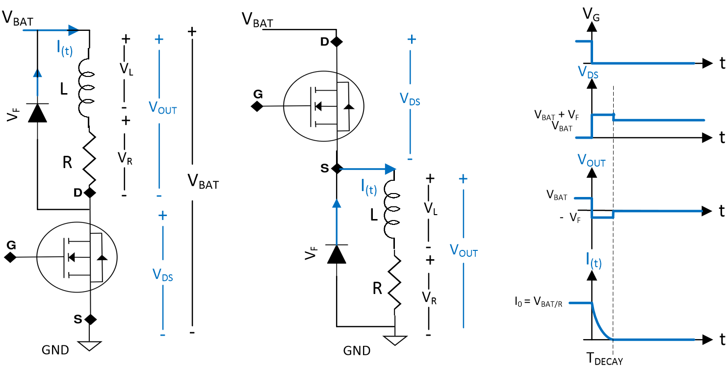

Freewheeling Diode Across the Load
Waveform when Switch turns off:
Demagnetization current I_{(t)} decays from initial value I₀ to final 0
Voltage across the load:
  V_{OUT} = – V_{F}
Voltage across the Switch:
  V_{DS} = V_{BAT} + V_{F}
Demagnetization time T_{DECAY} is logarithmic function inversely proportional to clamp voltage
Demagnetization energy dissipated across the diode
E_{demag =}=0.8 L $\frac{VF}{R}\frac{VBAT}{R}$
Simplified formula valid for any condition
Safe
The stored energy is dissipated in the freewheeling diode and not in the FET
For detailed calculation, please visit Driving inductive load section

Slide 11

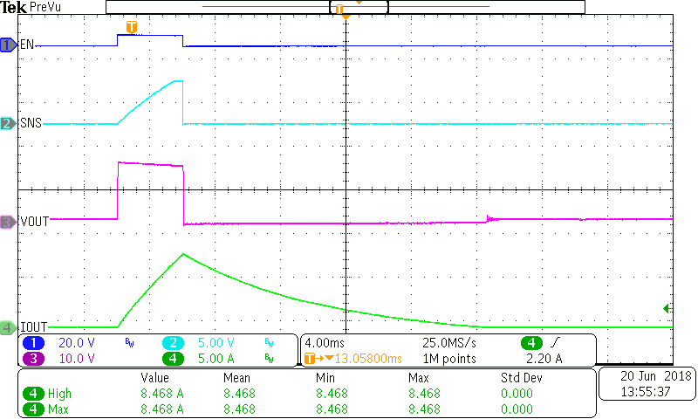
Lab results: turning off with an external diode
External diode V_{F} of 0.7V means even small 1mH load takes ~10ms to dissipate, compared to internal clamp which would take <1ms.
EN
ISNS
V_{OUT}
8.5A peak
I_{OUT}
V_{CLAMP} of 0.7V means even small 1mH load takes ~20ms to dissipate

Slide 12
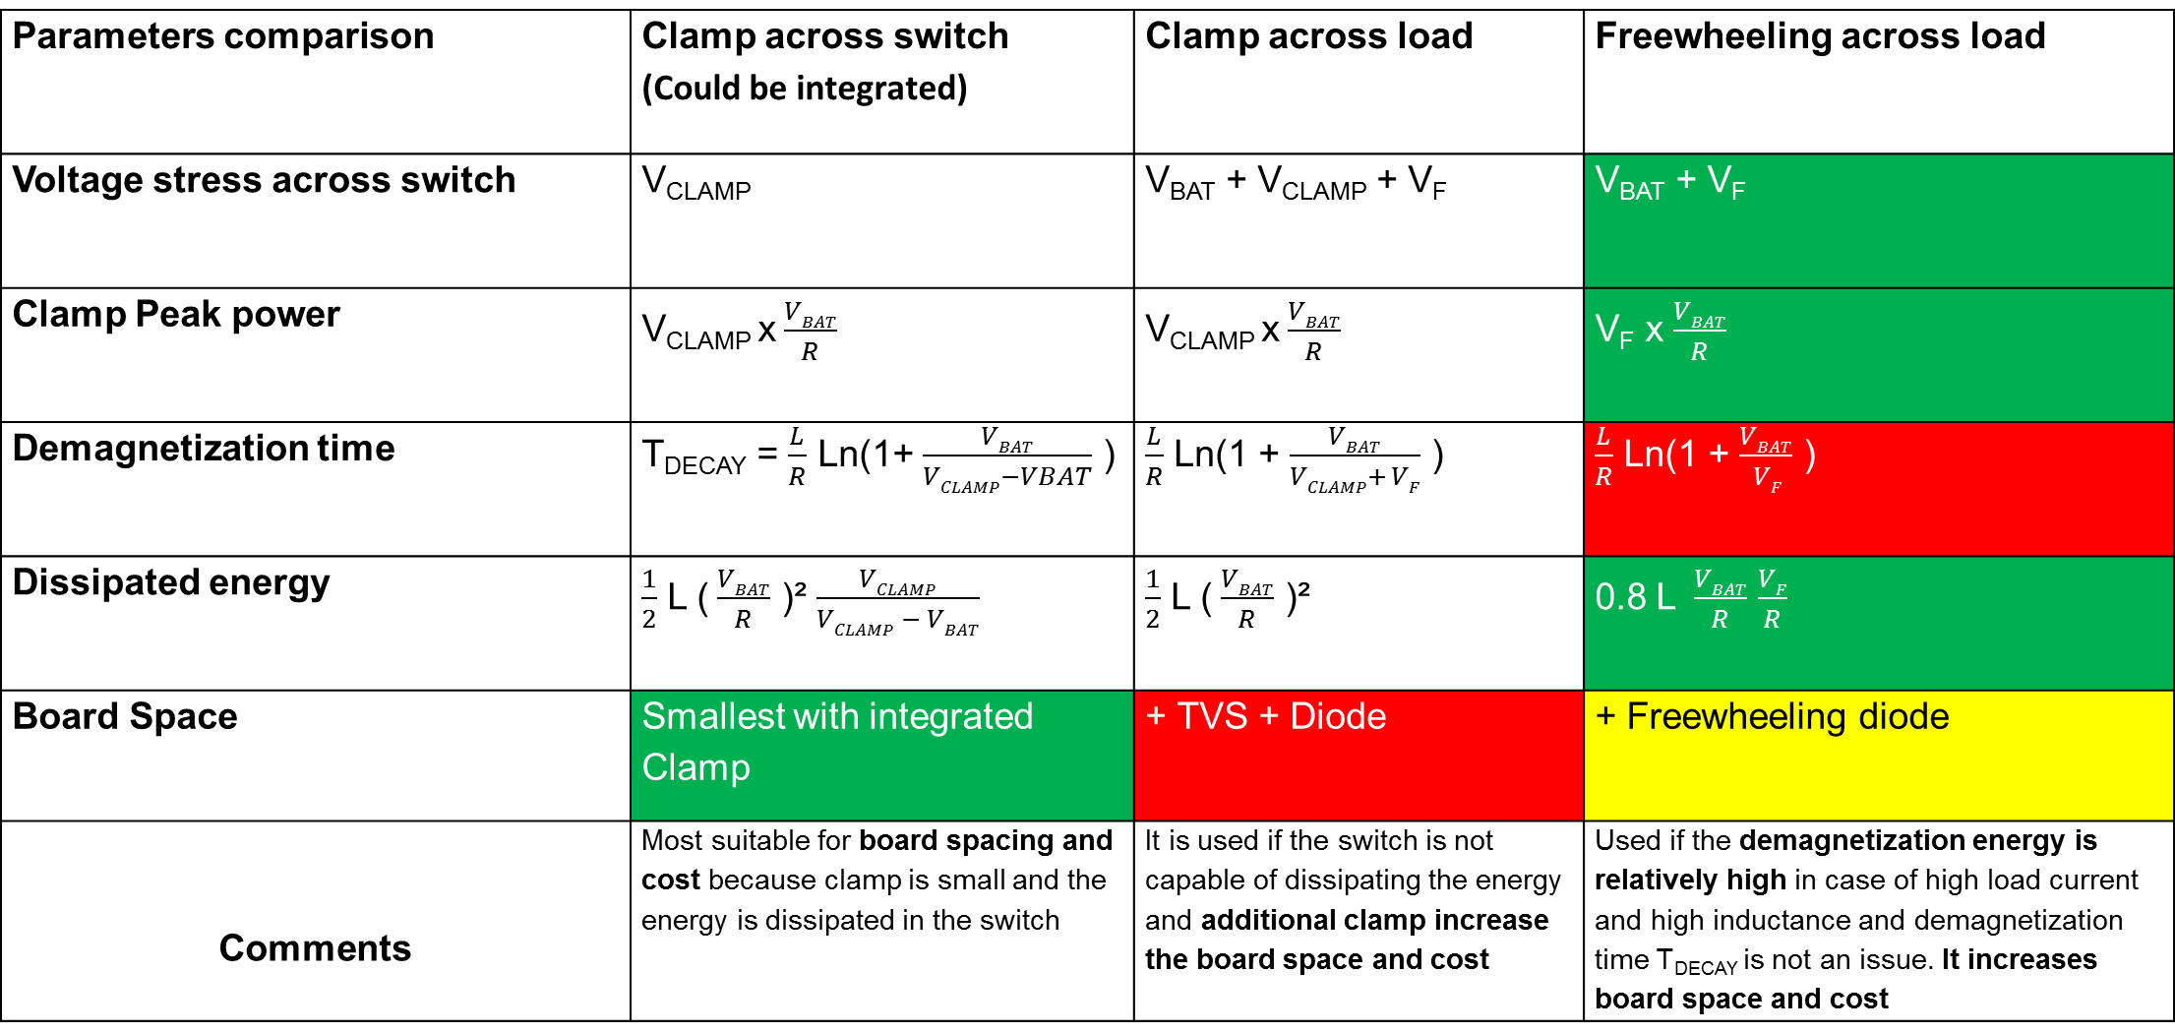
De-energizing methods summary
Parameters comparison | Clamp across switch (Could be integrated) | Clamp across load | Freewheeling across load
Voltage stress across switch | V_{CLAMP} | V_{BAT} + V_{CLAMP} + V_{F} | V_{BAT} + V_{F}
Clamp Peak power | V_{CLAMP} x$\frac{VBAT}{R}$ | V_{CLAMP} x$\frac{VBAT}{R}$ | V_{F} x $\frac{VBAT}{R}$
Demagnetization time | T_{DECAY} = $\frac{L}{R}$ Ln(1+ $\frac{VBAT}{VCLAMP−VBAT}$ ) | $\frac{L}{R}$ Ln(1 + $\frac{VBAT}{VCLAMP+ VF}$ ) | $\frac{L}{R}$ Ln(1 + $\frac{VBAT}{ VF}$ )
Dissipated energy | $\frac{1}{2}$ L ($\frac{VBAT}{R}$ )² $\frac{VCLAMP}{VCLAMP − VBAT}$ | $\frac{1}{2}$ L ($\frac{VBAT}{R}$ )² | 0.8 L $\frac{VBAT}{R}$ $\frac{VF}{R}$
Board Space | Smallest with integrated Clamp | + TVS + Diode | + Freewheeling diode
Comments | Most suitable for board spacing and cost because clamp is small and the energy is dissipated in the switch | It is used if the switch is not capable of dissipating the energy and additional clamp increase the board space and cost | Used if the demagnetization energy is relatively high in case of high load current and high inductance and demagnetization time T_{DECAY} is not an issue. It increases board space and cost

Slide 13
  Smart high side switches driving inductive loads

Slide 14
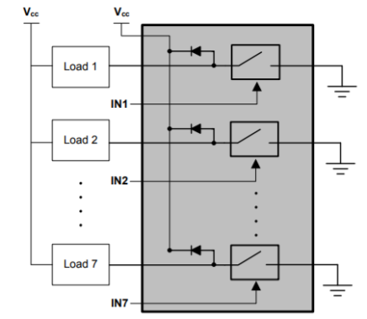
Integrated clamp: smart high side switch and low side switch
High Side Switch
High-side switch:
  is a power management device that connects to a battery input and switches on/off downstream loads and protects against short circuit and other faults
  Integrates clamp across the switch
Low-side switch:
  is a power management device that connects from the load and switches on/off to ground
  Integrates freewheeling diode
High-side switch is preferred due to improved protection, as constant load current can be avoided when a short to ground at the load occurs
V_{BAT}/V_{IN}
LOAD
Low Side Switch
Learn more about the differences in switch type here: Basics of Power Switch App Note

Slide 15
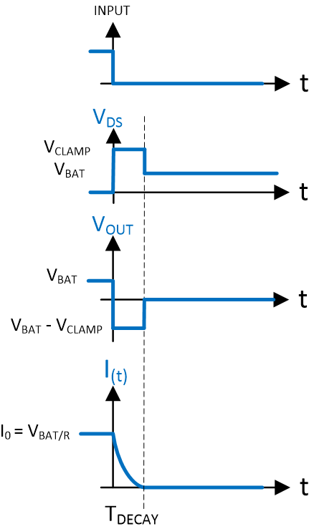
TI high side switches driving inductive loads
Embedded clamp across the FET between drain and gate. FET is turned off, V_{OUT} tends to go negative and gate is biased. The FET is ON in saturation region and drive the current to zero during demagnetization time T_{DECAY}. The demagnetization energy is dissipated in the FET and not in the clamp. The clamp is only to bias the gate. Drain to source voltage is almost the same as V_{CLAMP}. FET breakdown voltage is higher than the clamp voltage
V_{CLAMP}

Slide 16
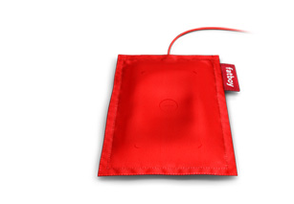
Inductive Load Driving Considerations
Maximum On resistance
Ensure the Smart High Side Switch can drive the inductive load in on state by keeping the junction temperature below 150C
Maximum energy dissipation
Ensure the smart high side Switch can dissipate the inductive load stored energy before using an external TVS clamp or freewheeling diode
Demagnetization time
Ensure that the V_{CLAMP} is high enough to limit the demagnetization time per system requirement

Slide 17
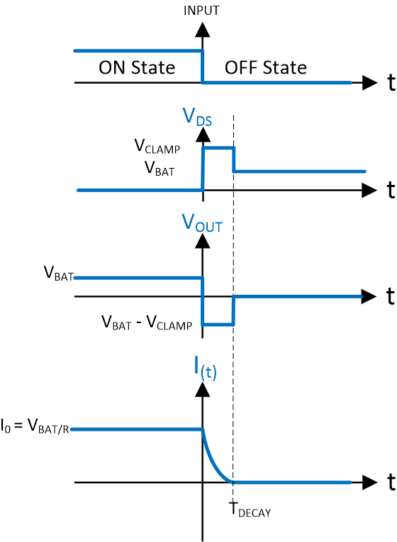
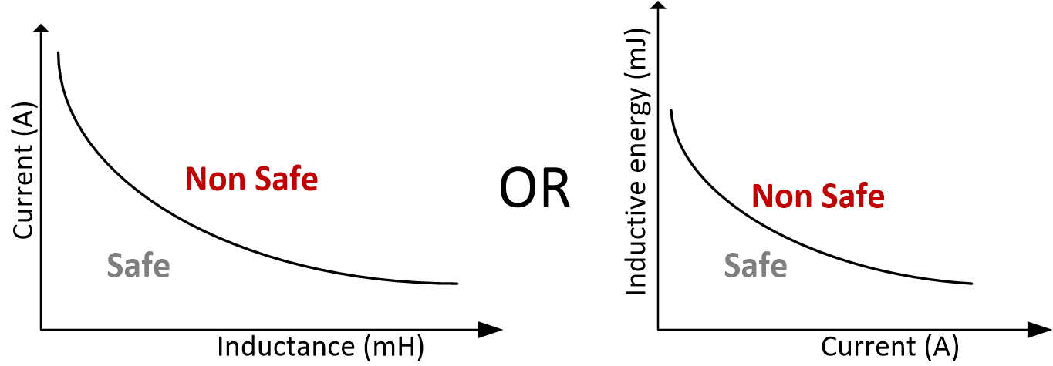
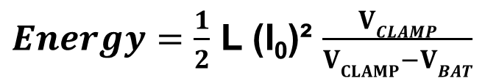
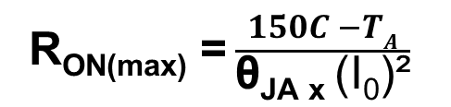
Selecting the right high side switch: Inductive Loads
Datasheet parameters in OFF state
Drain to source internal clamp voltage | V_{CLAMP}
Inductive load switch-off energy dissipation | Plots
Datasheet parameters in ON state
FET on resistance | R_{ON}
Junction temperature | T_{J}
Ambient temperature | T_{A}
Junction to ambient thermal resistance | θ_{JA}
R_{ON(max)} = $\frac{150C −TA}{\text{θ}\text{JA} \text{x} \text{(}\text{I}\text{0}\text{)²}}$
$Energy=\frac{1}{2}$ L (I₀)² $\frac{VCLAMP}{VCLAMP−VBAT}$
Key high side switch selection considerations
On resistor R_{ON(max)} keeps the junction temperature below 150C in ON state
Switch-off energy dissipation is within the safe area

Slide 18
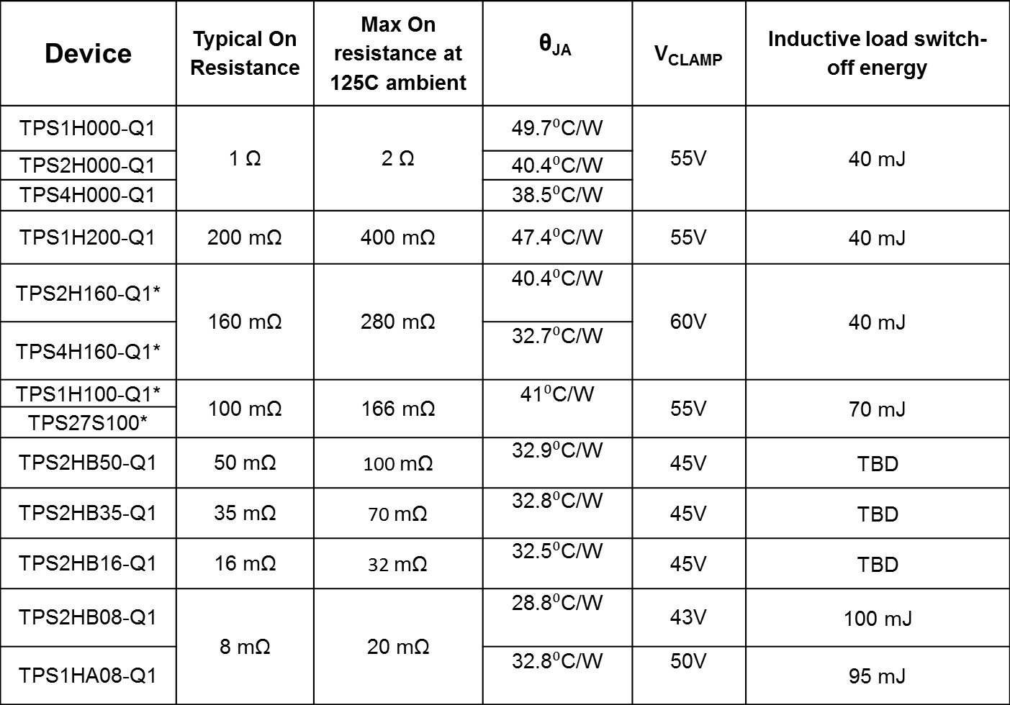
Selecting the right high side switch : Parameters
DC current-focused parameters
Inductive load-focused parameter
Device | Typical On Resistance | Max On resistance at 125C ambient | $$\text{θ}\text{JA}$$ | V_{CLAMP} | Inductive load switch-off energy
TPS1H000-Q1 | 1 Ω | 2 Ω | 49.7⁰C/W | 55V | 40 mJ
TPS2H000-Q1 |  |  | 40.4⁰C/W
TPS4H000-Q1 |  |  | 38.5⁰C/W
TPS1H200-Q1 | 200 mΩ | 400 mΩ | 47.4⁰C/W | 55V | 40 mJ
TPS2H160-Q1* | 160 mΩ | 280 mΩ | 40.4⁰C/W | 60V | 40 mJ
TPS4H160-Q1* |  |  | 32.7⁰C/W
TPS1H100-Q1* | 100 mΩ | 166 mΩ | 41⁰C/W | 55V | 70 mJ
TPS27S100*
TPS2HB50-Q1 | 50 mΩ | 100 mΩ | 32.9⁰C/W | 45V | TBD
TPS2HB35-Q1 | 35 mΩ | 70 mΩ | 32.8⁰C/W | 45V | TBD
TPS2HB16-Q1 | 16 mΩ | 32 mΩ | 32.5⁰C/W | 45V | TBD
TPS2HB08-Q1 | 8 mΩ | 20 mΩ | 28.8⁰C/W | 43V | 100 mJ
TPS1HA08-Q1 |  |  | 32.8⁰C/W | 50V | 95 mJ
*Full energy vs inductance plot available
Rest coming soon

Slide 19
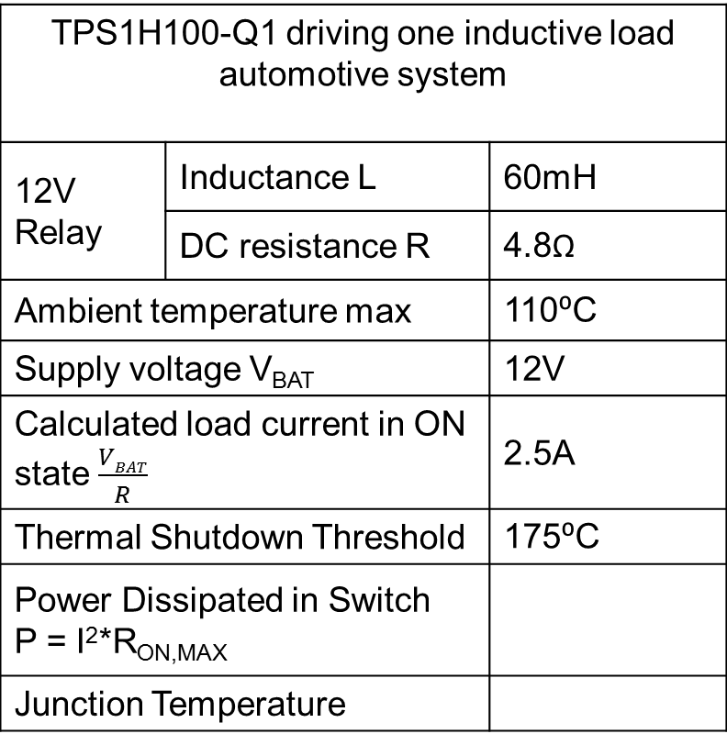
Relay (inductive load) application example
TPS1H100-Q1 driving one inductive load automotive system
12V Relay | Inductance L | 60mH
 | DC resistance R | 4.8Ω
Ambient temperature max |  | 110⁰C
Supply voltage V_{BAT} |  | 12V
Calculated load current in ON state $\frac{VBAT}{R}$ |  | 2.5A
Thermal Shutdown Threshold |  | 175⁰C
Power Dissipated in Switch P = I²*R_{ON,MAX}
Junction Temperature
Safe
1.0375 W
152.5⁰C
Why is the single channel TPS1H100 a good fit for this application?
Junction Temperature does not cause the part to shut down at max R_{ON}
Switch-off energy dissipation is within the safe area

Slide 20
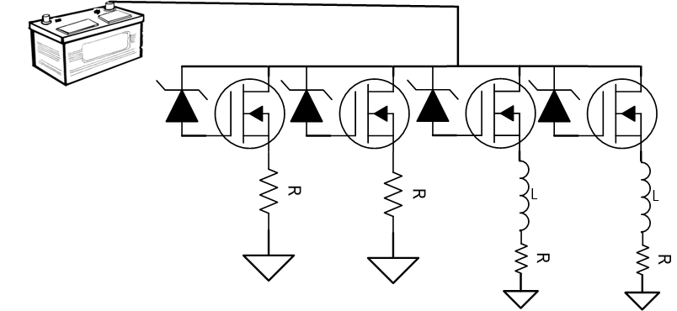
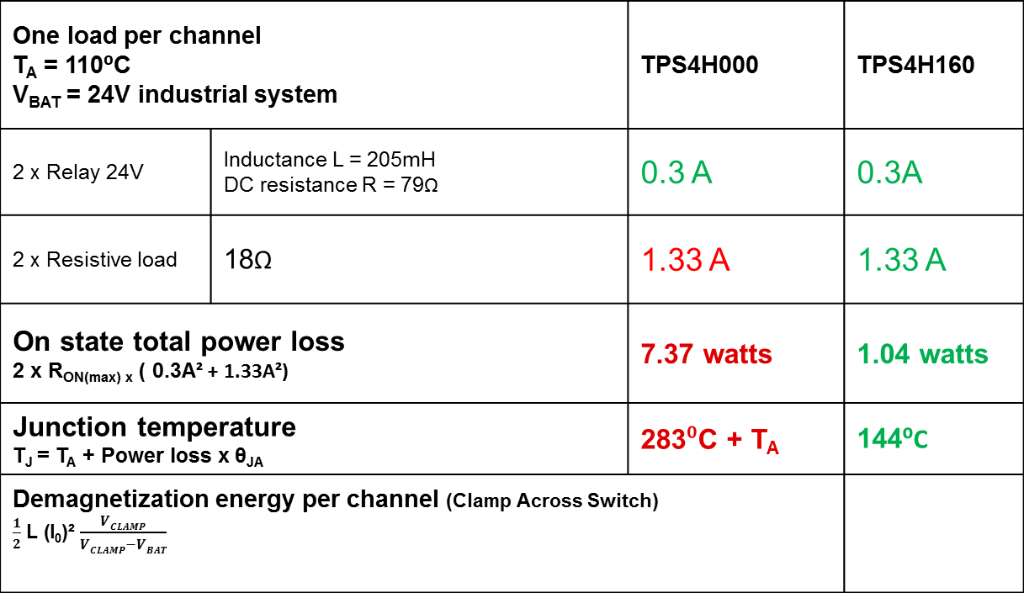
4 independent loads: inductive and resistive combined
One load per channel T_{A} = 110⁰C V_{BAT} = 24V industrial system |  | TPS4H000 | TPS4H160
2 x Relay 24V | Inductance L = 205mH DC resistance R = 79Ω | 0.3 A | 0.3A
2 x Resistive load | 18Ω | 1.33 A | 1.33 A
On state total power loss 2 x R_{ON(max) x} ( 0.3A² + 1.33A²) |  | 7.37 watts | 1.04 watts
Junction temperature T_{J} = T_{A} + Power loss x $\text{θ}\text{JA}$ |  | 283⁰C + T_{A} | 144⁰C
Demagnetization energy per channel (Clamp Across Switch) $\frac{1}{2}$ L (I₀)² $\frac{VCLAMP}{VCLAMP−VBAT}$
Safe
11.5 mJ
Why is quad channel TPS4H160 a good fit for this application?
Device total power losses, in ON state, keeps the junction temperature below 150⁰C
Switch-off energy dissipation is within the safe area

Slide 21
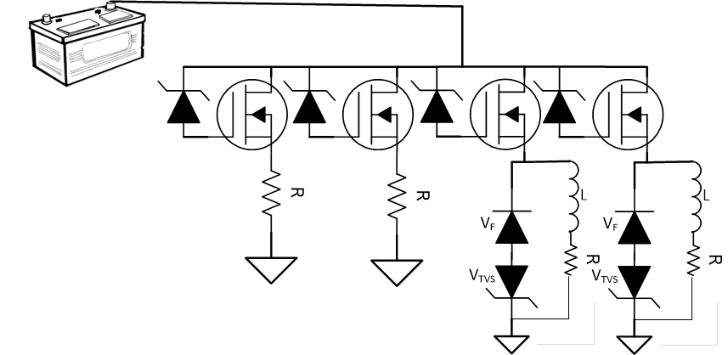
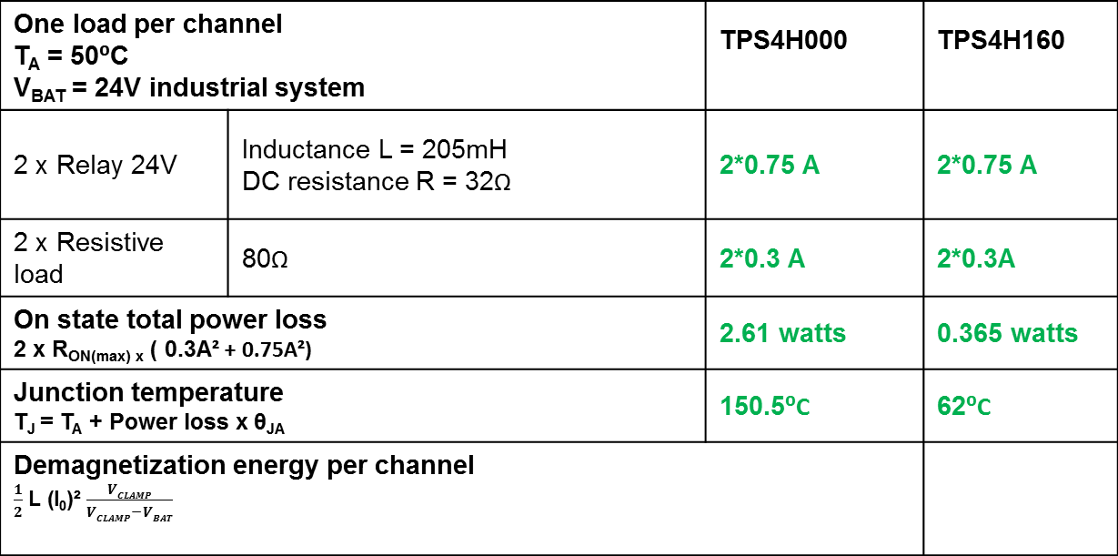
External TVS clamp
One load per channel T_{A} = 50⁰C V_{BAT} = 24V industrial system |  | TPS4H000 | TPS4H160
2 x Relay 24V | Inductance L = 205mH DC resistance R = 32Ω | 2*0.75 A | 2*0.75 A
2 x Resistive load | 80Ω | 2*0.3 A | 2*0.3A
On state total power loss 2 x R_{ON(max) x} ( 0.3A² + 0.75A²) |  | 2.61 watts | 0.365 watts
Junction temperature T_{J} = T_{A} + Power loss x $\text{θ}\text{JA}$ |  | 150.5⁰C | 62⁰C
Demagnetization energy per channel $\frac{1}{2}$ L (I₀)² $\frac{VCLAMP}{VCLAMP−VBAT}$
Damage!
170.8 mJ
Quad channel TPS4H160 is a good fit for this application but it needs an external TVS clamp
Device total power losses, in ON state, keeps the junction temperature below 150⁰C
Switch-off energy dissipation is not within the safe area and needs external TVS capable of dissipating 170.8mJ
TVS voltage clamp V_{TVS} must be less than V_{CLAMP} - V_{BAT}

Slide 22
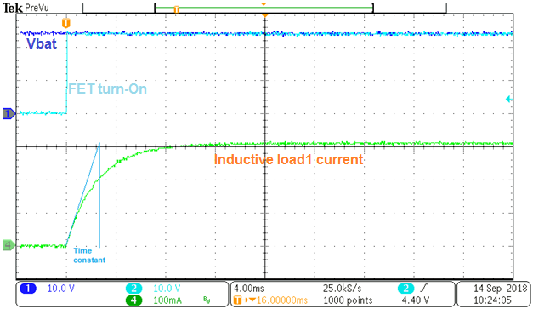
What if Inductance is unknown?
Apply step voltage i.e 24V
Measure the steady state current R = 24V/I
Measure the time constant τ = L/R
R | Time constant τ | L = τ x R
24V/0.303A = 79Ω | 2.56mS | 204.8mH
The solenoids and relays inductance coil are not always described in the datasheet.
Inductance value is necessary to calculate the magnetic stored energy.
Effective method is to apply a step voltage and measure the time constant

Slide 23
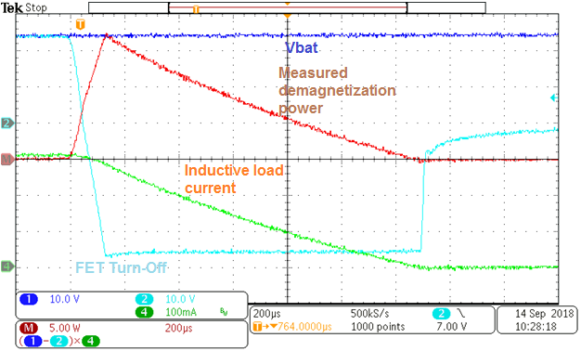
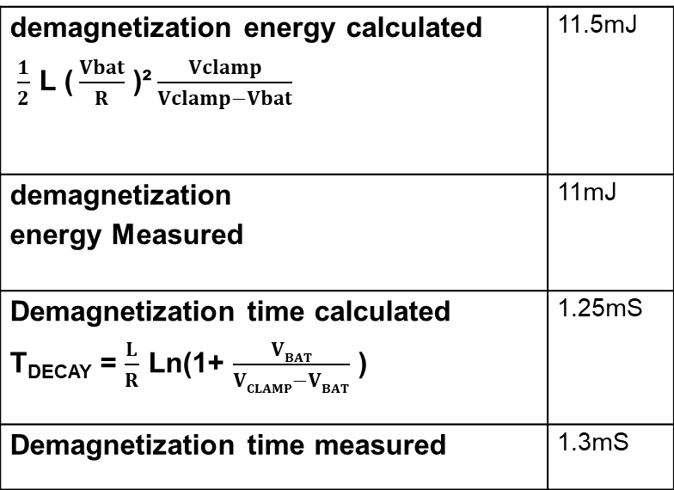
Measuring demagnetization energy in the lab using TPS4H160
demagnetization energy calculated $\frac{1}{2}$ L ($\frac{Vbat}{R}$ )²$\frac{Vclamp}{Vclamp−Vbat}$ | 11.5mJ
demagnetization energy Measured | 11mJ
Demagnetization time calculated T_{DECAY} = $\frac{L}{R}$ Ln(1+ $\frac{VBAT}{VCLAMP−VBAT}$ ) | 1.25mS
Demagnetization time measured | 1.3mS
Lab measurement prove the calculation accuracy

Slide 24
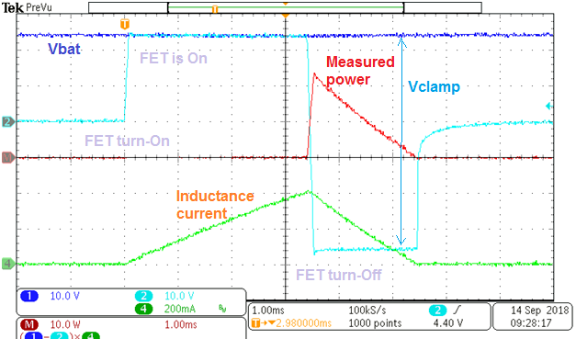
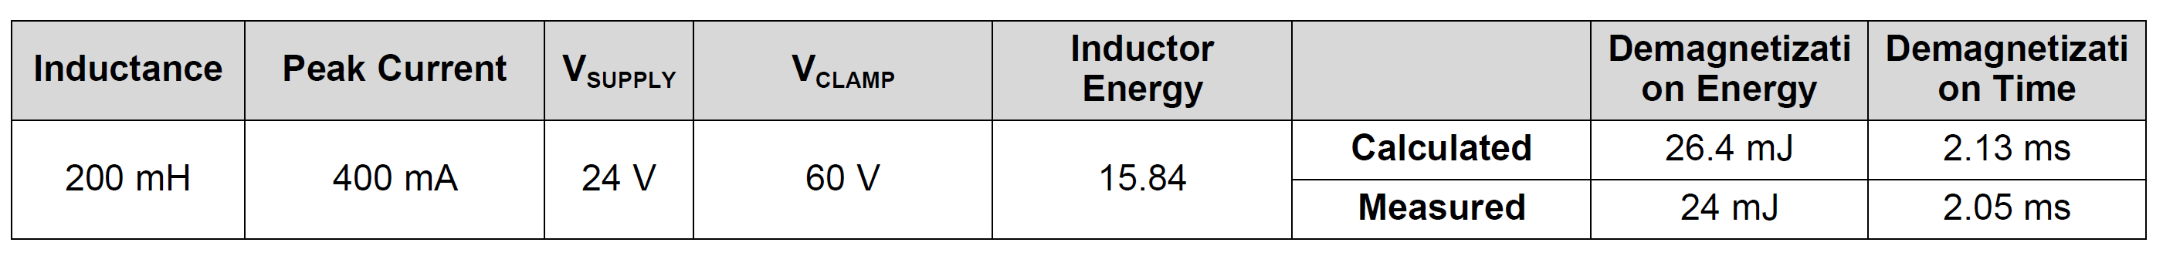
Pure inductive load lab measurement using TPS4H160
Safe
Stressing the high side switch at different points (Peak current, Inductance) gives the inductive load switch-off energy dissipation capability plot

Slide 25
Inductive Load Driving Considerations
Maximum On resistance
Ensure the Smart High Side Switch can drive the inductive load in on state by keeping the junction temperature below 150C
Maximum energy dissipation
Ensure the smart high side Switch can dissipate the inductive load stored energy before using an external TVS clamp or freewheeling diode
Demagnetization time
Ensure that the V_{CLAMP} is high enough to limit the demagnetization time per system requirement

Slide 26
Summary
Driving Inductive loads storing magnetic energy generates very high voltage spikes at switching off time. High voltage spike leads to severe damage. To prevent damage, a voltage clamp and controlled demagnetization energy dissipation is a must
TI smart high side switches integrate a clamp which offers significant advantages for inductive load driving with no need of external TVS clamping in most applications
The calculated formulas are accurate and can be used to safely design a system to switch inductive loads on/off

Slide 27
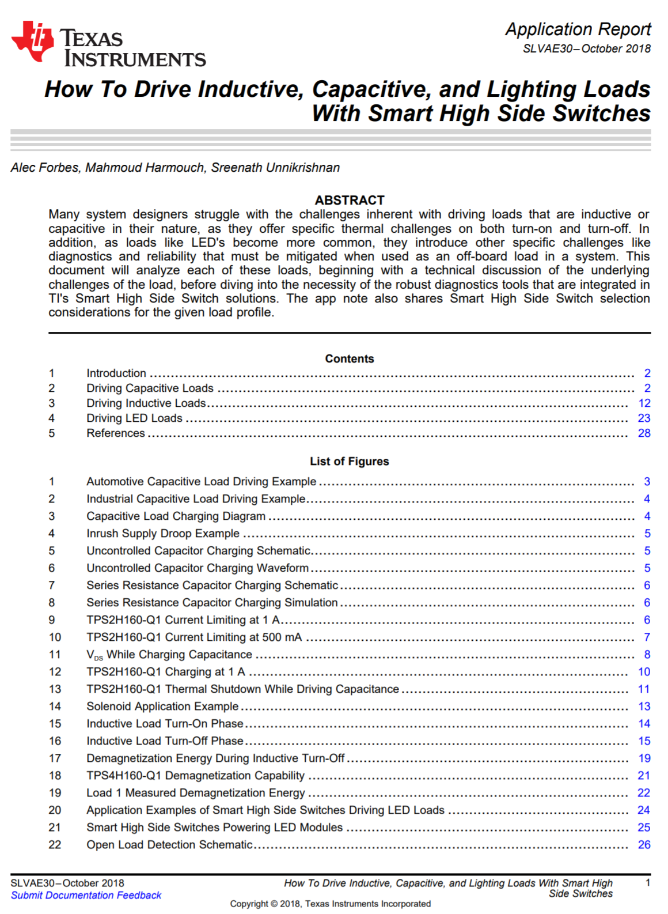
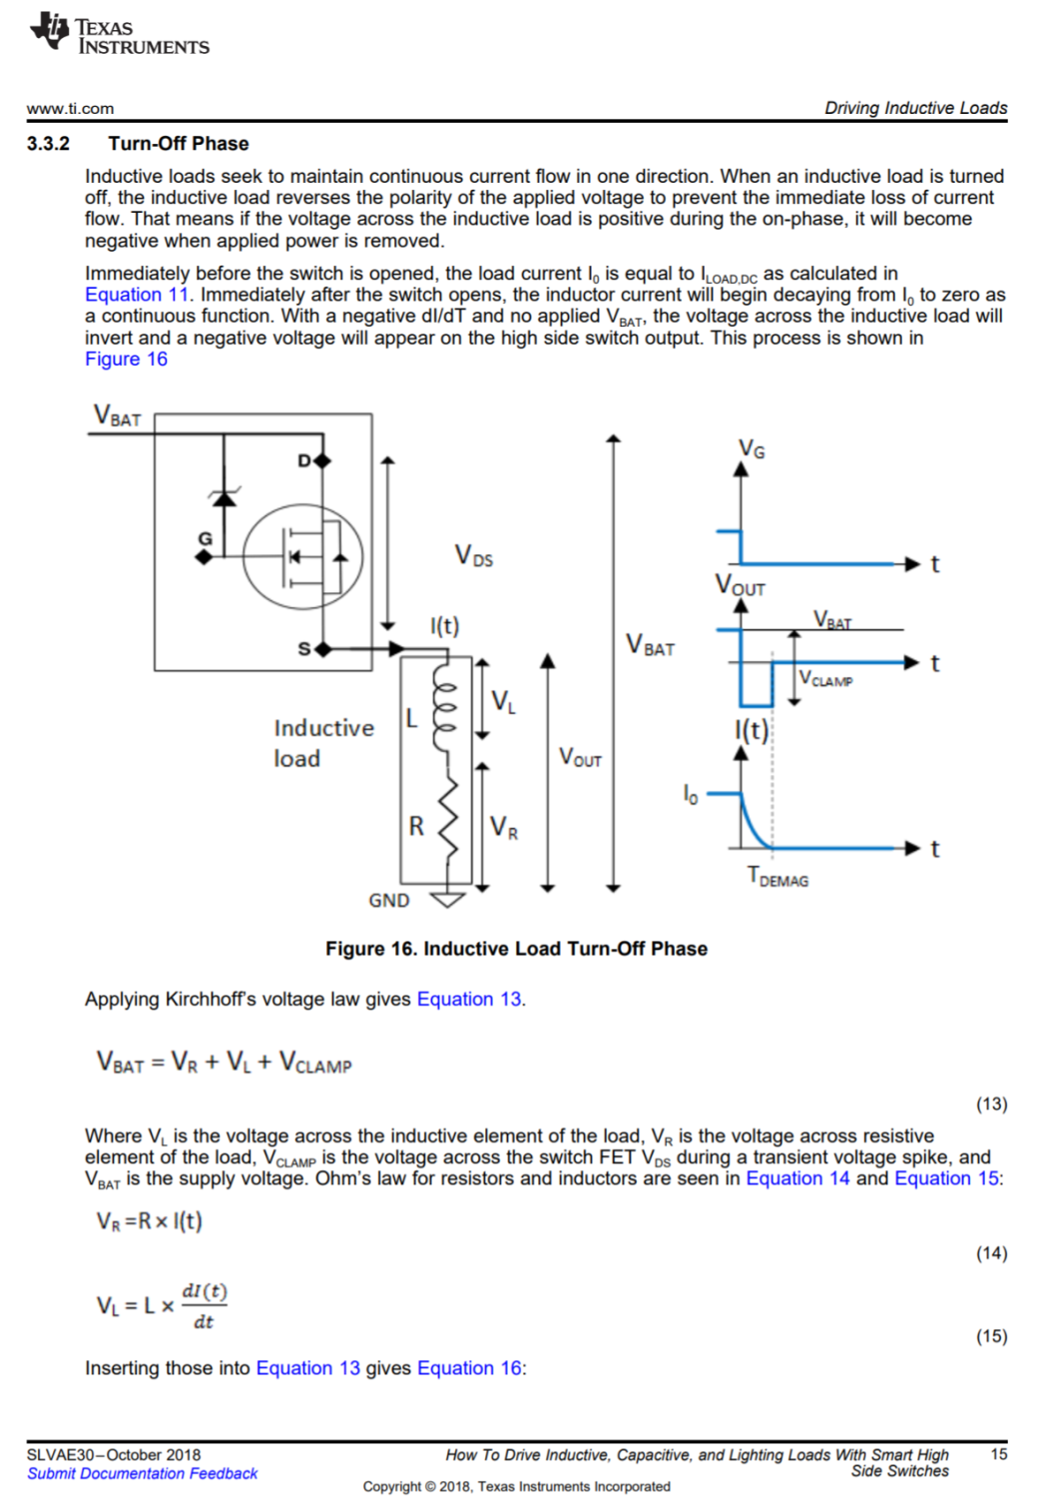
For additional information: SLVAE30 application report

Slide 28

Notes:
This slide should be retained for the recording… Leave on screen for 5 seconds.

Slide 29
Backup

Slide 30
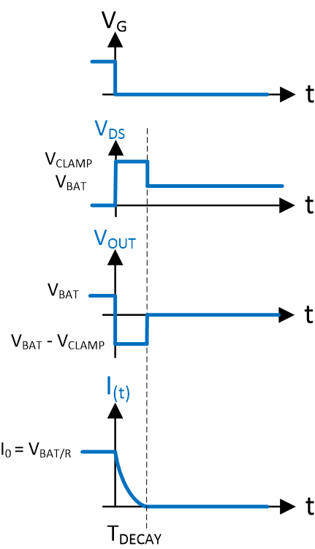
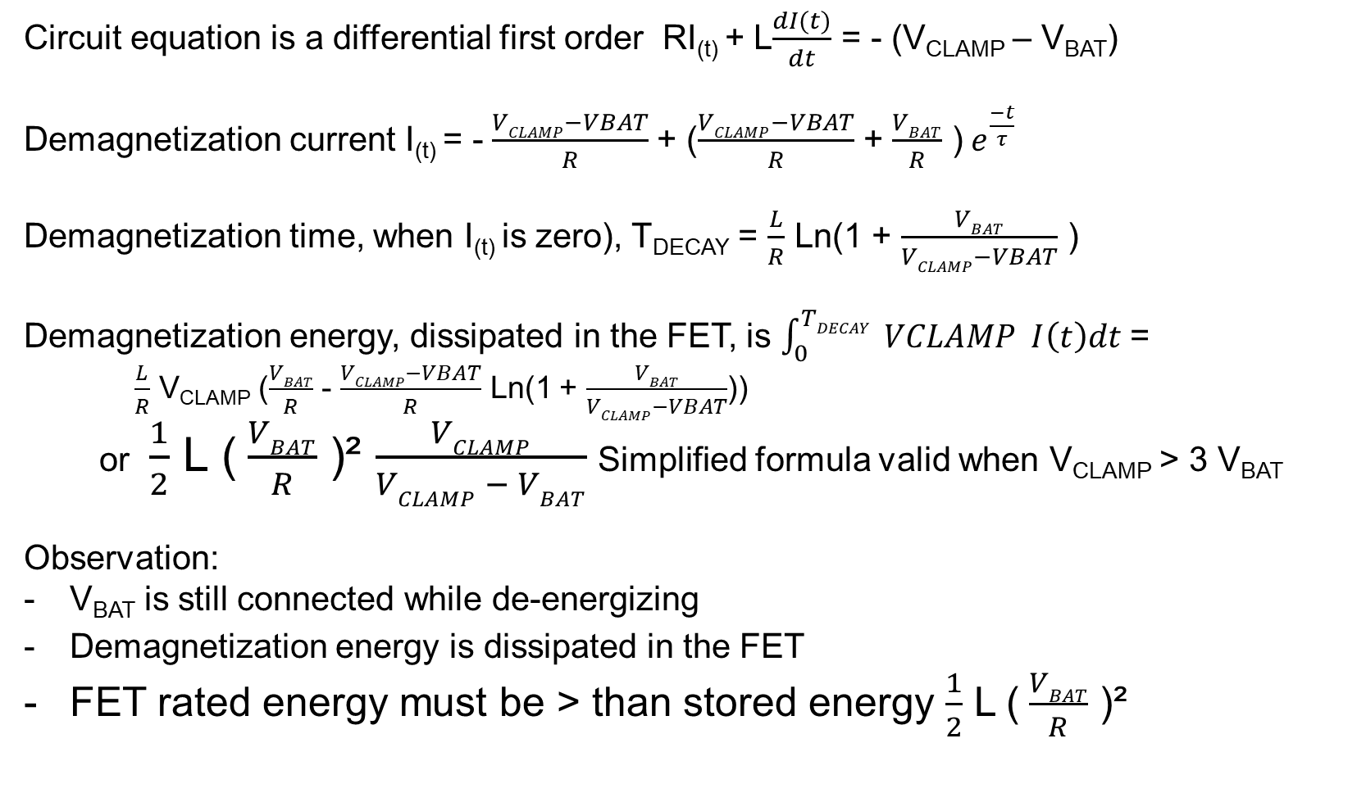
De-energizing with clamp across the switch formulas
Circuit equation is a differential first order RI_{(t)} + L$\frac{dI(t)}{dt}$ = - (V_{CLAMP} – V_{BAT})
Demagnetization current I_{(t)} = -$\frac{VCLAMP−VBAT}{R}$ + ($\frac{VCLAMP−VBAT}{R}$ + $\frac{VBAT}{R}$ )$e^{\frac{−t}{τ}}$
Demagnetization time, when I_{(t)} is zero), T_{DECAY} = $\frac{L}{R}$ Ln(1 + $\frac{VBAT}{VCLAMP−VBAT}$ )
Demagnetization energy, dissipated in the FET, is $\int_{0}^{TDECAY}{ VCLAMP I\left(t\right)dt }$=
$\frac{L}{R}$ V_{CLAMP} ($\frac{VBAT}{R}$ - $\frac{VCLAMP−VBAT}{R}$ Ln(1 + $\frac{VBAT}{VCLAMP−VBAT}$))
or $\frac{1}{2}$ L ($\frac{VBAT}{R}$ )² $\frac{VCLAMP}{VCLAMP − VBAT}$Simplified formula valid when V_{CLAMP} > 3 V_{BAT}
Observation:
V_{BAT} is still connected while de-energizing
Demagnetization energy is dissipated in the FET
FET rated energy must be > than stored energy $\frac{1}{2}$ L ($\frac{VBAT}{R}$ )²

Slide 31
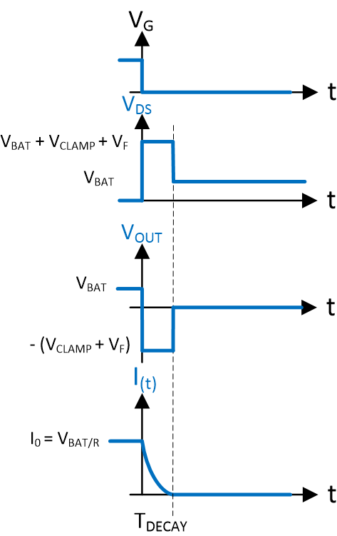
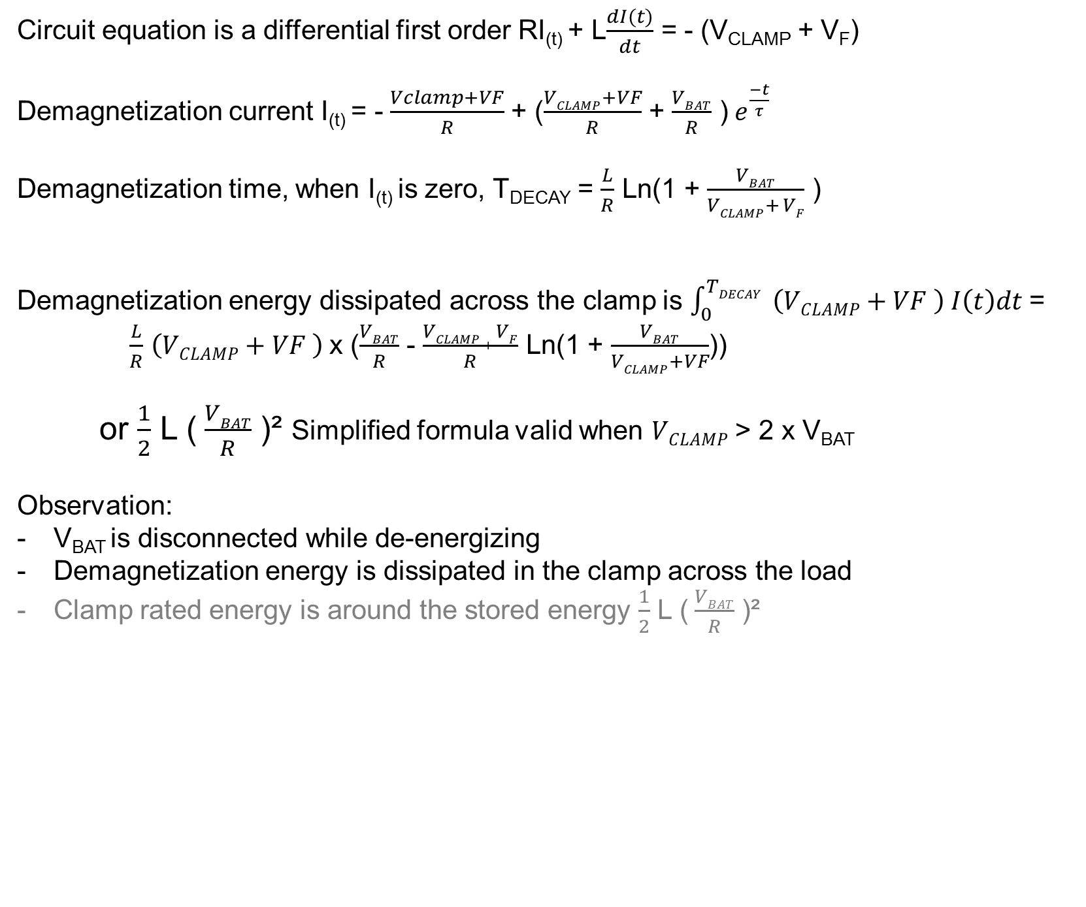
De-energizing with a TVS clamp across the load formulas
Circuit equation is a differential first order RI_{(t)} + L$\frac{dI(t)}{dt}$ = - (V_{CLAMP} + V_{F})
Demagnetization current I_{(t)} = -$\frac{Vclamp+VF}{R}$ + ($\frac{VCLAMP+VF}{R}$ + $\frac{VBAT}{R}$ )$e^{\frac{−t}{τ}}$
Demagnetization time, when I_{(t)} is zero, T_{DECAY} = $\frac{L}{R}$ Ln(1 + $\frac{VBAT}{VCLAMP+ VF}$ )
Demagnetization energy dissipated across the clamp is $\int_{0}^{TDECAY}{ \left(VCLAMP+VF \right) I\left(t\right)dt }$=
$\frac{L}{R}$ $\left(VCLAMP+VF \right)$x ($\frac{VBAT}{R}$ - $\frac{VCLAMP + VF}{R}$ Ln(1 + $\frac{VBAT}{VCLAMP+VF}$))
or $\frac{1}{2}$ L ($\frac{VBAT}{R}$ )² Simplified formula valid when $VCLAMP$ > 2 x V_{BAT}
Observation:
V_{BAT} is disconnected while de-energizing
Demagnetization energy is dissipated in the clamp across the load
Clamp rated energy is around the stored energy $\frac{1}{2}$ L ($\frac{VBAT}{R}$ )²

Slide 32
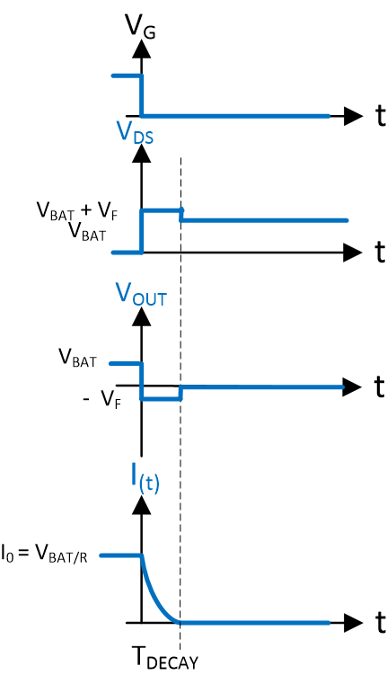
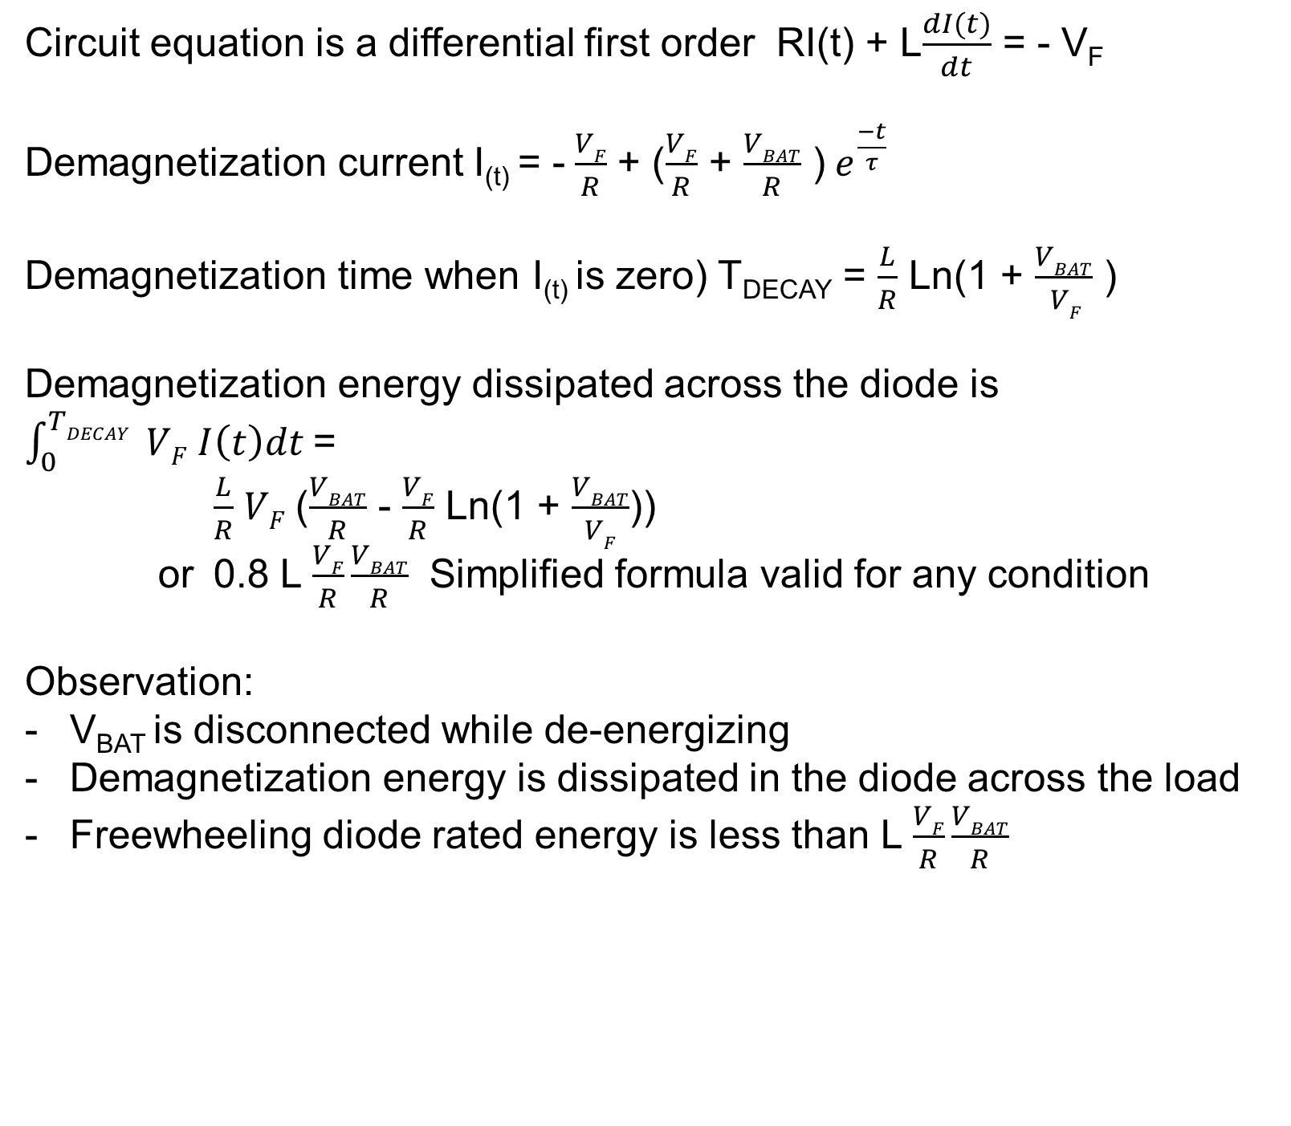
De-energizing with a freewheeling diode across the load formulas
Circuit equation is a differential first order RI(t) + L$\frac{dI(t)}{dt}$ = - V_{F}
Demagnetization current I_{(t)} = -$\frac{VF}{R}$ + ($\frac{VF}{R}$ + $\frac{VBAT}{R}$ )$e^{\frac{−t}{τ}}$
Demagnetization time when I_{(t)} is zero) T_{DECAY} = $\frac{L}{R}$ Ln(1 + $\frac{VBAT}{ VF}$ )
Demagnetization energy dissipated across the diode is $\int_{0}^{TDECAY}{ VF I\left(t\right)dt }$=
$\frac{L}{R}$ $VF$($\frac{VBAT}{R}$ - $\frac{VF}{R}$ Ln(1 + $\frac{VBAT}{VF}$))
or 0.8 L $\frac{VF}{R}\frac{VBAT}{R}$ Simplified formula valid for any condition
Observation:
V_{BAT} is disconnected while de-energizing
Demagnetization energy is dissipated in the diode across the load
Freewheeling diode rated energy is less than L $\frac{VF}{R}\frac{VBAT}{R}$

