Slide 1
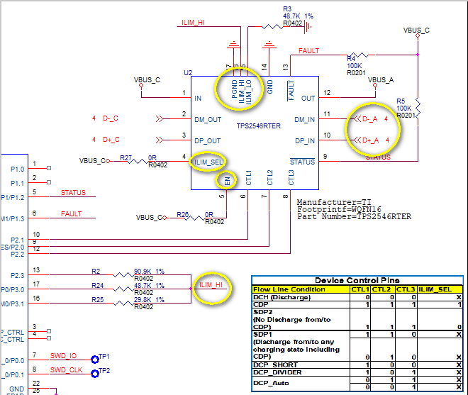
Schematic
SchematicSchematic

Slide 2
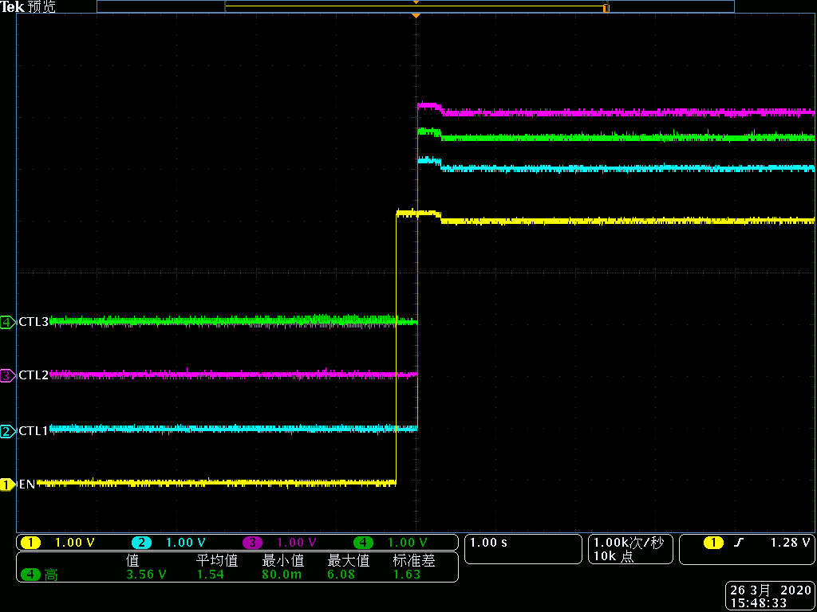
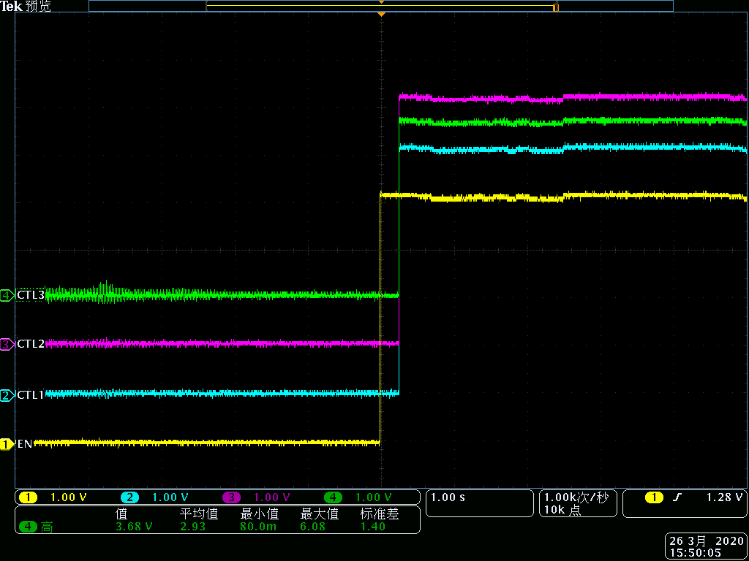
CTL1,CTL2,CTL3,EN=VBUS_C
starting up
power off

Slide 3
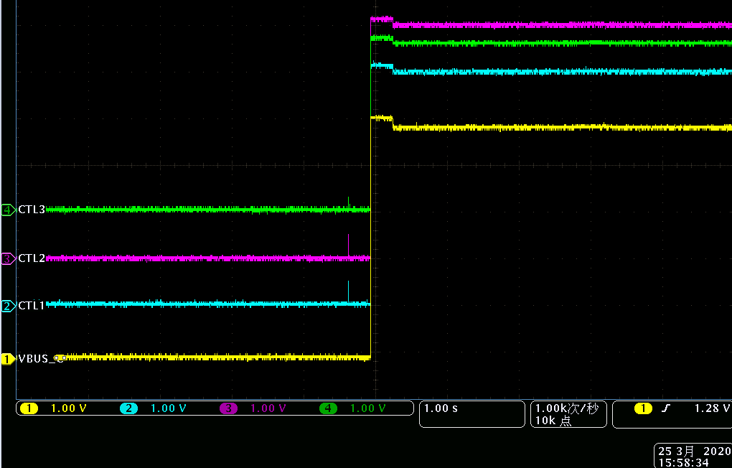
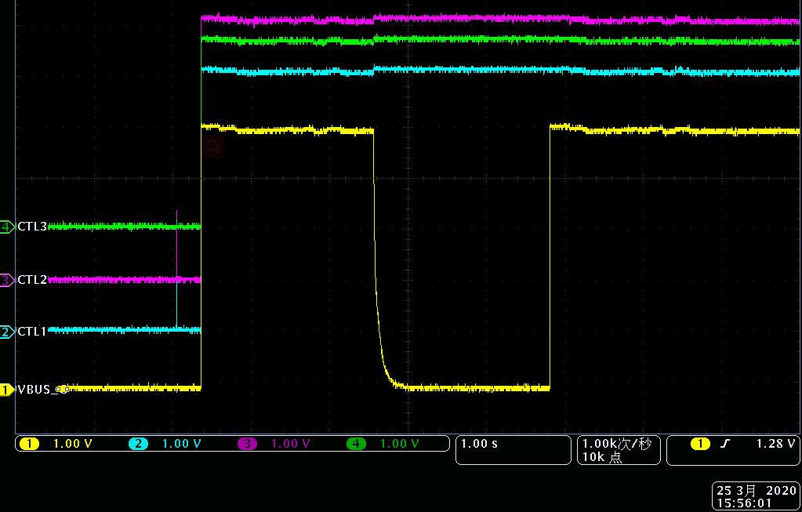
CTL1,CTL2,CTL3,VBUS_A
starting up
power off

Slide 4
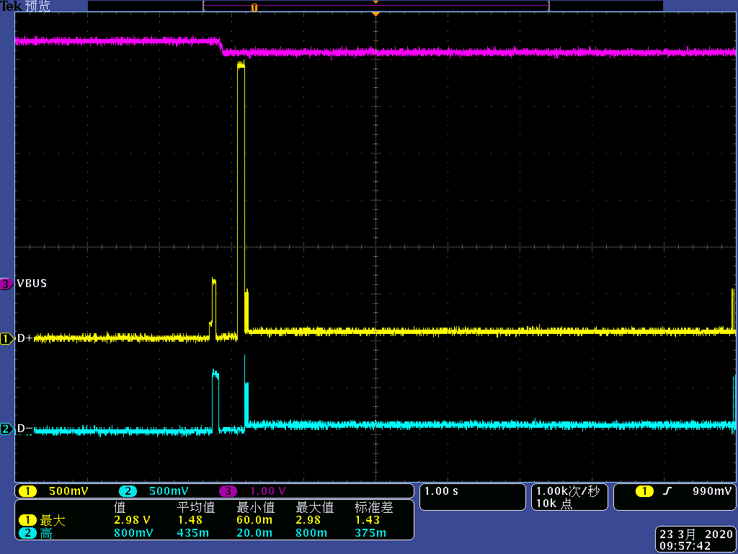
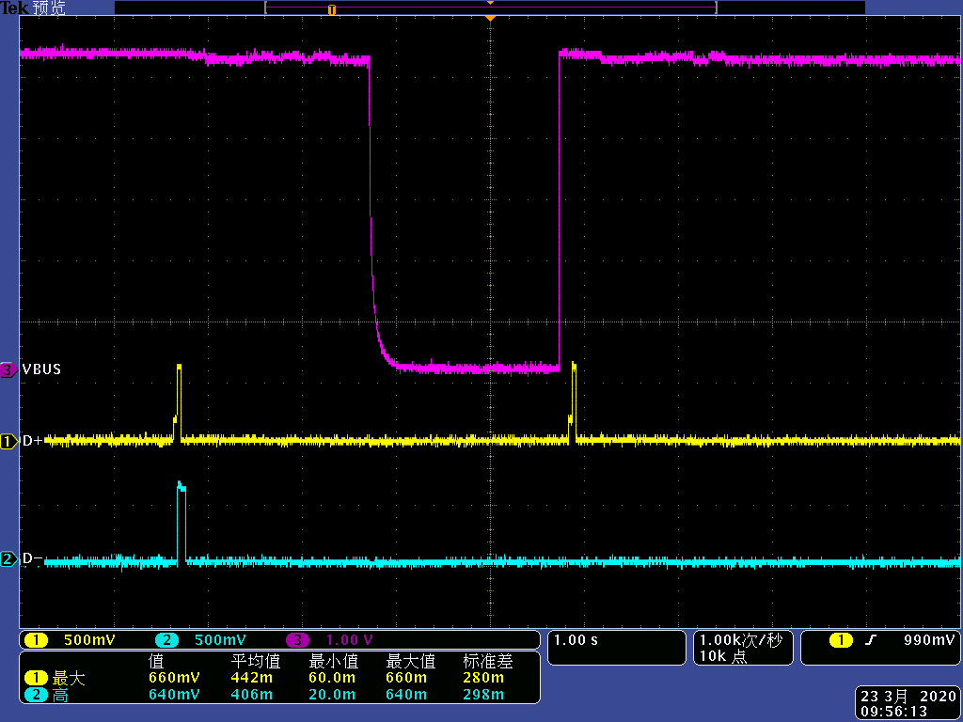
D+,D-,VBUS_A, CTL1,2,3 = 111
starting up
power off

Slide 5
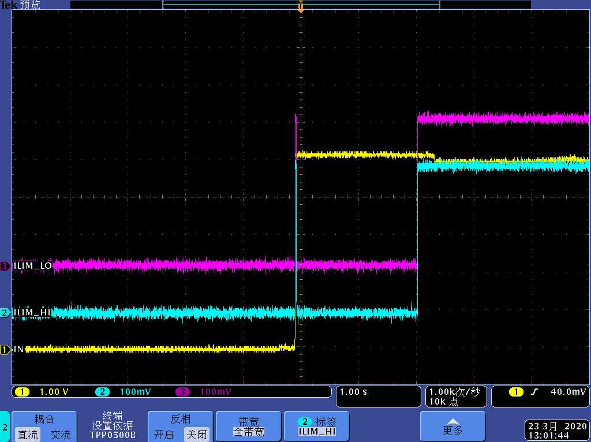
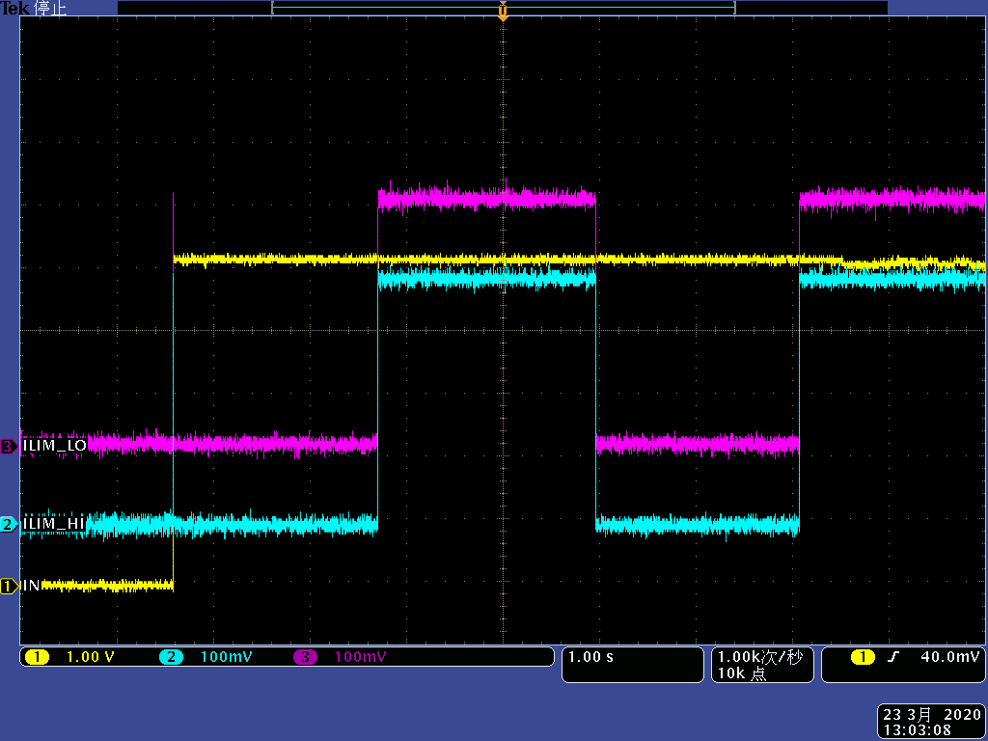
ILIM_LO,ILIM_HI,EN=VBUS_C, CTL1,2,3 = 111
starting up
power off

Slide 6
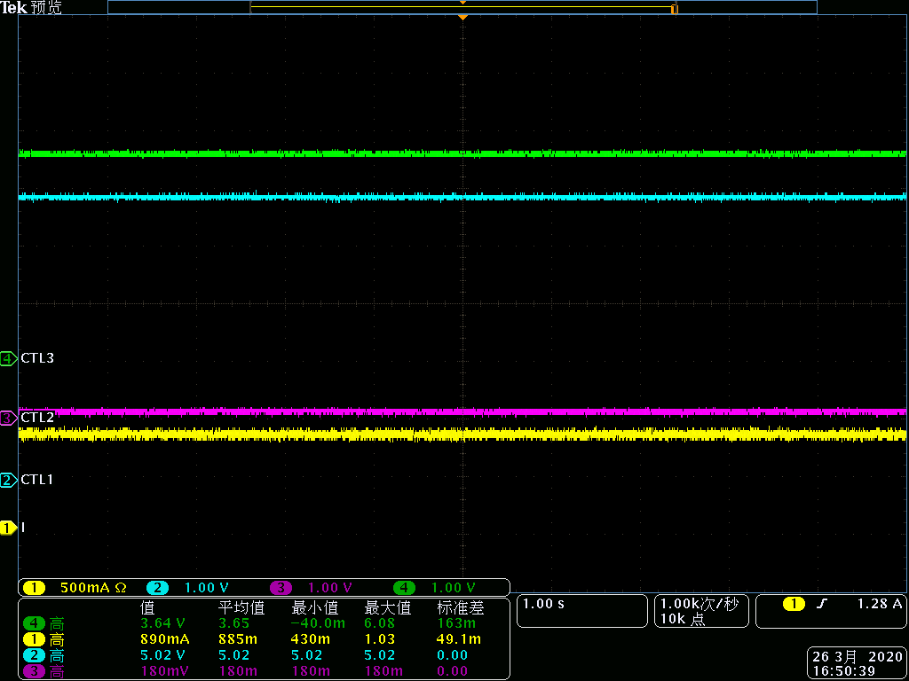
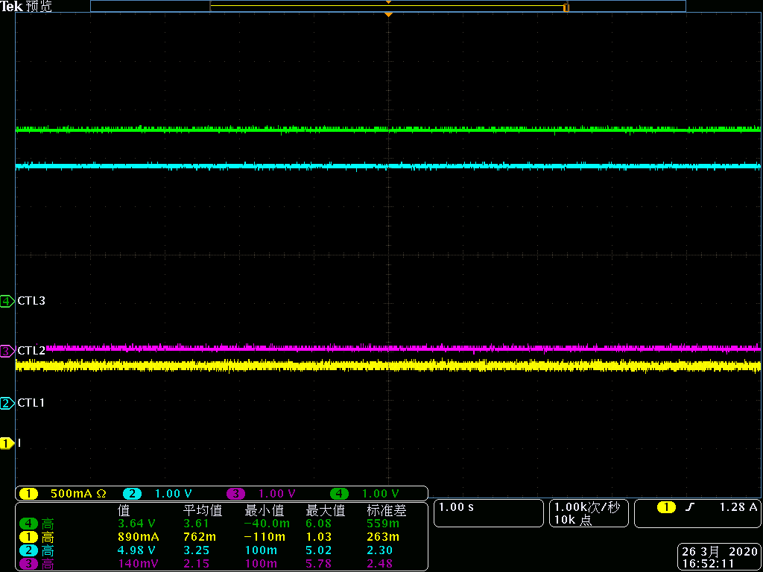
CTL1=1,CTL2=0,CTL3=1,current
Current goes well when 101 DCP on CTL1,2 3, but DCP do not support Data transfer
starting up
power off

