Slide 1
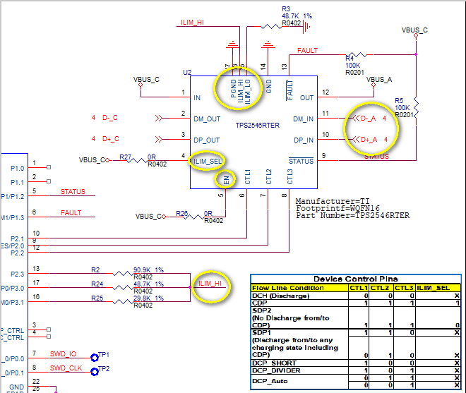
Schematic
SchematicSchematic

Slide 2
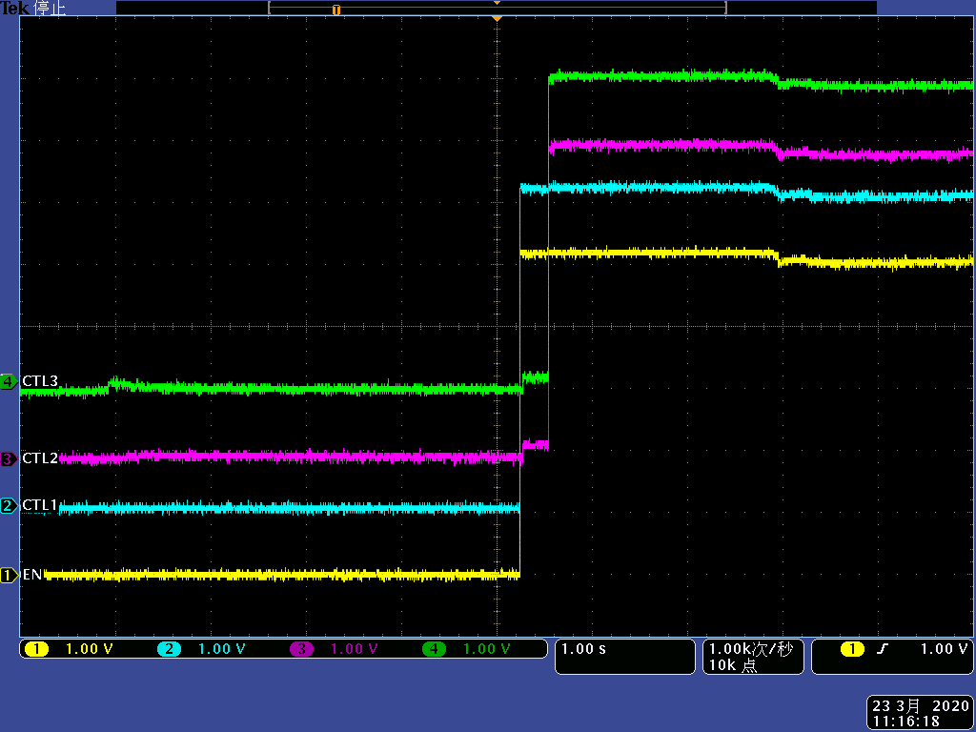
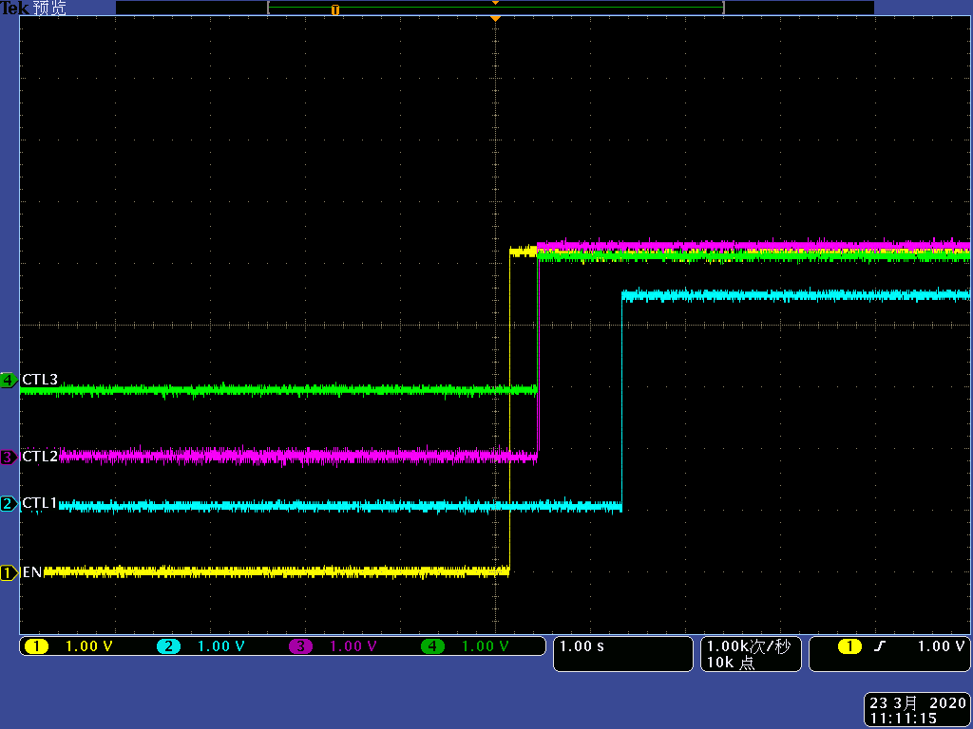
CTL1,CTL2,CTL3,EN=VBUS_C
starting up
power off

Slide 3
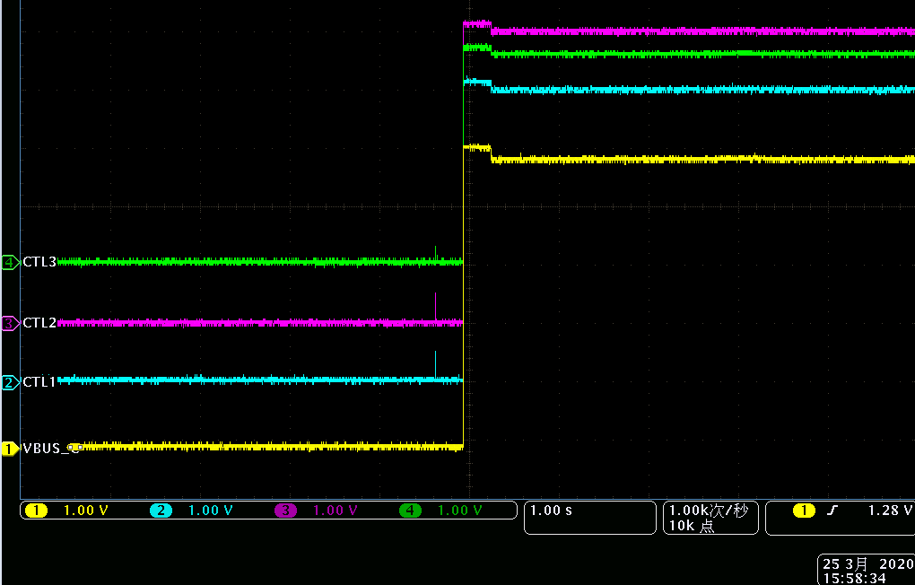
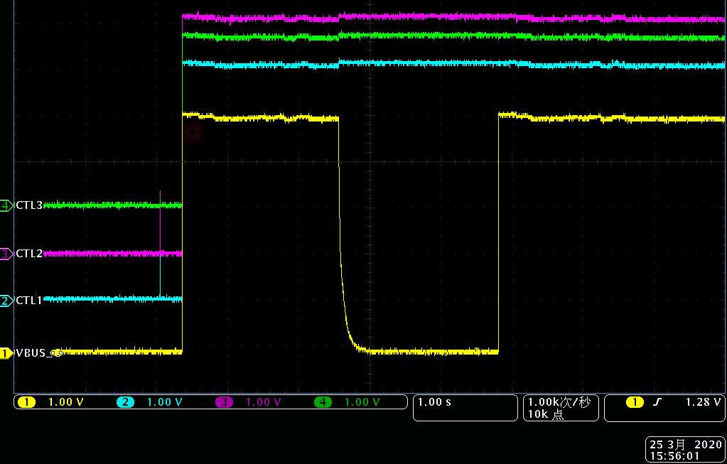
CTL1,CTL2,CTL3,VBUS_A
starting up
power off

Slide 4
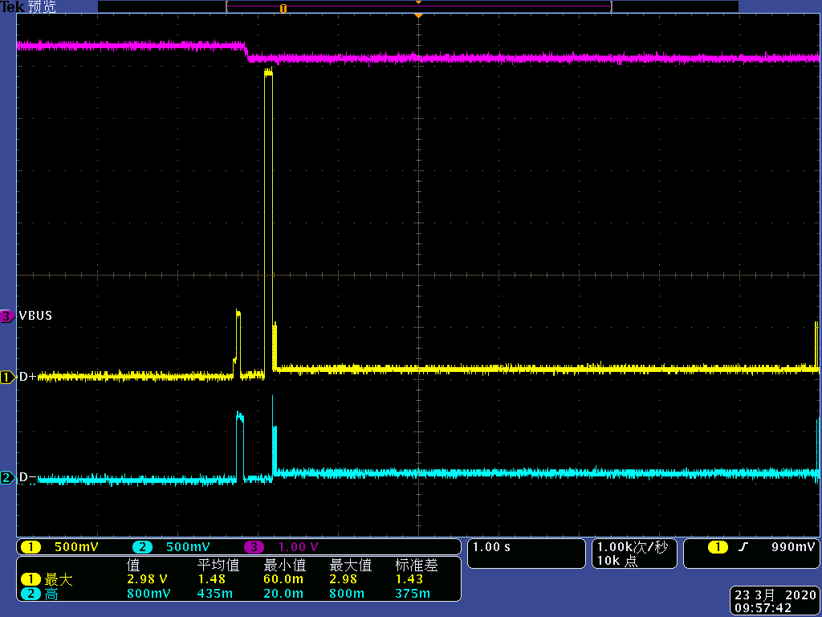
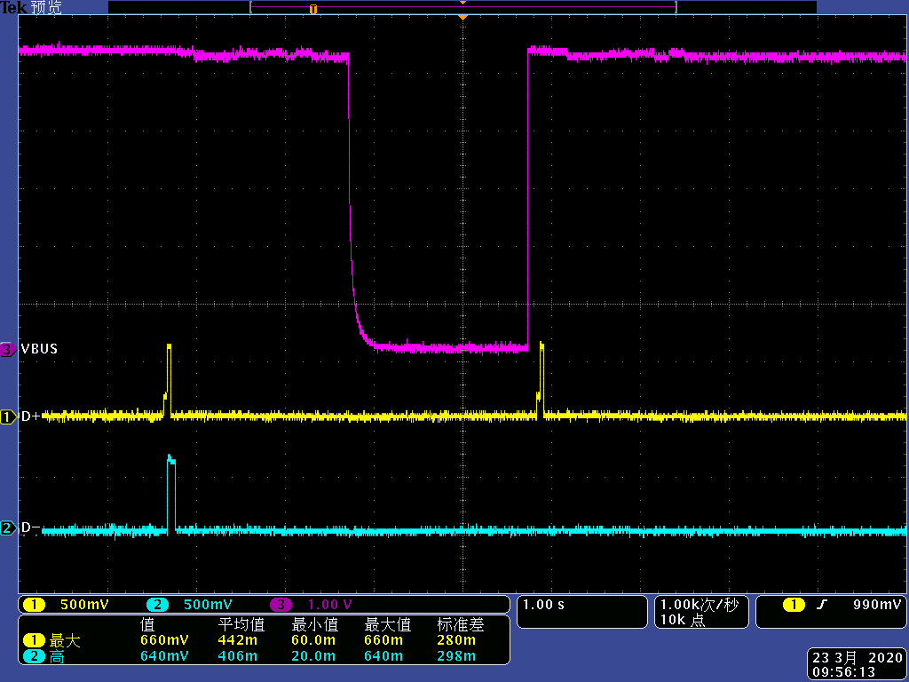
D+,D-,VBUS_A
starting up
power off

Slide 5
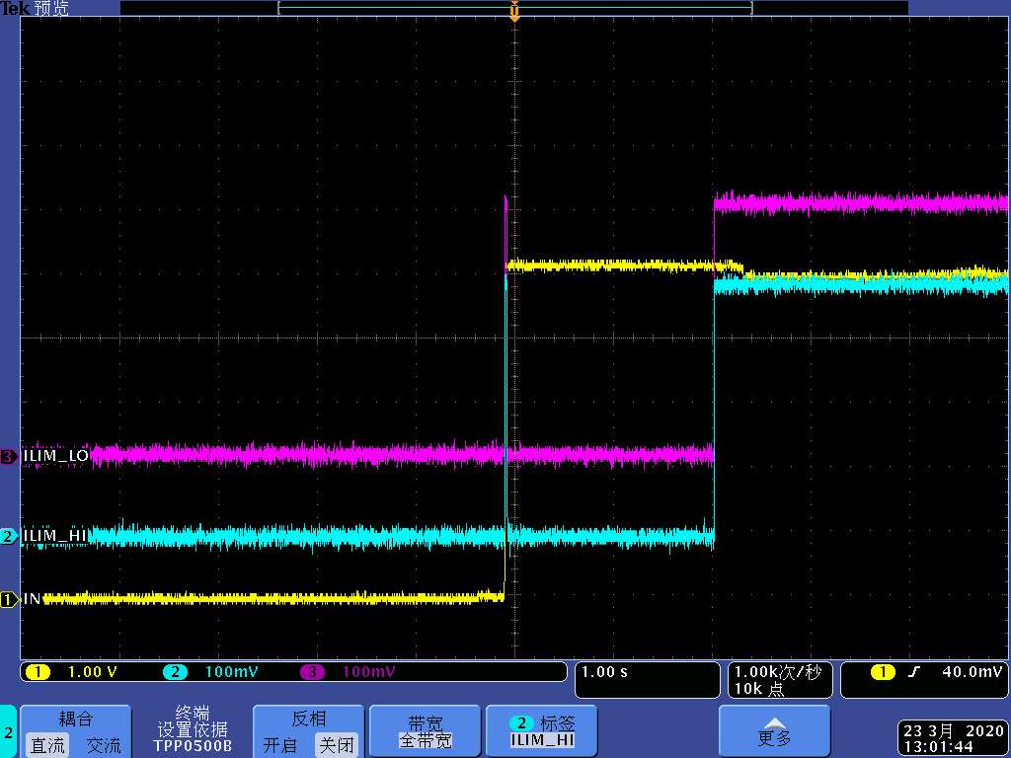
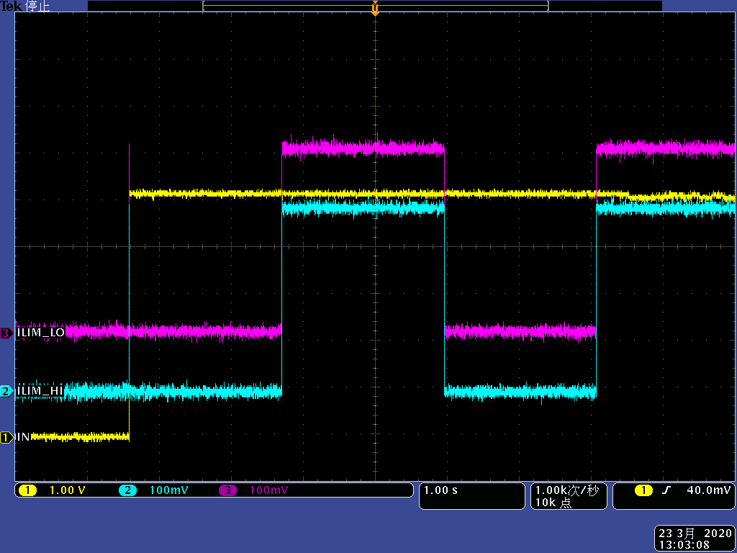
ILIM_LO,ILIM_HI,EN=VBUS_C
starting up
power off

