Slide 1
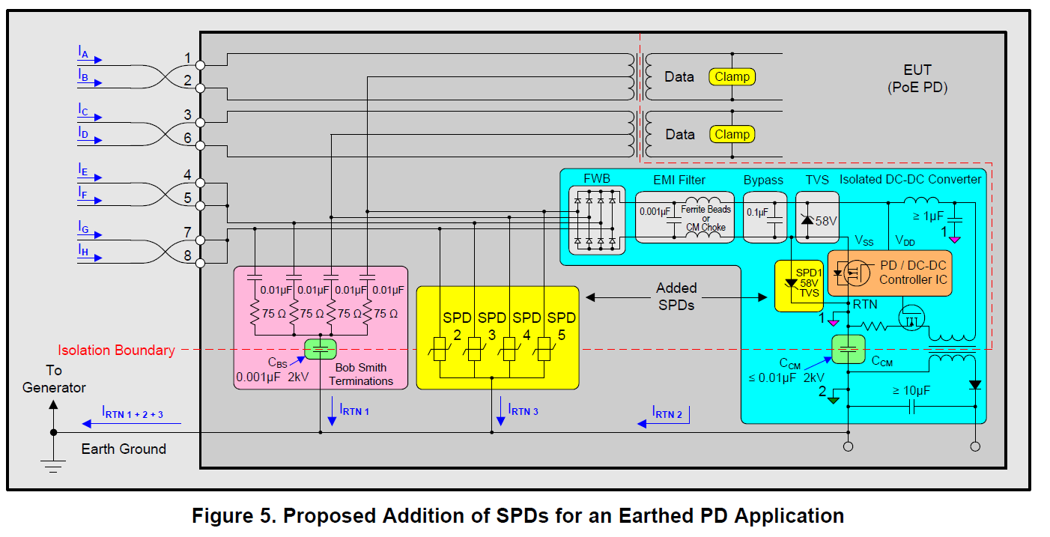
Is it possible to change to 0.01uF
If possible, it can be same as this.

