Slide 1
A guide to implementing inverting buck-boost converters
Davor Glisic, David Baba
3:45pm, May 18, 2022
Munich, Germany
Level of presentation: intermediate
Notes:
Hello everyone! My name is Davor Glisic. I am a systems engineer in the BSR-WV high-current team. I’m responsible for the definition of >60-V, >4-A converters and modules.
Today, I will be presenting the topic of implementing inverting buck-boost converters. At this time, I would also like to thank David Baba, who is an applications manager in the high-current applications team, for his help with generating the content for this presentation.

Slide 2
Agenda
Where do we need negative output rails?
Inverting buck-boost basics
Design considerations
Design examples
AC analysis
BSR-WV “IBB” devices coming soon
Notes:
This is the agenda for today. In this session will show where negative output rails are needed, provide a quick overview of the IBB topology and its basics, and share key design considerations for implementing IBB circuits. Topics such as maximum load, loop stability, level-shifting system I/Os, and adjusting output voltage “on-the-fly” will be discussed in detail and accompanied with real world design examples.
One of the lacking aspects of the existing TI solutions is the ease-of-use. The second part of the presentation will introduce a new TI solution – LM67680 65-V, 8-A buck converter (currently in development), with features designed specifically for the IBB applications and with a goal to reduce system complexity and design time. The value proposition, solution size and cost savings that it brings will be highlighted. A LM67680-based module definition will also be revealed and opened to your suggestions and feedback.

Slide 3
Where do we need negative output rails?
Medical imaging
  Ultrasound, MRI, X-Ray machines
Test & measurement
  Oscilloscopes, probes, power analyzers
Communications infrastructure
  AAS Radio (gate bias for GaN PAs)
Automotive
  OLED modules
Philips Ultrasound Machine Power Tree
Notes:
There is a need for negative output rails in an array of end equipment. In medical imaging, we see negative rails in ultrasound machines, MRI, an X-ray machines. Generally, in these systems, negative rails are needed to provide negative bias to amplifiers.
Similarly, negative output rails are found in test and measurement equipment such as oscilloscopes, probes, and power analyzers. On the communications infrastructure side, gate bias of GaN power amplifier in AAS ratio systems also require negative rails. OLED modules used in automotive market are another example of the need.
On the right hand side of the slide, there is a block diagram of a power tree of Philips ultrasound machine. As you can see, there is a set of positive and negative rails generated off of the 24-V bus. The negative output rails typically range from minus 3 to minus 15V and with loads as high as 4A.

Slide 4
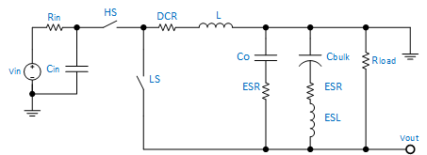
Inverting buck-boost basics
Any buck converter can be configured as an inverting buck-boost converter.
Using buck as an inverting-buck boost
  Ground the output
  Take output from GND → Negative VOUT
Two switches
Many resistive losses
  HS, LS Rdson
  Inductor DCR
  Input Resistance
Note: Controller sees V_{IN} + |V_{OUT}|
Notes:
This and subsequent slides provide some basic information about reconfiguring a standard buck as an IBB converter and details about its operation. As you may already know, any buck converter can be configured as an inverting buck-boost converter. Simply, ground the output terminal of the buck, and take the output from the buck ground to obtain a negative output. with respect to the system ground. The input voltage remains the same as in the buck converter, however, the controller “sees” the difference between the VIN and negative VOUT. That is effectively the sum of the VIN and the absolute value of the negative VOUT.
Similar to a buck, an IBB circuit has many resistive losses, however, these losses may be significantly higher, as it will be discussed in the later slides.

Slide 5
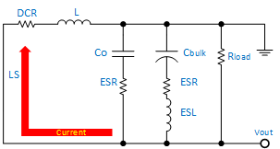
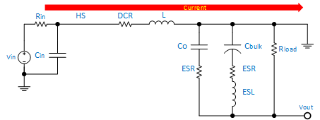
Off-time current flow
On-time current flow
Inductor is connected to V_{IN.}
All load current must be supplied by output capacitors.
Energy is stored in the inductor magnetic field.
Inductor is connected to V_{OUT.}
V_{OUT} must be negative to keep the inductor current flowing in the same direction.
Stored energy is released to the load.
Notes:
On this slide, we show basic operation of an IBB converter.
During the ON time, the inductor is connected to VIN. All load current must be supplied by the output capacitors. The energy is stored in the inductor magnetic field.
During the OFF time, the inductor is connected to VOUT. As you can see, the VOU must be negative to keep the inductor current flowing in the same direction. The stored energy is released to the load.

Slide 6
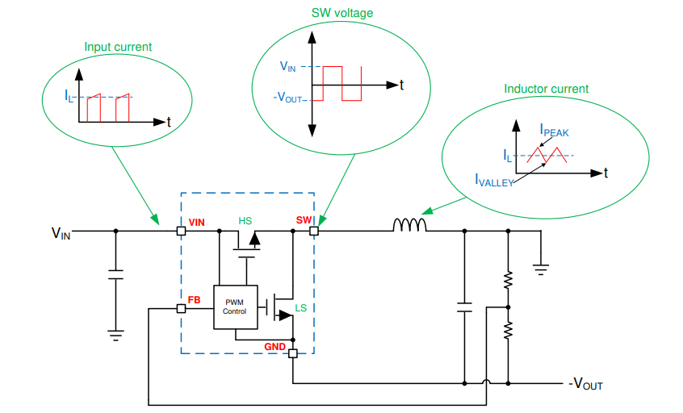
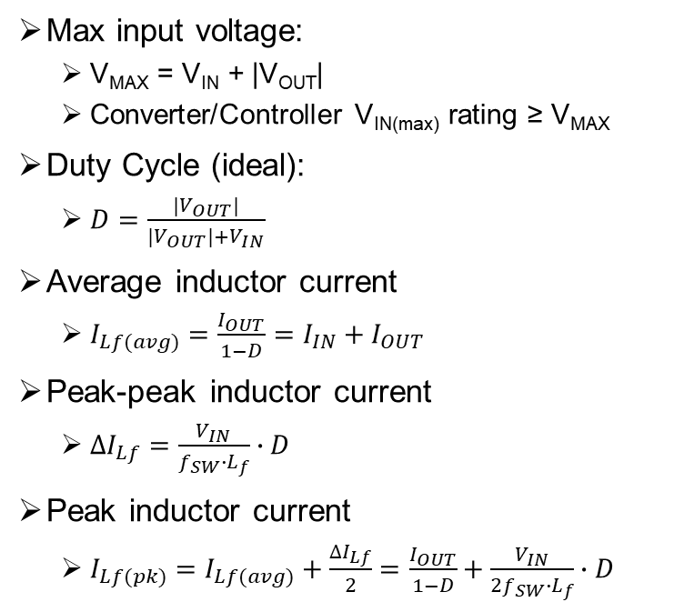
Basic equations
Max input voltage:
  V_{MAX} = V_{IN} + |V_{OUT}|
  Converter/Controller V_{IN(max)} rating ≥ V_{MAX}
Duty Cycle (ideal):
  $D=\frac{{|V}_{OUT}|}{{|V}_{OUT}|+V_{IN}}$
Average inductor current
  $I_{Lf(avg)}=\frac{I_{OUT}}{1−D}$ $=I_{IN}+I_{OUT}$
Peak-peak inductor current
  $∆I_{Lf}=\frac{V_{IN}}{f_{SW}∙L_{f}}∙D$
Peak inductor current
  $I_{Lf(pk)}=I_{Lf(avg)}+\frac{∆I_{Lf}}{2}=\frac{I_{OUT}}{1−D}+\frac{V_{IN}}{{2f}_{SW}∙L_{f}}∙D$
Notes:
These are the basic IBB equations.
The maximum input voltage defines required VIN rating of a buck controller to be used in an IBB topology.
The duty cycle helps determine average, peak to peak, and peak inductor currents. These are critical for inductor selection and defining maximum output load an IBB circuit can support given the converter’s current limit.
Note, that this is an ideal duty cycle equation that assumes no losses in the circuit.

Slide 7
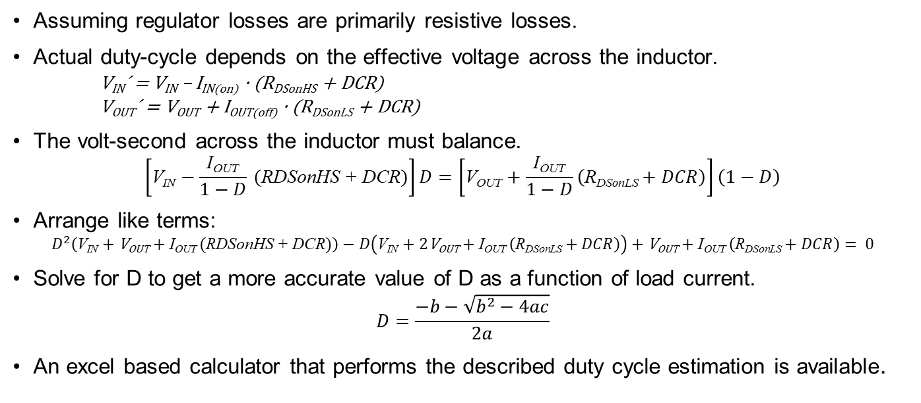
A more accurate duty cycle equation
Assuming regulator losses are primarily resistive losses.
Actual duty-cycle depends on the effective voltage across the inductor.
      V_{IN}´ = V_{IN} – I_{IN(on)} · (R_{DSonHS} + DCR)
      V_{OUT}´ = V_{OUT} + I_{OUT(off)} · (R_{DSonLS} + DCR)
The volt-second across the inductor must balance.
$\left[\text{V}\text{IN}−\frac{\text{I}\text{OUT}}{1−D} (\text{RDSonHS}\text{ + }\text{DCR})\right]D=\left[\text{V}\text{OUT}+\frac{\text{I}\text{OUT}}{1−D}\left(\text{R}\text{DSonLS}+DCR\right)\right]\left(1−D\right)$
Arrange like terms:
$D^{2}\left(\text{V}\text{IN}+\text{V}\text{OUT}+\text{I}\text{OUT} (\text{RDSonHS}\text{ + }\text{DCR})\right)−D\left(\text{V}\text{IN}+2\text{V}\text{OUT}+\text{I}\text{OUT} \left(\text{R}\text{DSonLS}+DCR\right)\right)+\text{V}\text{OUT}+\text{I}\text{OUT} \left(\text{R}\text{DSonLS}+DCR\right)= 0$
Solve for D to get a more accurate value of D as a function of load current.
$$D=\frac{−b−\sqrt{b^{2}−4ac}}{2a}$$
An excel based calculator that performs the described duty cycle estimation is available.
Notes:
As seen on the previous slide, duty cycle equation is very useful for IBB circuit analysis and predicting its maximum loading capability. A more accurate equation provides more accurate results.
Simply, if we introduce the resistive losses, we can derive a more accurate results.
The actual duty-cycle depends on the effective voltage across the inductor as defined with the Vin’ and Vout’ equations. As you may know, the volt-second across the inductor must balance. If we manipulate the balance equation, arrange like terms to form a quadratic equation, and solve for duty cycle, we can get a more accurate duty cycle estimate.
An excel based calculator that performs the described duty cycle estimation is available.

Slide 8
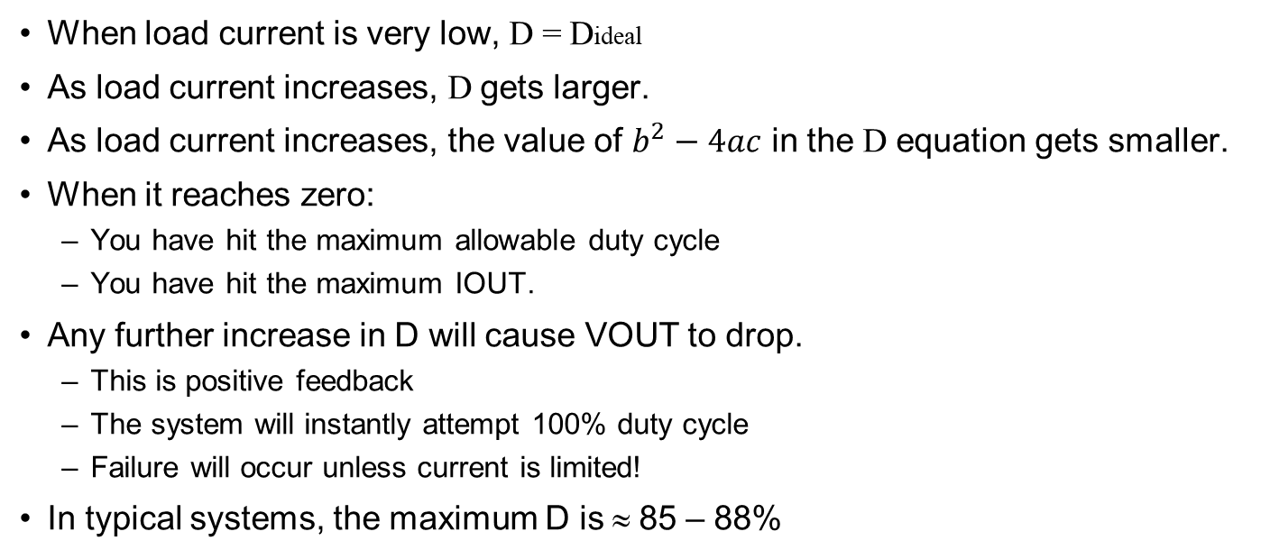
Key insights about duty equation
When load current is very low, D = Dideal
As load current increases, D gets larger.
As load current increases, the value of $b^{2}−4ac$ in the D equation gets smaller.
When it reaches zero:
  You have hit the maximum allowable duty cycle
  You have hit the maximum IOUT.
Any further increase in D will cause VOUT to drop.
  This is positive feedback
  The system will instantly attempt 100% duty cycle
  Failure will occur unless current is limited!
In typical systems, the maximum D is ≈ 85 – 88%
Notes:
These are the key insights about the duty equation.
When load current is very low, the actual duty is close to an ideal duty cycle.
As load current increases, the actual Duty gets larger.
As load current increases, the value of the 𝑏^2−4𝑎𝑐 term in the duty cycle equation gets smaller.
When it reaches zero:
You have hit the maximum allowable duty cycle and the maximum IOUT. This is just based on the duty cycle. Thermals and current limits are ignored.
Any further increase in duty cycle will cause VOUT to drop.
This is positive feedback.
The system will instantly attempt 100% duty cycle
Failure will occur unless current is limited!
In typical systems, the maximum D is » 85 – 88%

Slide 9
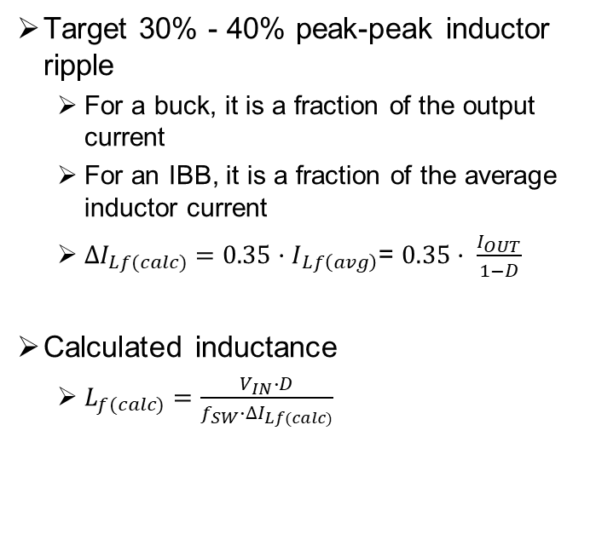
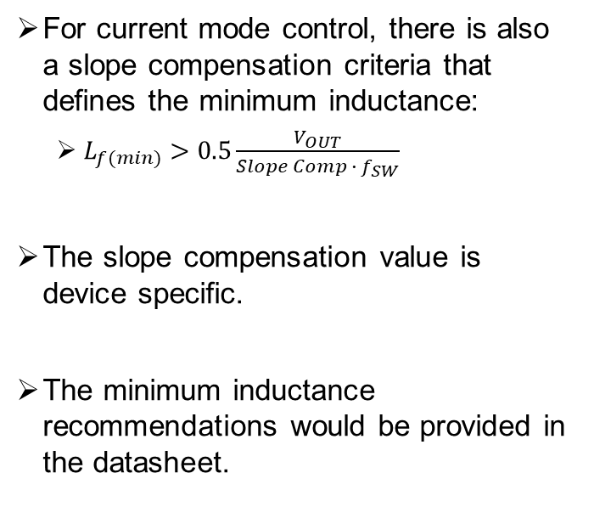
Inductor selection
Target 30% - 40% peak-peak inductor ripple
  For a buck, it is a fraction of the output current
  For an IBB, it is a fraction of the average inductor current
  $∆I_{Lf(calc)}={0.35·I}_{Lf\left(avg\right)}$= $0.35· \frac{I_{OUT}}{1−D}$
Calculated inductance
  $L_{f(calc)}=\frac{V_{IN}∙D}{f_{SW}∙∆I_{Lf(calc)}}$
For current mode control, there is also a slope compensation criteria that defines the minimum inductance:
  $L_{f(min)}>0.5\frac{V_{OUT}}{Slope Comp ∙ f_{SW}}$
The slope compensation value is device specific.
The minimum inductance recommendations would be provided in the datasheet.

Slide 10
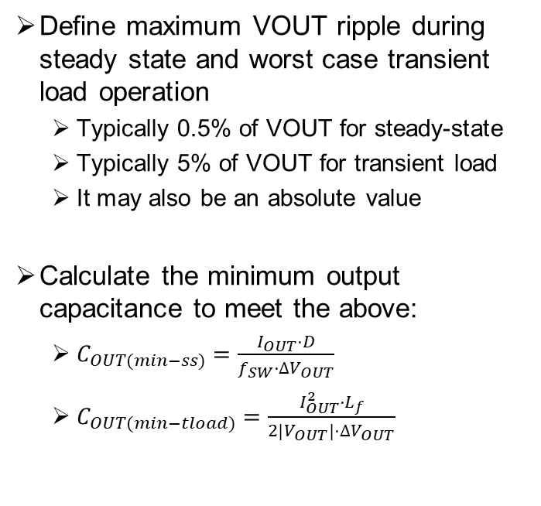
Output capacitor selection
Define maximum VOUT ripple during steady state and worst case transient load operation
  Typically 0.5% of VOUT for steady-state
  Typically 5% of VOUT for transient load
  It may also be an absolute value
Calculate the minimum output capacitance to meet the above:
  $C_{OUT(min−ss)}=\frac{I_{OUT}·D}{f_{SW}·∆V_{OUT}}$
  $C_{OUT(min−tload)}=\frac{I_{OUT}^{2}·L_{f}}{2|V_{OUT}|·∆V_{OUT}}$

Slide 11
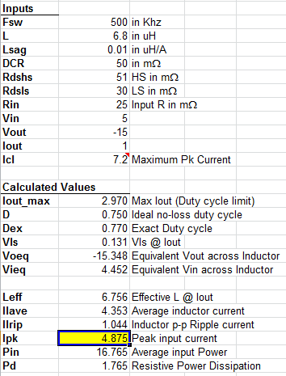
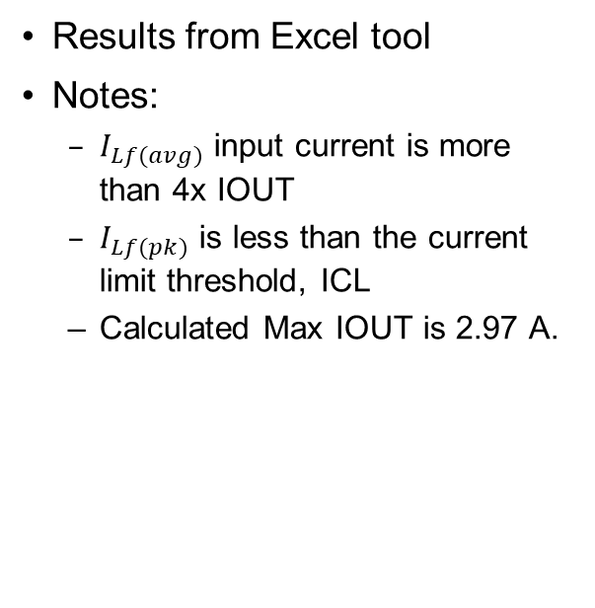
Example: VIN = +5 V, VOUT = -15 V @ 1 A
Results from Excel tool
Notes:
  $I_{Lf(avg)}$ input current is more than 4x IOUT
  $I_{Lf(pk)}$ is less than the current limit threshold, ICL
  Calculated Max IOUT is 2.97 A.
Notes:
On this slide, I have example calculation from the excel tool.
As inputs, I have fSW, inductance, VIN of 5V and VOUT of -15V. Load is 1A and current limited at 7.2A. The restive losses are also defined as inputs.
On the outputs, note that the average inductor current is more than 4x the output current. Still, the peak inductor current is below the current limit.
At 1A load, different between the ideal and actual duty cycle is not significant. The maximum IOUT is 2.97A.

Slide 12
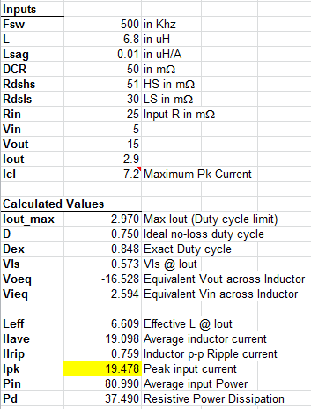

Example: VIN = +5 V, VOUT = -15 V @ 2.9 A
Results from Excel tool
Notes:
  $I_{Lf(avg)}$ current is more than 19A!!
  $I_{Lf(pk)}$ is greatly exceeds current limit ICL
Notes:
Here is another example calculation from the excel tool.
As inputs, the fSW, inductance, current limit, VIN and VOUT are the same as in the previous example. Load is now at 2.97A..
On the outputs, note that the average inductor current is now more than 19A. This greatly exceed the current limit, so 2.97 A load definitely cannot be supported.
At this high load, difference between the ideal and actual duty cycle is significant.

Slide 13
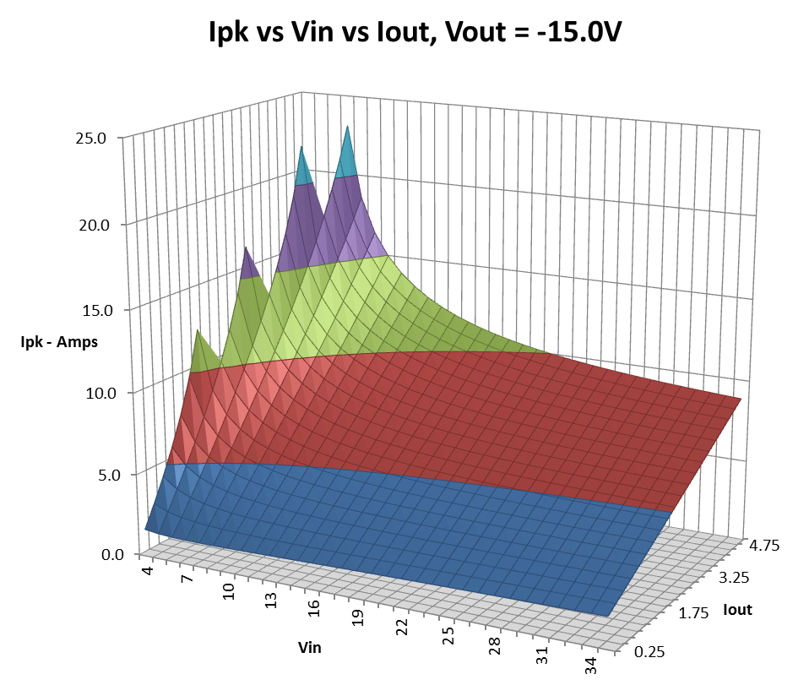
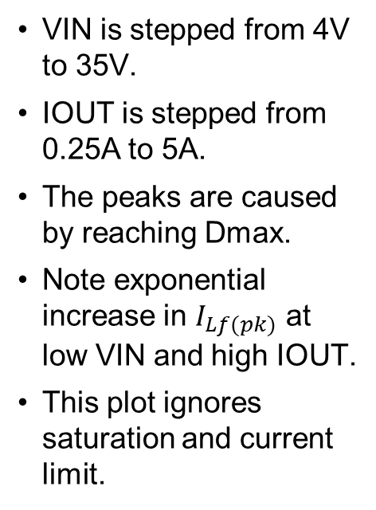
3D contour of I_{Lf(pk)} vs V_{IN} vs I_{OUT}
VIN is stepped from 4V to 35V.
IOUT is stepped from 0.25A to 5A.
The peaks are caused by reaching Dmax.
Note exponential increase in $I_{Lf(pk)}$ at low VIN and high IOUT.
This plot ignores saturation and current limit.
Notes:
On this slide, I’m showing a 3D contour of the peak inductor current as function of the input voltage and output current.
VIN is stepped from 4V to 35V. IOUT is stepped from 0.25A to 5A.
The peaks are caused by reaching Dmax. Note exponential increase in $I_{Lf(pk)}$ at low VIN and high IOUT.
This plot ignores saturation and current limit.

Slide 14
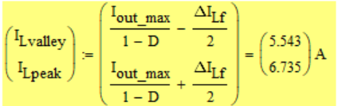

Design considerations: maximum load / current limit
Peak inductor current for IBB topology is much larger than for a buck
IBB: 12V→ -12V, 3A @ 400 kHz
Buck: 24V→12V, 3A @ 400 kHz
ILpeak vs. VIN vs. Load: 12 V → -12 V @ 400 kHz, CL =11.5A
Notes:
One of the key design considerations when selecting a buck converter for an IBB topology is the maximum load it can support.
As shown in the example calculations. the peak inductor current is much larger for an IBB topology than it is for a standard buck.
In this example, the ideal duty cycle for both buck and IBB topology is at 50%. Yet, the peak inductor current is 2x higher for the IBB topology.
With the current limits at 11.5A, which is typically a current limit for an 8-A buck, the maximum output current supported is only 3A at the low VIN of 5.5V.

Slide 15
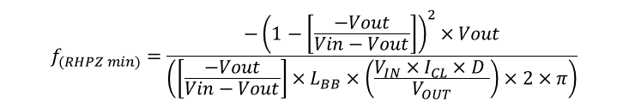


Design considerations: stability and RHPZ
$$P_{IN max}=V_{IN}×I_{CL}×D$$
$$f_{(RHPZ min)}=\frac{{−\left(1−\left[\frac{−Vout}{Vin−Vout}\right]\right)}^{2}×Vout}{\left(\left[\frac{−Vout}{Vin−Vout}\right]×L_{BB}×\left(\frac{V_{IN}×I_{CL}×D }{V_{OUT}}\right)×2×π\right)}$$
$$I_{OUT max}=\frac{P_{IN}}{V_{OUT}}=\frac{V_{IN}×I_{CL}×D }{V_{OUT}}$$
This calculation assumes that the input power is equal to the ideal duty cycle times the peak input current times the input voltage,
The output current is equal to the input power divided by the output voltage. This ignores all losses but represents the highest possible output current and thus the worst case low frequency RHPZ at maximum load.
Notes:
Another key design consideration for an IBB converter is stability. Although the IBB is built using an ordinary buck regulator, the small signal closed-loop characteristics are quite different from that of a buck. The most outstanding difference is that the IBB loop contains a "righthalf-plane" (RHP) zero in the small signal frequency response. This zero adds a lagging phase to the loop, rather than leading phase, as an ordinary zero would contribute. As a result the phase margin of the closed loop response is reduced, leading to potential instability and poor load transient response.
The standard RHP frequency equation is given in the upper left corner while the worst case equation is on the right. The worst case equation is obtained by ignores all the losses that result in the highest possible output current.
The table shows the worst case RHP frequency as a function of input and output voltages. It assumes a 3A load and 10uH inductor.
Generally, the RHP frequency must be about 4 times the loop gain crossover frequency. From the RHP frequency equation, we see that decreasing the size of the inductance will increase the frequency of the RHP zero and help to keep it away from the loop gain crossover point. However, the minimum inductance may be limited by other considerations. Another way to help with this issue is to reduce the loop gain crossover frequency by using a larger output capacitance than would normally be used with a buck. This may also help with the load transient response and reduce the output voltage ripple. If external feed-back resistors are used, then a feed-forward capacitor across the top feed-back resistor can be used. Sometimes this capacitor can give enough phase lead to improve both the phase margin and load transient response.

Slide 16
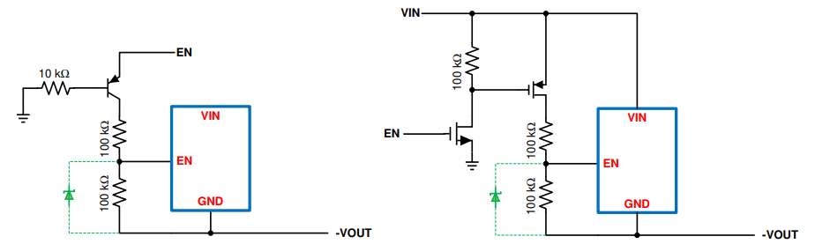
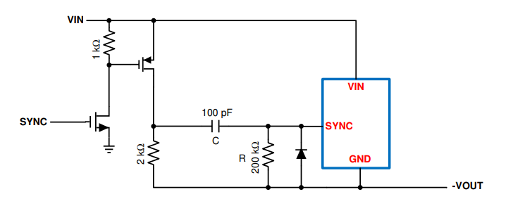
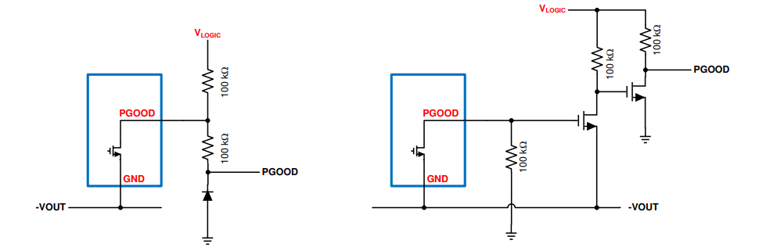
Design considerations: level shifters
System interface to the EN, SYNC, and PG pin of an IBB circuit requires level-shifters.
Reference SNVA856A for more details.
Notes:
With the device ground becoming a negative output voltage, a direct system interface to the device EN, SYNC, and PGOOD pins requires external level shifter circuits.
On this slide, example level shifter circuits are shown for each of the pins. Detailed information is provided in the reference.

Slide 17
Design example: gate bias supply for GaN PAs
Example requirements (Ericsson AAS - gate bias supply for GaN PAs)
  V_{IN} = 9 V – 55 V
  V_{OUT} = -10 V (Negative rail)
  I_{OUT} = 1 A @ T_{A} = 100° C
Maximum voltage seen by controller:
  V_{MAX} = V_{IN} + |V_{OUT}| = 55 V + 10 V = 65 V
  Converter/Controller V_{IN(max)} rating ≥ 65 V
ILpk vs. VIN vs. Load: 9 → -15V @ 400 kHz, CL =11.5A
Notes:
Lets now take a look at a actual design example. The design requirements are for a gate bias supply for GaN power amplifiers in Ericsson AAS system.
The input voltage is from 9V to 55V, the output voltage is at -10V, with the output current at 1A and the maximum ambient temperature at 100C.
Based on the maximum Vin and the Vout, it is easy to determine that the controller needed should have greater than 65V input voltage rating.
Based on the excel tool, at the minimum input voltage of 9V and the max load of 1A, the peak inductor current is at less than 3A. Based on this, a suitable device current limit can be set and the minimum inductor saturation current defined.

Slide 18
Design example: supply for OLED module
Example requirements (Conti HMI – OLED module supply)
  V_{IN} = 5.5 V – 36 V, 13.5 V typ (12-V battery)
  V_{OUT} = -5 V to -12 V (adjustable on the fly), 100 mV – 200 mV steps
  I_{OUT} = 3 A
Maximum voltage seen by controller:
  V_{MAX} = V_{IN} + |V_{OUT}| = 36 V + 12 V = 48 V
  Converter/Controller V_{IN(max)} rating ≥ 48 V
Input V | Load I
10.907 | 0.25 | 0.5 | 0.75 | 1 | 1.25 | 1.5 | 1.75 | 2 | 2.25 | 2.5 | 2.75 | 3 | 3.25 | 3.5 | 3.75 | 4 | 4.25 | 4.5 | 5 | 6
5.5 | 1.272 | 2.084 | 2.908 | 3.744 | 4.593 | 5.454 | 6.328 | 7.216 | 8.117 | 9.033 | 9.962 | 10.907 | 11.867 | 12.843 | 13.835 | 14.843 | 15.868 | 16.911 | 19.052 | 23.566
6 | 1.254 | 2.018 | 2.791 | 3.574 | 4.367 | 5.170 | 5.983 | 6.806 | 7.641 | 8.486 | 9.343 | 10.211 | 11.091 | 11.984 | 12.888 | 13.805 | 14.735 | 15.679 | 17.607 | 21.637
7 | 1.235 | 1.923 | 2.618 | 3.320 | 4.028 | 4.743 | 5.465 | 6.193 | 6.930 | 7.673 | 8.424 | 9.182 | 9.948 | 10.722 | 11.503 | 12.293 | 13.091 | 13.897 | 15.536 | 18.920
8 | 1.228 | 1.861 | 2.498 | 3.140 | 3.787 | 4.439 | 5.096 | 5.758 | 6.424 | 7.097 | 7.774 | 8.456 | 9.144 | 9.838 | 10.537 | 11.242 | 11.952 | 12.668 | 14.118 | 17.091
10 | 1.234 | 1.790 | 2.348 | 2.909 | 3.473 | 4.040 | 4.609 | 5.182 | 5.758 | 6.336 | 6.918 | 7.503 | 8.091 | 8.682 | 9.276 | 9.873 | 10.474 | 11.078 | 12.295 | 14.771
12 | 1.252 | 1.757 | 2.263 | 2.771 | 3.281 | 3.793 | 4.307 | 4.823 | 5.341 | 5.861 | 6.382 | 6.906 | 7.432 | 7.960 | 8.490 | 9.022 | 9.556 | 10.093 | 11.171 | 13.355
14 | 1.274 | 1.742 | 2.212 | 2.683 | 3.155 | 3.628 | 4.103 | 4.580 | 5.058 | 5.537 | 6.018 | 6.500 | 6.983 | 7.468 | 7.955 | 8.443 | 8.932 | 9.423 | 10.409 | 12.400
16 | 1.297 | 1.738 | 2.180 | 2.623 | 3.067 | 3.512 | 3.959 | 4.406 | 4.854 | 5.304 | 5.754 | 6.206 | 6.659 | 7.112 | 7.567 | 8.023 | 8.481 | 8.939 | 9.859 | 11.712
18 | 1.319 | 1.739 | 2.160 | 2.581 | 3.004 | 3.427 | 3.851 | 4.276 | 4.702 | 5.129 | 5.556 | 5.985 | 6.414 | 6.844 | 7.275 | 7.707 | 8.140 | 8.573 | 9.443 | 11.194
20 | 1.340 | 1.743 | 2.147 | 2.551 | 2.957 | 3.362 | 3.769 | 4.176 | 4.584 | 4.993 | 5.402 | 5.812 | 6.223 | 6.635 | 7.047 | 7.460 | 7.873 | 8.287 | 9.118 | 10.789
22 | 1.359 | 1.749 | 2.139 | 2.529 | 2.921 | 3.312 | 3.705 | 4.097 | 4.491 | 4.885 | 5.280 | 5.675 | 6.071 | 6.467 | 6.864 | 7.262 | 7.660 | 8.058 | 8.858 | 10.464
24 | 1.378 | 1.756 | 2.134 | 2.513 | 2.892 | 3.272 | 3.653 | 4.034 | 4.415 | 4.797 | 5.180 | 5.563 | 5.946 | 6.330 | 6.714 | 7.099 | 7.485 | 7.871 | 8.644 | 10.198
26 | 1.394 | 1.763 | 2.131 | 2.501 | 2.870 | 3.240 | 3.611 | 3.982 | 4.353 | 4.725 | 5.097 | 5.470 | 5.843 | 6.216 | 6.590 | 6.965 | 7.339 | 7.715 | 8.466 | 9.976
28 | 1.410 | 1.770 | 2.130 | 2.491 | 2.852 | 3.214 | 3.576 | 3.938 | 4.301 | 4.664 | 5.027 | 5.391 | 5.755 | 6.120 | 6.485 | 6.851 | 7.216 | 7.582 | 8.316 | 9.788
30 | 1.424 | 1.777 | 2.130 | 2.484 | 2.838 | 3.192 | 3.546 | 3.901 | 4.257 | 4.612 | 4.968 | 5.324 | 5.681 | 6.038 | 6.395 | 6.753 | 7.111 | 7.469 | 8.187 | 9.627
32 | 1.437 | 1.784 | 2.131 | 2.478 | 2.826 | 3.173 | 3.522 | 3.870 | 4.219 | 4.568 | 4.917 | 5.267 | 5.617 | 5.967 | 6.318 | 6.669 | 7.020 | 7.371 | 8.075 | 9.487
Notes:
Here is another design example. This time, it is a supply for an automotive OLED module. The input is an automotive batter with the minimum input voltage of 5.5V.
A unique requirement for this application is the need to adjust the output voltage on the fly from -5V to -12V in small steps. The output current requirement is 3A.
Based on the maximum Vin and the Vout, it is easy to determine that the controller needed should have greater than 48V input voltage rating. A 65-V controller would be suitable here.
Based on the excel tool, at the minimum input voltage of 5.5V and the max load of 3A, the peak inductor current is close to 11A. Based on this, a suitable device current limit can be set and the minimum inductor saturation current defined. For this application a buck converter or a controller based regulator capable of supporting 8-10A would be suitable.
A solution for adjusting the output voltage on the fly is described on the next slide.

Slide 19
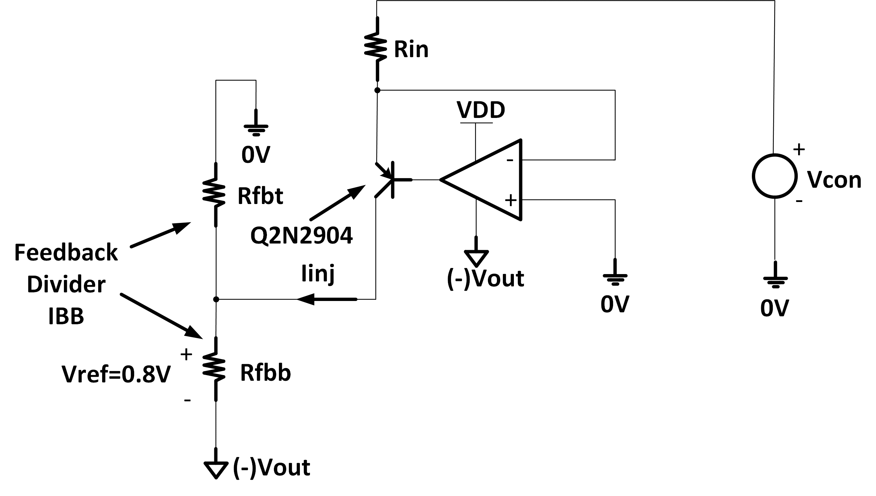

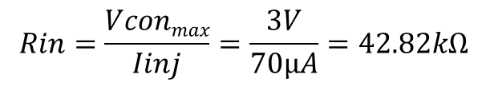

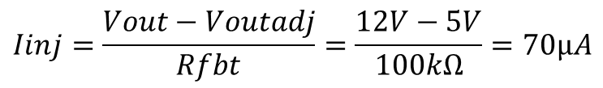



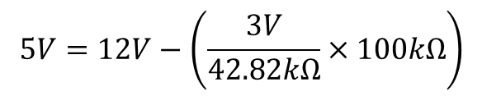
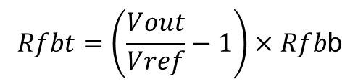

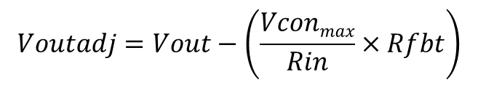
Design considerations: adjusting VOUT “on the fly”
$$Vcon=0 to 3V$$
$$Vconmin=0V→Vout=(−)12V$$
$$Vconmax=3V→Vout=(−)5V$$
$$Vref=0.8V$$
$$Rfbb=7.15kΩ$$
$$Rfbt=\left(\frac{Vout}{Vref}−1\right)×Rfb\text{b}$$
$$Rfbt=100kΩ$$
$$Iinj=\frac{Vout−Voutadj}{Rfbt}=\frac{12V−5V}{100kΩ}=70µA$$
$$Voutadj=Vout−\left(\frac{Vconmax}{Rin}×Rfbt\right)$$
$$Rin=\frac{Vconmax}{Iinj}=\frac{3V}{70µA}=42.82kΩ$$
$$5V=12V−\left(\frac{3V}{42.82kΩ}×100kΩ\right)$$
Notes:
This is the circuit that allows adjusting the negative output voltage on the fly using an external system ground referenced control voltage.
The circuit utilizes a single resistor, an op amp and a transistor. All voltages mentioned on this slide are absolute (|Vout|). This example level shifts the output voltage from -12V to -5V for an OLED application using a control voltage source from 0V to 3V.
We first set up the output voltage to its maximum value as in a normal case. In this example a 100K and 7.15K feedback resistors were selected for a 0.8V reference to give a -12V output.
When the control voltage source is 0V, no current is being injected into the feedback node. We know the max control voltage is 3V so we will calculate the value of Rin to give us a minus 7V drop on Vout to set Vout adjust to -5V.
With the assumption that the inputs to the op amp are matched, the voltage on the positive terminal of the op-amp is 0V (Grounded) and the the voltage on the negative terminal is also 0V.
This means that the Vcontrol voltage is always seen across Rin wrt the system Gnd. The Rin sets the current in the transistor emitter. Assuming the emitter and collector current are the same, the current through Rin is the injection current into the FB node. The injection current will cause Vout to drop accordingly.
The amount Vout drops is equal to the injection current times the top feedback resistor (Iinj*Rfbt). For the output voltage to drop 7V we know that the amount of current injected into the FB node needs to be (12V-5V)/100k = 70uA.
To set up 70uA of injection current for a Vcontrol of 3V, the Rin is calculated to be 3V/70uA = 42.82k.

Slide 20
IBB AC Analysis
Notes:
In this section we are going to show the AC analysis of the IBB converter for the two common modes of control.
That is the current mode control (CMC) and Voltage mode control (VMC). The material covered in this section will provide you with the Mathematical Transfer functions to model the AC response.

Slide 21
Current Mode Control Modulator and Power Stage
Notes:
The schematic model in top left of slide shows how the inductor current in measured and compared to the output of the Error amplifier which is the error signal. We can see that we need to measure the inductor current, Amplify it and sum a voltage sloe to the current sense signal Ri. Where Ri is the Sensed current multiplied by gain of the current sense Amplifier. Ri= Rense * Avcs.
The IBB current mode power stage has two zeros, one formed by the output capacitor and its ESR and the other formed by the right half plane zero (RHPZ). The right have plane zero exhibits is a loop response that causes the duty cycle to increase due to a load step whereby the time left to deliver the energy during the 1-D period has been reduced. In the frequency domain this is described as a +20dB per decade gain (as a zero behaves) and a -90 degree phase shift (as a pole behaves). The strategy for compensation of an IBB is always to cross over before the effects of the RHPZ is realized to avoid resulting instability due to the RHPZ interaction with the loop. Therefore, the compensation scheme should be implemented in such a way to avoid the frequency effects of the RHPZ by crossing over at a frequency much less than it.
The IBB current mode power stage also has two poles that splits the complex conjugate of the LC double pole (seen in VMC) into 2 separate poles the first is formed by the load pole Wp described above and the second pole at a much higher frequency (WL). WL is set by the amount of Slope compensation, the Current sense resistance and the inductor value. Provided there is an adequate amount of sensed current when compared to the added slope, the complex conjugate is always split in to two separate poles whereby the WL pole site at a much higher frequency than the load pole. This is the beauty of CMC ensure that compensation of an IBB is easier to attain than VMC.
AVC is the DC gain and is set by Ri, Rload (Rout) and the Duty ratio (D) the current sense amplifier gain and the duty ratio.
NOTE: the analysis assumes that CIN<<COUT. In AC analysis a DC voltage source is a short circuit therefore CIN is in parallel with COUT. Therefore the equations are approximations as damping response, Phase margin and cross over frequency may differ slightly from actual results.
Note: S = 2*pi*F
The Bode Plot shows a graphical representation of the Power and modulator stage of an IBB using CMC. We can see the frequency at which the Poles and zeros typically occur.

Slide 22
Type II Transconductance Amplifier
22
Notes:
22
Many of our CMC converters use a transconductances or Gm amplifier for the Error Amplifier (EA) and that is what is shown here. This slide shows a schematic of a Type II compensator in the top left of the slide. The mathematical transfer function is shown in the bottom right of the slide, while the top right shows the frequency response on a bode plot.
The details needed to determine the frequency response of the Feedback compensator stage is the top and bottom FB resistors, the gm of the Gm amp (in A/V) and the output resistance of the transconductance amplifier. As previously mentioned, a good strategy for compensation is to make sure you cross over at a frequency much lower than the RHPZ, setting the Wzea to the load pole of the power stage and set the high frequency pole to the RHPZ. For more details on compensation refer to “compensation made easy” by Robert Sheehan.
The transfer function is multiplied by the modulator and power stage transfer function to obtain the complete closed loop response.

Slide 23







Voltage-Mode IBB Modulator and Power Stage
40
20
0
GAIN (dB)
-20
-40
-60
10
100
1,000
10,000
100,000
1,000,000
FREQUENCY (Hz)
23
Notes:
23
We have some customers using a VMC controller like the LM5145/6 implemented as an IBB. Following the same slide format as the previous slides the modulator and power stage details are given in this slide.
As before we have the ESR zero and also the RHPZ however, Voltage mode Control (VMC) in IBB is a little more tricky to compensate. As mentioned we have a complex conjugate double pole formed by the LC filter described mathematically as the S term and an S squared term in the denominator. The strategy is to always make sure we have enough PM from 180 degrees at the cross over frequency. As with the Current mode approach regarding the RHPZ we ensure we are crossing over way below the RHPZ. However if if this is avoided, we will need to use a Type III compensator as opposed to Type II due to the double pole complex conjugate mentioned. In addition to the TYPE III compensator, we can also get some help with the Wz to get some phase boost, if the ESR and Cout is large enough. As before, we have described all mathematical terms to the model and show how these terms relate in the Bode plot in the top right of the slide.
Regarding AVC, above shows the Modulator/DC gain of a voltage feedforward (VFF) ramp generator for the modulator. If it’s a fixed Ramp AVC becomes 1/Vramp *(Vin/(1-D)^2)
NOTE: the analysis assumes that CIN<<COUT. In AC analysis a DC voltage source is a short circuit therefore CIN is in parallel with COUT. Therefore the equations are approximations as damping response, Phase margin and cross over frequency may differ slightly from actual results.

Slide 24
Type III Error Amplifier
24
Notes:
24
Following the same format as a type II compensator, this slide shows Type III compensation using a voltage Error amplifier.
Following the strategy for compensating a VMC loop in IBB, we set the two zeros (WZEA and WFZ) to the double pole (Wo) frequency.
Set the two poles (WFP and WHF) to the RHPZ (Wr) and the zero formed by COUT and Its ESR (Wz)

Slide 25
Model Verifications
Notes:
This section we show the accuracy of the mathematical models presented compared to simulation results.

Slide 26
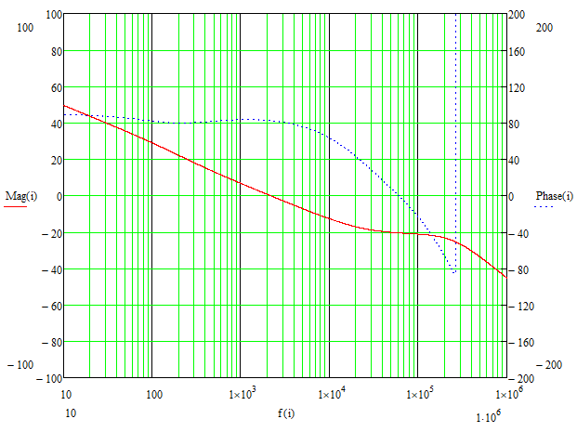
Current Mode with Type II GM EA example
Parameter | Value
Vin | 12 V
Vout | 12 V
Iout | 4 A
Lbb | 10 μH
Cout | 470 μF
CoutESR | 0.05 Ω
RFBT | 10 kΩ
RFBB | 1.148 kΩ
Rcomp | 20 kΩ
Ccomp | 33 nF
CHF | 1.5 nF
ROUT | 100 MΩ
Gm | 720 μS
Rsense | 20 mΩ
Acs | 5.2
MathCAD
SIMPLIS
Notes:
On this slide, we see comparison of MatchCAD computations and SIMPLIS Simulation for the current mode with type 2 GM error amplifier example.
Results show good correlation for the component values shown in the table.
Shows a cross over frequency of 2 kHz and a PM of 80 degrees.

Slide 27
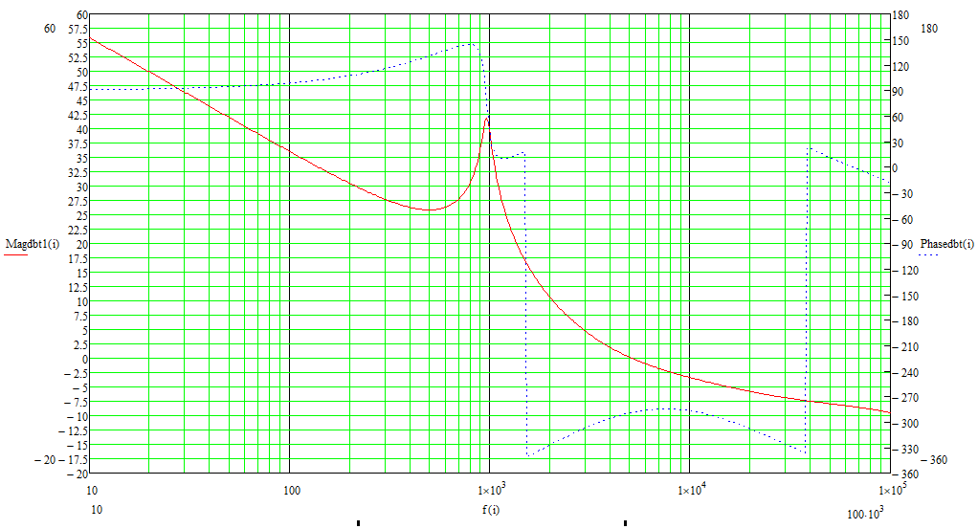
Voltage Mode with Type III Voltage EA example
Parameter | Value
Vin | 12 V
Vout | 12 V
Iout | 4 A
Lbb | 10 μH
Cout | 680 μF
CoutESR | 0.05 Ω
RFBT | 20 kΩ
Rcomp | 8.45 kΩ
Ccomp | 18 nF
CHF | 120 pF
Rff | 2.7 kΩ
Cff | 4.7 nF
Kff | 15
MathCAD
SIMPLIS
Notes:
Similarly, for the voltage mode with Type 3 voltage error amplifier example. the lide shows comparison of MatchCAD computations and SIMPLIS Simulation. Good correlation for the component values shown in the table. Results show double pole at ~900kHz. Cross over frequency of ~4kHz and a PM of ~>45 degrees

Slide 28
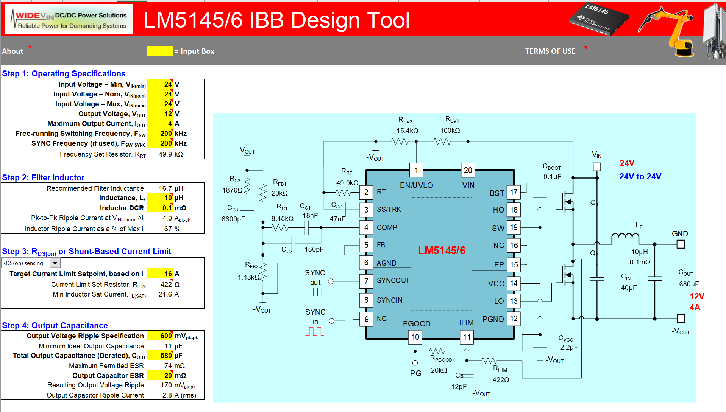
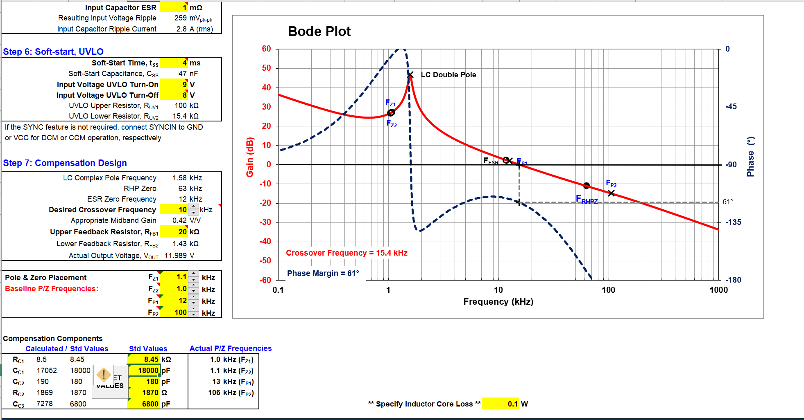
IBB Calculator for LM5145/6
Notes:
We have a QS tool about to be published to the product folder of the LM5145. The tool allows you to design a power stage and compensate the loop. It also estimate efficiency and power loss, this is a good place to start for all IBB designs using VMC.

Slide 29
BSR-WV “IBB” Devices in Definition / Development
Notes:
In this part of the presentation I will introduce LM67680 65-V, 8-A buck converter (currently in development), with features designed specifically for the IBB applications and with a goal to reduce system complexity and design time. The value proposition, solution size and cost savings that it brings will be highlighted. A LM67680-based module definition will also be revealed and opened to your suggestions and feedback.

Slide 30
Chiron+ IBB: LM67680/60/40
65-V, 8/6/4-A Synchronous Buck Converter for Inverting or Non-Inverting Outputs
Product Proposal Only (Schedule TBD)
Features
Benefits
Wide 3-V to 65-V input range (Abs Max 70 V)
1% accurate, fixed 3.3-V, 5-V or ADJ output from 0.8 V – 60 V (Buck)
Negative ADJ output up to -20 V (Inverting Buck-Boost)
Integrated level-shifters
  Provide easy interface to EN, PGOOD, MODE/CLKIN pins
Enhanced EMI performance enabled with:
  Dual Random Spread Spectrum (DRSS) with two f_{LF-MOD} ranges
  EMI-enhanced RLF package
  Programmable SW rising and falling edge slew rate
Programmable switching frequency from 200 kHz – 2.2 MHz
FPWM, DEM/PFM, or external frequency SYNC operations
Low quiescent current
  Shutdown I_{Q}: 5 µA
  No-load sleep I_{Q}: 50 µA (ext. COMP)
External COMP
Programmable soft-start
Current limiting and over-temperature protection schemes
EMI / thermally enhanced QFN-26 (4.5x4.5 mm) with wettable flanks
Single device allows easy implementation of either inverting or non-inverting output rails
  Enables compact designs with minimum BOM
Low min t_{ON} (25 ns) allows high-conversion ratios at 2.2 MHz
Low-EMI performance
  Eases design and qualification of noise sensitive industrial designs
Applications
Medical: Ultrasound, MRI, X-Ray machines
T&M: Oscilloscopes / probes, power analyzers

Slide 31
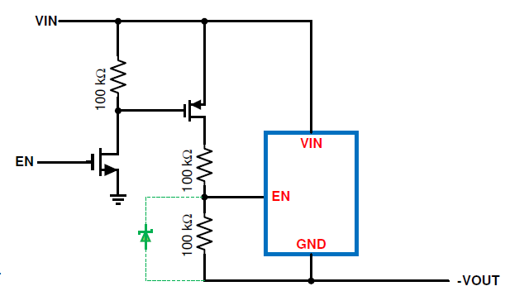
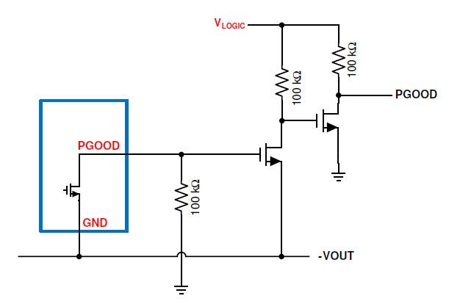
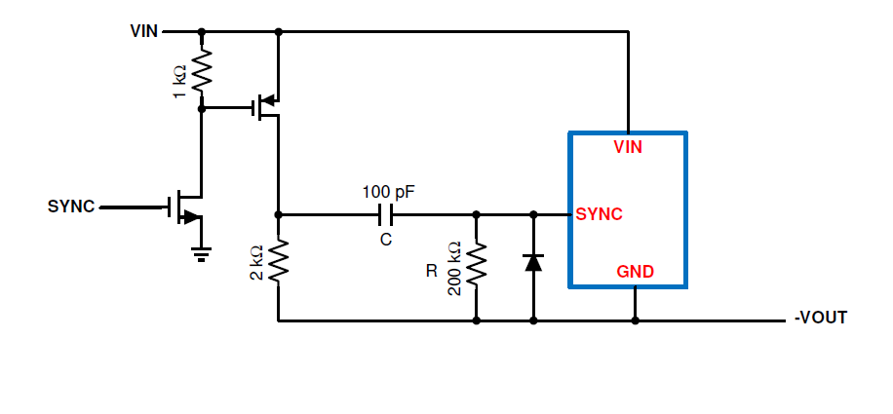
Chiron+ IBB | Solution Size & BOM Cost
 | # | Area (mm^2) | Unit Cost (cents) | Cumulative Cost (cents)
Chiron+ IBB | 1 | 20.3
Cio Cap (0603) | 1 | 1.3
Input Caps (1210) | 2 | 16.0
Output Caps (1210) | 2 | 16.0
Strap, FB, Comp Resistors (0603) | 5 | 6.4
Inductor, XEL6060 | 1 | 41.7
Boot, VCC, Comp Caps (0603) | 3 | 3.8
Small Signal Transistors (SOT-883) | 6 | 3.6 | 2 | 12
Resistors (0603) | 9 | 11.5 | 0.1 | 0.9
Diode (SOD-923) | 1 | 0.5 | 1 | 1
AC-Coupling Cap (0603) | 1 | 1.3 | 0.5 | 0.5
BOM Cost Savings w/ Internal Level-Shifters |  |  |  | 14.4
Solution Size w/ External Level-Shifters (+20% padding) |  | 146.8
Solution Size w/ Internal Level-Shifters (+20% padding) |  | 126.6
Solution Size Reduction w/ Internal Level-Shifters |  | 20.3 | 16%
External Level-Shifter Circuits
Integrated level-shifters:
Save 14-15c in BOM cost
Reduce solution size by ~15%

Slide 32
Chiron+ IBB Module: TPSM67660
65-V, 6-A Synchronous Buck Converter Module for Inverting or Non-Inverting Outputs
Product Proposal Only (Schedule TBD)
Features
Benefits
Wide 3-V to 65-V input range (Abs Max 70 V)
1% accurate, fixed 3.3-V, 5-V or ADJ output from 0.8 V – 15 V (Buck)
Negative ADJ output up to -15 V (Inverting Buck-Boost)
Integrated level-shifters
  Provide easy interface to EN, PGOOD, MODE/CLKIN pins
Enhanced EMI performance enabled with:
  Dual Random Spread Spectrum (DRSS) with two f_{LF-MOD} ranges
  EMI-enhanced RLF package, integrated HF bypass capacitors
  Programmable SW rising and falling edge slew rate
Programmable switching frequency from 200 kHz – 2.2 MHz
FPWM, DEM/PFM, or external frequency SYNC operations
Low quiescent current
  Shutdown I_{Q}: 5 µA, No-load sleep I_{Q}: 50 µA
Integrated COMP components and BOOT capacitor
Programmable soft-start
Current limiting and over-temperature protection schemes
EMI / thermally enhanced 6.5 x 7.5 mm RLF package
Operation up to 150°C T_{J}
Single module allows easy implementation of either inverting or non-inverting output rails
Small solution size: ~120 mm²
Low BOM count (as low as 4 external components) reduces system cost and eases layout
Ultra-Low EMI performance
  Eases design and qualification of noise sensitive end equipment
Applications
Medical: Ultrasound, MRI, X-Ray machines
T&M: Oscilloscopes / probes, power analyzers
Notes:
This is a 1-pager of the Chiron+IBB module. It is a 65-V, 6-A module which has all feature of the Chiron+IBB device.
3D RLF module construction allow small package size of 6.5 x 7.5mm and enables small total solution size.
The module integrates 2.2uH inductor together with the compensation components and boot capacitor.

Slide 33
Feedback needed
Chiron+ IBB module is at early stages of definition so any feedback package, pinout, or features is highly appreciated.
Thank you for attending!
Notes:
Chiron+ IBB module is at the early stages of the definition so any feedback on the package, pinout, or features is highly appreciated.
Thank you for attending!

Slide 34
References
De Stasi, Frank (2020). Working with Inverting Buck-Boost Converters. Application report. SNVA856A
Tucker, J. (2007). Using a buck converter in an inverting buck-boost topology. Technical brief SLYT286.
Tucker, J. (2007). Using the TPS5430 as an inverting buck-boost converter. Application report SLVA257A.

