Slide 1
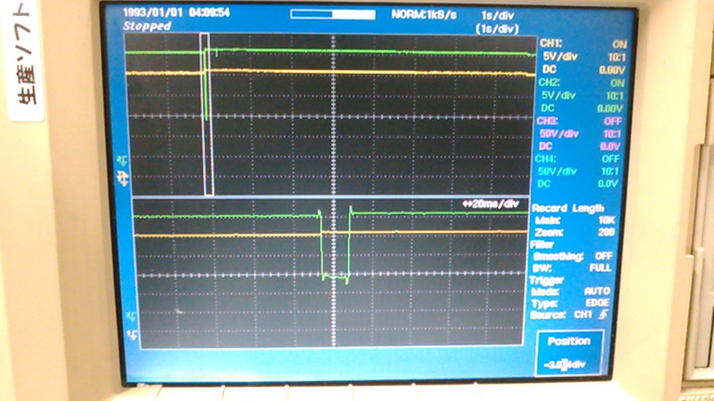
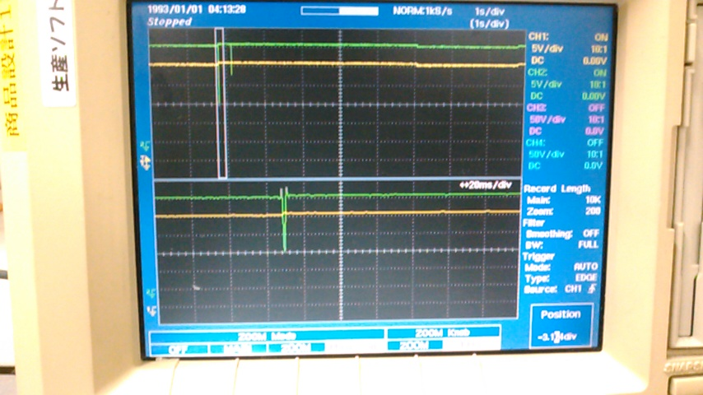
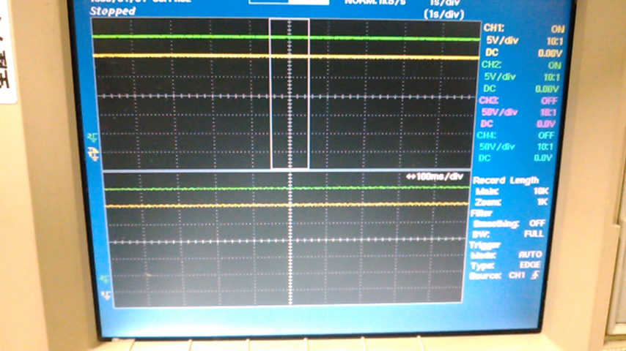
Ch.1 (Yellow) : Vin (FET Drain side)
Ch.2 (Green) :Vout (FET Source side)
System can restart, OK
System can not restart, NG
No issue, OK

Slide 2
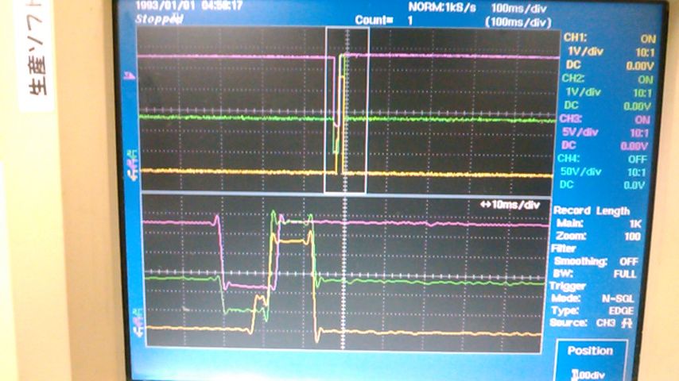
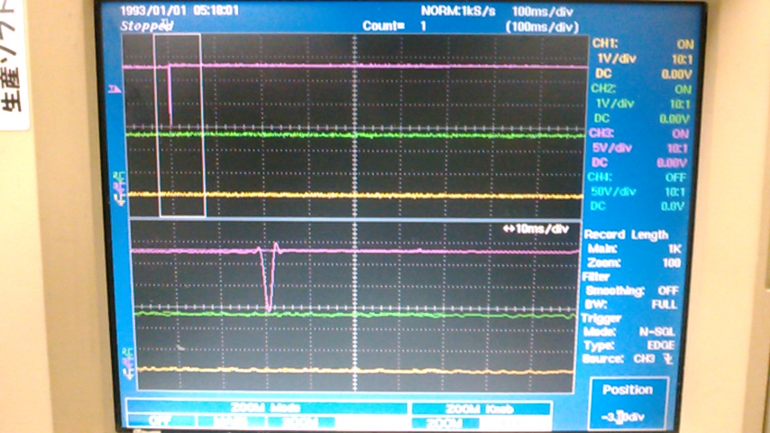
Ch.1 (Yellow) : PG
Ch.2 (Green) : FLT
Ch.3 (Purple) : Vout (FET Source side)
System can restart, OK
System cannot restart, NG

