Slide 1
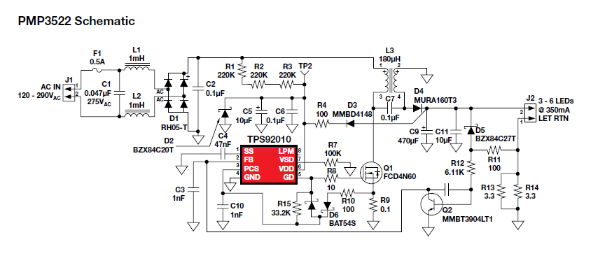
About PMP3522
【Customer demand】
1、AC IN : 90～110VAC
2、Output voltage ： 37.1～50.6V(typ：43.9V)
3、Output current ： 130mA(max)
10mA(min)
4、Control method ： Constant current control & dimming
5、Other ： SEPIC
【Question】
・I'd like to respond to the customer's request that refer to PMP3522.
・What part of PMP3522 should I modify?

