Slide 1
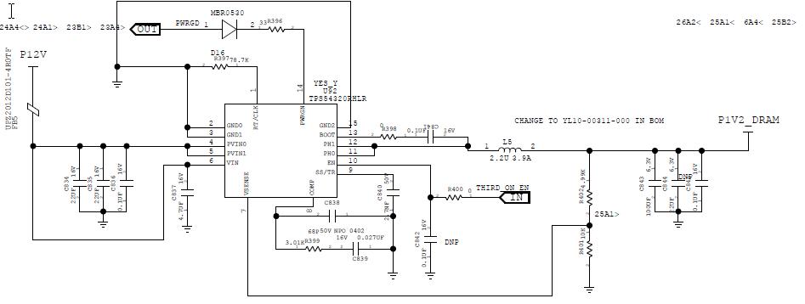
Use TPS54320 12V to 1.2V

Slide 2
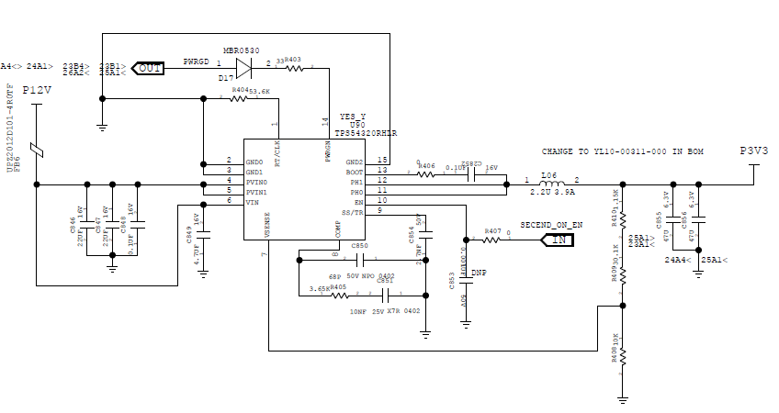
Use TPS54320 12V to 3.3V

Slide 3
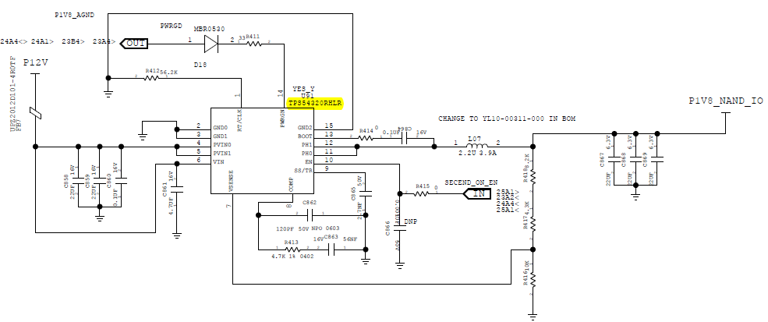
Use TPS54320 12V to 1.8V

