Slide 1
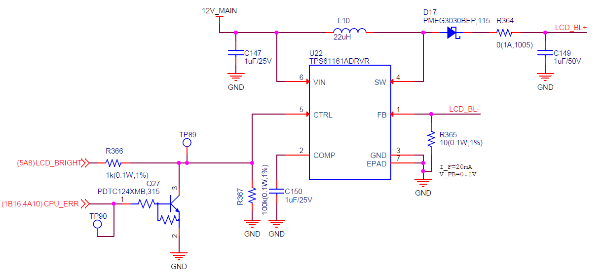
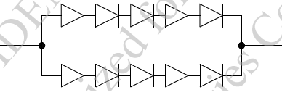
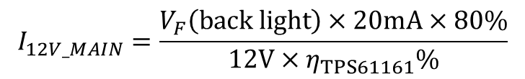
Circuitry and Question
PWM Signal
LCD back light
V_{F}(back light)=13.8-16.7V(Typ. 15.5V) @I_{F}=25mA
[Question]
In our application, Vin(12V_MAIN) is 12 voltage.
Could you tell me how to calculate current consumption for 12V_MAIN?
When PWM Signal is 80% on, is the following calculation correct?
$$I_{12V_MAIN}=\frac{V_{F}\left(back light\right)×20mA×80\%}{12V×η_{TPS61161}\%}$$

Slide 2
ロゴ以外不要
社内プレゼンテーションテンプレート 最終ページ

