Slide 1
Layout review
2/15/2024
Shane Hauser

Slide 2
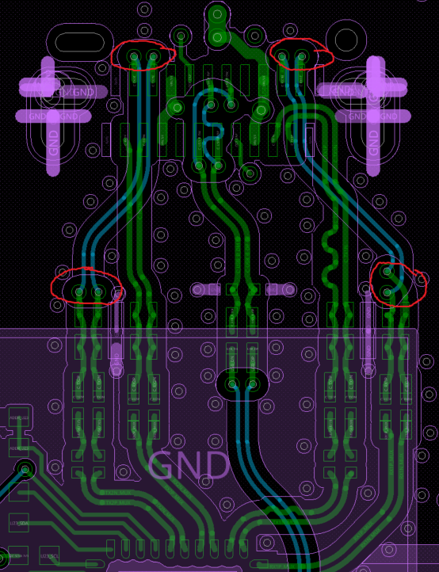
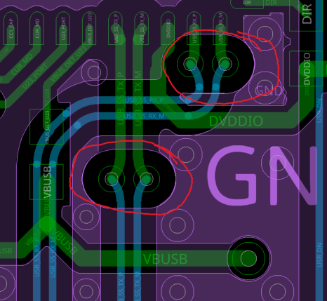
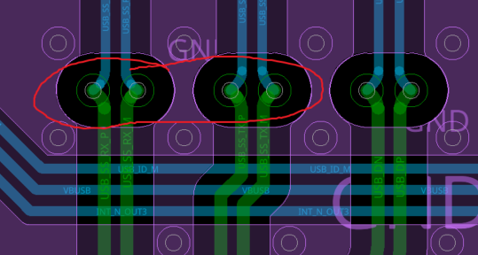
Reduce number of signal vias
SSRX1 and SSTX2 both have 4 vias on the signal path
This many vias could negatively impact the signal integrity
I recommend reducing the number of vias to 2 maximum on each high speed trace

Slide 3
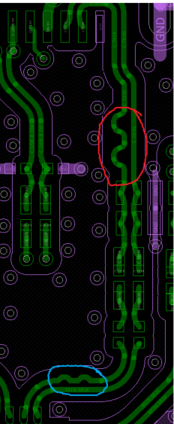
Use smaller curves to trace match
I recommend reducing the size of the curves circled in red for length matching.
The curves circled in blue are a good example

Slide 4



Superspeed signal loss
The total length of your RX trace is about 4.577 inches.
This is around 5 dB of loss in the trace (for FR4 material)
Adding 2.4 dB of loss from the 3220 totals around 7.4dB of total loss
You want to be sure your module can compensate for this

