Slide 1
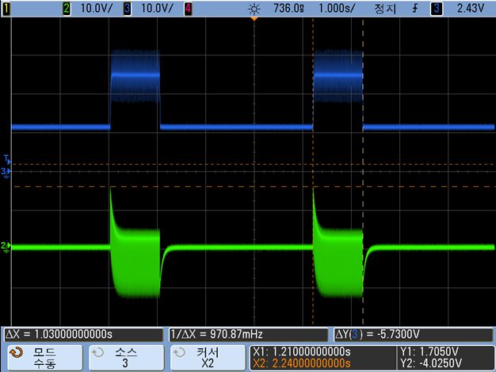
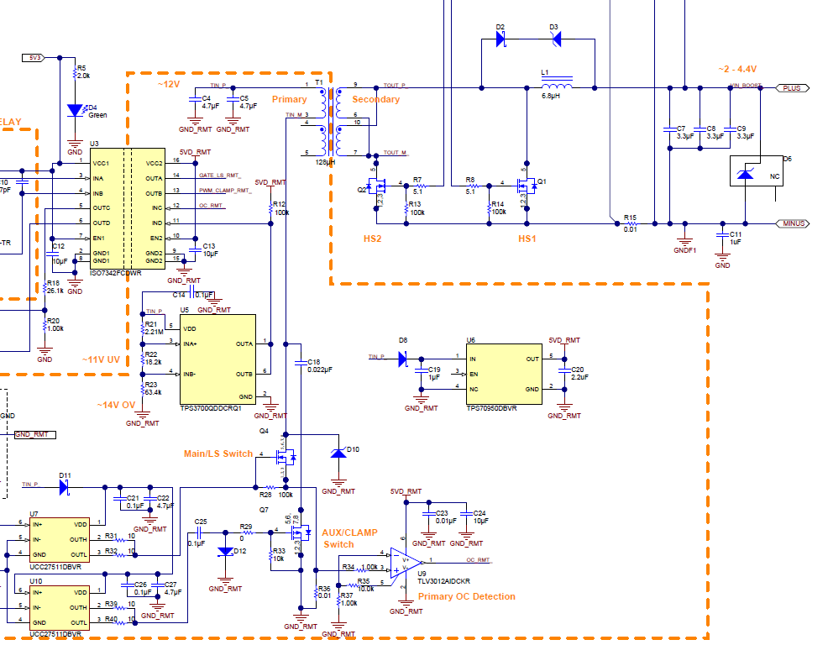
During discharge , Primary Vin

Slide 2
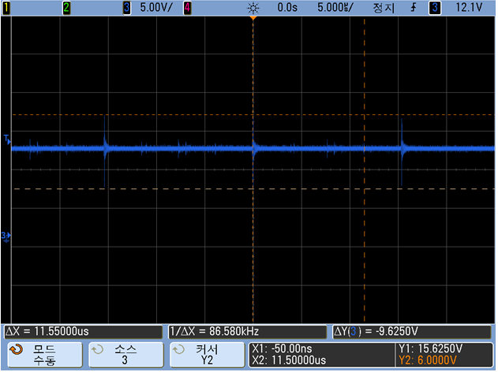
During discharge, Primary Vin -> Ccl 66nF change
Active clamp cap. Value chage

Slide 3
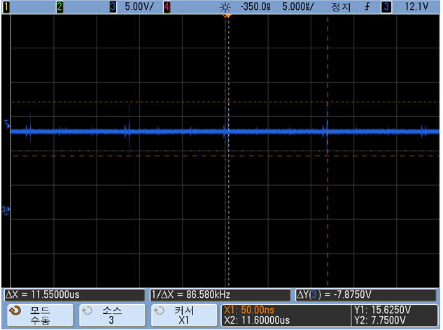
During discharge , add diode(1N4001) , Primary Vin
add Diode

Slide 4
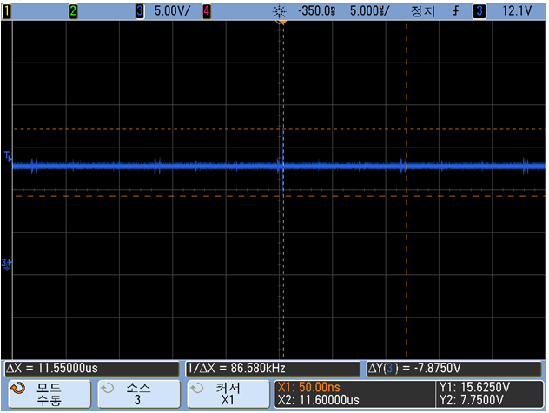
During discharge, Diode(1N4001) + Ccl 66nF, Primary Vin
add Diode
Active clamp cap. Value chage

