Slide 1
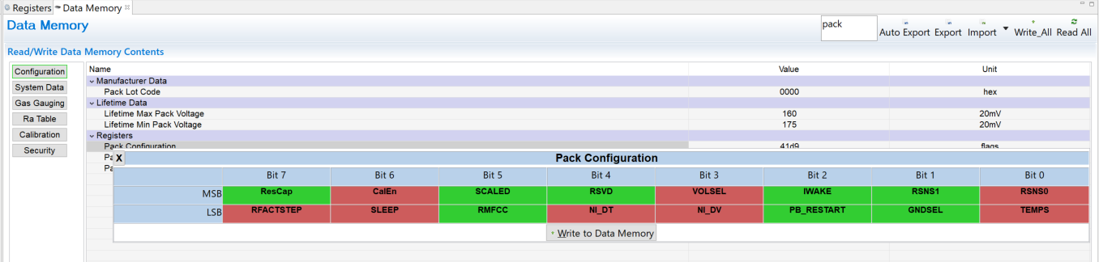
Data Memory
When I press the Write_All button of Data Memory, I get the following error.
However, I can write items one by one.
Is this a bug in BQ Studio?
I bought a brand new EVM and checked with the defaults.
The BQ Studio version is 1.3.111.

Slide 2
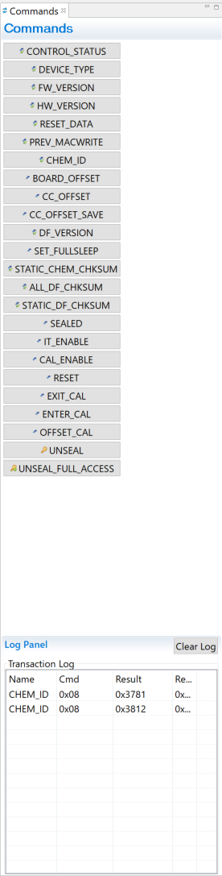
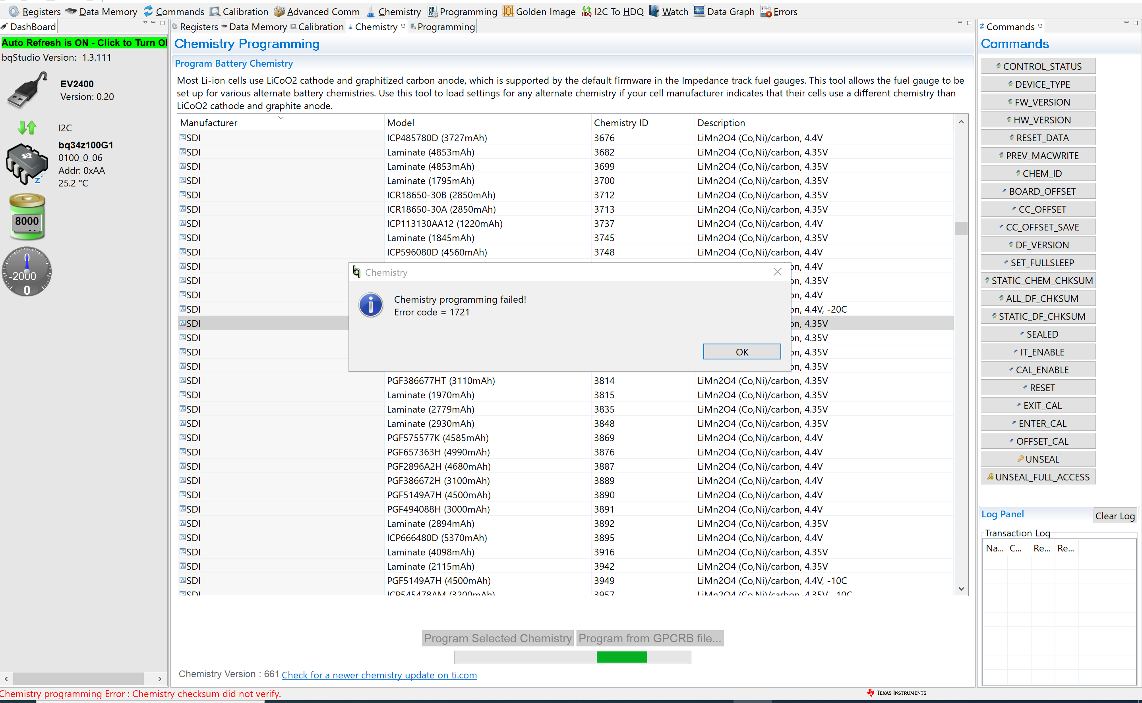
Chemistry
When I pressed the "Program Selected Chemistry" button in Chemistry, an Error occurred.
However, when I checked the "CHEM _ ID" command, the ID was rewritten.
Is it safe to assume that this is successful?
Is this a bug?

Slide 3
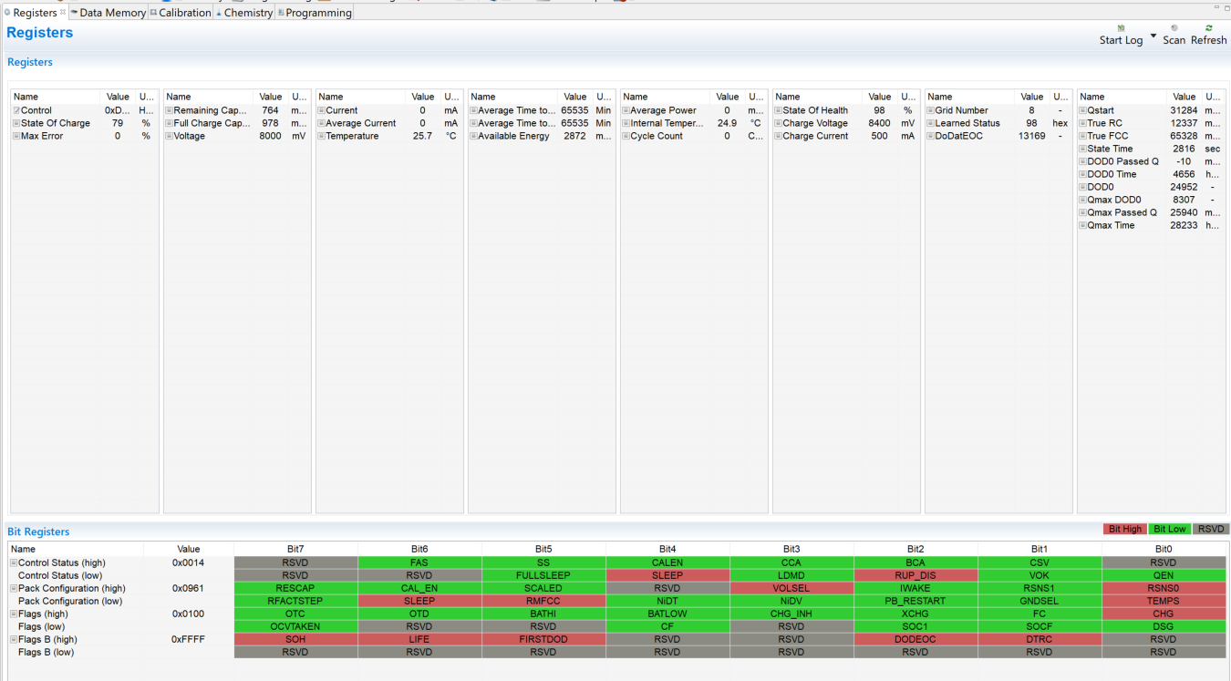
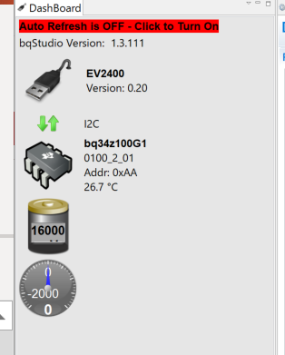
Register & I2C connection

